Slide 1
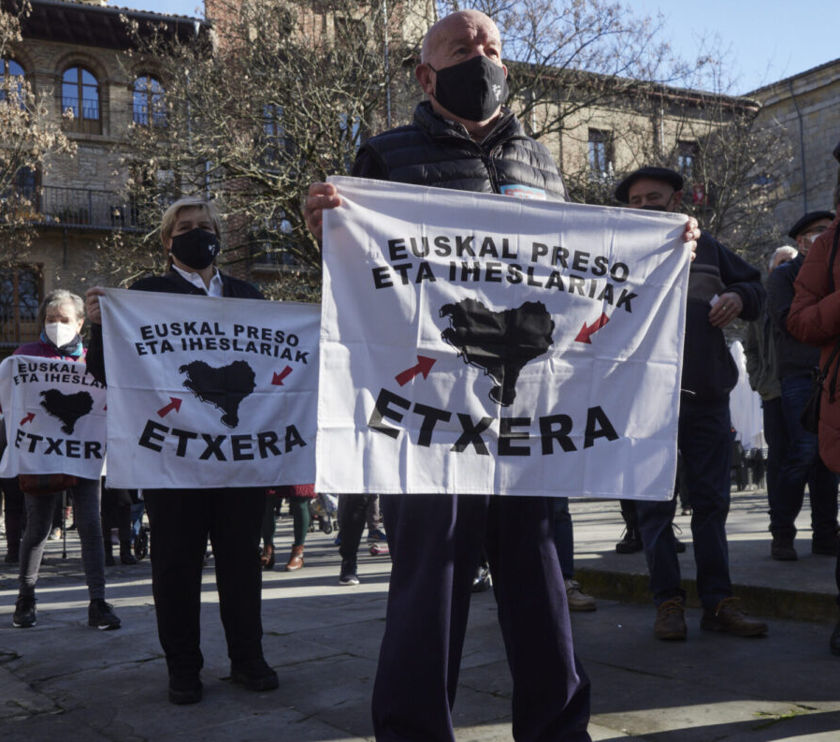
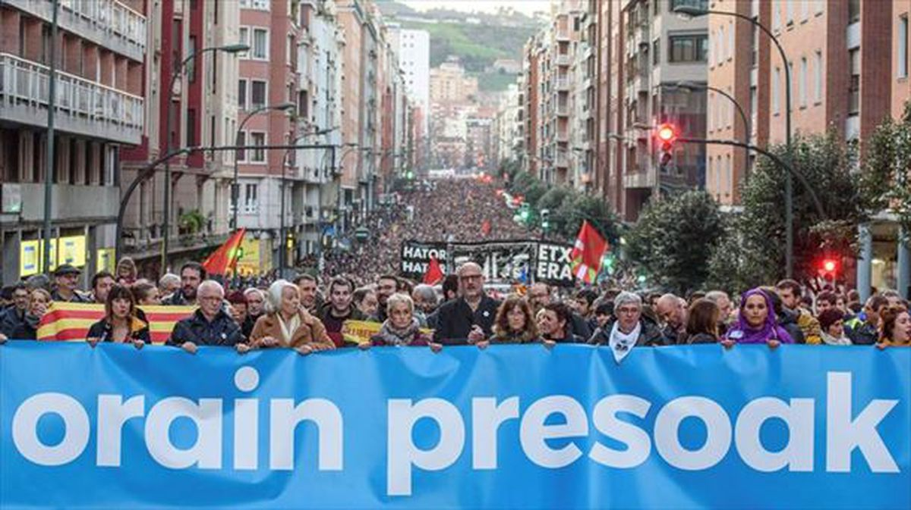
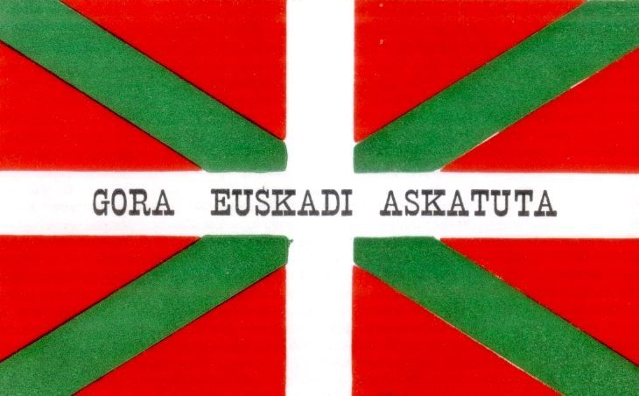
NACIONALISMO
VASCO
Origen y desarrollo
Notes:
Basque nationalism is famous throughout the world, due to the activities of the Basque organization known as ETA in the second half of last century. (ETA is an acronym for Euskadi Ta Askatasuna: "Basque Homeland and Liberty" or "Basque Country and Freedom").
But you cannot understand Basque nationalism if you don’t look at its history.

Slide 2
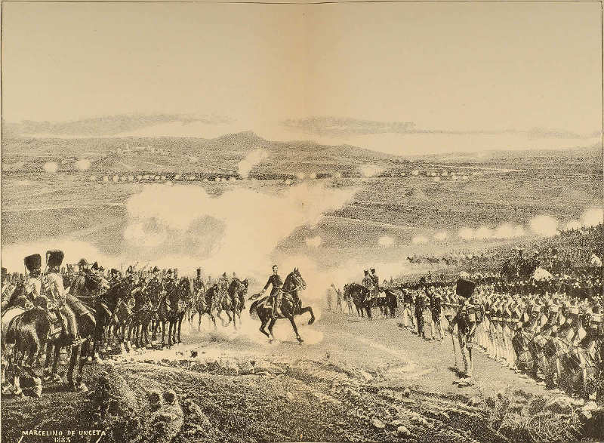
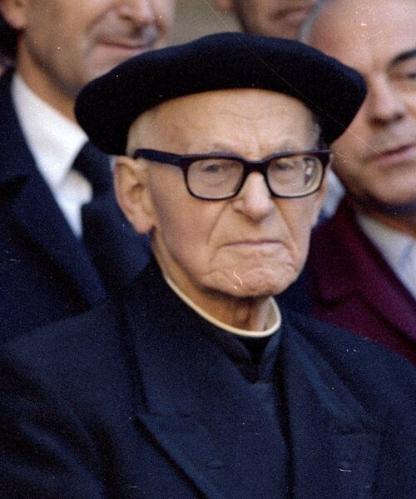
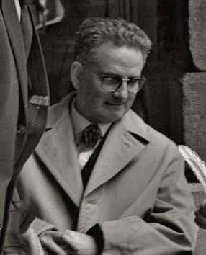
CONSECUENCIAS DE LAS GUERRAS CARLISTAS
La pérdida de las comunidades rurales frente a la sociedad urbana.
El apego a las tradiciones culturales propició el inicio de una revolución cultural vasca.
Surgió el interés por el folclore y las tradiciones orales..
Abren escuelas de euskera en Bilbao y Donostia.
Batalla de Mendigorria, 1825
Miguel de Barandiaran
Juan Caro Baroja
Notes:
This coincided with the emotional and intellectual effects of the Carlist Wars, which ended in 1876.
As we saw in Lecture One, support of the Carlist rebellions was high in the Basque provinces, especially in highly devout and Catholic Navarre.
The Carlist Basques wanted to preserve the traditional structures and traditions of the Spain of the old regime, and resist against the new urban dominance and the liberal ideologies that came with it.
There was awareness of what had been lost.
More Basques were choosing to write books in Basque, as opposed to Spanish or French, and Basque folklore was being widely collected and recorded, in both print and audio form.
By the end of the 19th century the first Ikastola (Basque medium schools) opened in Bilbao and Donostia, along with the first Basque language academy (Euskaltzaindia). In 1888 the first professorship for Euskara was set up at the Instituto Bizkaino (The historyan Mark Kurlansky focuses on the symbolic importance of the Bizkaian professorship. Once advertised, a number of men applied for the post, each fighting for the most votes from the interviewing panel. The first applicant, Resurreccion Maria Azkue, secured the post with ten votes and went on to become a significant scholar of Basque language, culture and folklore. The second applicant, Miguel de Unamuno, who gained three votes, was a scholar who later became one of Spain’s most influential authors and intellectuals. But it was the third candidate, Sabino Arana, an applicant who did not win any votes at all, who had arguably the greatest impact on Basque culture and history in the twentieth century.)
Until the late nineteenth century these developments were more linked to the idea of “Basque-ness” as opposed to the idea of a “Basque nation”.
But all these factors created the perfect conditions for such ideas to emerge.

Slide 3
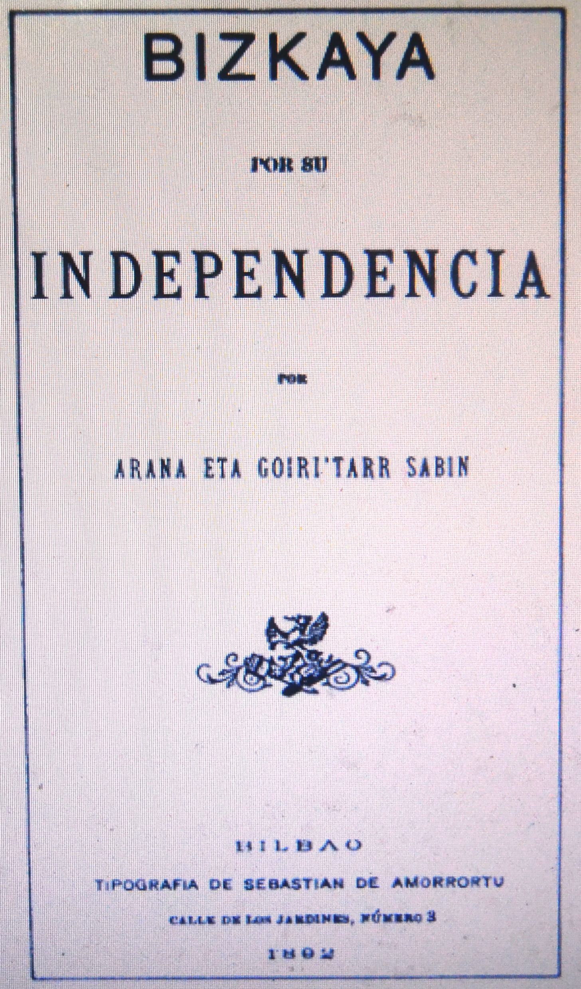
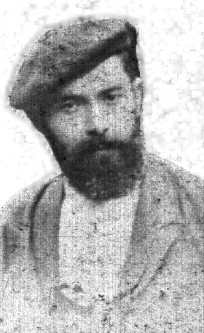
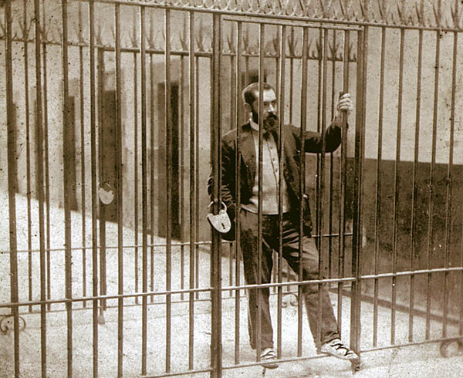
Sabino Arana
A Arana se le atribuye el mérito de ser el padre del nacionalismo vasco, o abertzaletasuna.
Nació en 1865 en Arrigorriaga.
Familia en el bando perdedor de la guerra (carlista).
Firmemente antiespañol, comenzó a abogar por una nación vasca..
Arana vio que los vascos carecían de elementos conceptuales necesarios para la idea de nación..
Sabino Arana en la cárcel de Larrinaga, 1895
Notes:
Arana recalls in later life that on one occasion, when he was talking with his older brother, his brother said: “Bizkaia is not Spain”. This single statement, and the idea behind it, had a great impact on the young Arana. He subsequently began thinking and publishing on these issues in depth.
Originally just Bizkaia, later arguing that “the Basques are a nation and should have a country”.
The historian Mark Kurlansky focuses on the symbolic importance of the Bizkaian professorship. Once advertised, a number of men applied for the post, each fighting for the most votes from the interviewing panel. The first applicant, Resurreccion Maria Azkue, secured the post with ten votes and went on to become a significant scholar of Basque language, culture and folklore. The second applicant, Miguel de Unamuno, who gained three votes, was a scholar who later became one of Spain’s most influential authors and intellectuals. But it was the third candidate, Sabino Arana, an applicant who did not win any votes at all, who had arguably the greatest impact on Basque culture and history in the twentieth century.

Slide 4
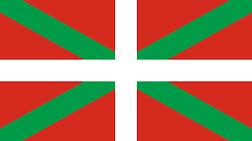
Sabino Arana
Creador del PNV(Partido Nacionalista Vasco).
Creador de la bandera vasca o Ikurriña.
Sabino Arana en la cárcel de Larrinaga, 1895
Notes:
Arana recalls in later life that on one occasion, when he was talking with his older brother, his brother said: “Bizkaia is not Spain”. This single statement, and the idea behind it, had a great impact on the young Arana. He subsequently began thinking and publishing on these issues in depth.
Originally just Bizkaia, later arguing that “the Basques are a nation and should have a country”.
The historian Mark Kurlansky focuses on the symbolic importance of the Bizkaian professorship. Once advertised, a number of men applied for the post, each fighting for the most votes from the interviewing panel. The first applicant, Resurreccion Maria Azkue, secured the post with ten votes and went on to become a significant scholar of Basque language, culture and folklore. The second applicant, Miguel de Unamuno, who gained three votes, was a scholar who later became one of Spain’s most influential authors and intellectuals. But it was the third candidate, Sabino Arana, an applicant who did not win any votes at all, who had arguably the greatest impact on Basque culture and history in the twentieth century.

Slide 5
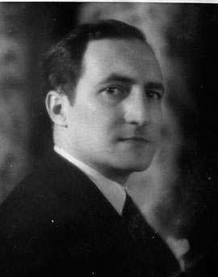
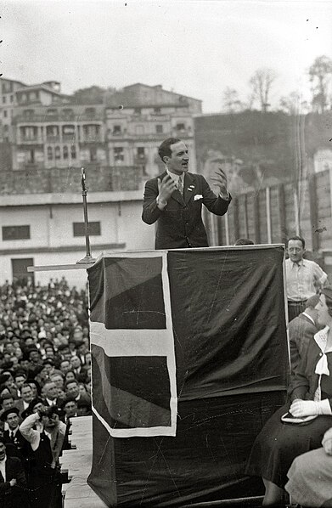
Principios del siglo XX.: crecimiento del nacionalismo
El nacionalismo vasco creció a principios del siglo XX.
Los vascos estaban unidos por un nuevo líder político.
José Antonio Aguirre fue moderado y construyó puentes.
Presidente del PNV(Partido Nacionalista Vasco)
Lideró a los vascos en la Guerra Civil (Gobierno en el exilio).
Jose Antonio Aguirre
en 1933
Notes:
Basque nationalism continued to gain support in Spain through the early twentieth century. Spain’s first democratic government – known as the Republic – was elected in 1931. It was politically left of centre.
Initially, it was only the urban areas of the Basque country that were enthusiastic about this new governmental regime. The Republicans’ left-wing bias primarily appealed to workers in the big industrial centres like Bizkaia and Gipuzkoa, where workers’ unions, and communist and socialist parties emerged to check the worst excesses of contemporary capitalism.
But the more traditional rural areas of the Basque country who were still ideologically tied to the Carlist movement with its strong support for the Catholic Church and traditional values were less keen. They were more aligned with the falangists (fascists) or the far-right monarchists’ than the decidedly leftist Spanish government.
This all changed with Jose Antonio Aguirre.
Born in 1904 in Bilbao, the young Aguirre grew up in a Basque-speaking home and as a teenager played football for Athletic Bilbao. As he matured and became more political he was drawn to the fledgling Basque nationalist party, which at this time was still largely “underground”.
He quickly became its director of youth. Handsome, charismatic and athletic, Aguirre was not only able to attract and inspire large crowds but he also helped to raise the acceptability of the movement. He became the acknowledged head of the Basque nationalist Party.
Aguirre “contradicted the outside world’s Basque stereotypes” by being temperate and conciliatory and adhering to a less extreme form of Catholicism.
Importantly, he was able to build bridges by arguing for a more moderate Basque nationalism that was more compatible with the ideals of the Spanish government. Since the time of Aguirre, the Basque nationalist party has consistently been left wing.

Slide 6
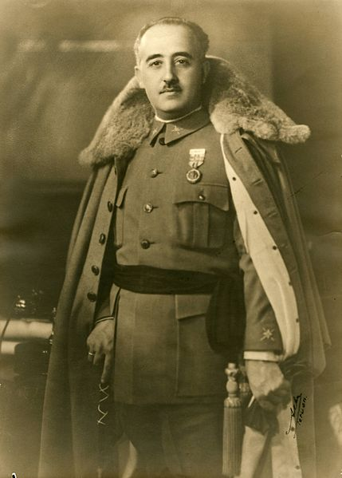
El levantamiento de Franco
El nacionalismo español también estaba en ascenso, impulsado por Francisco Franco.
El apoyo a los falangistas (fascistas) era fuerte en Navarra.
En julio de 1936, Franco y sus rebeldes dieron un golpe de Estado.
Ese golpe de Estado desembocó en la guerra civil española.
Francisco Franco en 1930
Notes:
In the 1930s this emergent nationalism was heavily shaped by the rise of the Spanish major-general, Francisco Franco (1892-1975).
In the 1930s the Republican democracy of Spain was continuously threatened by the more right-wing parties (that included Fascists, Carlists, Monarchists and Clergy). Support for the fascists also remained strong in parts of the Basque country, particularly Navarre.
General Franco rose to power in this period and he became a very influential flag-bearer for this right-wing cause.
In July 1936 Franco and his ring-wing “rebels” attempted to overthrow the democratic Republican government in a coup which, though unsuccessful, precipitated the Spanish Civil War.

Slide 7
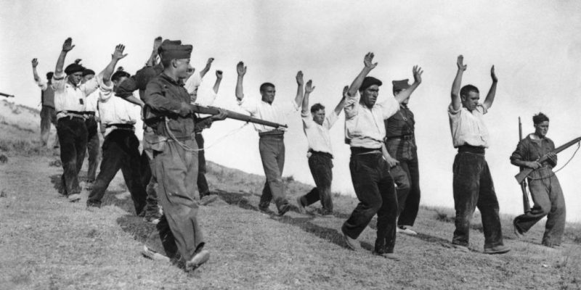
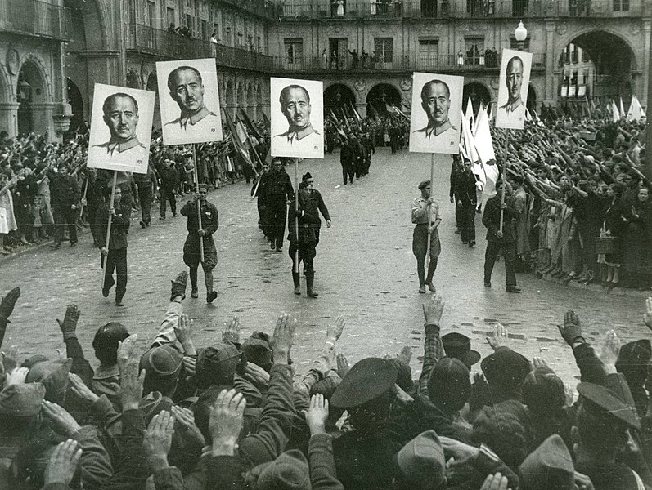
La guerra civil española
El Gobierno republicano acelera las propuestas de autonomía vasca.
Aguirre “hasta que el fascismo sea derrotado, el nacionalismo vasco seguirá en su puesto”.
El año siguiente se produjo una oleada de actividad cultural.
Se formó el cuerpo de policía autonómica vasca: la Ertzaintza.
Franco juró “la aniquilación completa de los nacionalistas vascos”.
Manifestación franquista en Gijón, 1937
Notes:
Once war was declared, the Republican government needed all the help they could get to resist Franco. In order to shore up Basque support they accelerated some proposals for Basque autonomy put forward in 1931, and these were approved in the three Spanish provinces by an overwhelming majority.
Once this autonomy was gained, in October 1936, and still only in his early thirties, Aguirre, as the head of the Basque Nationalist Party, was unanimously elected the first president of the Provisional Government of the Basque Country.
SLIDE “Until Fascism is defeated, Basque nationalism will remain at its post”.
The nine months following this election saw a flurry of programmes initiated in support of Basque culture and language, including Basque language schools and the Erzaintza, a Basque police force (with candidates primarily athletes from Basque nationalist families).
Franco swore to cement his authority by rooting out any remaining centres of Republicanism and this included “the complete annihilation of Basque nationalists”.
He charged a man named General Mola to defeat the Basques, with a force made up of Spanish, Germans, Italians and Basques with fascists sympathies, particularly the Navarrese.
Mola distributed flyers around the Basque country that stated:
“If submission is not immediate, I will raze Vizcaya to the ground, beginning with the industries of war”.
His first strike was to bombard Durango at 7:20 in the morning when the churches were full of parishioners attending mass. 258 civilians were killed. Franco’s government denied all involvement in the massacre and in any subsequent atrocities.
As the offensive continued, Mola was surprised by the intensity of the Basque resistance.
Eventually the Basque forces, hugely out-numbered and out-gunned, retreated into the Gernika area of Bizcay. And it is here, in Gernika, that one of the most significant and tragic events in the whole of recent Basque history took place.

Slide 8
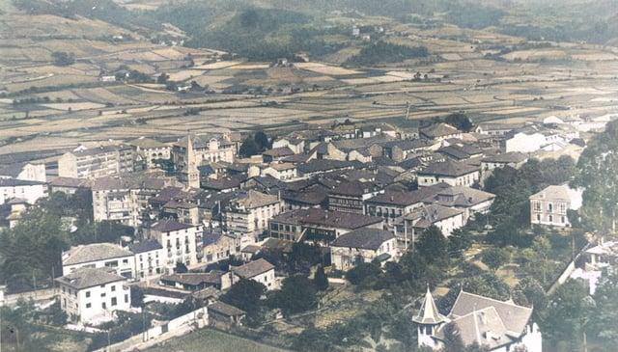
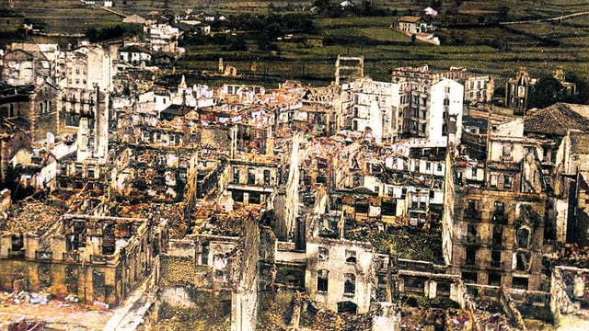
Gernika
Era día de mercado en la ciudad principal de la región..
A las 4:40 p.m. las campanas de la iglesia sonaron para advertir sobre la aproximación de aviones bombarderos.
La ciudad no tenía defensas aéreas..
Nuevos aviones alemanes e italianos lanzaron bombas y ametrallaron sin obstáculos..
El ataque duró tres horas.
El Gobierno vasco estima que murieron 1.645 personas.
Gernika antes y después de los bombardeos
Notes:
The attack happened on April 26th 1937 in the town of Gernika, on market day, when the streets were filled with people.
At 4:40pm the church bells rang out to warn the town that planes were coming.
Because the town had no air defences, the German and Italian planes could drop their bombs unhindered.
As people fled, they were shot down with heavy calibre machine guns. The attack lasted for three hours.
The numbers of dead have not been verified because it was only Franco’s troops, who occupied the town three days later, who could count the dead and they never released the figure. But the Basque government estimated that 1,645 had died.

Slide 9
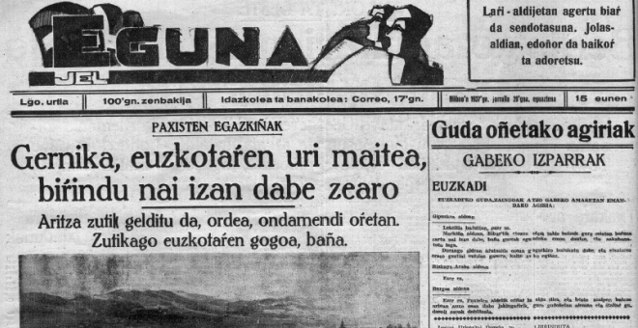
Notes:
“They have tried to completely flatten Gernika, the Basques’ beloved city”.
“But the oak tree has remained up standing, amongst the destruction. The willing of Basques to continue is more upstanding, still”.

Slide 10
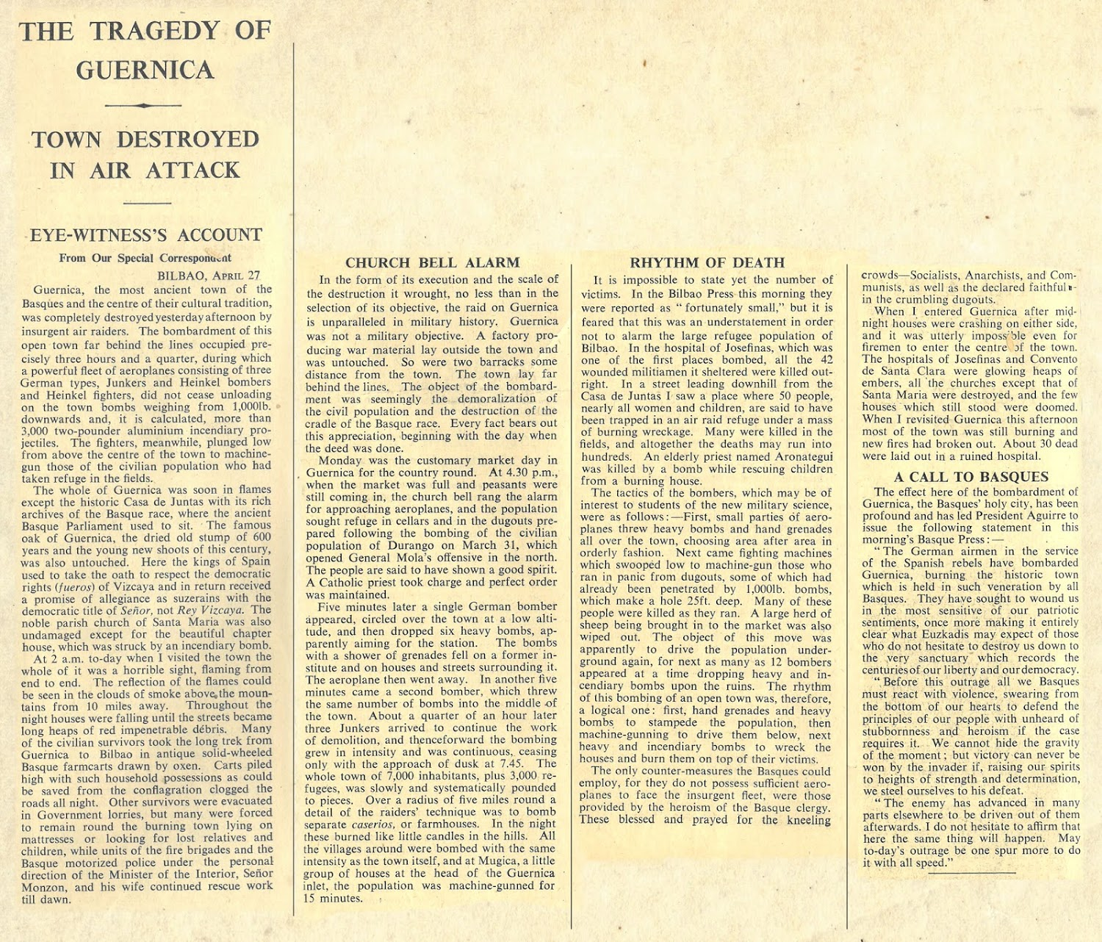

Slide 11
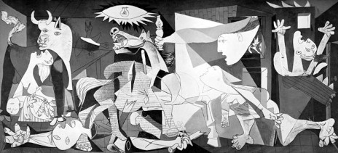
Picasso’s Guernica
Notes:
The world was horrified.
Franco denied the crime and made excuses in an attempt to prove that it wasn’t the falangist or fascist forces that committed the atrocity. He even suggested that the attack had been conducted by Basques targeting their own people.
But there were thousands of witnesses and one frustrated officer admitted, after being pressed, that:
“Of course it was bombed. We bombed it, and bombed it, and bombed it, and Bueno, why not”.
Pablo Picasso made a painting in remembrance of the massacre named after the city that year.
It is made all the more poignant by the fact that Gernika was the place where King Ferdinand confirmed the fueros of Biscay in 1476 and where the Basque assemblies had met under the great Oak Tree since 1512.
Nearly 1,000 Basque nationalists were executed and many more thousands imprisoned. Thousands more fled abroad, many to Latin America.
Aguirre set up a Basque government in exile in France.
By 1938 Franco’s control of all the dissenting areas of Spain was politically complete.
Soon after Gernika, Franco was faced with the outbreak of the second world war.
France was overwhelmed by the German offensive and from 1940 was either directly or indirectly (via the Petain government) under German rule.
But Franco kept Spain in a position of neutrality, a position which caused him political problems in later years.

Slide 12
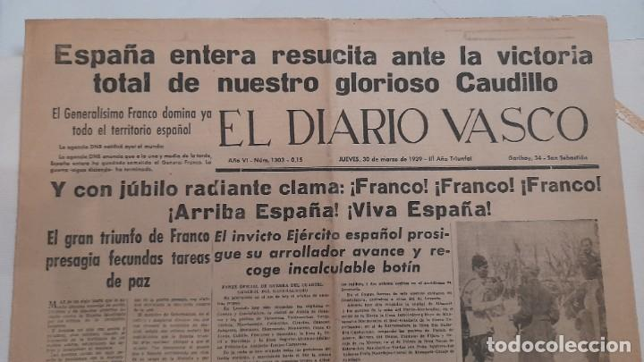
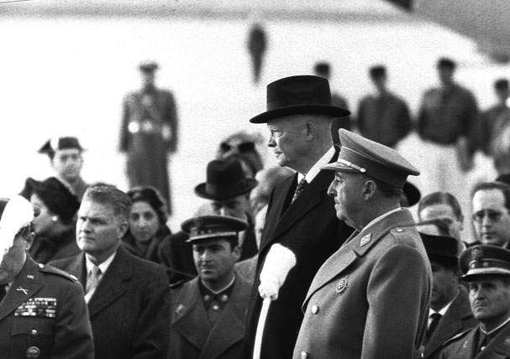
Represión en la posguerra
El gobierno fascista reprimió la autonomía regional y la expresión cultural.
Ejecuciones casi diarias de nacionalistas vascos.
Se disuadió todo uso de la lengua vasca y se prohibió su uso público..
El movimiento nacionalista vasco se paralizó por décadas.
Franco se relacionó con los nazis en Europa, pero su postura anticomunista significó que España se convirtiese en un aliado clave de EE.UU.
Diario Vasco en 1939
Franco y Eisenhower en 1959
Notes:
But throughout the war and in the post-war years Franco continued to repress the Basque nationalist cause.
It has been claimed by the nationalists, that during the war Franco executed over 20,000 Basques (check this in Kurlansky).
At a prison in Donostia, Franco’s men executed Basque nationalists – on an almost daily basis – right up until 1947.
Franco was also anxious to repress Basque culture in other ways. The Basque language was banned in all three Spanish-Basque provinces, and the people were told to “speak Christian”. We shall be exploring this in much more depth later in the term.
Given this repression, during and after the war the Basque nationalist party was exiled, dispersed and largely inactive. They laid low, hoping that things would get better.
They had good reason for optimism.
Franco was unpopular in Europe because although he denied that he ever supported Hitler, he was suspected of having pro-Nazi sympathies. Spain was excluded from all newly created political alliances – notably the UN and NATO – and became a political pariah.
The Basque government in exile, lodged in Paris, hoped that with the help of diplomatic efforts in league with the US and the allies, this isolation meant that Franco’s end was near. Aguirre even reinstated a Basque intelligence network in Spain to assist with the hoped-for invasion.
But it was not to be.
When the Korean War broke out General Franco’s hatred of communism ensured that he became a key ally to the US.
Franco’s status was further solidified when France removed the diplomatic status of the Basque government in exile, ejected it from its headquarters in Paris and reinstated the building as a Spanish embassy.
Aguirre lamented that the move was “a weakening of moral force in the fight against totalitarianism”.

Slide 13
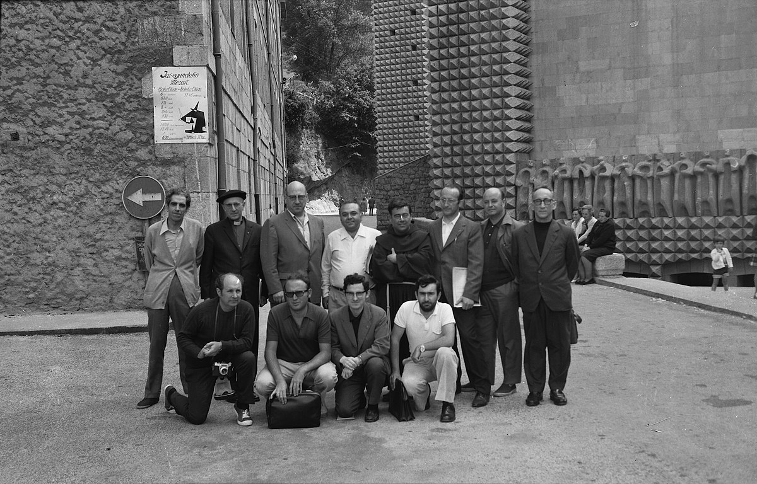
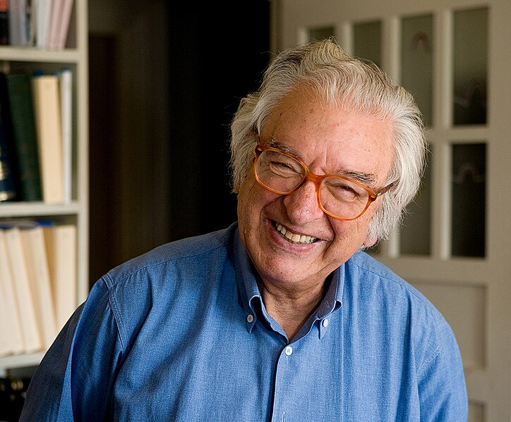
Los nacionalistas se reagrupan
En la década de 1950 surgieron grupos pro vascos.
Los jóvenes universitarios de Bilbao se sienten frustrados por la postura del PNV en el exilio.
Un escritor vasco, Txillardegi, y otros formaron un grupo de resistencia.
ETA inicialmente giraba en torno al uso del euskera.
Redefinieron postulados nacionalistas, como la definición de persona vasca..
Etxebarrieta se convirtió en líder y en la década de 1960 ETA cometió numerosas acciones armadas en nombre de la independencia vasca..
Primeros miembros de la Academia Vasca
Txillardegi (1929-2012)
Notes:
But in the 1950s the nationalist flame was rekindled.
A new nationalist party was created by young undergraduates from the area of Bilbao who supported Basque nationalist ideology but were increasingly disgruntled at the ineffective political action of the Basque Nationalist Party, as led by Aguirre.
Small resistance groups were set up in Donostia and then Bilbao. One of the founder members was the Basque linguist and writer José Luis Álvarez Enparantza (1929 – 2012), better known by his pseudonym Txillardegi.
The organization first called itself ATA (aberri ta askatasuna) but because ATA meant “duck” in Bizkaian, they changed it to ETA. This turned out to be an inspired choice, for ETA – as you know – is also the word for “and”.
In these early days, ETA considered itself to be a group of intellectuals dedicated to promoting the Basque language, with the aspiration to instating a Basque nation running as a secondary, less important, aim.
They set about revising both the Catholic and racist elements of Arana’s doctrine and reverted the definition of a Basque person back to the original “Euskaldun”, that is, someone who speaks Basque.
By the end of the 1950s ETA, now grown to around 250 members, had begun researching armed liberation movements.
They studied the tactics of the Zionist Irgun group, which had used violence to in their attempts to drive the British out of Palestine when they were trying to create a Jewish state.
In the following years they claimed responsibility for the detonation of several bombs, and several other killings.
In mid-1960s the ETA leader Txillardegi was replaced by Txabi Etxebarrieta.
Born in 1944, Etxebarrieta was even more committed than his predecessor, to fight for Basque independence though selective violence, and through close alliances with social causes and labour unions.

Slide 14
El comienzo de la lucha armada
ETA había estudiado los movimientos armados de liberación de los años 50 y 60 (Argelia, Irlanda, etc.)
En 1968, ETA mató al capitán de la policía española Melitón Manzanas, y al sucesor de Franco, Luis Carrero Blanco.
Franco tomó represalias en ambas ocasiones, torturando y asesinando a muchos miembros y sospechosos de ETA.
Los miembros de ETA a menudo se escondían en Iparralde.
Cuando Franco condenó a muerte a miembros de ETA, hubo protestas generalizadas en España y Europa.
Franco prohibió las universidades públicas en el País Vasco y todas las asignaturas de humanidades.
Notes:
Thus began a tense and blood-stained period in Basque history.
In 1968 ETA killed an unpopular police captain Meliton Manzanas. In response, Franco placed the whole country under siege, with the repression culminating in the Burgos trials, where 16 alleged ETA members were charged with “military rebellion, banditism and terrorism”.
ETA detonated a bomb in Madrid that assassinated Franco’s predicted successor, Admiral Luis Carrero Blanco.
Over this period, Franco retaliated by apprehending, torturing and incarcerating many Basques, including many of the ETA leaders.
ETA members hid in the French-Basque country, where the French Government’s hatred of the Franco regime allowed them a level of sanctuary.
As a result of these tensions, “an eye for an eye would come to define the relationship between ETA and the Spanish”.
But despite this violence, ETA was developing a wider appeal.
Their subjection at the hands of Franco revived the ideology of the 1930s and 40s – when Basque nationalists were heroic figures who stood up to Fascism.
Through this lens, the ETA members punished by Franco attained the status of the religious martyr.
After three ETA members were sentenced to death in ***, widespread protests did not only erupt in the Basque country but also in Barcelona, Madrid, and Seville.
Many European governments petitioned Franco to withdraw the sentences and he was compelled to backtrack.
The depth of the animosity between ETA and Franco was illustrated in 1970 when Franco attended the 1970 Pelota championships, where a man named Joseba Elosegi set himself on fire, shouting “gora Euskadi askatuta”, and jumped 15 feet to land below where the dictator stood in the stands.
On subsequent investigation, it was revealed that Elosegi had been Captain of the only Basque military unit stationed at Guernica the day of the bombings, been sentenced to death and then escaped.
Faced with this kind of resistance, Franco attempted to repress this growing nationalist spirit in other ways. Worried about the dissemination of national ideologies, he banned the establishment of universities in the Basque country, with only two private universities sanctioned to teach.
Basque students had to travel outside the region to study, and Franco didn’t let them study literature, history and political science in the Basque country, though science subjects were taught, as it was a region of industry.
(Note: Sartre also wrote about this Sartre et la question basque (revolutionpermanente.fr), could be a reading for the students.
This was a big mistake from Franco – Txabi had been an economics graduate from Sarriko, and Deustu in France became known as a “breeding ground for militant Basque Nationalism”.

Slide 15
ETA y el Comunismo
ETA marcó diferencias con grupos nacionalistas anteriores.
La generación posterior a 1950 se sintió atraída por las ideologías marxistas.
Esto acercó a ETA a los movimientos obreros.
En 1967, su ideología oficial se definió como “un movimiento de liberación nacional socialista vasco”.
“La doctrina de ETA era una mezcla compleja de Marx, Mao, Castro y Arana: la peor pesadilla de Miguel de Unamuno, ideologías desbocadas, un ismo sobre otro ismo”. Kurlansky, Historia vasca del mundo
Notes:
It is important to note that ETA’s ideology differed in certain ways from the nationalist groups of the past.
Traditionally, the Basque nationalist movements had always been anti-communist – but the new generation that emerged as ETA post-1950, were drawn to the Marxist ideologies that were so detested by Franco.
In this way, Marxism acted as a bridge that moved ETA closer to the worker’s movements and away from the more traditional and less militaristic, Basque Nationalist Party.
In 1967 (the same year that the Basque language was standardised?), ETA held a summit in Getaria, where they published a document that they called “the official ideology of ETA”.
In this document, the organization was defined as “a Basque socialist national liberation movement”, and “revolutionary nationalism”.
According to Kurlansky, the ETA doctrine ideology “was a complex blend of Marx Mao, Castro, and Aran – Miguel de Unamuno’s worst nightmare, ideologies run amok, ism heaped on ism”. In their turn, the Basque Nationalist Party condemned ETA as “a Communist organisation”.

Slide 16
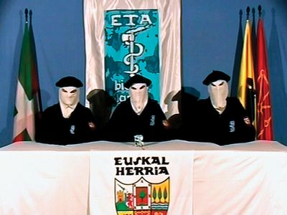
Post-Franco
Franco murió en Noviembre de 1975.
Los partidos autonomistas vascos obtienen mayoría en las elecciones democráticas.
Los navarros votaron por un estrecho margen no unirse a la comunidad vasca.
Muchos de los hombres de Franco permanecieron en el poder español.
La nueva capital de la Comunidad Autónoma Vasca fue Vitoria-Gasteiz.
Notes:
Franco died in November 1975.
His death marked a sea-change for Basque nationalists of all kinds.
After a messy transition period, the first democratic elections two years later saw the pro-autonomy Basque parties win a majority the Basque country.
When the Spanish were drafting the new post-Franco constitution it was clear, that in order to secure long-term stability and co-operation the Basque country would need to be granted a degree of autonomy.
This led to the establishment of the Basque Autonomous Community, with its own devolved government, which included all the Spanish Basque province with the sole exclusion of Navarre.
This community has persevered into the present.
The city of Vitoria-Gasteiz, in the province of Álava, is the de facto capital. It hosts the headquarters of the Basque government and is the residence of the President of the Basque Autonomous Community, in the Palace of Ajuria Enea.

Slide 17
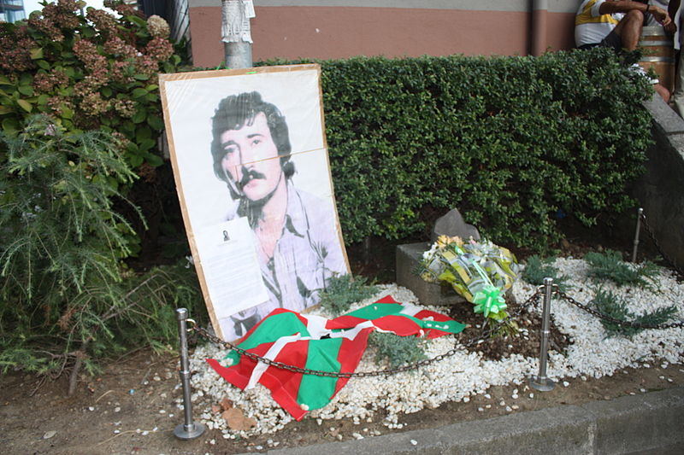
ETA continuó
ETA intensificó su actividad armada ante esta “ocupación continuada”.
Se estima que entre 1978 y 1980 ETA ejecutó a unas 235 personas.
Muchos fascistas lideraron una contrarresistencia.
El grupo GAL fue creado ilegalmente por el gobierno español.
En 1979, Amnistía Internacional denunció casos de tortura en toda España.
ETA mantuvo el apoyo popular en el País Vasco, sobre todo con el partido político Herri Batasuna.
Eugenio “Tigre”, miembro de ETA
asesinado por los GAL
Notes:
These arrangements did not suit everybody. Many people opposed the new Spanish constitution and the establishment of the Basque Autonomous Community because it did not give sufficient independence to the Basques.
Basque politicians criticized the arrangement as "the continuing occupation of the Basque Country".
These conditions inspired and enabled ETA to continue and escalate their violent resistance.
It is very hard to accurately assess the number of deaths for which ETA was responsible in this period. According to Alberto Abadie and Javier Gardeazabal:
“ETA’s activity was low before 1973 with no more than two victims in any given year. The
death toll increased sharply during the mid-1970’s, with an average of almost 16 victims per year in the period of 1974–1977. The bloodiest three years of ETA, 1978–1980, witnessed
a total of 235 victims. In subsequent years, the number of killings decreased gradually”.
These activities provoked counter-resistance. The Guardia Civil, still not purged of Franco-era personnel, responded with force and in 1979 Amnesty International sent a team to Spain that reported on the use of torture in Madrid, Barcelona and Bilbao.
In addition, simmering anti-Basque feeling within the Spanish military saw organisations emerge specifically to counter the ETA threat.
The paramilitary group GAL, which was illegally established by officials of the Spanish government in 1983 and composed of mercenaries from the ring-wing French military, underworld hitmen from Marseille, Italian neo fascists and former Portuguese colonialists, conducted at least 27 assassinations of Basque nationalists.
Interestingly, a contemporary poll indicated that these killings were supported by 51 percent of Spaniards.
This zero-tolerance approach to ETA continued under the socialist government installed in Madrid in 1982.
However, the complexity of this picture is reinforced by the fact that ETA still enjoyed an undisclosed level of popular support in the Basque country itself, particularly among the young.
The coalition of left-wing nationalist political groups known as Herri Batasuna, founded in 1978, openly expressed ETA sympathies.
Herri Batasuna emerged as a pro-eta party.

Slide 18
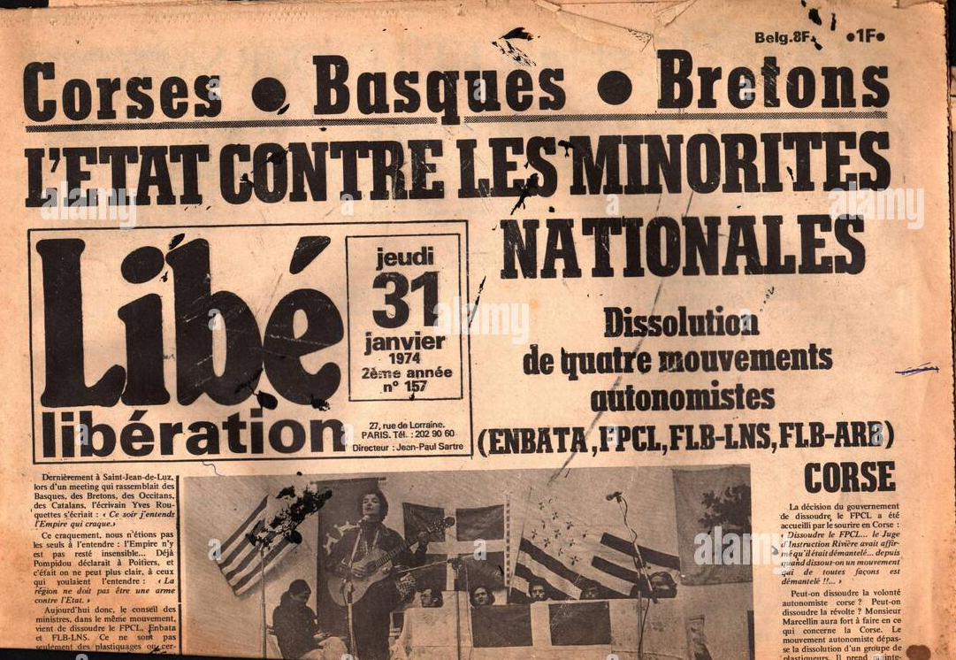
El papel del estado francés
Al principio, los franceses hicieron poco para detener las operaciones de ETA en Iparralde hasta la década de 1980.
Después de Franco, la situación cambió.
Paramilitares del GAL cruzaban la frontera para perseguir a objetivos de ETA.
En la década de 1980, las nuevas leyes españolas que permitían el uso de la tortura, cambiaron la postura francesa..
Notes:
In France, the dominant attitude toward the Basque nationalist issue was to keep it in Spain.
But this was increasingly difficult.
Many Spanish-Basque refugees and members of ETA had escaped Spanish arrest by seeking refuge on the French side of the border, and the paramilitary GAL group crossed over the border into France to track down its ETA targets.
Post-Franco, Spanish political refugees were considered less welcome due to the perception that Spain was now free of the dangerous Franco regime.
Despite these changing attitudes, however, the passing of new Spanish laws that allowed the use of torture meant that extradition was not made compulsory.

Slide 19
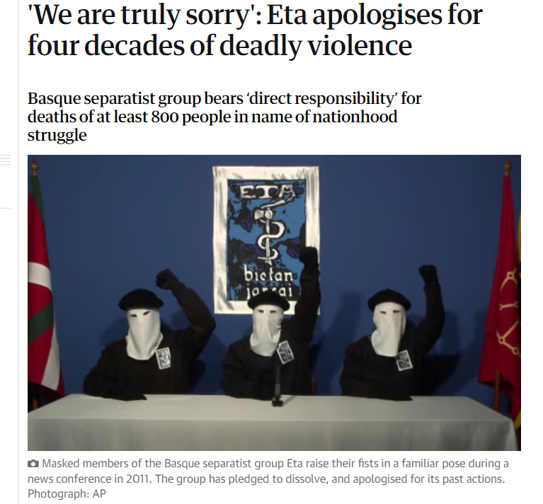
El final de ETA
En 2008 cesaron actividades y en 2018 se disolvieron.
Cientos de militantes de ETA siguen encarcelados en Francia y España.
Notes:
After the peak violence in 1978-80 the number of ETA killings gradually decreased. From the late 1990s onwards, ETA agreed to series of ceasefires and in May 2018, ETA formally announced that it had "completely dissolved all its structures and ended its political initiative".
To this day, these complex tensions are one of the reasons that the Spanish Basque country remains the most policed population in Europe.
As we shall explore in later chapters, although ETA has been dissolved, nationalist feeling remains strong in the Basque country but in a more benign form.
As we shall find out in many of our later lectures, it emerges in relation to many different aspects of Basque culture, such as the revitalization of the Basque Language, bertsolari and football, along with other themes that we shall discuss throughout the year.

Slide 20
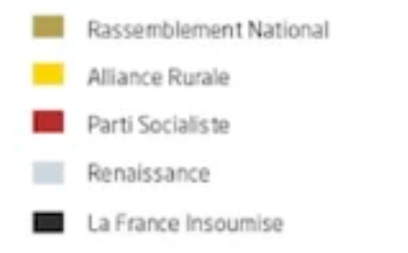
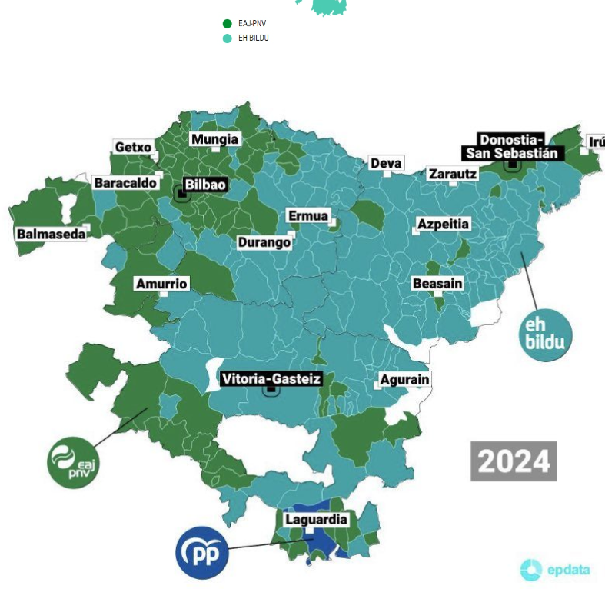
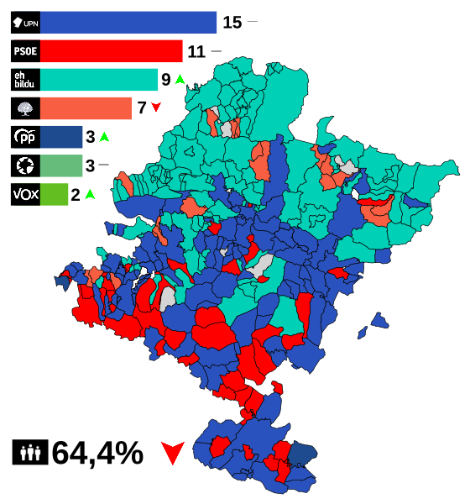
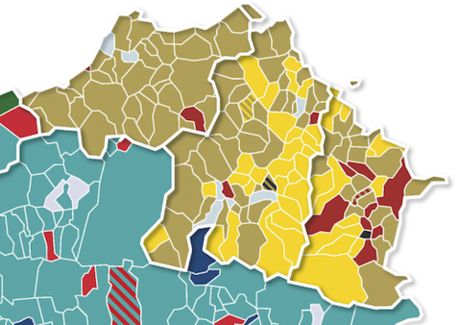
Panorama político contemporáneo
CAV
Nafarroa
Iparraldea
Notes:
Archivo:Mapa de los resultados de las elecciones autonómicas de Navarra 2023 por municipios.svg - Wikipedia, la enciclopedia libre
Un mapa diverso y disputado que va transformándose | Euskal Herria | Naiz

Slide 21
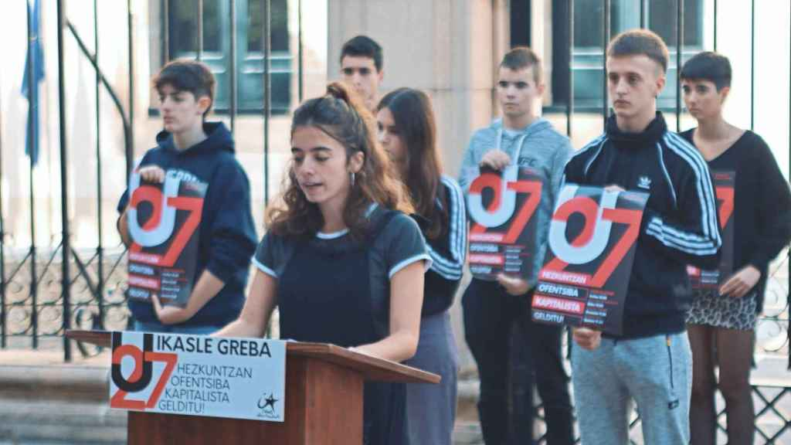
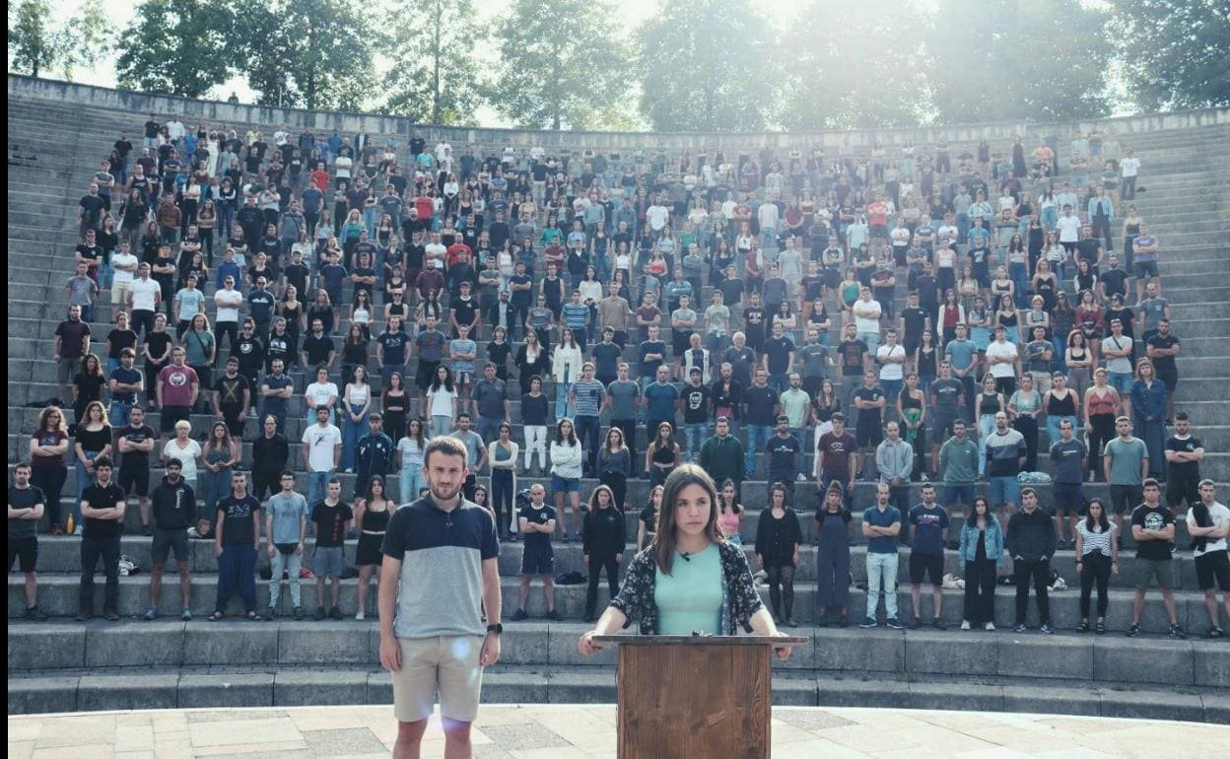
Nationalist legacy
El nacionalismo vasco sigue siendo importante hoy en día, pero hay una división considerable entre los partidos PNV y Bildu.
La independencia ha dejado de ser un objetivo realista.
Los movimientos políticos juveniles son muy activos.
Ernai y GKS son elementos altamente volátiles..
Movimientos juveniles

