Slide 1

Inglés Pre Intermedio (CEFL b1)
Explaining Visual Aids

Slide 2
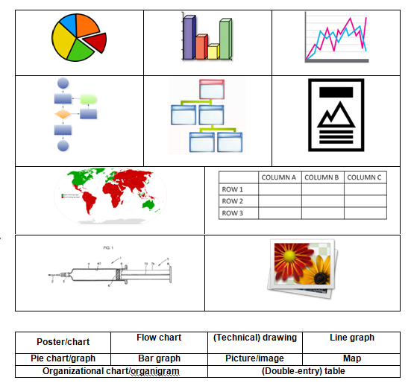
Pie chart/graph
Bar graph
Line graph
Flow chart
Organizational chart
Organigram
Poster/chart
Map
(Double-entry) table
(Technical) drawing
Picture/image
Connect these names with the type of visual aids above:

Slide 3
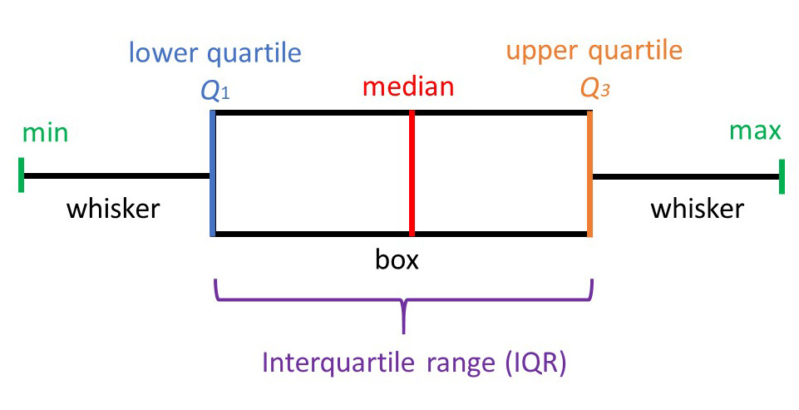
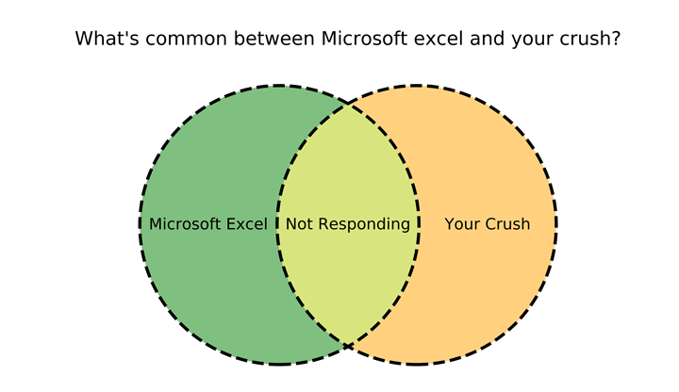
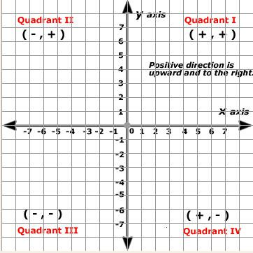
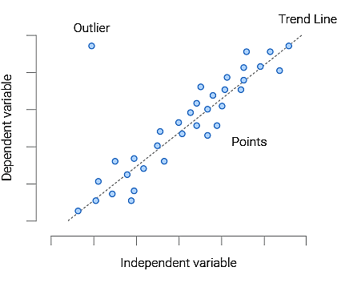
Others:
Box Plot
Venn Diagram
Cartesian Plane
Scatter Plot

Slide 4

In the upper right corner
In the center
On the left
On the right
In the bottom left corner
Across the top
On the top
Down the right
Across the bottom
On the bottom

Slide 5
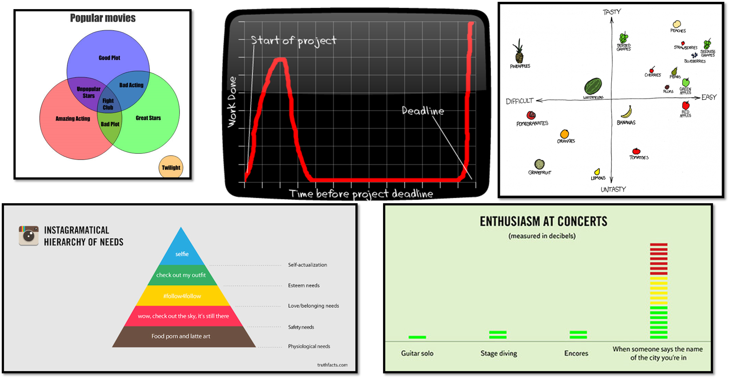
Practice 1: Where is the information?

Slide 6
The following flow diagram shows a
simple and practical way to explain visual aids
Introducing the visual aid:
Say the name or topic.
Briefly reviewing its components:
Explain the main elements related to the point you want to make.
Don’t need to explain every detail.
Making your point:
In relation to your presentation, say what we can conclude from the information you selected from the aid.
The type of aid.

Slide 7
Look at the following example
(analyze it for a couple of minutes):
For making what point do you think you could use it?

Slide 8


Slide 9
Introducing the visual aid:
The following line graph is titled State-of-the-art AI performance on benchmarks relative to human performance.
OR MAYBE
The next line graph is about the evolution of AI performance on different areas as compared to humans’ performance.
Briefly reviewing its components:
On top, you can see the performance areas in diiferent colors. Across the center, you have human performance at 100% as a reference for AI evlolution between 1998 and 2022.
Making your point:
If we look at 2014, we learn that AI started to overcome human performance at a very high rate, so it’s not hard to believe that many health profesional will soon be replaced my computers and machines.

Slide 10
Practice
Select one graph from the following options and make a point
following the 3-step model

Slide 11

Practice 2: Choose one of the following graphs and explain it with your partners in passive voice.

Slide 12
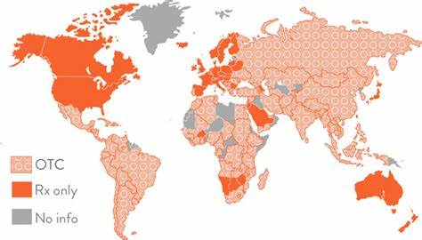
Birth control pills over the counter availability around the world
*OTC = over the counter. Rx only = prescription only.

Slide 13


Slide 14
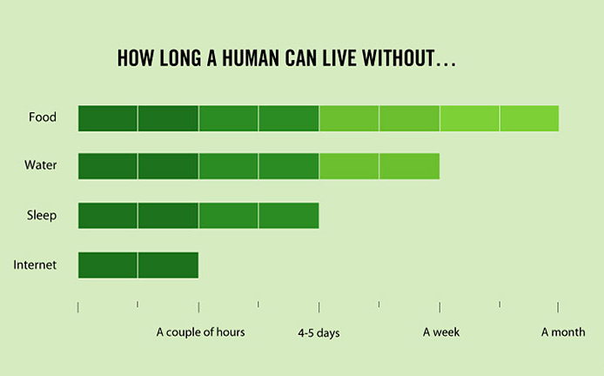

Slide 15
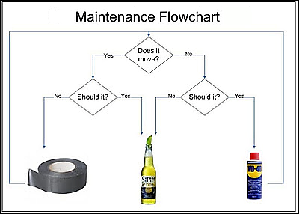

Slide 16
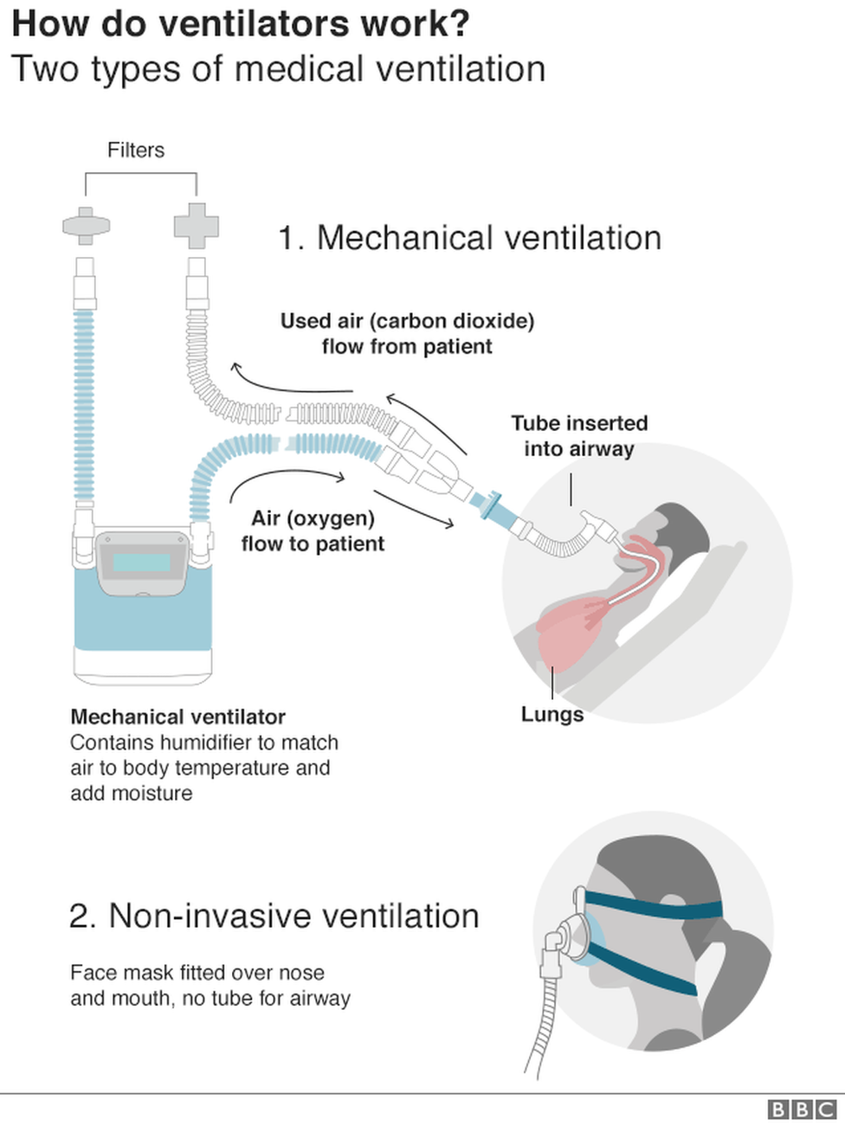

Slide 17


Slide 18
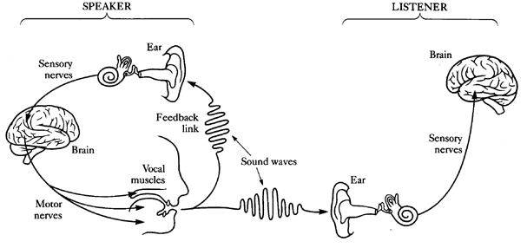

Slide 19
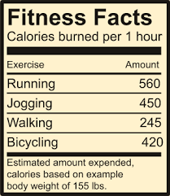

Slide 20
