Slide 1
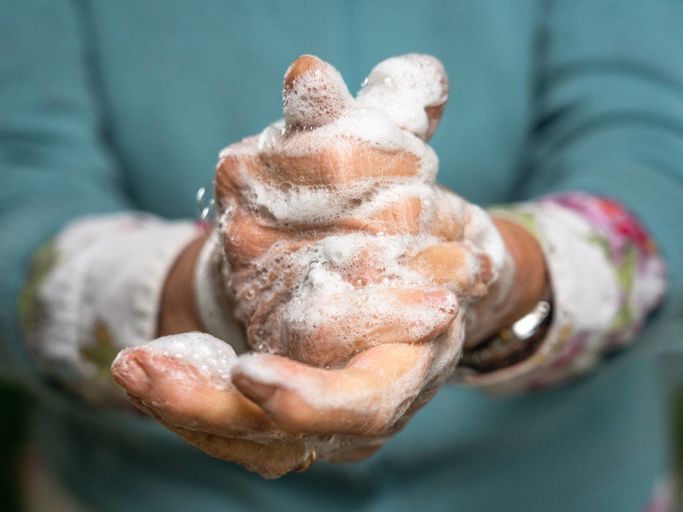
The Importance of Hand Hygiene in Healthcare

Slide 2
Hand hygiene is a critical practice for healthcare professionals to prevent the spread of infections. Clean hands help protect both patients and healthcare workers from harmful germs. Proper hand hygiene involves washing hands with soap and water or using hand sanitizers.
Why is hand hygiene important? Hand hygiene is crucial because it helps reduce the risk of transmitting infections. Healthcare professionals often get in contact with patients who may have reduced immune systems or existing health conditions, making them more susceptible to infections. By maintaining clean hands, healthcare workers can prevent the transfer of harmful microorganisms from one patient to another, reducing the likelihood of healthcare-associated infections.

Slide 3
How to practice hand hygiene?
Hand Washing: When hands are visibly dirty, it's best to wash them with soap and water for at least 20 seconds. Scrub all areas of your hands, including the back of your hands and under your nails, before rinsing thoroughly.
Hand Sanitizers: If hands are not visibly dirty, using an alcohol-based hand sanitizer is effective. Apply a sufficient amount to cover all surfaces of your hands and rub them together until dry.
When to perform hand hygiene? Hand hygiene is essential:
Before and after patient contact
Before putting on and after removing gloves
Before and after performing medical procedures
After touching surfaces or objects in the patient's vicinity
Hand hygiene is a simple but powerful practice that healthcare professionals should prioritize. By keeping their hands clean, they contribute to a safer healthcare environment for everyone involved. Regular and thorough hand hygiene is a responsibility that helps prevent the spread of infections and ensures better patient care.

Slide 4
Exercise: Answer these questions about the text with your partner. Then, read aloud for the whole class.
Why is hand hygiene important for healthcare professionals?
What are the two main methods of practicing hand hygiene?
When should healthcare professionals perform hand hygiene?
How does hand hygiene contribute to patient care?
Why is it crucial for healthcare workers to prevent the spread of infections?

