Slide 1

Inglés Pre Intermedio (CEFL b1)
Expressing opinions and debating.

Slide 2
Self-study.

Slide 3
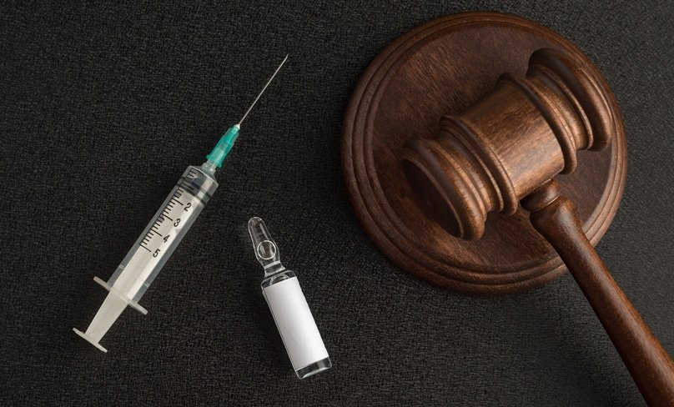
Read the following cases taken from ‘Taboos and issues’ (MacAndrews and Martínez) and list arguments that could be used for and against euthanasia in each. Practice explaining aloud.
Alan Jones, aged 78, had a second stroke three weeks ago. He had severe brain damage and his condition is getting worse. At the request of his daughter, a nurse stops giving him oxygen until his heart stops. The nurse then starts giving him oxygen again. People think that mister Jones died naturally. Later, mister Jones’ daughter tells a friend what happened. The friend is married to a police officer. As a result, the police charge the nurse with ‘murder’.

Slide 4
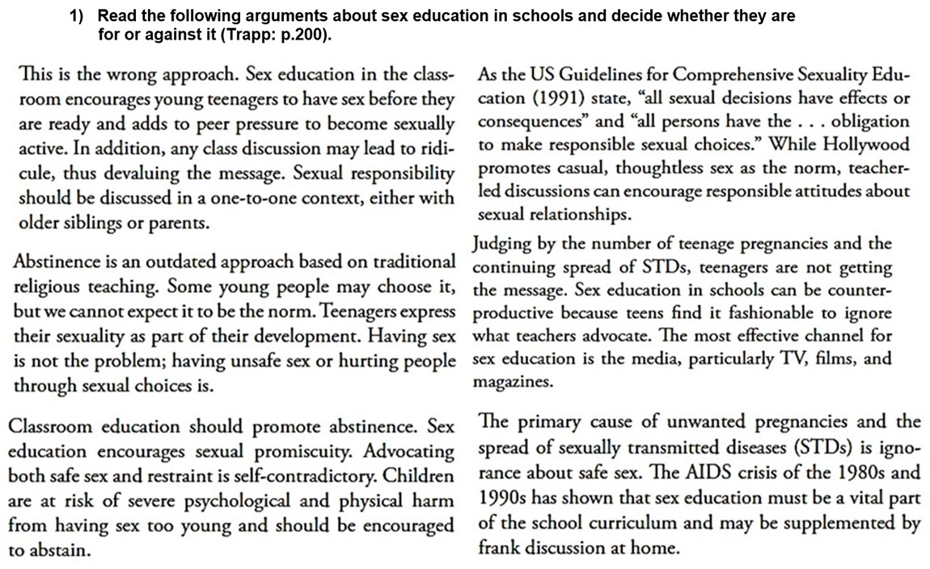
A
F
F
A
A
F

Slide 5
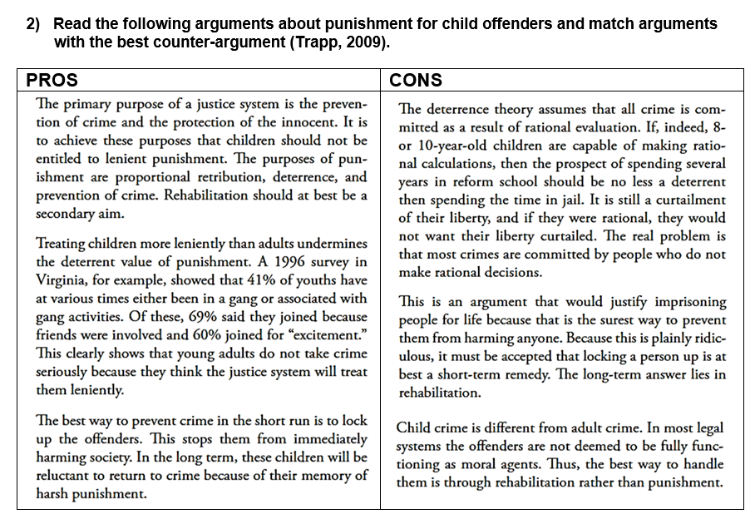

Slide 6



Listening.
Do you know what wilfing* is?
Listen to the following debate about wilfing and list the argument for and against.
PROs | CONs
wilfing* (click this to see the meaning)
browsing the Internet without any particular purpose.

