Slide 1

Inglés Pre Intermedio (CEFL b1)
Expressing opinions and debating.

Slide 2

What do you think are the top 5 most polemic issues in Chile right now?
Why are those topics so controversial? What do people believe about them?

Slide 3
Social issues discussion.
What welfare(1) benefits are you familiar with(2)? What do you think of them?
Are nursing homes(3) a good idea for elderly(4) people?
Should drinking be allowed(5) in public places?
What is your stand(6) regarding(7) graffiti?
Should parents physically punish(8) their children?
What do you think of the idea of owning(9) a gun?
related to social help 2) acquainted 3) care center for the elderly 4) older 5) permitted 6) posture 7) about
8) discipline 9) possessing

Slide 4


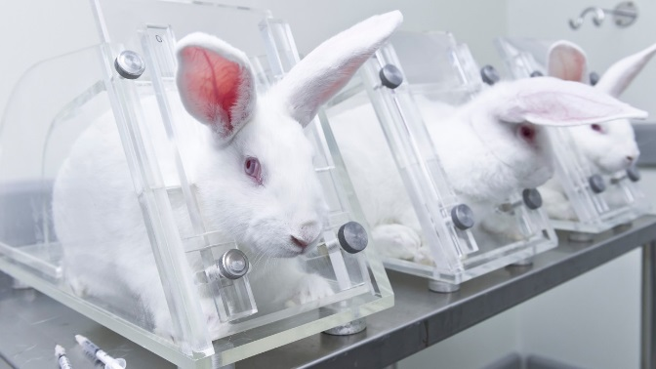
Discussion.
Work in groups/pairs. Choose three of the following topics and discuss them with your partner.
Genetically modified food
Universal health care
Abortion
Legalization of marijuana
Condoms in school
Assited suicide
Not vaccinating your kids
Caring about body image/Fatphobia
Animal cruelty
Inmigration policies.
Vegetarianism
Veganism.
LGBTQ+ adoption rights

Slide 5
Self-study.

Slide 6

Read the following cases taken from ‘Taboos and issues’ (MacAndrews and Martínez) and list arguments that could be used for and against euthanasia in each. Practice explaining aloud.
Alan Jones, aged 78, had a second stroke three weeks ago. He had severe brain damage and his condition is getting worse. At the request of his daughter, a nurse stops giving him oxygen until his heart stops. The nurse then starts giving him oxygen again. People think that mister Jones died naturally. Later, mister Jones’ daughter tells a friend what happened. The friend is married to a police officer. As a result, the police charge the nurse with ‘murder’.

Slide 7
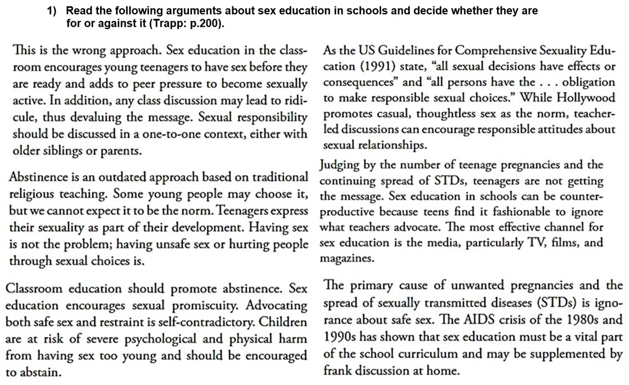
A
F
F
A
A
F

Slide 8
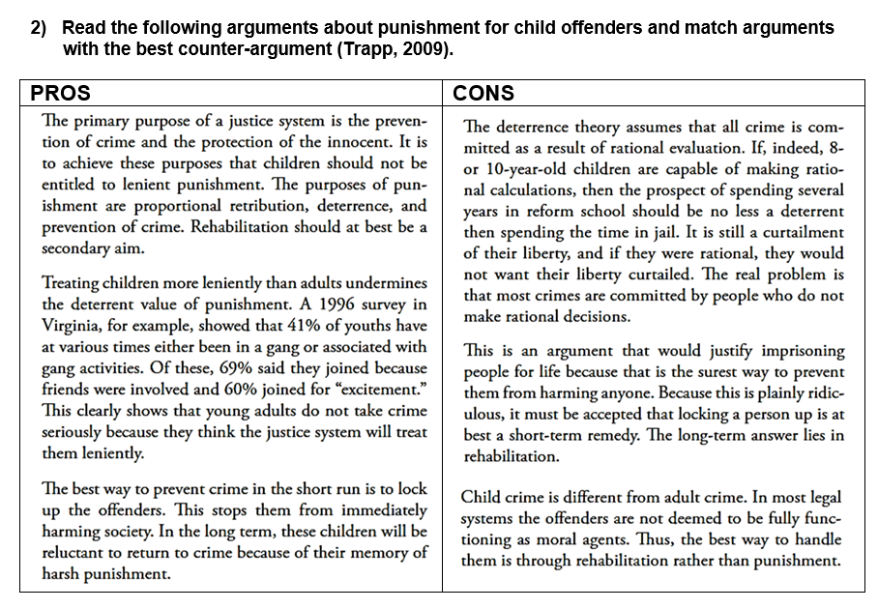

Slide 9



Listening.
Do you know what wilfing* is?
Listen to the following debate about wilfing and list the argument for and against.
PROs | CONs
wilfing* (click this to see the meaning)
browsing the Internet without any particular purpose.

