Slide 1
Survey: Complete the following table with answers from the 5 questions below:
Questions:
What is the best way to study for university tests?
What is the best way to relax?
What is the most delicious dish?
What is the main weakness of our current healthcare system?
What is the most difficult thing about learning English?

Slide 2
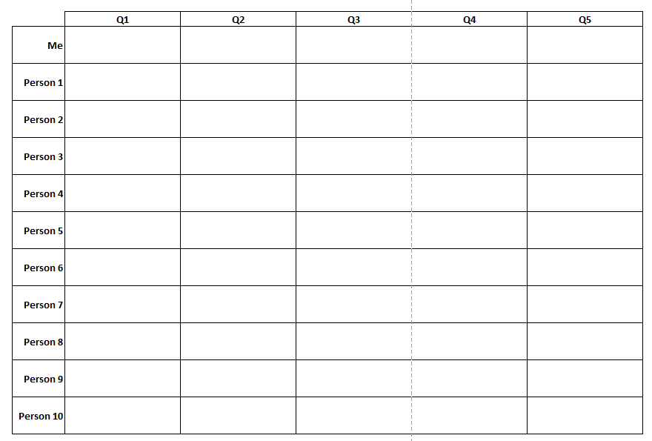

Slide 3
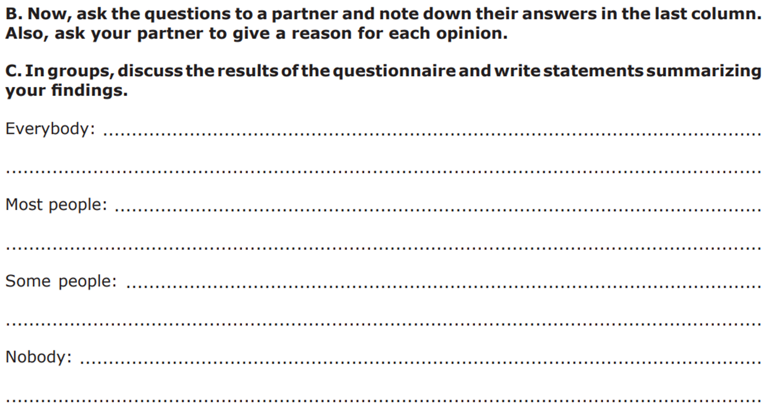

Slide 4
Four corners:
There are 4 signs around the classroom (maybe 2 for small sections):
Strongly agree
Agree
Disagree
Strongly disagree
You teacher will reveal some statements. Go to the corner that better represent your say regarding those ideas and discuss with your peers why you think that way. Then report to the class.

Slide 5
Multinational corporations are responsible for most problems in the world today.
Smoking should be banned utterly (completely).
Children should be allowed to eat fast food.
Politician and authorities should be made accountable for the sources of the information they share.
The death penalty is acceptable in some cases.
People should be able to live in any country they choose.
Real human communication is getting worse because of the internet.
Quality life will improve in the future.

