Slide 1
Functions of the Body

Slide 2
Form groups of 4 or 5 and watch the video. Take some notes and do the following exercises:
https://youtu.be/Ae4MadKPJC0
Mention at least 5 of the 10 major systems which are responsible for the body's functions.
Choose TWO of them and write two or three characteristics.

Slide 3
Watch this video and answer.
https://www.youtube.com/watch?v=q1xNuU7gaAQ
When I see a film I use this sense.__________________
When I touch my dog I use this sense._______________
When I smell my mom's perfume I use this sense.
When I listen to music I use this sense. ______________
When I taste my favorite food I use this sense. _________

Slide 4
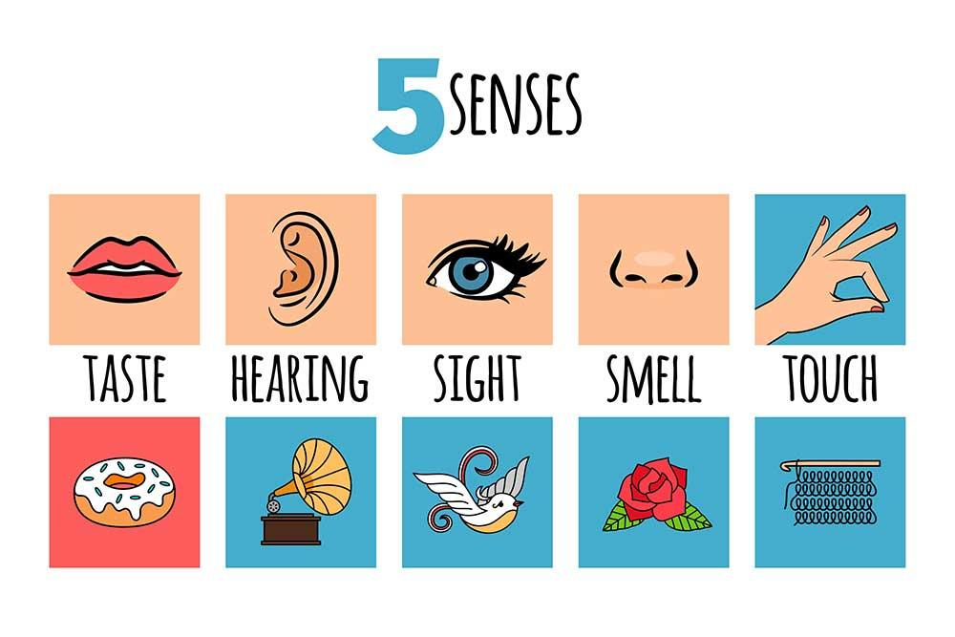
The Five Senses
In relation to the senses, we can say that in addition to smell and taste, the senses include sight (or vision), hearing, and touch (also called sensation or feeling).

Slide 5
Work in pairs and do these exercises:
Notice five things that you can see. Look around you…
Notice four things that you can feel. Tune in to your sense of touch…
Notice three things you can hear. Listen carefully …
Notice two things you can smell…
Notice one thing you can taste.
And now, ask your partner the following questions:
What is the most beautiful thing you have seen ?
Is there any smell you will never forget?
Which foods taste bad to you?
Imagine that you have a friend who has no sense of touch. How would you describe to your friend what it is like to touch something?
Is there any noise you like most?

Slide 6
Do you remember the definitions?
let’s see!

Slide 7
Body part | Definition
Bladder | ___ __It is the central organ of the human nervous system, and with the spinal cord makes up the central nervous system.
2. Kidneys | ___ __It is the part projecting above the mouth on the face of a person or animal, containing the nostrils and used for breathing and smelling.
3. Nose | ______They are a pair of spongy, air-filled organs located on either side of the chest (thorax).
4. Eye | ______It is a round, bag-like organ that stores urine.
5. Stomach | ______It is an organ which reacts to light and pressure. It allows vision.
6. Lungs | ______They are the organs that filter waste products from the blood.
7. brain | ______ It helps digest food by mixing it with digestive juices and churning it into a thin liquid.

Slide 8
Health and Illnesses

Slide 9
English | Spanish
illness | enfermedad (concepto genérico, malestar sin diagnóstico)
disease | enfermedad (propiamente identificada, como la influenza o el cáncer)
asthma | asma
heart attack | Ataque al corazón
heart disease | Cardiopatía
hepatitis | hepatitis
ulcer | úlcera
flu | influenza
wound | herida
injury | lesión

Slide 10
English | Spanish
nurse | enfermera
Injection/ shot | inyección
prescription | Receta médica
painful | doloroso
painless | Indoloro
bandage | Venda
Band aid | Vendita, parche curita
wheelchair | Silla de ruedas
To feel good | Sentirse bien
To catch a cold | resfriarse

Slide 11
English | Spanish
To sneeze | estornudar
To cough | toser
To feel sick | sentirse enfermo
To feel dizzy | sentirse mareado
To faint | desmayarse
To have backache | tener dolor de espalda
To have (an) earache | tener dolor de oído
To have a sore throat | tener dolor de garganta
To have a stomachache | Tener dolor de estómago
To throw up / vomit | vomitar

Slide 12
Now let’s put this vocabulary into practice

Slide 13
Watch the video and answer these questions.
https://www.youtube.com/watch?v=VPM2WYQetEo&t=102s
How does Emily feel?
_______________________________________
What is the matter with Emily?
____________________________________________________________________________________
Does she have a sore throat?
Choose 3 sentences or important expressions from the video and write them down.

Slide 14
Complete the following table
English | Spanish
illness
disease
asthma
heart attack
heart disease
hepatitis
ulcer
flu
wound
injury

Slide 15
English | Spanish
nurse
Injection/ shot
prescription
painful
painless
bandage
Band aid
wheelchair
To feel good
To catch a cold

Slide 16
English | Spanish
To sneeze
To cough
To feel sick
To feel dizzy
To faint
To have backache
To have earache
To have a sore throat
To have a stomachache
To throw up

Slide 17
Most Common Illnesses

Slide 18
Tick the illnesses that are more common in your field. Then, compare with a partner. PART A
1. Hypertension ("high blood pressure")
2. Upper Respiratory Tract Infection (coughs, colds, "flu", etc.)
3. Allergies
4. Headaches
5. Diarrhea & gastrointestinal pathologies (gastroesophageal reflux disease, irritable colon, etc)
6. Bronchitis - tonsilitis
7. Degenerative Joint Disease ("arthritis", etc.)

Slide 19
Tick the illnesses that are more common in your field. Then, compare with a partner. PART B
8. Attention deficit hyperactivity disorder
9. Otitis ("ear infection")
10. Depression
11. Alzheimer’s disease
12. Anorexia nervosa
13. Back pain
14. Bipolar disorder
15. Breast cancer

Slide 20
How often are these people affected by one of these illnesses? Discuss in groups.
Example: Many senior citizens are usually affected by arthritis, especially in winter.
Or: Many senior citizens usually suffer from arthritis…
Infants (0-2 years of age):
Children 2-10 y.o.a :
Children 11-13:
Teens 14-20:
Adults 20-40:
Adults 41-60:
Seniors 61 + :

Slide 21
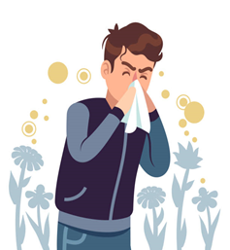
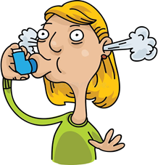
And what about you? How often do you suffer from a common illness? Which one(s) affects you more often? Compare your answers with a partner.
For example:
A: I always get allergies in spring. What about you?
B: No, I don’t, but I usually get asthma in winter.

Slide 22
Illness v/s Diseases
"Illness" and "disease" are related terms often used interchangeably, but they have distinct meanings in the context of health and medicine.
Disease: A disease refers to a specific pathological condition or disorder that affects the normal functioning of the body or mind. It involves a deviation from the normal state of health, and it often has specific physical, physiological, or biochemical characteristics. Diseases can be caused by various factors, such as pathogens (bacteria, viruses, etc.), genetic mutations, environmental factors, lifestyle choices, and more.
Illness: Illness, on the other hand, is a larger and more subjective term. It refers to the way an individual experiences and perceives their state of being unwell. Illness involves not only the physical aspects of a disease but also the psychological and emotional responses to being unwell. It considers how an individual feels, their perceptions of discomfort or distress, and the impact of the disease on their overall well-being. Illness is influenced by cultural, social, and personal factors and can vary from person to person even if they have the same disease.
In summary, disease refers to the specific physiological or pathological condition that disorders normal bodily functions, while illness includes the individual's overall experience, including physical, psychological, and emotional aspects, when they are not in a state of well-being.

Slide 23
True or false?
An illness refers to a specific pathological condition or disorder that affects the normal functioning of the body or mind.__________________
Diseases can be caused only by bacteria(s)____________________
Illness refers to the way an individual experiences and perceives the state of being unwell _____________
An illness does not include the individual's overall experience ________________
illnesses or Disease ?
Allergies. —--------------------- Illness
Colds and Flu.
Conjunctivitis ("pink eye“)
Diarrhea.
Headaches.
Mononucleosis.
Stomach Aches.
Cancer. ...
Chronic Respiratory problem
Obesity. ...
Alzheimer's
Diabetes. ...
Substance Abuse. ...
Infectious Diseases.

