Slide 1
VERB “TO BE”
Simple Present Tense

Slide 2
When do we use Verb to be in English
Describing Identity:
I am a student.
She is a doctor.
They are friends.
Describing Nationality:
He is Spanish.
We are American.
Describing Origin:
The book is from Germany.
Those shoes are Italian.
4.Describing Location:
1.The cat is on the table.
2.The school is near the park.
5. Describing Time:
1.It is 3 o'clock.
Today is Monday.

Slide 3
6. Describing Feelings:
1.She is happy.
2.They are tired.
7.Making Sentences Negative:
1.I am not hungry.
2.He is not here.
8. Asking Questions:
1.Is she your friend?
2.Are they coming to the party?
9. Describing weather conditions:
It is cold
It is cloudy

Slide 4
Personal Pronouns
Singular Plural
I We
You You
He
She
It They

Slide 5
Simple Present of “BE”
I am an English teacher.
You are my friend.
He is a good student.
She is a new classmate.

Slide 6
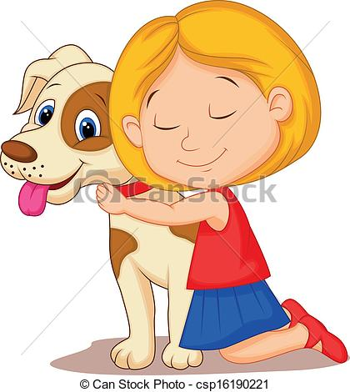
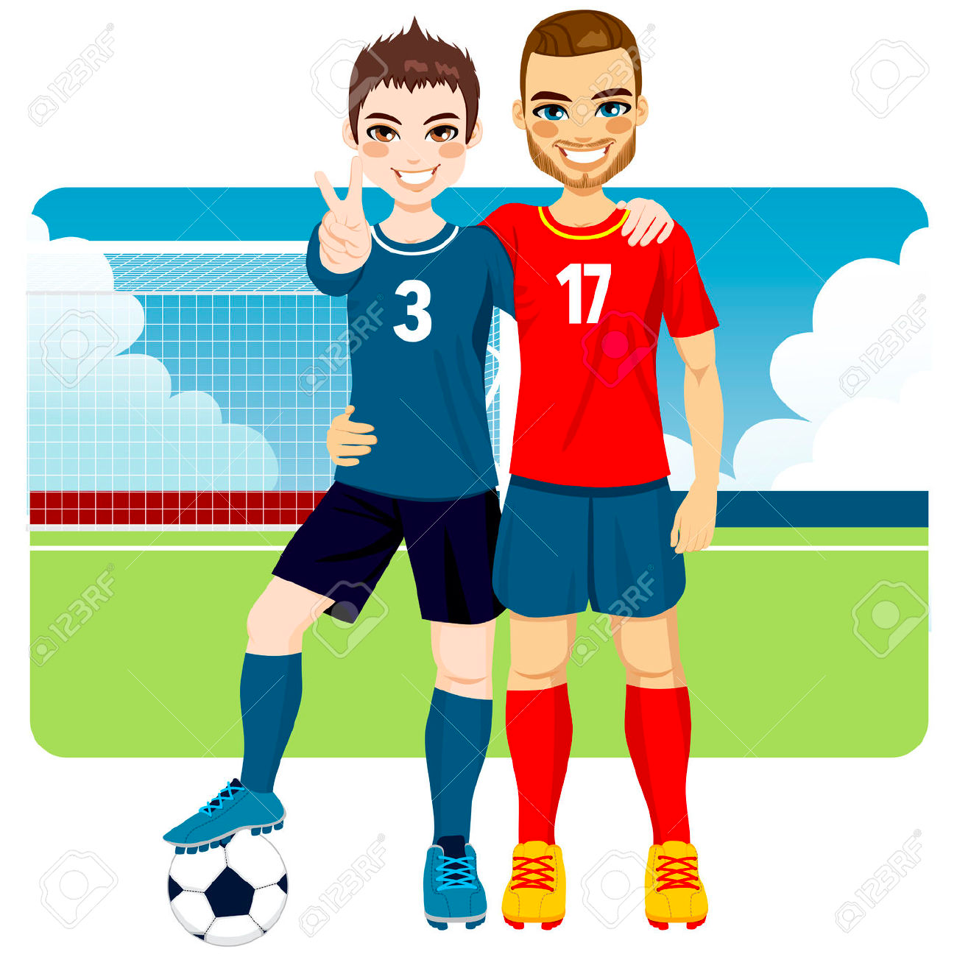
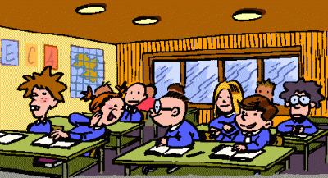
It is my pet.
We are good friends.
You and Peter are soccer players.
They are in class.

Slide 7
Contractions
Complete the following sentences as in the example.
I’m I’m an English teacher.
You’re _____________________________________
He’s _____________________________________
She’s _____________________________________
It’s _____________________________________
We’re ______________________________________
They’re ______________________________________

Slide 8
Negative Form
I’m a teacher. I’m not a doctor.
You’re a student. You aren’t a bus driver.
He’s a good student. He isn’t lazy.
She’s my mother. She isn’t my sister.
It’s a dog. It isn’t a cat.
We are friends. We aren’t brothers.
They are in class. They aren’t in the cafeteria.

Slide 9
Interrogative Form (Yes/ No Questions)
Are you a teacher? Yes, I am.
Is she a good student? Yes, she is.
Is he a good soccer player? Yes, he is.

Slide 10
Are you a doctor?
No, I’m not.
I’m a teacher.
Is she a bad student?
No, she isn’t.
She’s a good student.
Is he a bad player?
No, he isn’t.
He’s a good player.

Slide 11
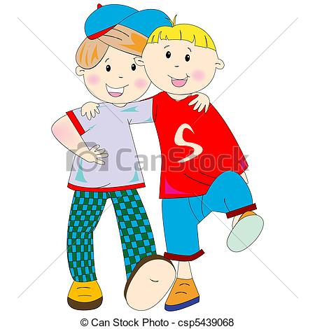
Is it a cat? Yes, it is.
Are you and Paul students? Yes, we are.
Are they in class? Yes, they are.

Slide 12
Is it a dog?
No, it isn’t. It is a cat.
Are you and Paul teachers?
No, we aren’t.
We’re students.
Are they in the cafeteria?
No, they aren’t.
They’re in class.

Slide 13
Let’s practice Verb To be now !

Slide 14
Exercise 1: Fill in the blanks with the appropriate form of the verb "to be.“ AM- IS- ARE
The patient's vital signs _____________ stable.
The doctor _____________examining the patient's X-rays.
Nurses ____________an integral part of the healthcare team.
A healthy diet and regular exercise _______ important for overall well-being.
The medical equipment _________ ready for the surgery.
Patient safety ________ the top priority in any healthcare setting.
The symptoms ____________indicative of a possible infection.
Communication between healthcare professionals _____ essential for coordinated care.
The wound ____________clean and healing well.
Personal protective equipment (PPE) ___________ mandatory in certain situations.
The patient's condition ____________ improving after receiving the appropriate treatment.
The MRI results ______________ indicating a potential issue with the spine.
Proper hydration _______crucial, especially in hot weather.
The radiologist's primary responsibility is interpreting medical imaging.
In critical situations, quick decision-making is crucial for positive outcomes.
Patient records ___________ considered confidential and must be handled carefully.

