Slide 1
PRONOUNS IN ENGLISH ARE WORDS THAT ARE USED TO REPLACE NOUNS IN ORDER TO AVOID REPETITION. HERE ARE SOME COMMON ENGLISH PRONOUNS WITH THE CORRESPONDING POSSESSIVE ADJECTIVE:

Slide 2
Certainly! Here's a table of pronouns in English with example sentences:
Example sentences:
Subject Pronoun | Object Pronoun (After the verb or verb phrase) | Possessive Determiner/Adjective (Before the noun) | Possessive Pronoun (After or before the verb) | Reflexive Pronoun (At the end of the sentence)
I am | Me | My | Mine | Myself
You are | You | Your | Yours | Yourself
He is | Him | His | His | Himself
She is | Her | Her | Hers | Herself
It is | It | Its | *Its (It is not normally used as a possessive pronoun) | Itself
We are | Us | Our | Ours | Ourselves
You are | You | Your | Yours | Yourselves
They are | Them | Their | Theirs | Themselves

Slide 3
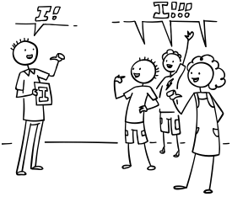
EXAMPLE SENTENCES:
I
SUBJECT: I AM GOING TO THE STORE.
OBJECT: THEY INVITED ME TO THE PARTY.
POSSESSIVE DETERMINER: THIS IS MY BOOK.
POSSESSIVE PRONOUN: THE LAPTOP IS MINE.
REFLEXIVE: I CAN DO IT BY MYSELF.

Slide 4
YOU (SINGULAR)
SUBJECT: YOU ARE VISITING THE DOCTOR TOMORROW.
OBJECT: I MET YOU LAST WEEK. DON´T YOU REMEMBER?
POSSESSIVE DETERMINER: I LIKE YOUR NEW CELL PHONE.
POSSESSIVE PRONOUN: IS THAT BOOK YOURS?.
REFLEXIVE: YOU HURT YOURSELF, SO GO TO THE EMERGENCY CENTER

Slide 5
You
Subject: You are my best friend.
Object: I saw you at the mall.
Possessive Determiner: Is this your car?
Possessive Pronoun: The decision is yours.
Reflexive: Be true to yourself.
SHE
SUBJECT: SHE LOVES TO READ.
OBJECT: I ADMIRE HER INTELLIGENCE.
POSSESSIVE DETERMINER: HAVE YOU SEEN HER NEW APARTMENT?
POSSESSIVE PRONOUN: THE NECKLACE IS HERS.
REFLEXIVE: SHE HERSELF OPERATED THE PATIENT.

Slide 6
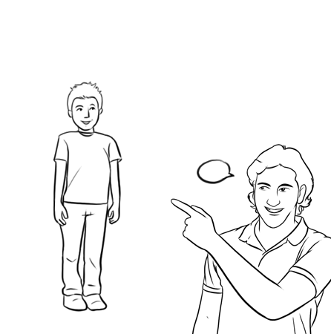
She
Subject: She loves to read.
Object: I admire her intelligence.
Possessive Determiner: Have you seen her new apartment?
Possessive Pronoun: The necklace is hers.
He
Subject: He is coming to the party.
Object: I gave the gift to him.
Possessive Determiner: I like his new shirt.
Possessive Pronoun: The dog is his.
Reflexive: He hurt himself while playing.
Reflexive: She bought the dress for herself
HE
SUBJECT: HE IS COMING TO THE PARTY.
OBJECT: I GAVE THE GIFT TO HIM.
POSSESSIVE DETERMINER: I LIKE HIS NEW SHIRT.
POSSESSIVE PRONOUN: THE DOG IS HIS.
REFLEXIVE: HE HURT HIMSELF WHILE PLAYING.

Slide 7
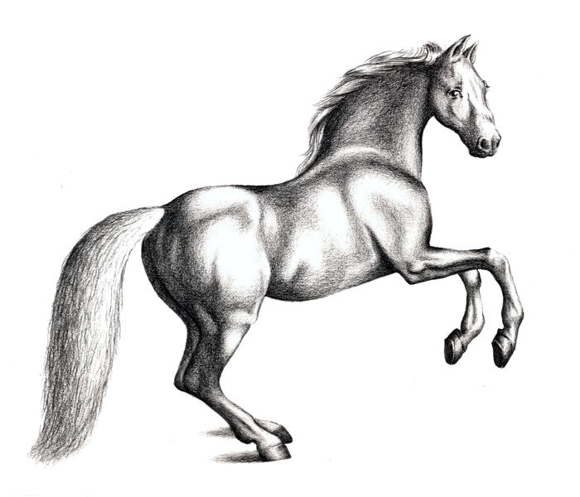
IT
SUBJECT: I THINK IT WAS A DIFFICULT EXAM.
OBJECT: YOU CAN FIND IT IN THE CLOSET.
POSSESSIVE DETERMINER: ITS BUILDINGS ARE BEAUTIFUL.
POSSESSIVE PRONOUN: *VERY RARE IN ENGLISH
REFLEXIVE: THE CAR ITSELF WAS ALSO EXTREMELY SLOW.

Slide 8
It
Subject: It is raining outside.
Object: I found it on the table.
Possessive Determiner: The cat is cleaning its paws.
Possessive Pronoun: The decision is up to you; it is yours.
Reflexive: The cat is grooming itself.
WE
SUBJECT: WE ARE GOING ON A TRIP.
OBJECT: THEY INVITED US TO THE EVENT.
POSSESSIVE DETERMINER: THIS IS OUR PROJECT.
POSSESSIVE PRONOUN: THE VICTORY IS OURS.
REFLEXIVE: WE CAN SOLVE THE PROBLEM BY OURSELVES.

Slide 9
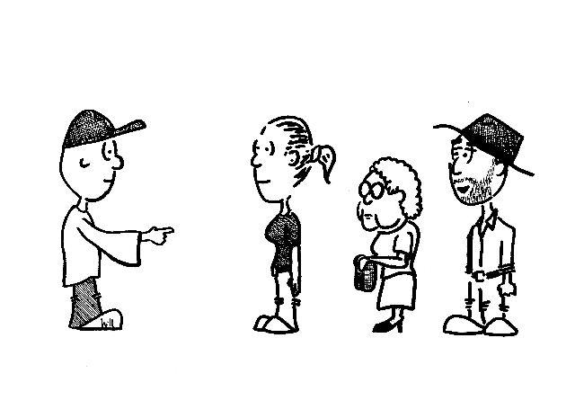
YOU (PLURAL)
SUBJECT: YOU ARE DOING A GREAT JOB.
OBJECT: I APPRECIATE WORKING WITH YOU.
POSSESSIVE DETERMINER: PLEASE BRING YOUR LAPTOPS.
POSSESSIVE PRONOUN: THE DECISION IS YOURS.
REFLEXIVE: WORK ON THE PROJECT BY YOURSELVES.

Slide 10
THEY (HUMAN BEINGS AND NON HUMAN BEINGS IN PLURAL)
SUBJECT: THEY ARE COMING TO THE MEETING.
OBJECT: I SAW THEM IN THE PARK.
POSSESSIVE DETERMINER: I LIKE THEIR NEW HOUSE.
POSSESSIVE PRONOUN: THE CAR IS THEIRS.
REFLEXIVE: THEY ORGANIZED THE EVENT BY THEMSELVES.

Slide 11
TAKE A LOOK AT THIS VIDEO FOR EXTRA INFO AND DO THE ACTIVITIES BELOW. IN ADDITION, DO THE EXERCISES IN THE HANDOUT: 5, 17 AND 18.
HTTPS://YOUTU.BE/H_GNSOIFWF4?SI=J8-M9HEPW19UUPHX

Slide 12
1. WRITE A SHORT PARAGRAPH ABOUT YOUR OWN HEALTH EXPERIENCE.
2. CREATE SCENARIOS WHERE IN PAIRS OR GROUPS ACT OUT INTERACTIONS AT A PHARMACY.
3. USE PRONOUNS TO DESCRIBE PERSONAL HEALTH JOURNEYS OR ENCOUNTERS WITH HEALTHCARE PROFESSIONALS.
4. DESIGN A HEALTH SURVEY WITH QUESTIONS RELATED TO PERSONAL HABITS, EXERCISE ROUTINES, AND DIETARY PREFERENCES.

Slide 14
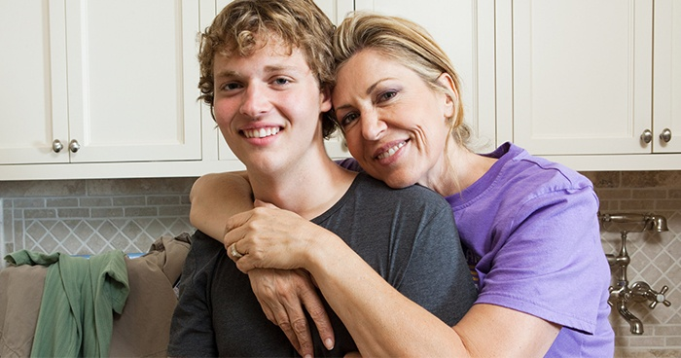
I’m Jack. This is ….. mum.
my

Slide 15
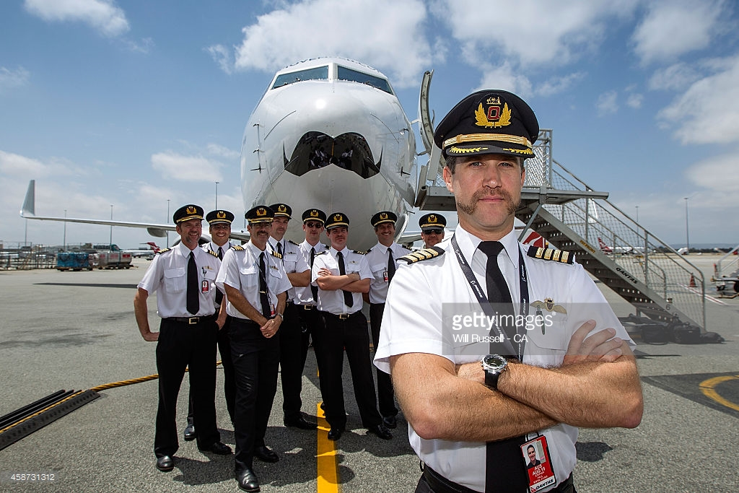
They are pilots. This is………plane.
their

Slide 16
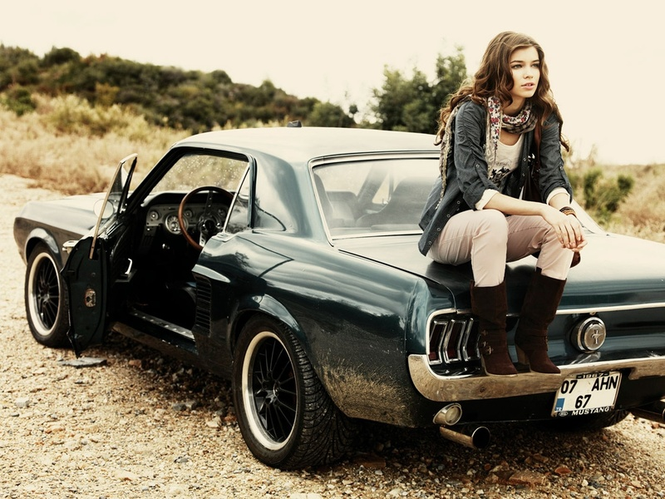
She’s Lilly. It’s …….. car.
her

Slide 17
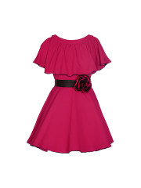
You are a girl. It’s……….dress.
your

Slide 18
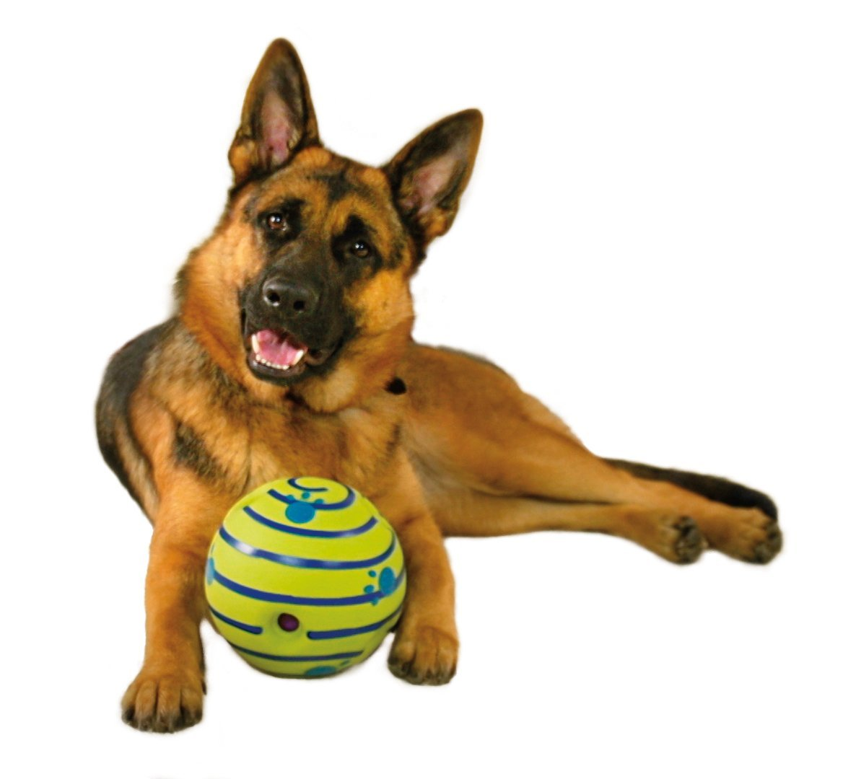
It’s a dog. It’s…….ball.
its

Slide 19
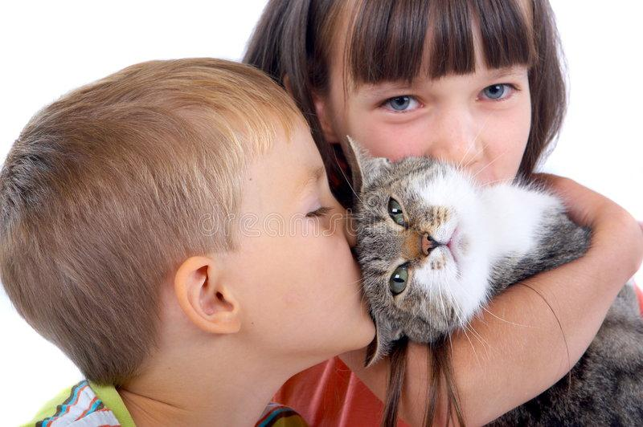
We are Nora and Sam.This is………cat.
our

Slide 20
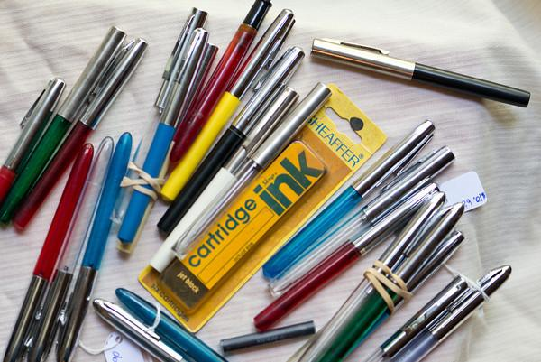
You are students.These are …….pens.
your

Slide 21
He is a father. This is ….. daughter.
his

