Slide 1
Unit 1
Parts of the body and symptoms
Take a look at the following video:
https://www.woodwardenglish.com/parts-of-the-body-english-video/

Slide 2
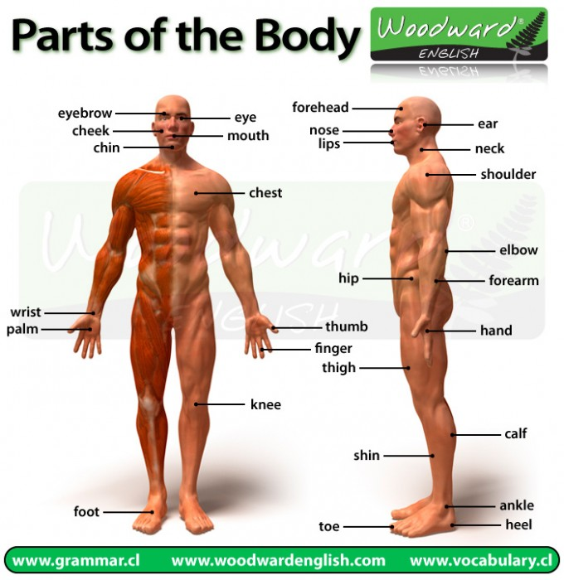
https://www.woodwardenglish.com/parts-of-the-body-english-video/

Slide 3
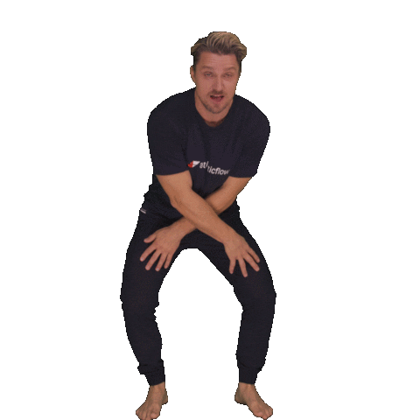
Additional practice
https://youtube.com/watch?v=Ozzo7GQLoAE

Slide 4
Body and Symptoms
SPANISH | ENGLISH
ojos | eyes
boca | Mouth
oreja | Ear
nariz | Nose
cuello | Neck
espalda | Back
pecho | Chest
estómago | Stomach
diente-dientes | Tooth – teeth

Slide 5
SPANISH | ENGLISH
Brazo | arm
codo | Elbow
mano | Hand
muñeca | Wrist
pierna | Leg
rodilla | Knee
pie-pies | Foot – feet
dedos pies | Toes
tobillo | ankle

Slide 6
Headache | Dolor de cabeza
Stomachache | Dolor de estómago
Backache | Dolor de espalda
Toothache | Dolor de dientes/ muelas
earache | Dolor de oído
Cold | Resfrío
Fever | Fiebre
Cough | Tos
Sorethroat | Dolor de garganta
diarrhea | diarrea

Slide 7
Body and Symptoms
I. Complete the table with the right word in English.
SPANISH | ENGLISH
ojos
boca
oreja
nariz
cuello
espalda
pecho
estómago
diente-dientes

Slide 8
SPANISH | ENGLISH
Brazo
codo
mano
muñeca
pierna
rodilla
pie-pies
dedos pies
tobillo

Slide 9
And now, do the exercises on page 4.

