Slide 1
WELCOME TO STARTER
Week 10 : Unit 7-Unit 8.
2020-1

Slide 2
REMEMBER: Coming soon!
Check Starter Program
TEST | TYPE | PERCENTAGE OF FINAL MARK%
1 2 3 4. 5. 6. | Review online quiz READY (5%) Online quiz 1 :READY (6%) Online quiz 2 : Ready (6%) Online quiz 3 : Online Integrated quiz : Ready (20%) Video activity : Final written test Participation assessment (Homework )

Slide 3
OBJECTIVES: Unit 7/8
Comunication strategies and health problems
Prepositions of place
Prepositions of time
Linkers
Extra practice: listening and other exercises

Slide 4
Answer key: Simple past tense
III. Change the sentences into simple past. (affirmative, negative or interrogative)
1. We open the door.
We opened the door. / We didn´t open the door. / Did we open the door?
aff. neg. Int.
2. Do you write poems?
Did you write poems? / I wrote poems. / I didn´t write poems..
int. aff. neg.
3. Richard plays in the garden.
Richard played in the garden. / Richard didn´t play in the garden. / Did Richard play in the garden?
aff. neg. Int.
4. Kerry does not speak English.
Kerry didn´t speak English. / Kerry spoke English. / Did Kerry speak English?
neg. aff. Int.
IV. Ask for the bold part of the sentences.
1. What did he eat? Billy ate an apple
2. Where did the children play? The children played in the garden
3. When did the teacher mark all the tests? The teacher marked all the tests last Saturday
https://www.ego4u.com/en/cram-up/grammar/simple-past/exercises

Slide 5
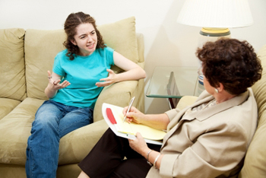
Last class:Dialogue
Frida is visiting her psychiatrist and telling her how her sessions with her new psychologist were.(ask your students to reak it.
Doctor: Come in…! Good morning, Frida.
Frida: Good morning Doctor Smith.
Doctor: How did you feel in the sessions with the psychologist?
Frida: I felt really good. She gave me 5 tips to deal with my emotions and overcome confinement.
Doctor: Did you do them?
Frida: Yes, I did. They worked very well. I feel much better. I also started doing yoga two times a week on Instagram. I did not know how good it was.
Doctor: Perfect…!

Slide 6
Answer key: regular and irregular verbs from the dialogue(In extra material, list of verbs available).
Regular
Irregular
EX. Study - studied
work- worked
start- started
EX. Break - broke
Feel - felt
Give – gave
Do – did
Be – was/were

Slide 7


Self study:
Prepositions of places:
Prepositions | Usage | Example
in | Within limits or area. | in the kitchen in the book in the car, in a taxi in the picture, in the world
on | On a surface, attached. Public transport. Television and radio. | on the wall on the table on a bus, plane on Tv, on the radio

Slide 8
at | Near the area occupied For tables, events Places where you are to do something typical. | at the door at the table at the concert at the cinema at work

Slide 9
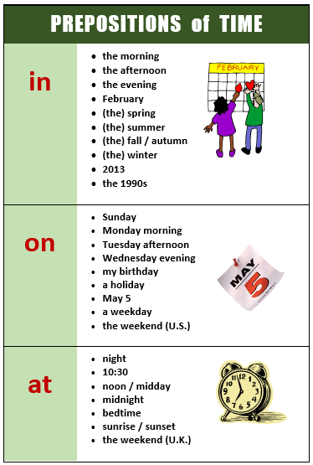
Self study

Slide 10
Extra exercises on prepositions:
https://es.liveworksheets.com/worksheets/en/English_as_a_Second_Language_(ESL)/Prepositions_of_time/Preposition_of_time_-_Multiple_choice_gp1224171au

Slide 11
Oral practice:Answer the following questions with the appropriate prepositions.
1. Where are you? ___________________________________
2. When is your birthday? ___________________________________
3. When do you have breakfast?______________________________
4. Does your best friend study at the university?_____________________
5. What time is your English class? ____________________________
6. Where do you live?_______________________________________
7. Why did you decide to study……?____________________________
8. Where were you born? ___________________________________
9. What were you doing yesterday at 5:00 pm?___________________
10. Did you study English last weekend? _________________________

Slide 12
Telling a story.
Linkers: and, so, because, and but.
And
We use and to link two related ideas or to add information.
'I like tea and coffee.'
Because
We use because to show a reason.
'I was late because there was so much traffic.'
But
We use but to show a contrast (link a positive and a negative idea).
'I enjoy swimming, but I don't enjoy running.'
So
We use so to show a consequence.
“ I don´t have a face mask, so I can´t go out”

Slide 13
Choose the appropriate linker: and, so, but or because.
(Check your answers in the supplementary material)
1. In summer we wear light clothes ______________the weather is hot.
2. I have a toothache_____________ I must see a dentist as early as I can
3. It is raining______________ and it is windy today.
4. I like walking______________I never go to school on foot______________it is 10 miles away from home.
5. Jane hates swimming_____________she spends her summer holidays on the beach___________she loves sunbathing.
http://www.englishexercises.org/makeagame/viewgame.asp?id=3937

Slide 14
Answer key:
Choose the appropriate linker: and, so, but or because.
1. In summer we wear light clothes because the weather is hot.
2. I have a toothache so I must see a dentist as early as I can
3. It is raining and it is windy today.
4. I like walking but I never go to school on foot because it is 10 miles away from home.
5. Jane hates swimming so she spends her summer holidays on the beach because she loves sunbathing.
http://www.englishexercises.org/makeagame/viewgame.asp?id=3937

Slide 15
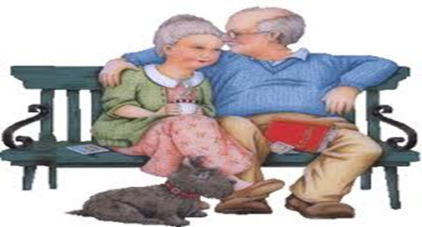
Asynchronous:Self study: Listen to two elderly people in a care home talking. Do they mention any of the ideas from your list below?. Audio in material docente.
Check answers in supplementary material
Edith doesn´t like Edith wants
___ The staff ___respect
___ Bárbara ___friends
___ her own name ___privacy
___ bingo ___to play bingo
___ coach trips ___more stimulation
___ her own home ___less stimulation
___ her old life ___ to go to the seaside
___ the food ___ independance
___ washing up ___ more food
___ to go home

Slide 16
MATERIAL DE CURSO
Recuerden hacer Homework assessment:
Self study: Material session
- PPt class.
- PPT Listening answer key + Linkers answer key

Slide 17
THANK YOU VERY MUCH!

