Slide 1
WELCOME TO STARTER
Zoom sesión.W4

Slide 2
STARTER 2021 – 1
Unit 1 and Unit 2
INTRODUCING YOURSELF
Semana 4 10.5- 14.5
Session 1: Zoom

Slide 3
Review:Classroom Language.
(Booklet p. 1)
A. Expressions used by the student:
¿Cómo se dice ______(en inglés)? = How do you say ______ (in English)?
¿Cómo se escribe/deletrea (sonido)? = How do you spell _________?
¿Cómo se pronuncia esta/esa palabra? = How do you pronounce this/that word?
¿Qué significa xxx ? = What’s the meaning of xxx? [míning]
¿Me puede repetir? = Could you repeat, please?
Lo siento, no entiendo. = Sorry, I don't understand.
¿Me podría explicar _________? = Could you explain __________?
No sé. = I don't know.
Disculpe, .... (para atraer la atención) = Excuse me, ...

Slide 4
Study previous contents (self study)to be prepare for the Quiz.
Review Online Quiz: From Monday May 10th to Friday, May 14th (5%) (45 minutes)
Remember:Participation assessment 3: Icon “tareas”(Fecha límite: 16 mayo)
.
-

Slide 5
OBJECTIVES:
Personal information in dialogues.
Personal information ( name, profession, marital status, time, country, nationality, age, birthday)
Health professions. Look at ppt in Material docente.
Vocabulary: Family members/ irregular nouns.
Grammar: verb to be, possessives(self study)

Slide 6
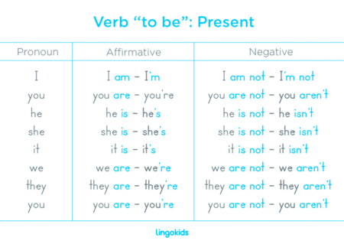
Review: verb to be. https://www.youtube.com/watch?v=rC6bmDuHsWE

Slide 7
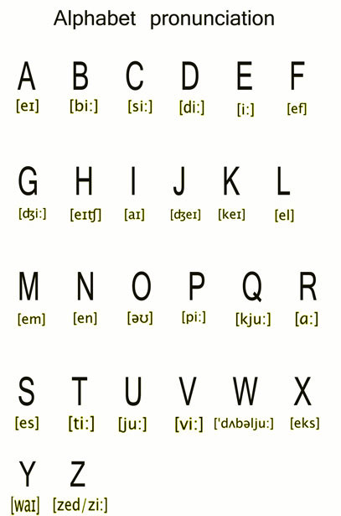
Review Oral practice:Dialogue
A: Hello.Nice to meet you.
B. Hi.Nice to meet you,too.
A: What´s your name?
B: My name is……….. /or I am…………
A: How do you spell your last name?
B: ………………………….
A: Are you single or married?(marital status)
B. I am ………………….
A:What is your profession or your job ?
B: I am a/an………………………..
A: Thanks
B: See you. Have a nice day!

Slide 8
Exercises:(check vocabulary using ppt in material docente).
(Class activity)
See the ppt and select the correct definition.
a. radiologist | b. geriatrician | c. anesthetist | d. pediatrician | e. midwife
f. general practitioner | g. x ray technician | h. cardiologist | i. occupational therapist | j. surgeon
k. nurse | l. nutritionist | m. physical therapist | n. speech therapist | o. medical technologist

Slide 9
1.__________ A heart specialist.
2.__________ A worker trained with special skills, taking radiographs.
3.__________ The work of a GP (= doctor) who treats the people who live in the local area and treats injuries and diseases that do not need a hospital visit.
4.__________ A doctor who is specially trained to perform medical operations.
5.__________ A doctor who gives anesthetic to people in hospital.
6.__________ A person who specializes in radiology.
7.__________ A professional who treats mentally or physically ill people by using therapeutic exercise, and physical modalities( massage).
8.__________ A doctor who specializes in the care and treatment of old people who are ill.
9.__________ A person, usually a woman, who is trained to help women when they are giving birth.
10.__________ A person who advises on matters of food and its impact on health.
11.__________ A doctor who has special training in medical care for children.
12.__________ An allied health professional who performs technical and scientific functions in medical laboratories.
13.__________ A professional that works with patients to help them achieve a satisfied state in life through the use of “purposeful activity or interventions” designed to achieve functional outcomes.
14__________ A professional who focuses on the care of individuals, families, and communities so they may attain, maintain, or recover optimal health and quality of life from conception to death.
15._________ A professional who specializes in communication disorders.

Slide 10
1.___h_______ A heart specialist.
2.___g_______ A worker trained with special skills, taking radiographs.
3.___f_______ The work of a GP (= doctor) who treats the people who live in the local area and treats injuries and diseases that do not need a hospital visit.
4.___j_______ A doctor who is specially trained to perform medical operations.
5.____c______ A doctor who gives anesthetic to people in hospital.
6.____a______ A person who specializes in radiology.
7._____i____ A professional who treats mentally or physically ill people by using therapeutic exercise, and physical modalities( massage).
8._____b____ A doctor who specializes in the care and treatment of old people who are ill.
9._____e_____ A person, usually a woman, who is trained to help women when they are giving birth.
10.___l_______ A person who advises on matters of food and its impact on health.
11.____d______ A doctor who has special training in medical care for children.
12.____o______ An allied health professional who performs technical and scientific functions in medical laboratories.
13._____m_____ A professional that works with patients to help them achieve a satisfied state in life through the use of “purposeful activity or interventions” designed to achieve functional outcomes.
14____k______ A professional who focuses on the care of individuals, families, and communities so they may attain, maintain, or recover optimal health and quality of life from conception to death.
15.____n_____ A professional who specializes in communication disorders.

Slide 11
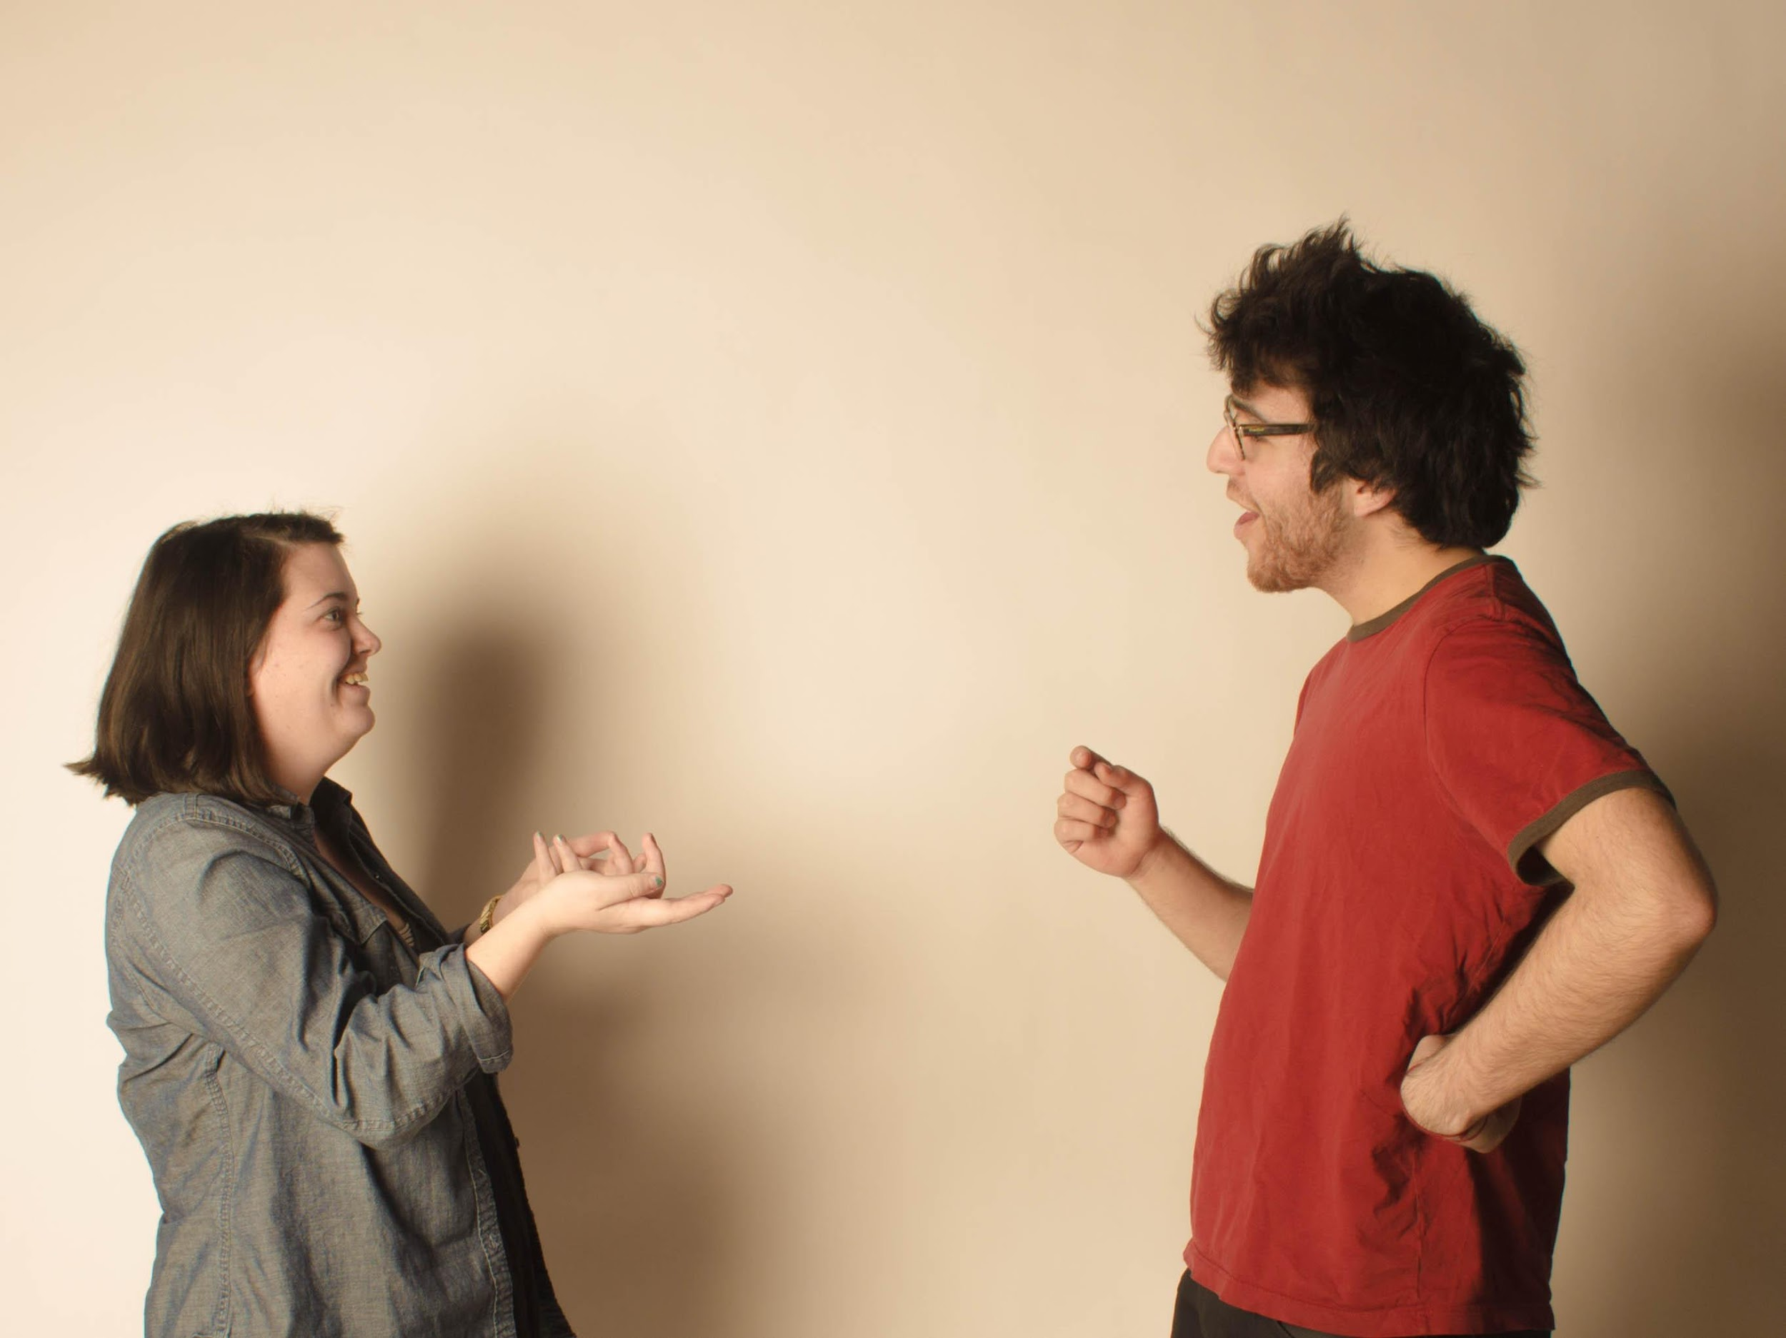
Review: Dialogue example: Oral practice
First day at the
University
Catalina: Hello, Are you Tom´s brother ?
Steven: No, I am not. My name is…….. Nice to meet you.
Catalina: Nice to meet you, too. Where are you from?
Steven: I am from Canada. Are you Chinese?
Catalina: No, I am not, I am Chilean. Are you a student?
Steven: Yes,……………... …..
Catalina: How old are you?
Steven: I am ………………years old.
Catalina: Oh, What time is it?
Steven: It is ………………………...
Catalina: Oh..! I am late!. See you later.
Steven: Bye, ……………. See you son, because I am going to my grandmother´s house

Slide 12
Family members: Complete the box(Self study). New content.
Male
Female
1.Grand father
2.…………………..
3.Husband
4…………………..
5. Son
6. ………………….
1.…..................................................
2.Mother
3.……………………………………..
4 Sister
6. ……………………………………
7 Aunt

Slide 13
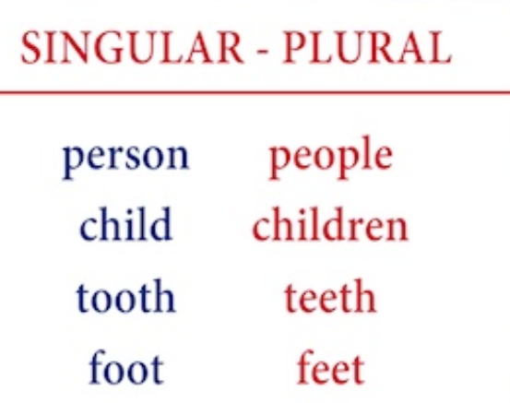
Irregular nouns:
Examples:
A person is sick
Children are happy

Slide 14
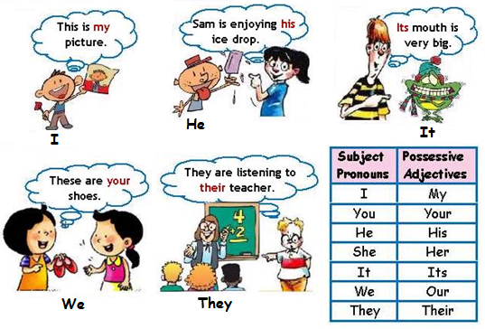
Review:Examples using possessive adjectives

Slide 15
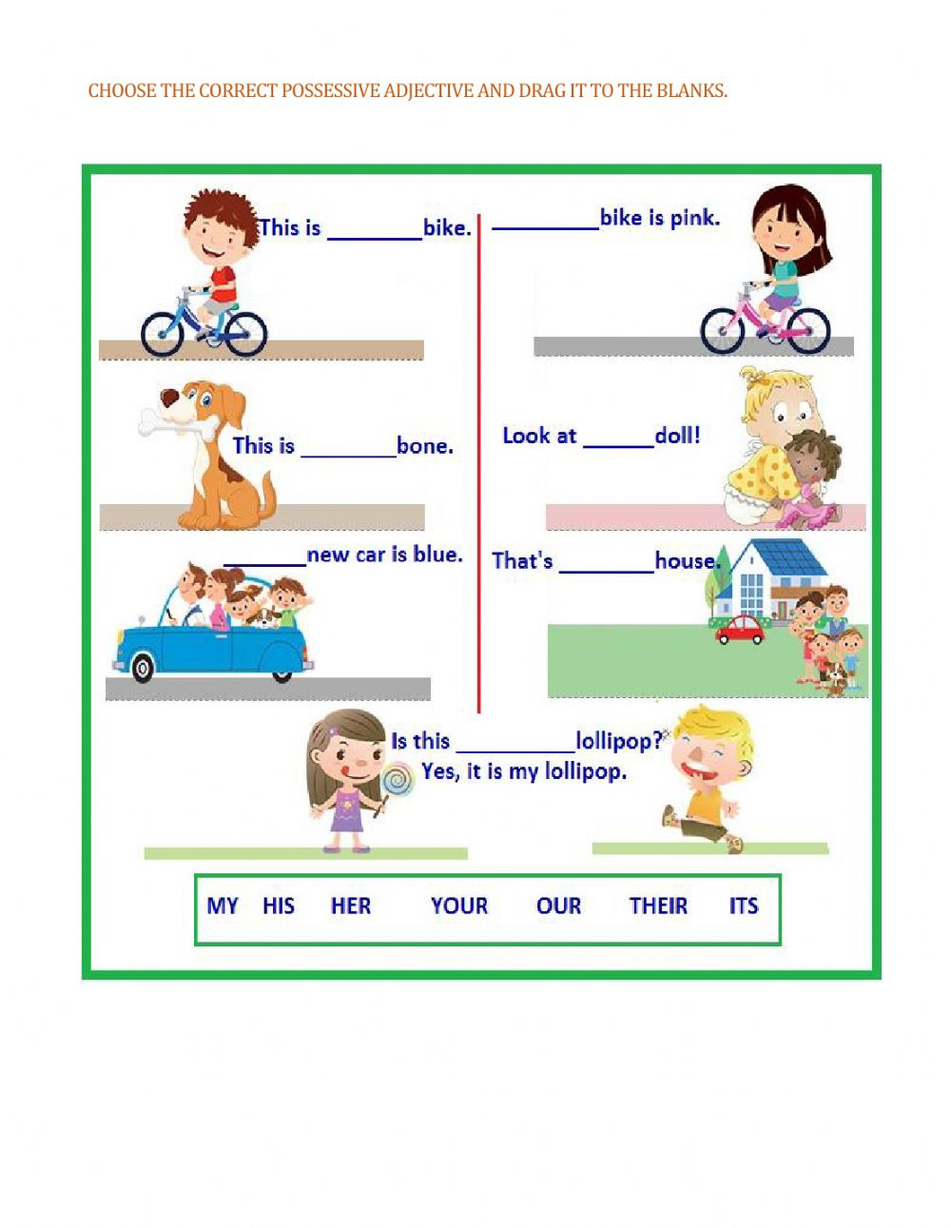
Oral activity

Slide 16
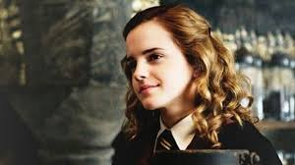
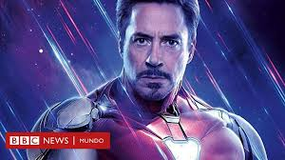
Review:
Answer key:Personal Information(self-study)
What is his name?
His name is Robert Downey Junior
Where is he from?
He is from The USA.
What is his nationality?
He is American.
How old is he?
He is 55 years old.
What is her name?
Her name is Ema W.
Where is she from?
She is from England
What is her nationality?
She is British
How old is she?
She is 30 years old

Slide 17
Question Words:Oral review
WHAT
WHERE
WHEN
WHO
HOW
HOW OLD
WHAT TIME

Slide 18
Complete the following sentences with WH. Oral review practice
HOW
1______ old are you ? (age)
2.______ is your name ?(things)
3______ are you from ? (place)
4.______ are your hobbies ?(things)
5______ is your birthday ? (time)
6._______ is your favourite singer ? (person)
7_______ is your favourite band ?(things)
8._______ are you interested in ? (things)
WHAT
WHERE
WHAT
WHEN
WHO
WHAT
WHAT

Slide 19
Answer key to questions.
1. I am ………………years old
2. My name is ………………./ I am……………………
3. I am from…………………
4.My hobbies are………………………/My hobby is ………………….
5. My birthday is on August 12th/ it is on August 12th/ it is in August.
6. My favorite Singer is …………………..
7. I am insterested in ……………..(for example: music)

Slide 20
Create questions according to the answers. Oral activity
III. Create questions according to the answers.
1.____________________________? 1._______________________?
His name is Robert Her name is Susan
2.____________________________? 2._______________________?
His favorite singer is Rihanna Her favorite singer is Madonna
3.____________________________? 3._______________________?
He is 10 years old She is 24 years old
4.____________________________? 4._______________________?
He is from Spain She is from the USA
5.____________________________? 5._______________________?
His favorite sport is soccer Her favorite sport is tennis
6.____________________________? 6._______________________?
His birthday is on may 9th Her birthday is on December 24th.

Slide 21
Answer key: Questions
What is his name?
Who is his favorite singer?
How old is he?
Where is he from?
What is his favorite sport?
When is his birthday?
What is her name?
Who is her favorite singer?
How old is she?
Where is she from?
What is her favorite sport?
When is her birthday?

Slide 22
GRAMMAR CAPSULE DEMONSTRATIVE ADJECTIVES
Grammar Capsule:
Demonstrative | adjectives
THIS | near /here | singular
THAT | far /there | singular
THESE | near/ here | plural
THOSE | far /there | plural

Slide 23
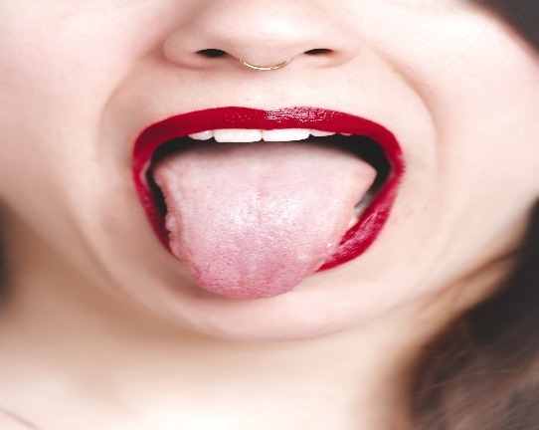
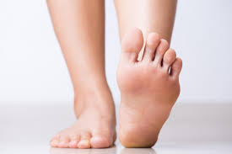
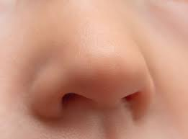
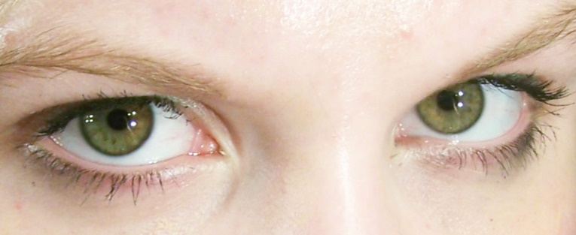
ANSWER THE QUESTIONS.
What´s this? (near)
What are these?(near)
What are those? (far)
What´s that? (far)

Slide 24
Tell your teacher what you learnt today.

Slide 25
Kahoot: Class review.Verb to be
https://create.kahoot.it/share/duplicate-of-present-simple-of-verb-to-be/506abc7a-4911-4669-9bed-4f69f3ec4d28

Slide 26
Thank you very much!
Remember :
Review Online Quiz: From Monday May 10th to Friday, May 14th (5%) (45 minutes)
Remember:Participation assessment 3: Icon “tareas”(Fecha límite: 16 mayo)

