Slide 1
STARTER: SELF- STUDY: Week 4

Slide 2
STARTER 2021 – 1
Unit 1
INTRODUCING YOURSELF
Semana 10.05- 14.05
Session 2/Self-study

Slide 3
Remember:Evaluation breakdown: Ver en programa Starter
TEST | TYPE | PERCENTAGE OF FINAL MARK%
1 2 3 4. 5. 6. | Review online quiz Online quizzes (3 quizzes) Online Integrated quiz Video activity Final written test Participation assessment (Homework and class participation) | 5% 18% (6% each one) 20% 20% 25% 12%

Slide 4
Study previous contents (self study)to be prepare for the Quiz.
Review Online Quiz: From Monday May 10th to Friday, May 14th (5%) (45 minutes)Icon”Tests”
Remember:Participation assessment 3: Icon “tareas”(Fecha límite: 16 mayo)
.
-

Slide 5
Objective: Session 2
Study
Personal information: dialogues.
Telling the time
Wh questions
Family members
Possessive adjectives

Slide 6
Health professionals
.
a. radiologist | b. geriatrician | c. anesthetist | d. pediatrician | e. midwife
f. general practitioner | g. x ray technician | h. cardiologist | i. occupational therapist | j. surgeon
k. nurse | l. nutritionist | m. physical therapist | n. speech therapist | o. medical technologist

Slide 7
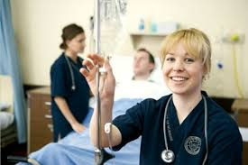
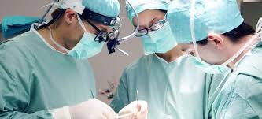
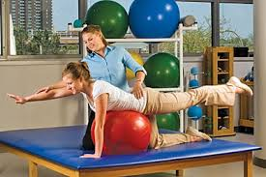
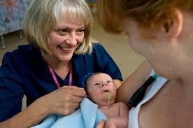
Say these people´s professions: Ex.: She is a nurse.
1.- ______________________ 2.- _______________________________ 3 .- ______________________________

Slide 8
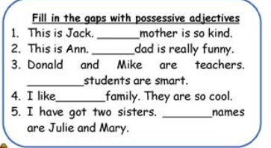
Complete with the right possessive adjective.

Slide 9
Answer key: Possessive adjectives
1. his
2. her
3.their
4.my
5.their

Slide 10
Possessive exercises.Self study
Check the following link.
https://www.english-4u.de/en/grammar-exercises/possessive-adjectives.htm

Slide 11
Wh-questions with verb to Be (self-study)
Please, find below both the link to watch the video explanations and the exercises link with answers. Remember, in case of any questions you may have, feel free to ask your teacher via Foro.
EXERCISES LINK
https://www.englishexercises.org/makeagame/viewgame.asp?id=2763

Slide 12
VERB TO BE: Exercises
https://www.english-4u.de/en/tenses-exercises/verb-to
https://www.englishexercises.org/makeagame/viewgame.asp?id=8213
https://www.englishexercises.org/makeagame/viewgame.asp?id=8214

Slide 13
Thank you very much!
Homework:
El material de esta ppt es Self study
Y recuerden tareas ya asignadas: dos actividades en ícono tareas. Fecha límite 9 de mayo.

