Slide 1
UNIT 4
PAST SIMPLE
PAST CONTINUOUS

Slide 2
The PAST TENSE indicates that an action is in the past relative to the speaker or writer.
when the time period has finished: "We went to Chicago last Christmas."
when the time period is definite: "We visited Mom last week."
with for, when the action is finished: "I worked with the FBI for two months."
Regular verbs use the verb's base form (scream, work) plus the -ed ending (screamed, worked). Irregular verbs alter their form in some other way (slept, drank, drove).

Slide 3
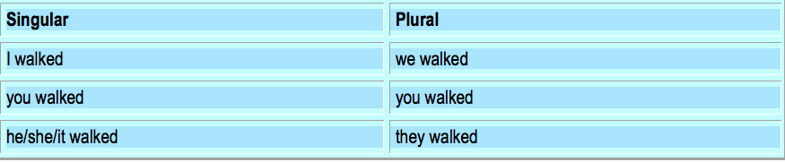
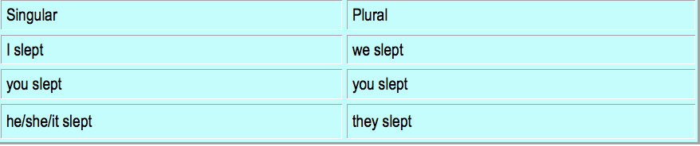

Slide 4
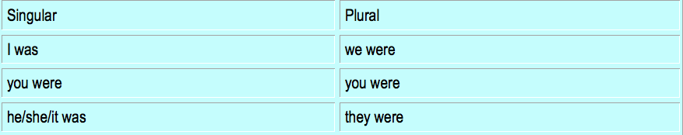
Past tense of the verb TO BE

Slide 5
Examples:
When I was a girl, I walked five miles to school every day.
Carmen slept through the entire class.
We worked really hard to make this a success, but then Chuck ruined it with his carelessness.
Every time I finished a sandcastle, the waves came in and washed it away.
Tarzan dove into the swamp and swam toward the alligator.
Signal words or past time expressions
Yesterday, last week, a month ago, a week ago, in 2002

Slide 6
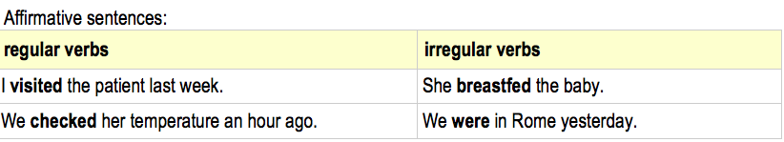
Form with regular verbs: infinitive + -ed with irregular verbs: 2nd column of the table of the irregular verbs

Slide 7
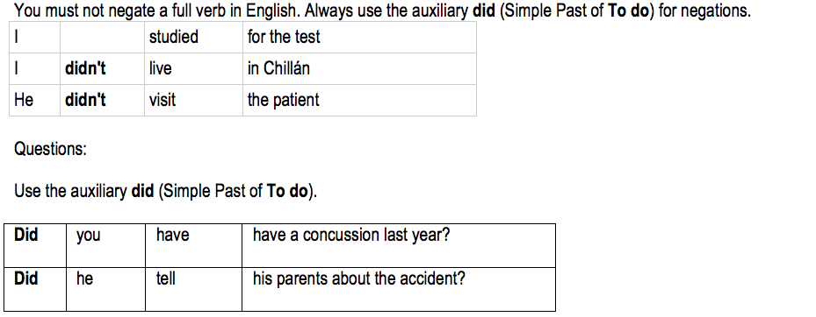
Negative sentences and Questions

Slide 8
Remember the irregular verbs
go/went - have/had - say/said - sleep/slept - put/put
Go to the list of irregular verbs for further information.
We usually use the past simple with events that have a defined moment in the past, even if this time in the past is omitted because it is clear from the context.
When did you buy this laptop? I bought it last month.
Where did you buy it? I bought it online.

Slide 9
Put these verbs in past simple.
1) I ______________________(not/drink) any beer last night.
2) She _________________________(get on) the bus in the center of the city.
3) What time ________________________(he/get up) yesterday?
4) Where __________________________(you/get off) the train?
5) I ___________________________(not/change) trains at Victoria.
6) We _________________________(wake up) very late.
7) What _______________________(he/give) his mother for Christmas?
8) I_____________________________(receive) £300 when my uncle died.

Slide 10
Now using what you know about the past write 2 affirmative sentences, 2 negative sentences and 2 questions:
2 Affirmative sentences.
_____________________________________________________________
_____________________________________________________________

Slide 11
2 Negative sentences.
___________________________________________________________
__________________________________________________________
2 Questions.
___________________________________________________________
___________________________________________________________

Slide 12
THE PAST CONTINUOUS
A) The past continuous puts emphasis on the course of an action in the past.
Example: He was playing football.
B) two actions happening at the same time (in the past)
Example: While she was preparing dinner, he was washing the dishes.
C)an action going on at a certain time in the past
Example: When I was having breakfast, the phone suddenly rang.

Slide 13
The past continuous describes actions or events in a time before now, which began in the past and was still going on at the time of speaking. In other words, it expresses an unfinished or incomplete action in the past.

Slide 14
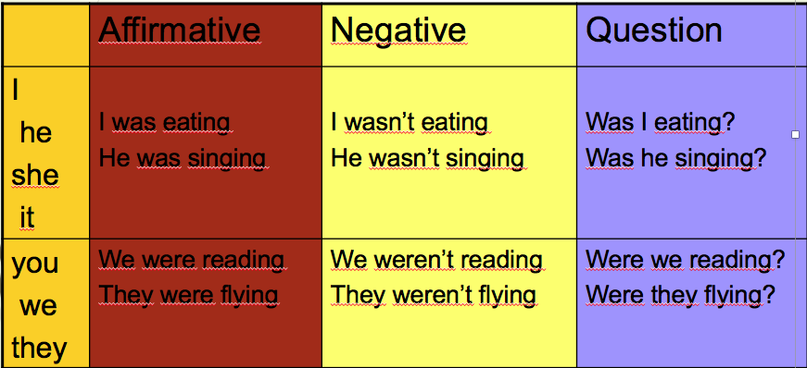
Forming the past continuous
This tense is formed using two components: the verb BE (in the past tense), and the -ING form of a verb. Here are the rules:

Slide 16
Wh – questions?
What Where Why | What were you doing yesterday at 6:00? Where was she going yesterday morning? Why was he crying yesterday?

Slide 17

EXERCISES
Put the verbs into the correct form
When I phoned my friends, they ________(play) monopoly.
Yesterday at six I ________________(prepare) dinner.
The kids________________ (play) in the garden when it suddenly began to rain.
I _____________________(practise) the guitar when he came home.
We ___________________(not / cycle) all day.

Slide 18

While Aaron _______________(work) in his room, his friends ______________(swim) in the pool.
I tried to tell them the truth but they ___________________ (listen / not) .
What________________ (you / do) yesterday?
Most of the time we _________________(sit) in the park.
very good

