Slide 1

UnIT 1:
THE BODY

Slide 2
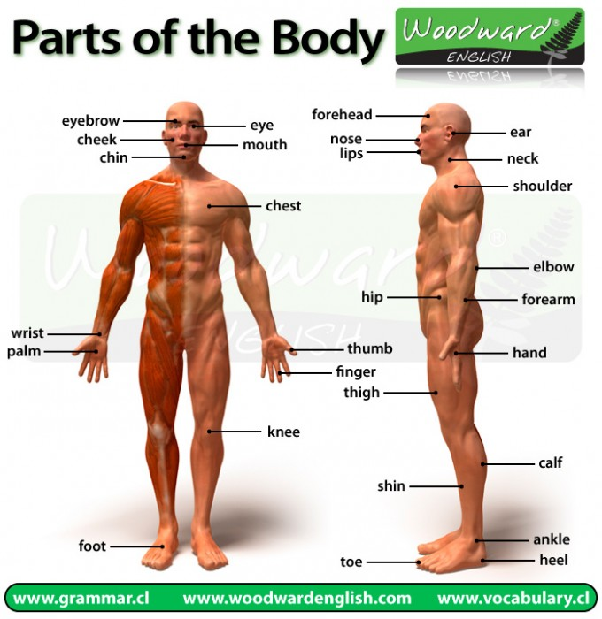
Check the link above.

Slide 3
Body and Symptoms
SPANISH | ENGLISH
ojos | eyes
boca | Mouth
oreja | Ear
nariz | Nose
cuello | Neck
espalda | Back
pecho | Chest
estómago | Stomach
diente-dientes | Tooth – teeth

Slide 4
SPANISH | ENGLISH
Brazo | arm
codo | Elbow
mano | Hand
muñeca | Wrist
pierna | Leg
rodilla | Knee
pie-pies | Foot – feet
dedos pies | Toes
tobillo | ankle

Slide 5
Headache | Dolor de cabeza
Stomachache | Dolor de estómago
Backache | Dolor de espalda
Toothache | Dolor de dientes/ muelas
earache | Dolor de oído
Cold | Resfrío
Fever | Fiebre
Cough | Tos
Sorethroat | Dolor de garganta
diarrhea | diarrea

Slide 6
Body and Symptoms
I. Complete the table with the right word in English.
SPANISH | ENGLISH
ojos
boca
oreja
nariz
cuello
espalda
pecho
estómago
diente-dientes

Slide 7
SPANISH | ENGLISH
Brazo
codo
mano
muñeca
pierna
rodilla
pie-pies
dedos pies
tobillo

Slide 8
II. Complete the sentences.
I have got a pain in my _______________________ I can´t walk.
I have got some spots all over my______________ I need some cream.
I am having trouble with my ___________________ I can´t write.
I have a pain in my ___________________________ I can´t move my feet.

Slide 9
Look at the following symptoms and complete the sentences.
headache stomachache backache toothache earache cold fever cough sore throat diarrhea
III.
I have a strong __________________. I need an aspirin.
My son has a bad ________________. He has a pulmonary disturbance.
My mom will have to go to the dentist. She has a __________________
I can´t speak. I have a _______________________

Slide 10
IV. Write a 5- line- dialogue about an appointment with Doctor Robinson.
A: Doctor, B: Patient.
Eg. A: Good morning. What is the matter?
B: I …….………………………………………………………..
A: …………………………………………………………………….
B. ……………………………………………………………………..
A………………………………………………………………………
B………………………………………………………………………

