Slide 1
Question Making
Present Simple and Verb To be

Slide 2
Pay attention to this formulae:
Questions with speak, live, study, etc.
(Wh- Question) + Do/Does + Pronoun +Verb +Complement
Do you study English at home?
When do you study Math?
How often does she go to the doctor)
How many kids does he have?
Questions with be
(Question) + Verb + Subject
How old are you?
Where are you from?
What time is it?

Slide 3
Write the questions for the following answers
Examples:
1. My best friend lives in Temuco.
Where does he (she) live ?
2. Laurita studies English every Friday.
When does she study English?
3. Yes, I do
Do you like dancing on weekends?
4. I am at home now
Where are you?

Slide 4
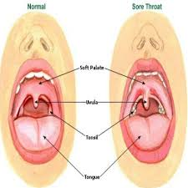
I have a sore throat.

Slide 5
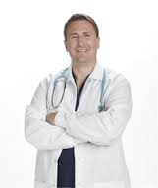
The nurse wears a white apron.

Slide 6
The cardiologist works from Monday to Thursday

Slide 7
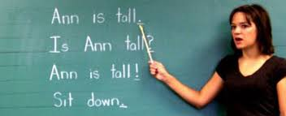
Your teacher says your English is pretty good.

Slide 8
Francisca feels very happy today.

Slide 9
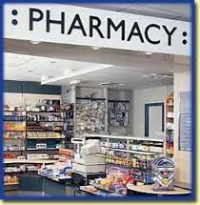
I never go to the pharmacy.

Slide 10
I am a speech therapist.

Slide 11
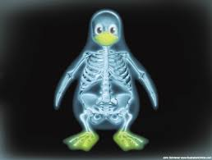
That tall man works in the X- ray Department

Slide 12
She is an oncologist.

Slide 13
Yes. I am always late for school.

Slide 14
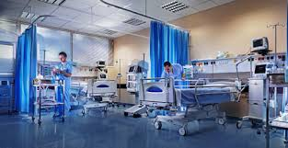
Sometimes we go to the intensive care unit to visit patients.

Slide 15
I am 22 years old.

Slide 16
The teacher is 65 years old.

Slide 17
The physiotherapist lives alone in a big old house.

Slide 18
My mother always collects coins and stamps.

Slide 19
No, I don’t

