Slide 1
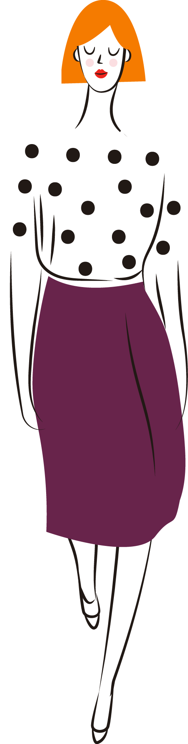
CLASE 15
FRANCÉS II
Prof. Carolina Ruiz

Slide 2
Objectifs
Comprendre des documents à ‘écrit.
Donner une opinion sur la mode

Slide 3
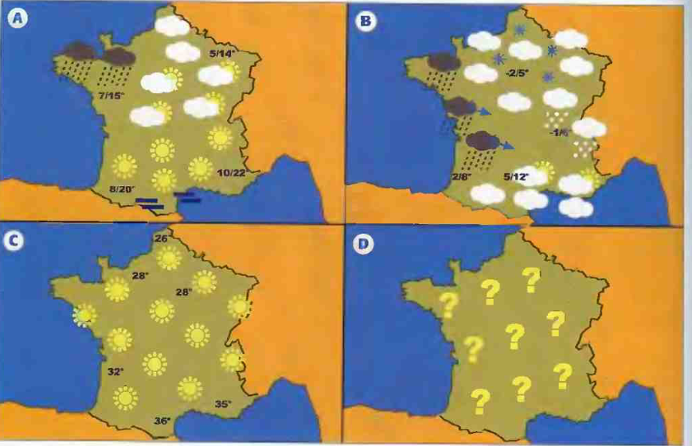
01

Slide 4
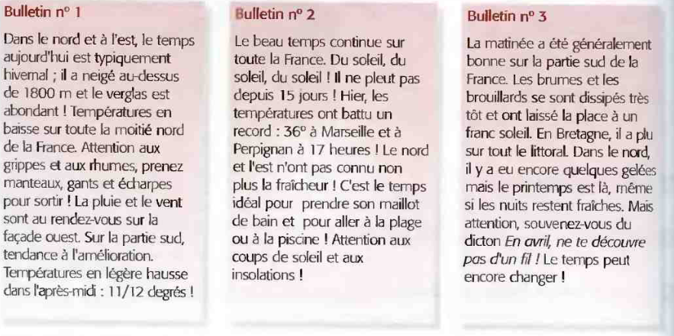
Mercury is the closest planet to the Sun and the smallest one in our Solar System—it’s only a bit larger than our Moon. The planet’s name has nothing to do with the liquid metal

Slide 5
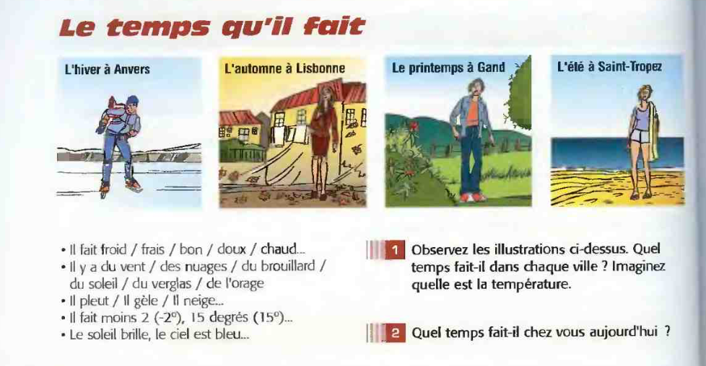
What I Do
Mercury is the closest planet to the Sun and the smallest one in our Solar System—it’s only a bit larger than our Moon. The planet’s name has nothing to do with the liquid metal, since Mercury was named after the Roman messenger god
Venus has a beautiful name and is the second planet from the Sun. It’s terribly hot—even hotter than Mercury—and its atmosphere is poisonous. It’s the second-brightest natural object in the night sky after the Moon

Slide 6
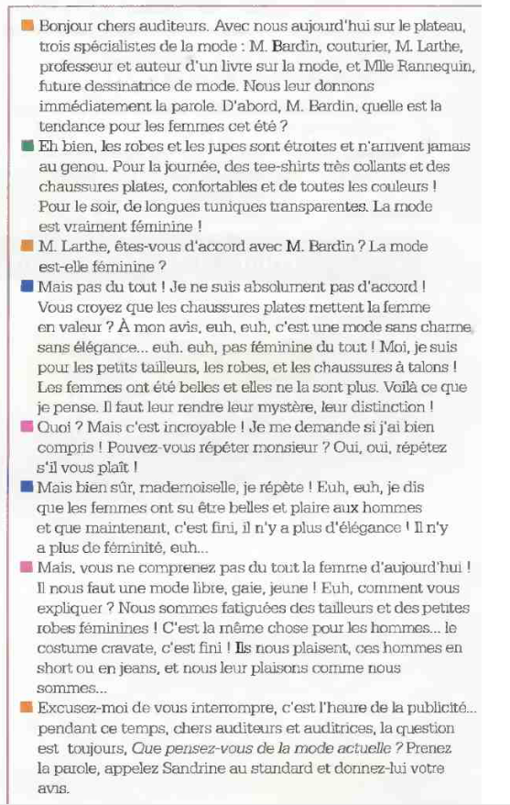

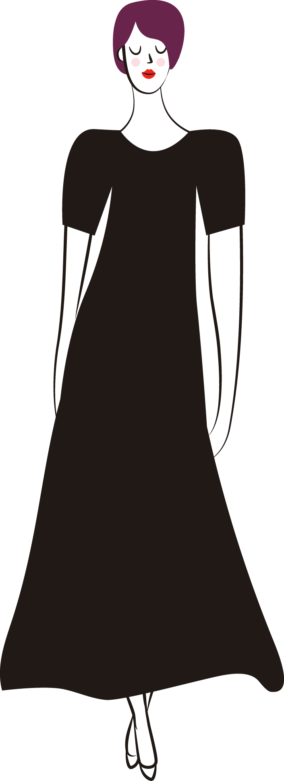
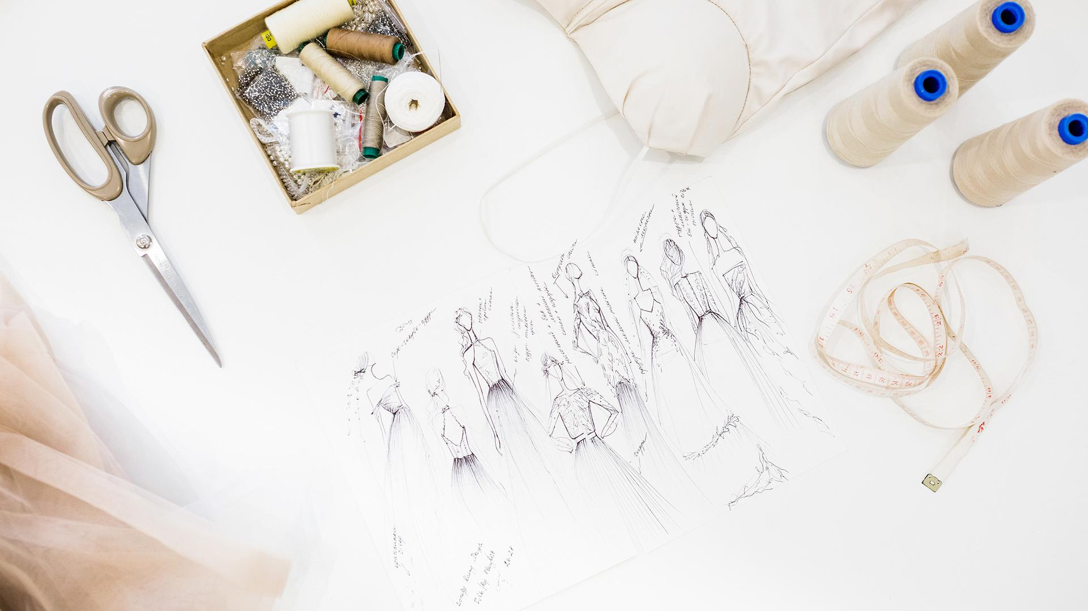
DEBAT:
POUR OU CONTRE LA MODE?

