Slide 1


4204 Unit 7A
First and Second Conditionals & Education
USE OF ENGLISH
AMERICAN ENGLISH FILE 3B. SECOND EDITION.

Slide 2
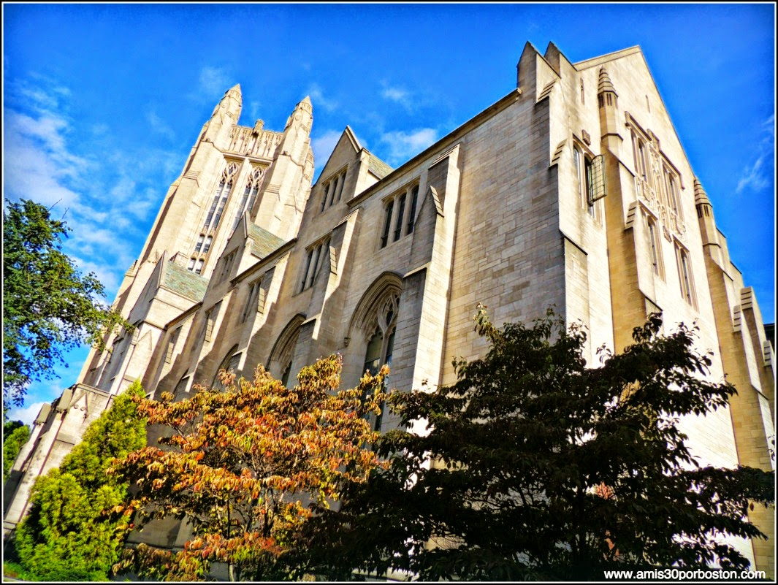
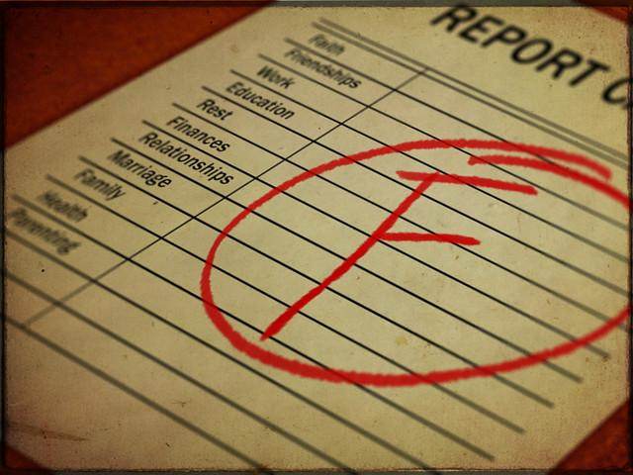
USE OF ENGLISH
Decide which word(s) has/have been incorrectly used or none of the above from the ones in CAPITAL LETTERS.
1.
If I got the SCORE I need, I WOULD LIKE to study in one of the Ivy League universities. Harvard seems great, but the engineering program at Yale sounds more interesting to me. I will definitely APPLY to it first place if I CAN.
a. score
b. would like
c. apply
d. can
e. None of the above
2.
A: How are you doing Andy?
B: Not so well, I think I’m going to REPROVE a couple of SUBJECTS this semester. Math and physics are not my thing.
A: Well, I’m good at both, so, if you WANT help studying, LET me know.
B: Thank you Barbara, could we meet tomorrow afternoon? I’ll buy you some coffee.
a. reprove
b. subjects
c. want
d. let
e. None of the above
fail

Slide 3
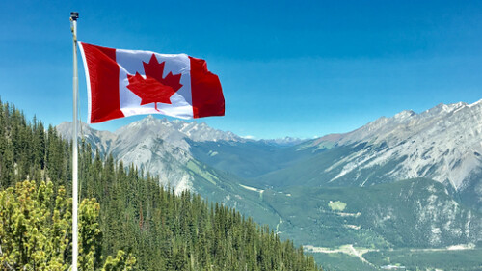
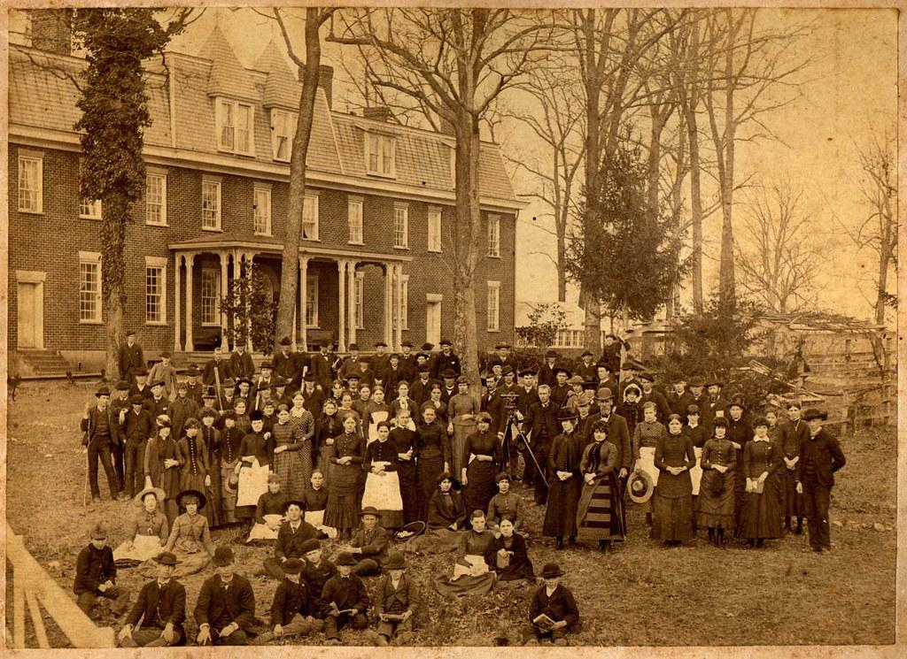
3.
A: If you HAD the chance to study abroad, where WILL you go?
B: I don’t know… I love Europe, but my area is more developed in Canada. Besides that, my COLLEGE has cooperation agreements with some universities there. I might consider getting a Master’s in Toronto after I GRADUATE.
A: Nice idea, I’d love to visit you!
a. had
b. will
c. college
d. graduate
e. None of the above
4.
I don’t know if I could study in a BOARDING school; just the idea of sleeping in the school freaks me out. I did that when I was in PRESCHOOL, and although I can’t remember a lot about that time, I don’t want to do it again, even if it was just for naps. I WOULD LOVE to study in a private school if I CAN, though; they normally have much better sports infrastructure, and I really enjoy exercising.
a. boarding
b. preschool
c. would love
d. can
e. None of the above
would
could

