Slide 1
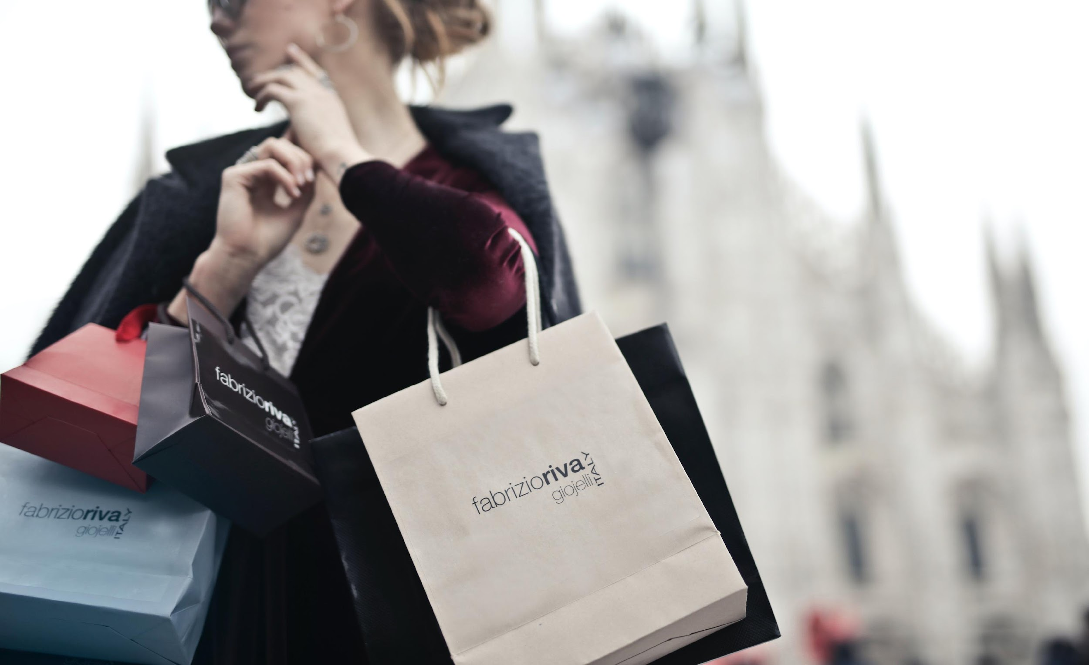

4204 Unit 8A
Reported Speech & Shopping
USE OF ENGLISH
AMERICAN ENGLISH FILE 3B. SECOND EDITION.

Slide 2
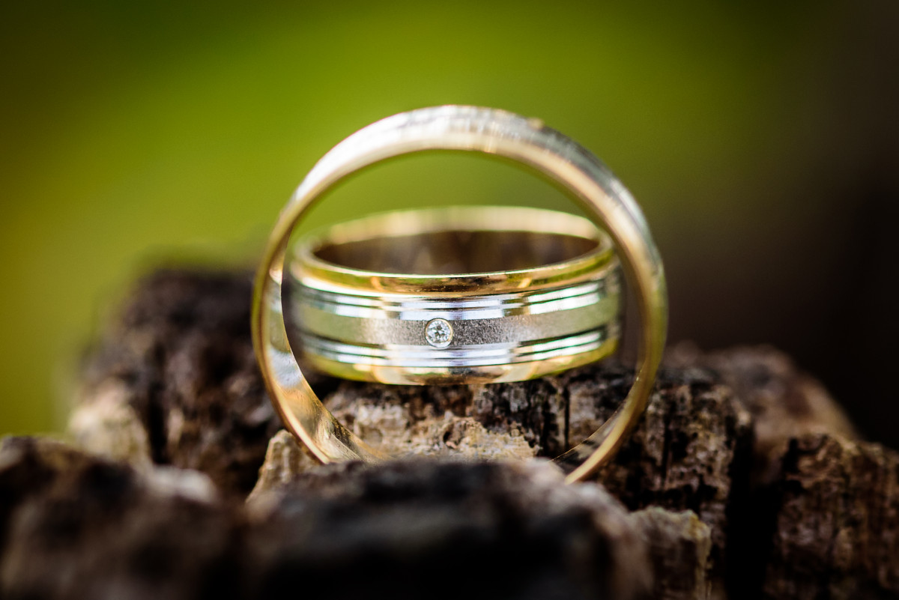
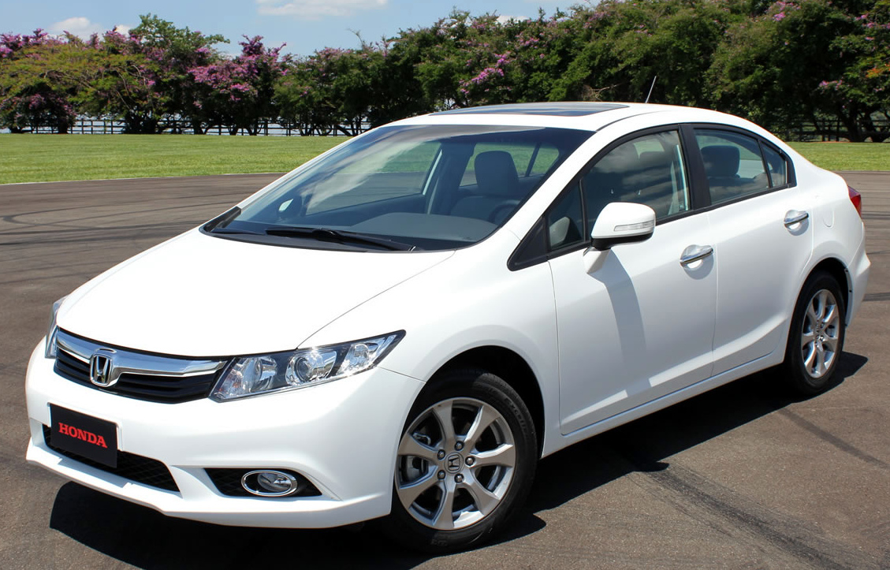
USE OF ENGLISH
Decide which word(s) has/have been incorrectly used or none of the above from the ones in CAPITAL LETTERS.
1.
Ethan found a very old ring FOR SALE in an antique shop last month. He SAID ME he HAD BOUGHT it because, although it wasn’t cheap, when compared to its market price, it was a real BARGAIN.
a. for sale
b. said me
c. had bought
d. bargain
e. None of the above
2.
A: Good afternoon, my name’s Carl and my friend Annie told me you WANTED to SALE your car, can you give some information about it?
B: Hello Carl, yes, that’s right, it’s a 2015 Honda Civic, it has 45,000km and automatic transmission. It comes with air conditioning and is well maintained. It’s in excellent condition, not FAULTY at all.
A: Great, can we schedule a visit and a test drive maybe?
B: Sure, what date SUITS you best?
a. wanted
b. sale
c. faulty
d. suits
e. None of the above
said / told me
sell
Esta foto de Autor desconocido está bajo licencia CC BY-SA

Slide 3

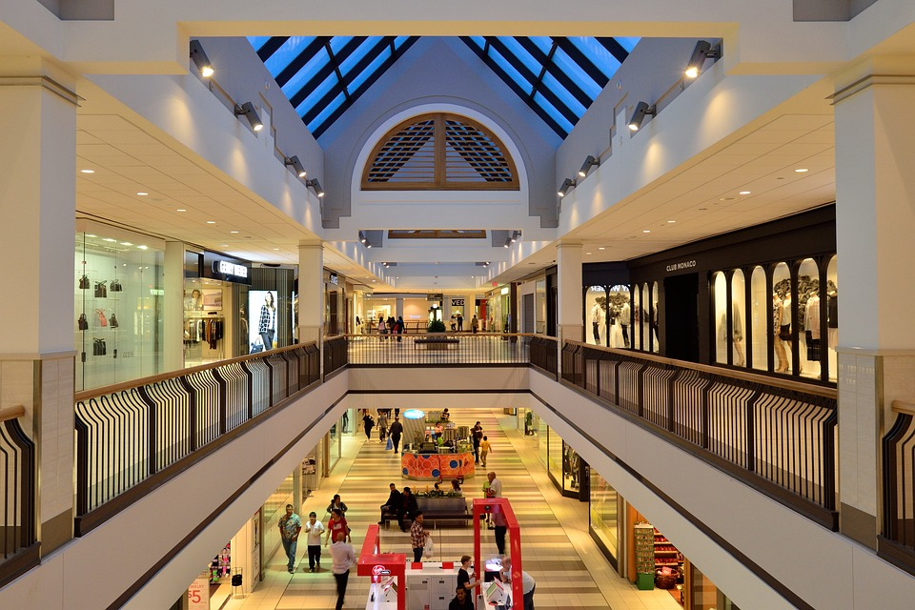
3.
Elizabeth asked me WHETHER I WOULD GO on vacation with her next summer. I told her that I wasn’t sure, but it depended on the COST of the trip. It’s not that I’m a CHEAP, but I promised my family in Italy that I would visit them for Christmas, so I don’t know if I can afford two expensive trips in one year.
a. whether
b. would go
c. cost
d. cheap
e. None of the above
4.
A: Do you want to come to the SHOPPING CENTER with me? They have good DISCOUNTS this season.
B: I don’t know… I’m not really FOND OF shopping malls, besides, I don’t really need anything.
A: But we could go and have something to eat, Lauren told me she had tried the new restaurant that opened last month HERE and it was great.
B: I’ve also heard good reviews about it. Ok, I’ll go, let’s give it a try.
a. shopping center
b. discounts
c. fond of
d. here
e. None of the above
there

