Slide 1


UNIT 6
8B JOBS
BY MISSCAROSAMA

Slide 2

SPEAKING TIME

Slide 4
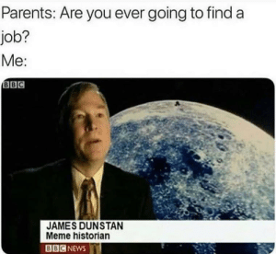
SPEAKING TIME

Slide 5
VOCABULARY

Slide 6
VOCABULARY

Slide 7
VOCABULARY

Slide 8
Let´s practice

Slide 9
ANSWER KEY
overtime
resign
applied
shifts
promoted
downsized
training
set
self-employed
retire

Slide 10


Slide 11
ANSWER KEY
in/part-time
In/temporary
for/in/of
in/well qualified
full-time/permanent
unemployed/self-employed

Slide 13
Gerunds and Infinitives (and base form)
LOVE
LOVING
TO LOVE
LOVE
GERUND
INFINITIVE
BASE FORM

Slide 14
GERUNDS
Sentences
Rules
I am good at LISTENING to people
TAKING risks doesn´t worry me
I enjoy IMPROVISING
After prepostions (At/of//for/with/ without, etc.)
Verb as a Noun (Initial position or as an Object)
After some verbs. Ex: enjoy

Slide 15
INFINITIVES
Sentences
Rules
It is hard TO STUDY at night
I drink coffee TO STAY awake
I want TO LIVE in Paris
1. After Adjectives
2. To express purpose
3. After some verbs. Ex: want

Slide 16
BASE FORM
Modal verbs
After LET and MAKE
Will Would
May Might
Can Could
Shall Should
Must
My parents didn´t LET me go to the party
Carol MAKES me watch series in English

Slide 17

After some verbs

Slide 18
V+INFI
Can´t afford, agree, decide, expect, help, hope, learn, need, offer, plan , pretend, promise, refuse, seem, want, would like
V+INF/GER
= MEANING
Hate, like,love, start, begin, continue
V+INF/GER
≠ MEANING
Forget, Remember, Try, Stop
Admit, avoid, deny, dislike, enjoy, feel like, finish ,keep, mind, miss, practice, prefer, recommend, spend time, suggest
V+GER

Slide 19
When the meaning changes
Verb | Gerund | Meaning | Infinitive | Meaning
STOP | He stopped smoking | He smoked for a time but then he quit. | He stopped to smoke. | He took a break from something else he was doing to have a cigarette (e.g. He stopped walking in order to smoke).
TRY | I tried eating less fat and it worked! | We probably tried other options as well, this is just one of the options. To experiment with sth. | I tried to eat less fat but I couldn´t. I have no willpower. | To make the effort

Slide 20

Verb | Gerund | Meaning | Infinitive | Meaning
REMEMBER | She remembers calling her friend. | She called her friend and she remembers that she did. | She remembered to call her friend. | She had a list of things to do, calling her friend was one of them, and she did it.
FORGET | She forgot locking the door. | She did lock the door, but then she forgot she had done it. | She forgot to lock the door. | She did not lock the door because she forgot.

Slide 21
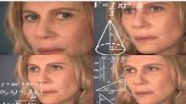
Still confused?
https://drive.google.com/file/d/1v9Gor963ZJ4canuB0G-pyTszPBUzaVsF/view?usp=sharing
Carol explaining Gerunds and Infinitives for you

Slide 22



Slide 24
ANSWER KEY
1. TO RETIRE
2, COMMUTING
3. NOT TO WORRY
4. LOCKING
5. NOT TO BUY
6. LEAVE
7. WEAR
8. NOT TO MAKE
9. WORKING

Slide 25


Slide 26
ANSWER KEY
giving
making
to pay
to fire
not going
having
working
to sign

Slide 27


Slide 28
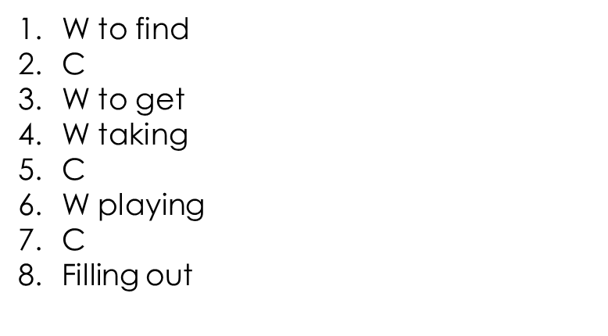
ANSWER KEY

Slide 30
ANSWER KEY
to tell
to meet
Lifting
to find
getting
applying
helping
accepting

Slide 31
LET´S READ

Slide 32

LET´S WATCH

Slide 33
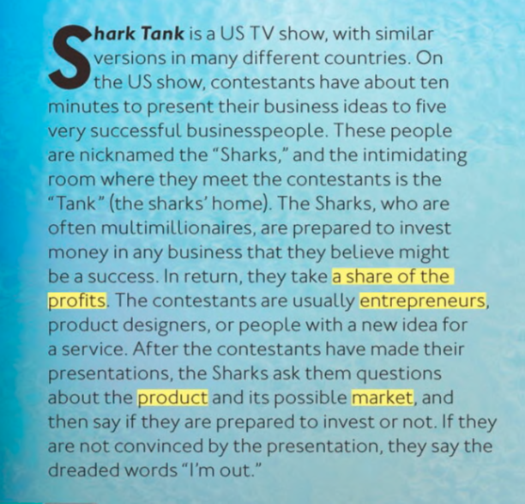
LET´S READ
ENTREPENEUR: one who organizes, manages,
and assumes the risks of a business or enterprise
PROFIT: a valuable return
Dreaded: feared

Slide 34
LET’S READ

Slide 35

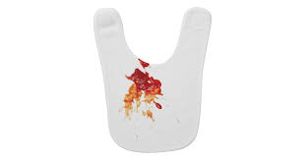
LET´S READ

Slide 36
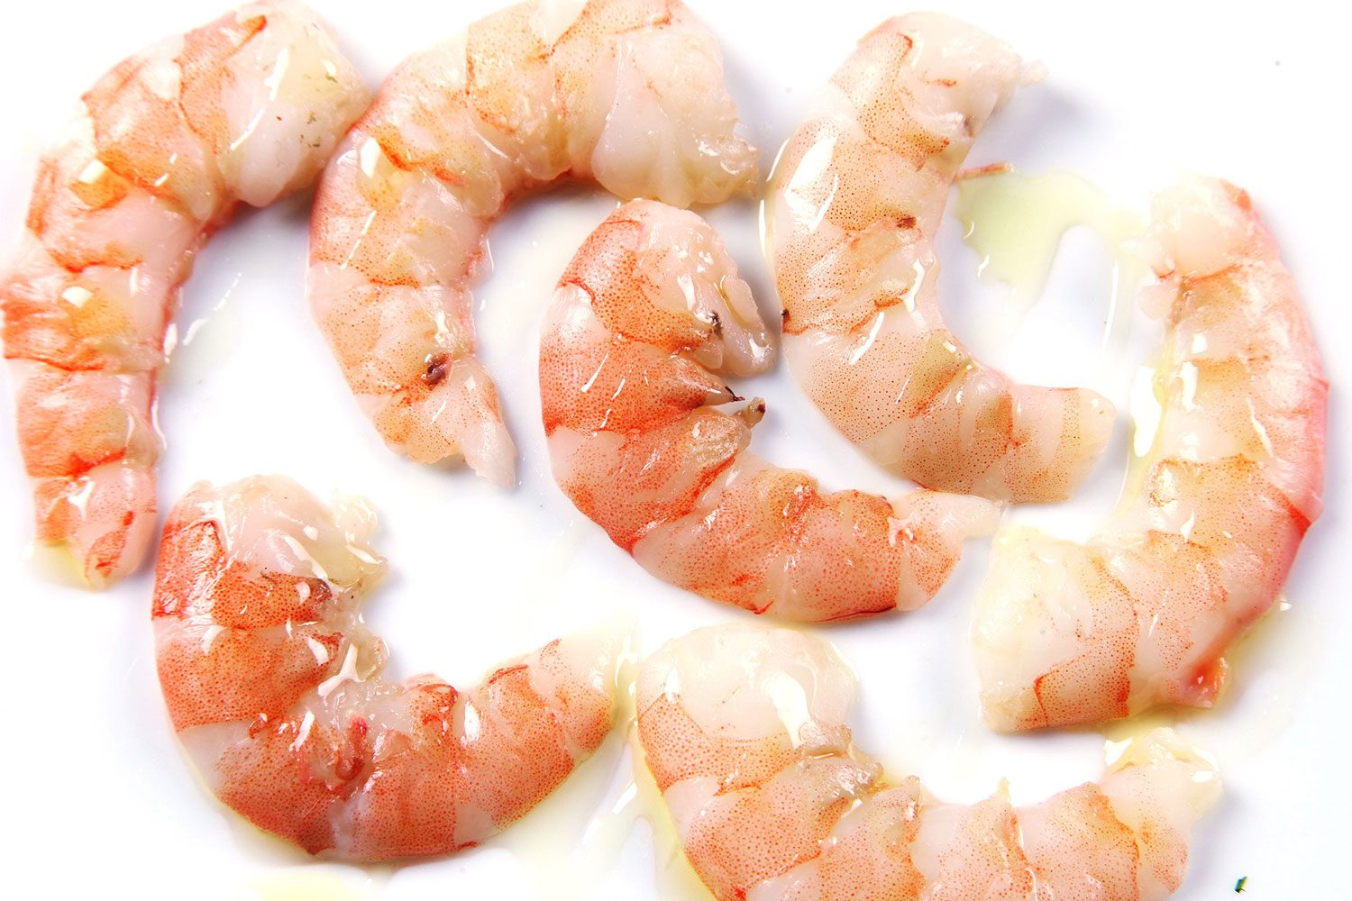
LET´S READ

Slide 37

VIETNAM!

Slide 38
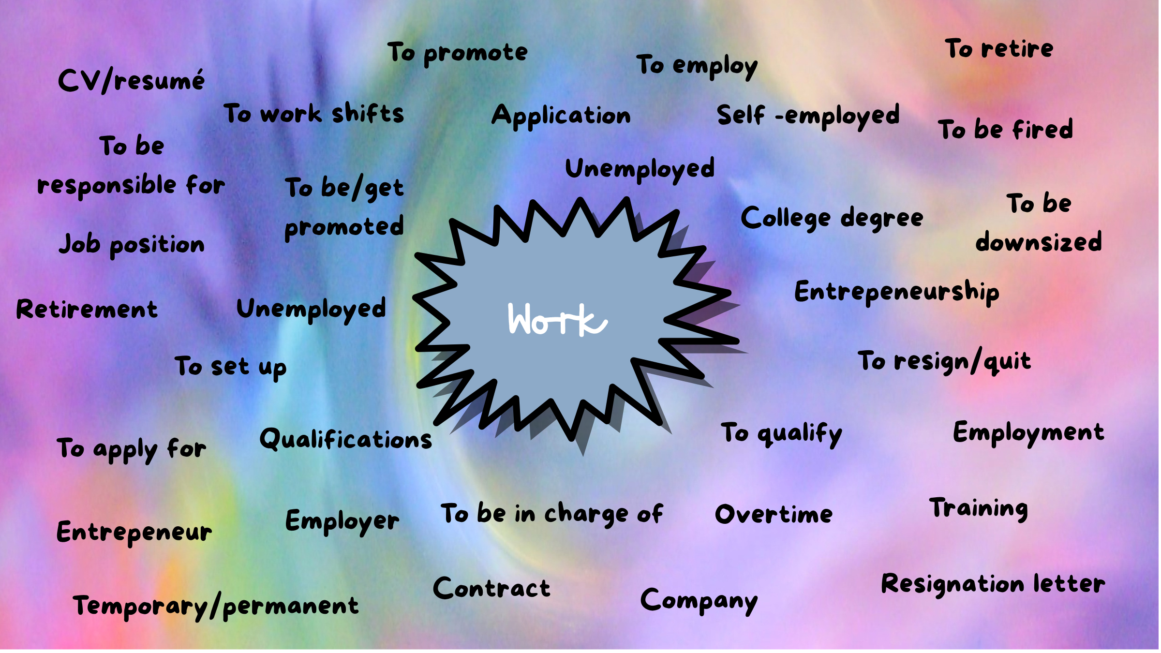

Slide 39
