Slide 1


UNIT 2
2B CHARITIES (changing lives)
By @misscarosama

Slide 2






Charities

Slide 3


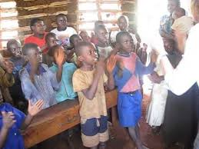
Adelante Africa

Slide 4

Let´s listen

Slide 5
I have been working for a charity for 7 years
Present Perfect Continuous

Slide 6
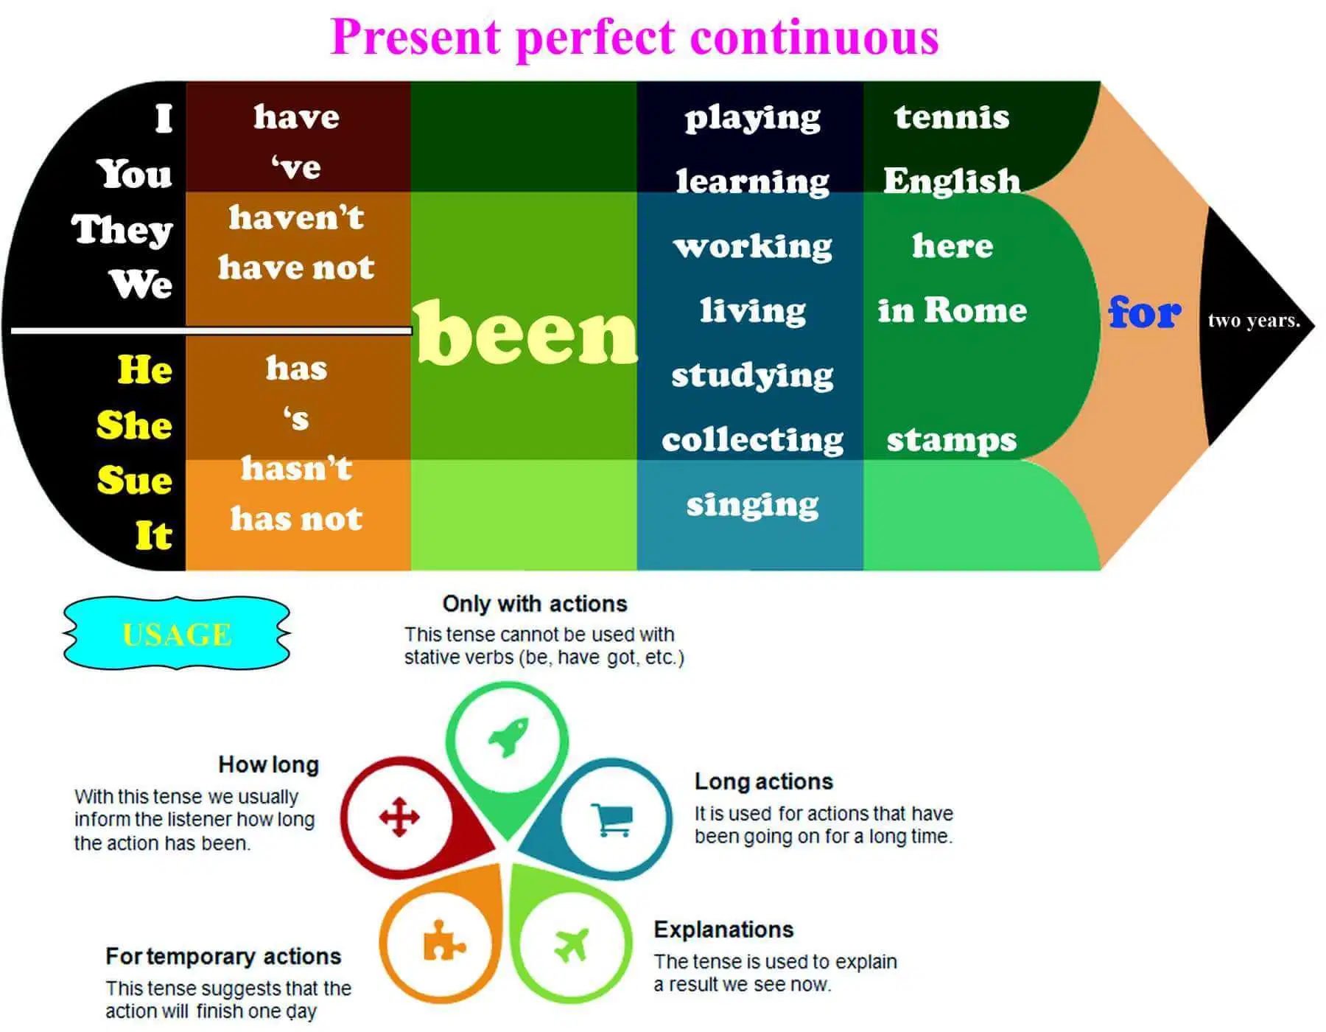

Slide 7

What´s the difference?
I have worked as a volunteer for 7 years
v/s
I have been working as a volunteer for 7 years
None!!
In both sentences the speaker started the action in 2012 and it is still going on.
Both are correct but in everyday use, native speakers prefer to use the Present Perfect Continuous .

Slide 8
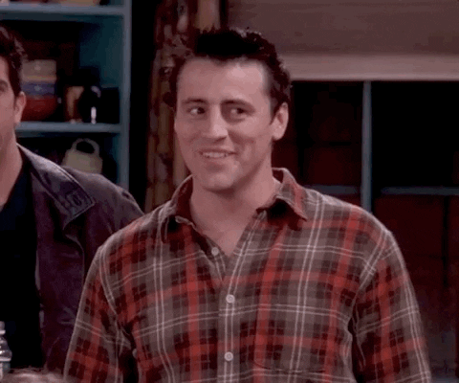

So, Can I use any of them?
But there are some restrictions…

Slide 9
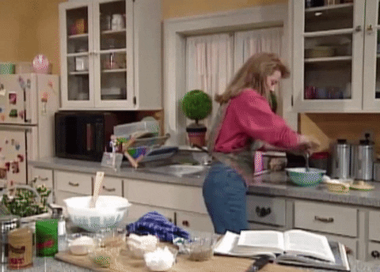
Restrictions to use the PPC
Quantities
a. I have been cooking 10 cakes
b. I have cooked 10 cakes

Slide 10

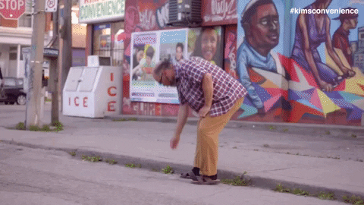
2. Punctual Verbs
a. I have found a 10 dollar bill on the Street
b. I have been finding a 10 dollar bill on the Street
Die
Stop
Start

Slide 11
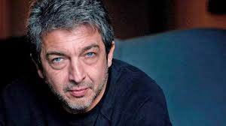
3. Non action verbs (like, have, know,etc)
a. I have loved Ricardo Daring since I was a little girl
b. I have been loving Ricardo Darin since I was a little girl
Caro uploaded a list of Non action Verbs for you in U cursos.

Slide 12
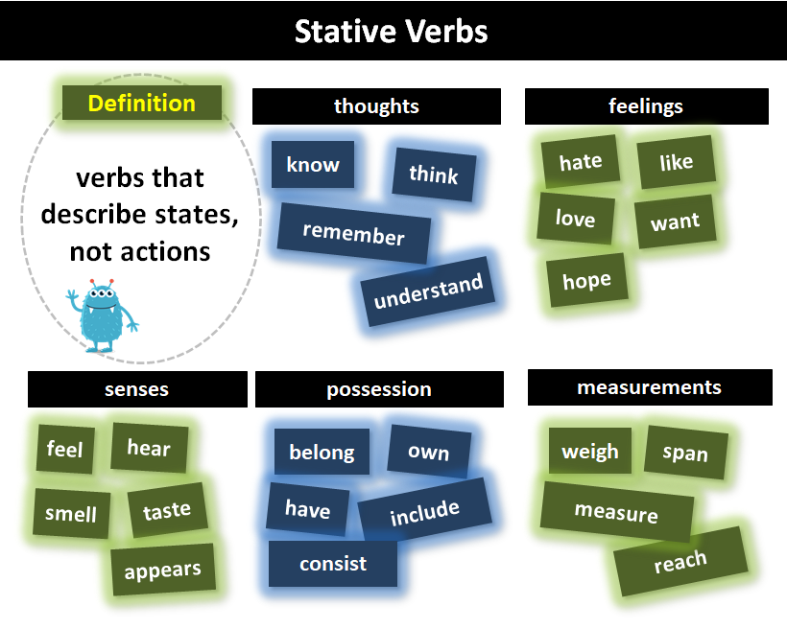

Slide 13
Let´s practice

Slide 14
Homework

Slide 15
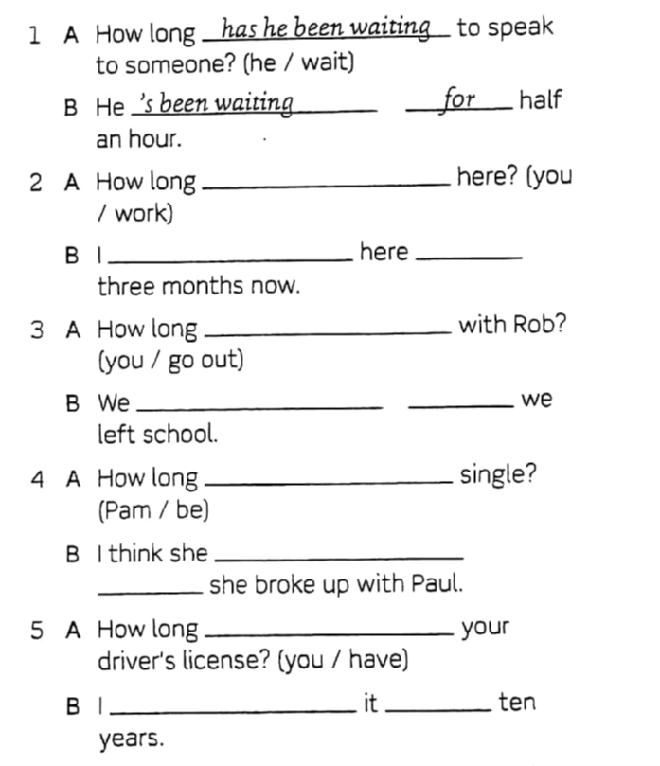
Homework

Slide 16
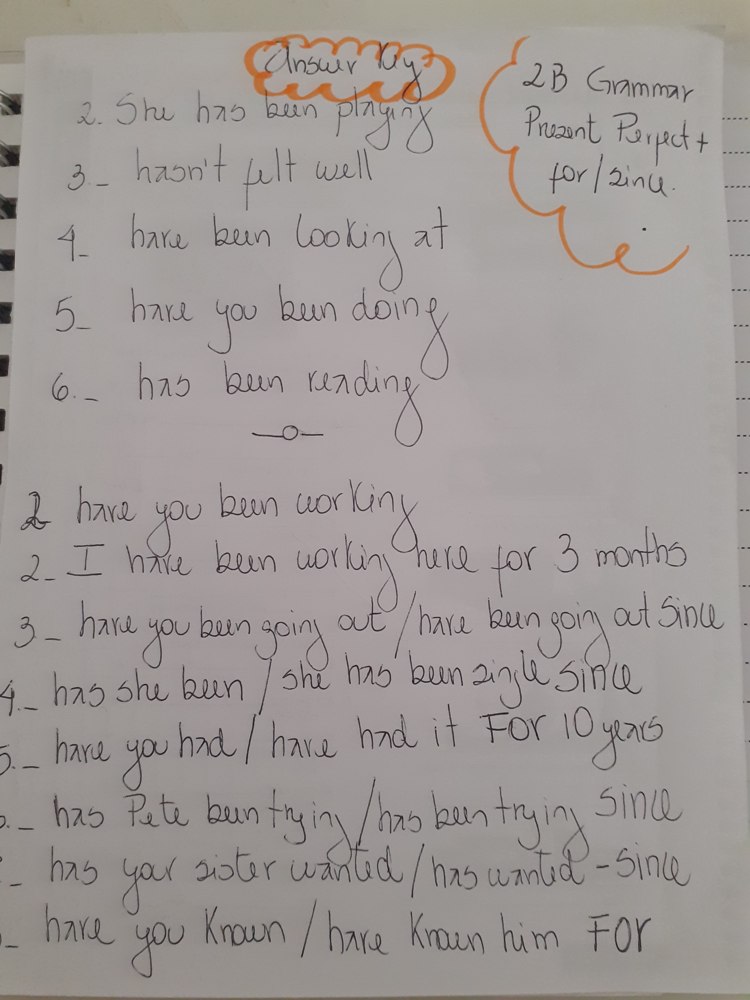

Slide 17

VIETNAM!

Slide 18
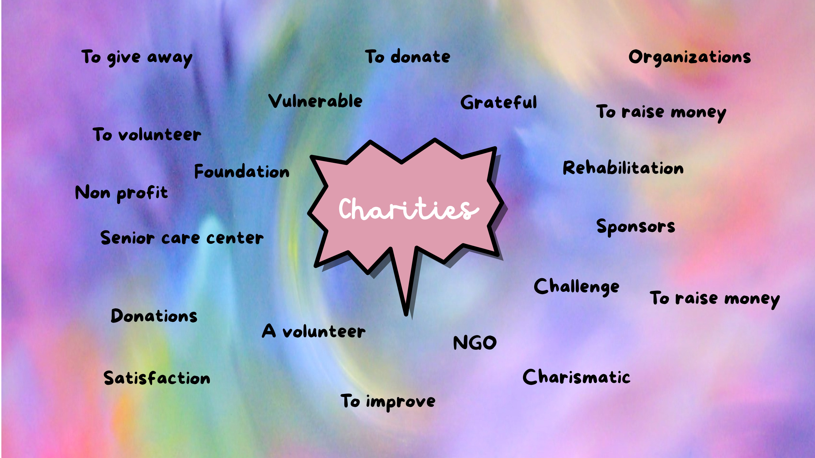

Slide 19
Speaking
If you could create your own charity, What would it be about?
Have you ever participated /worked for a charity?
What ‘s your opinion concerning the existance of charities? People´s solidarity or government´s inneficiency?

Slide 20
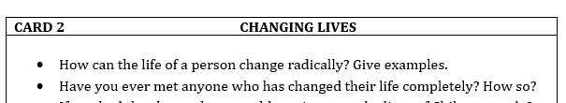

Slide 21
References
https://elmundodemonica107507327.wordpress.com/2018/11/09/el-present-perfect-continuous/

