Slide 1
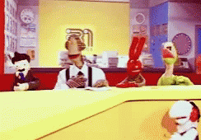
UNIT4 8B news
OR THE UNIT WHERE WE TALK ABOUT 31 MINUTOS

Slide 2
Stupid news
Group1
Lost Tourist
Group 2
Dog calls for help
Group 3
Chicken fight

Slide 3
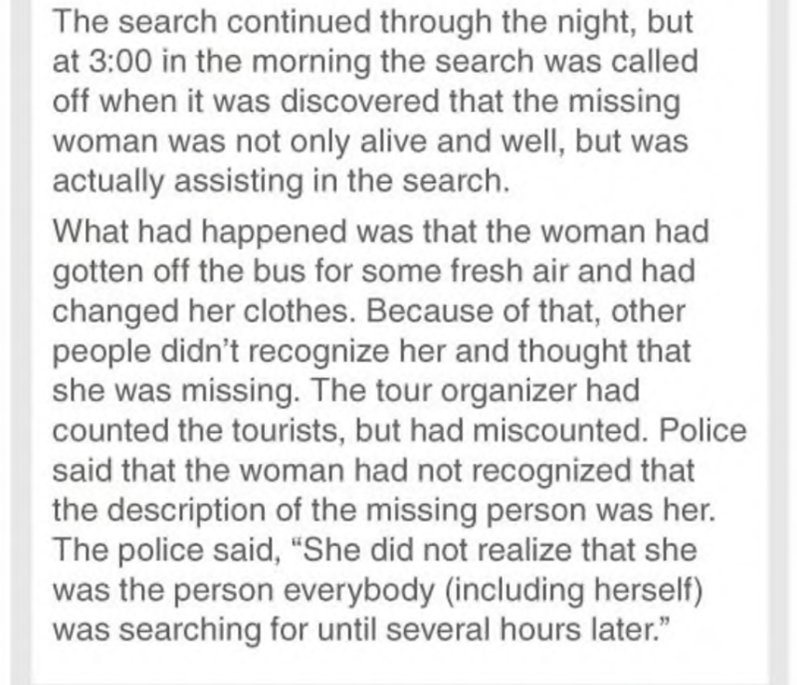

Slide 4
Chicken fight

Slide 6
Reporting verbs

Slide 7
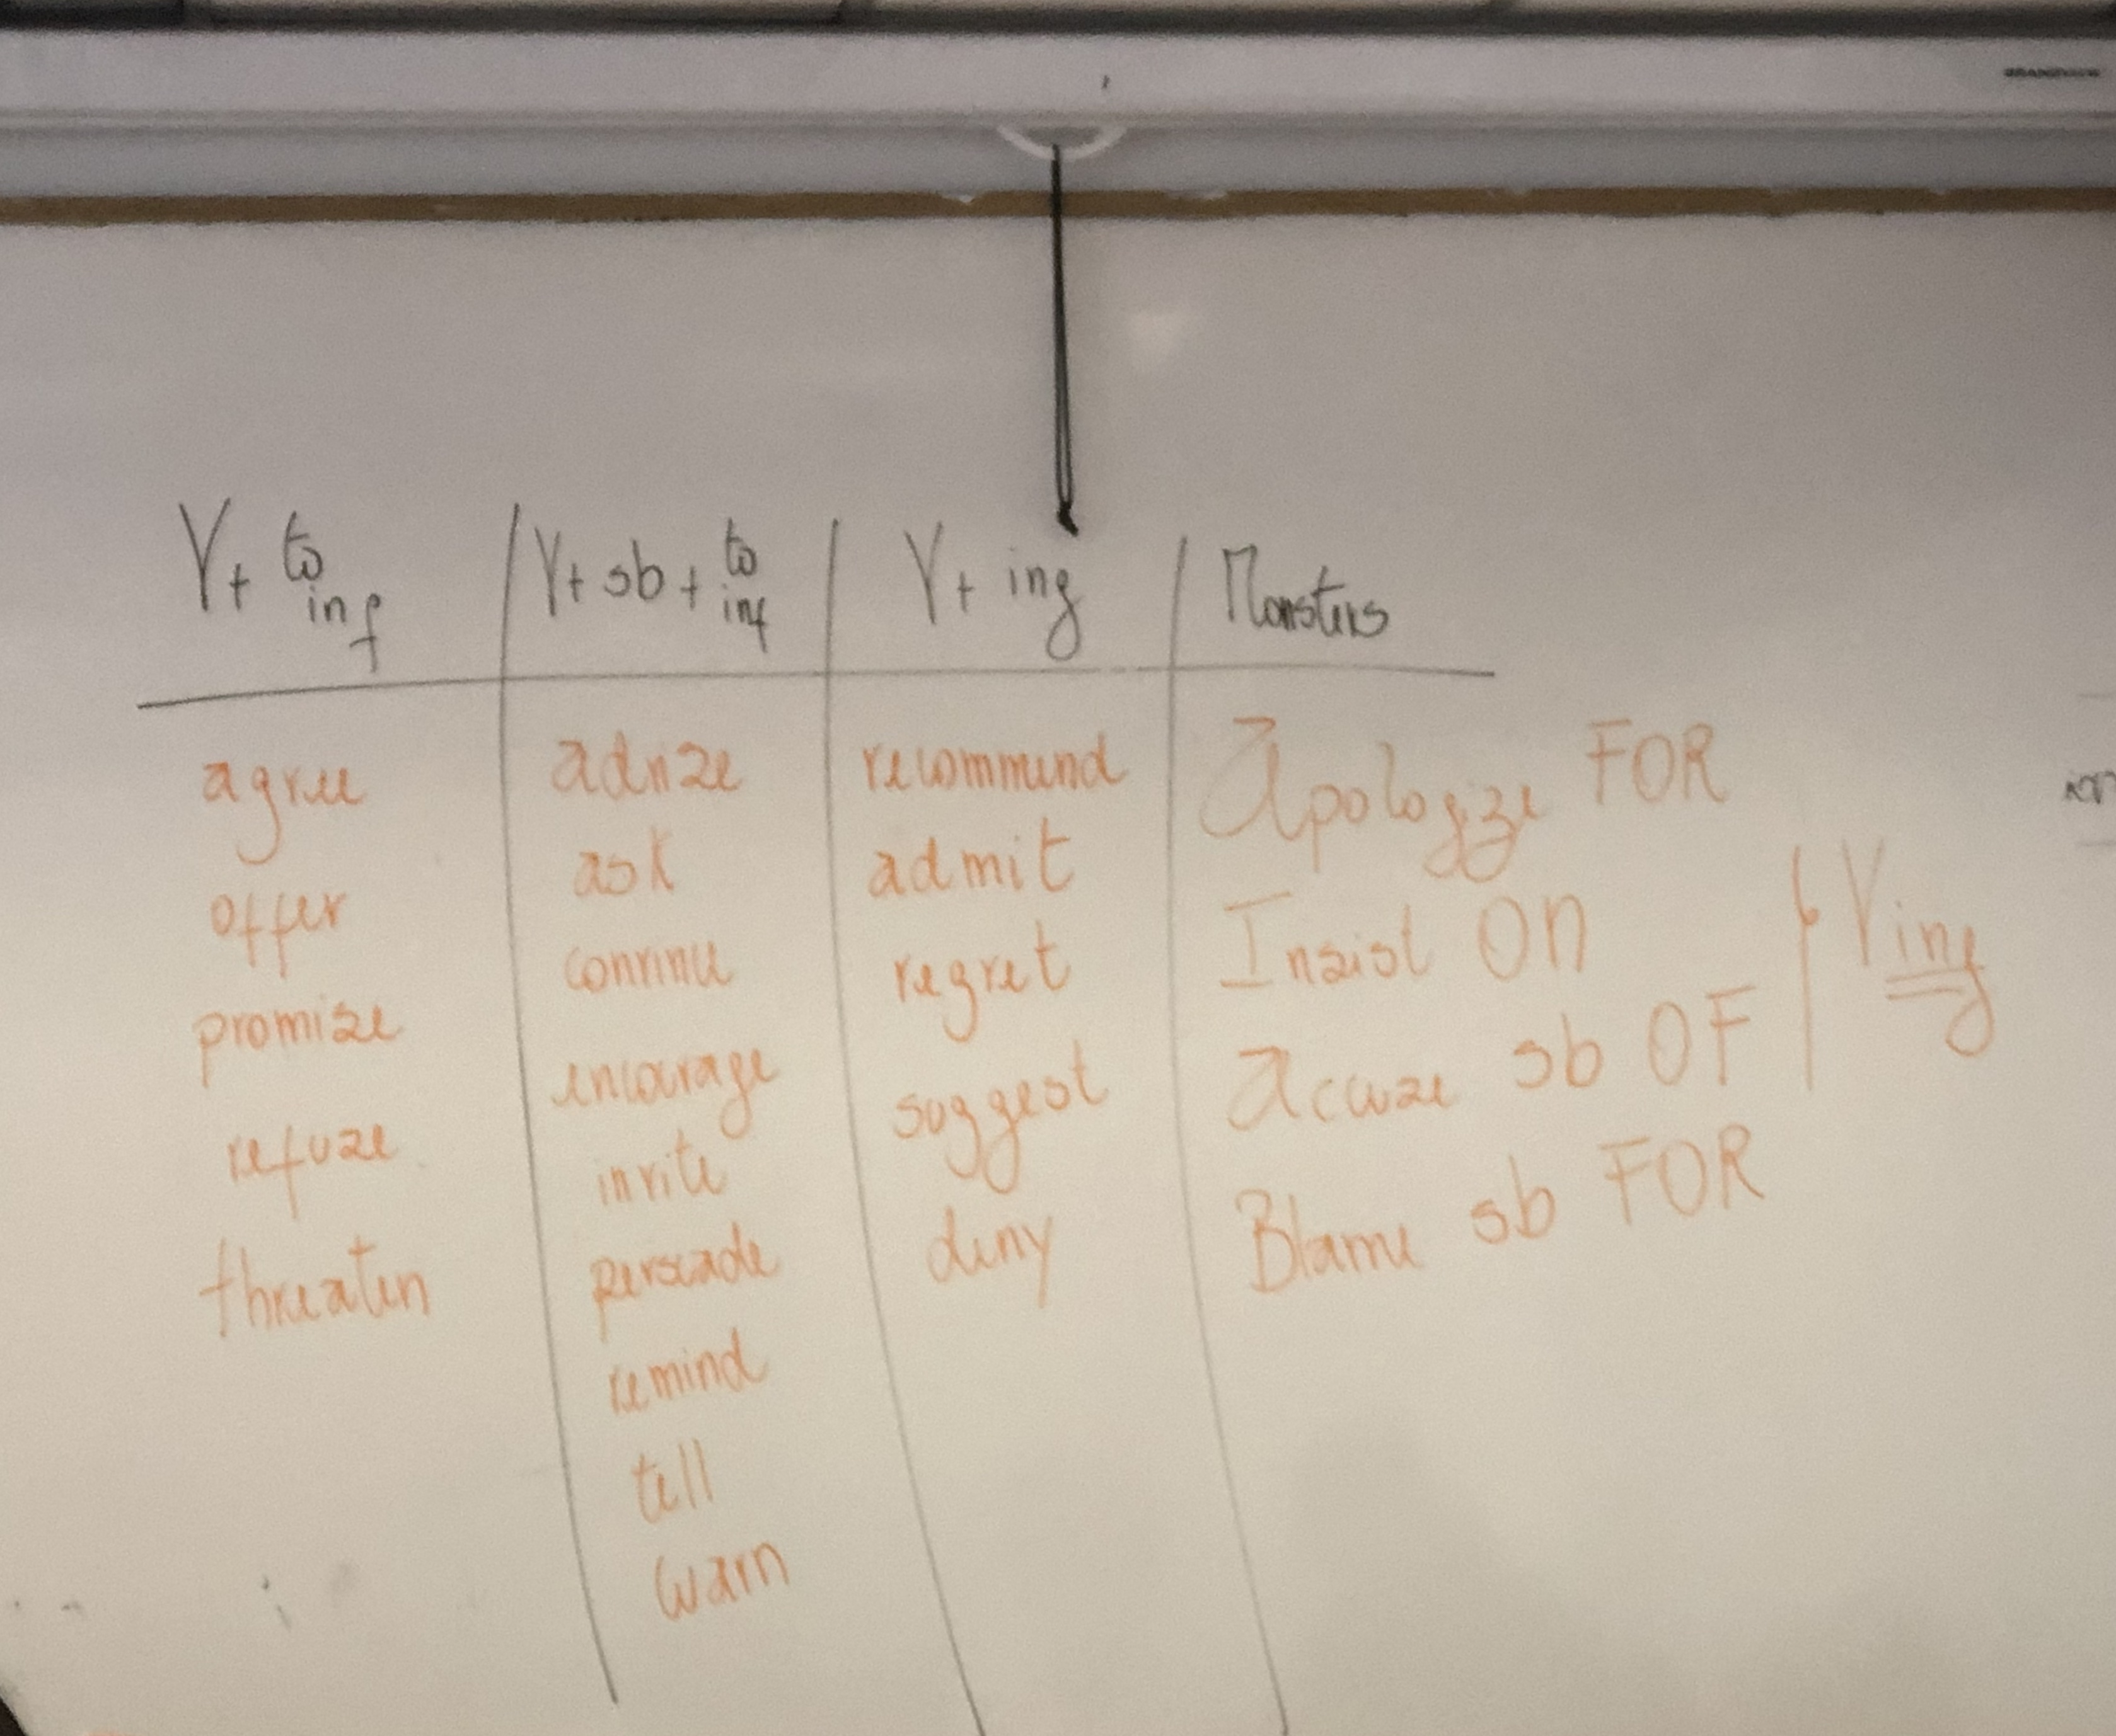

Slide 8
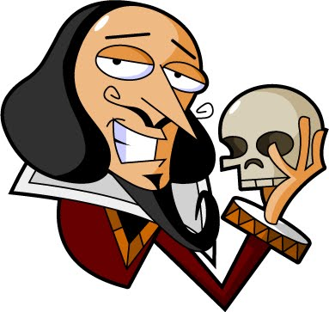
Reporting verbs
She reminded me NOT to be late
She regretted NOT going to the party
To be or NOT to be

Slide 9
Reporting verbs

Slide 10
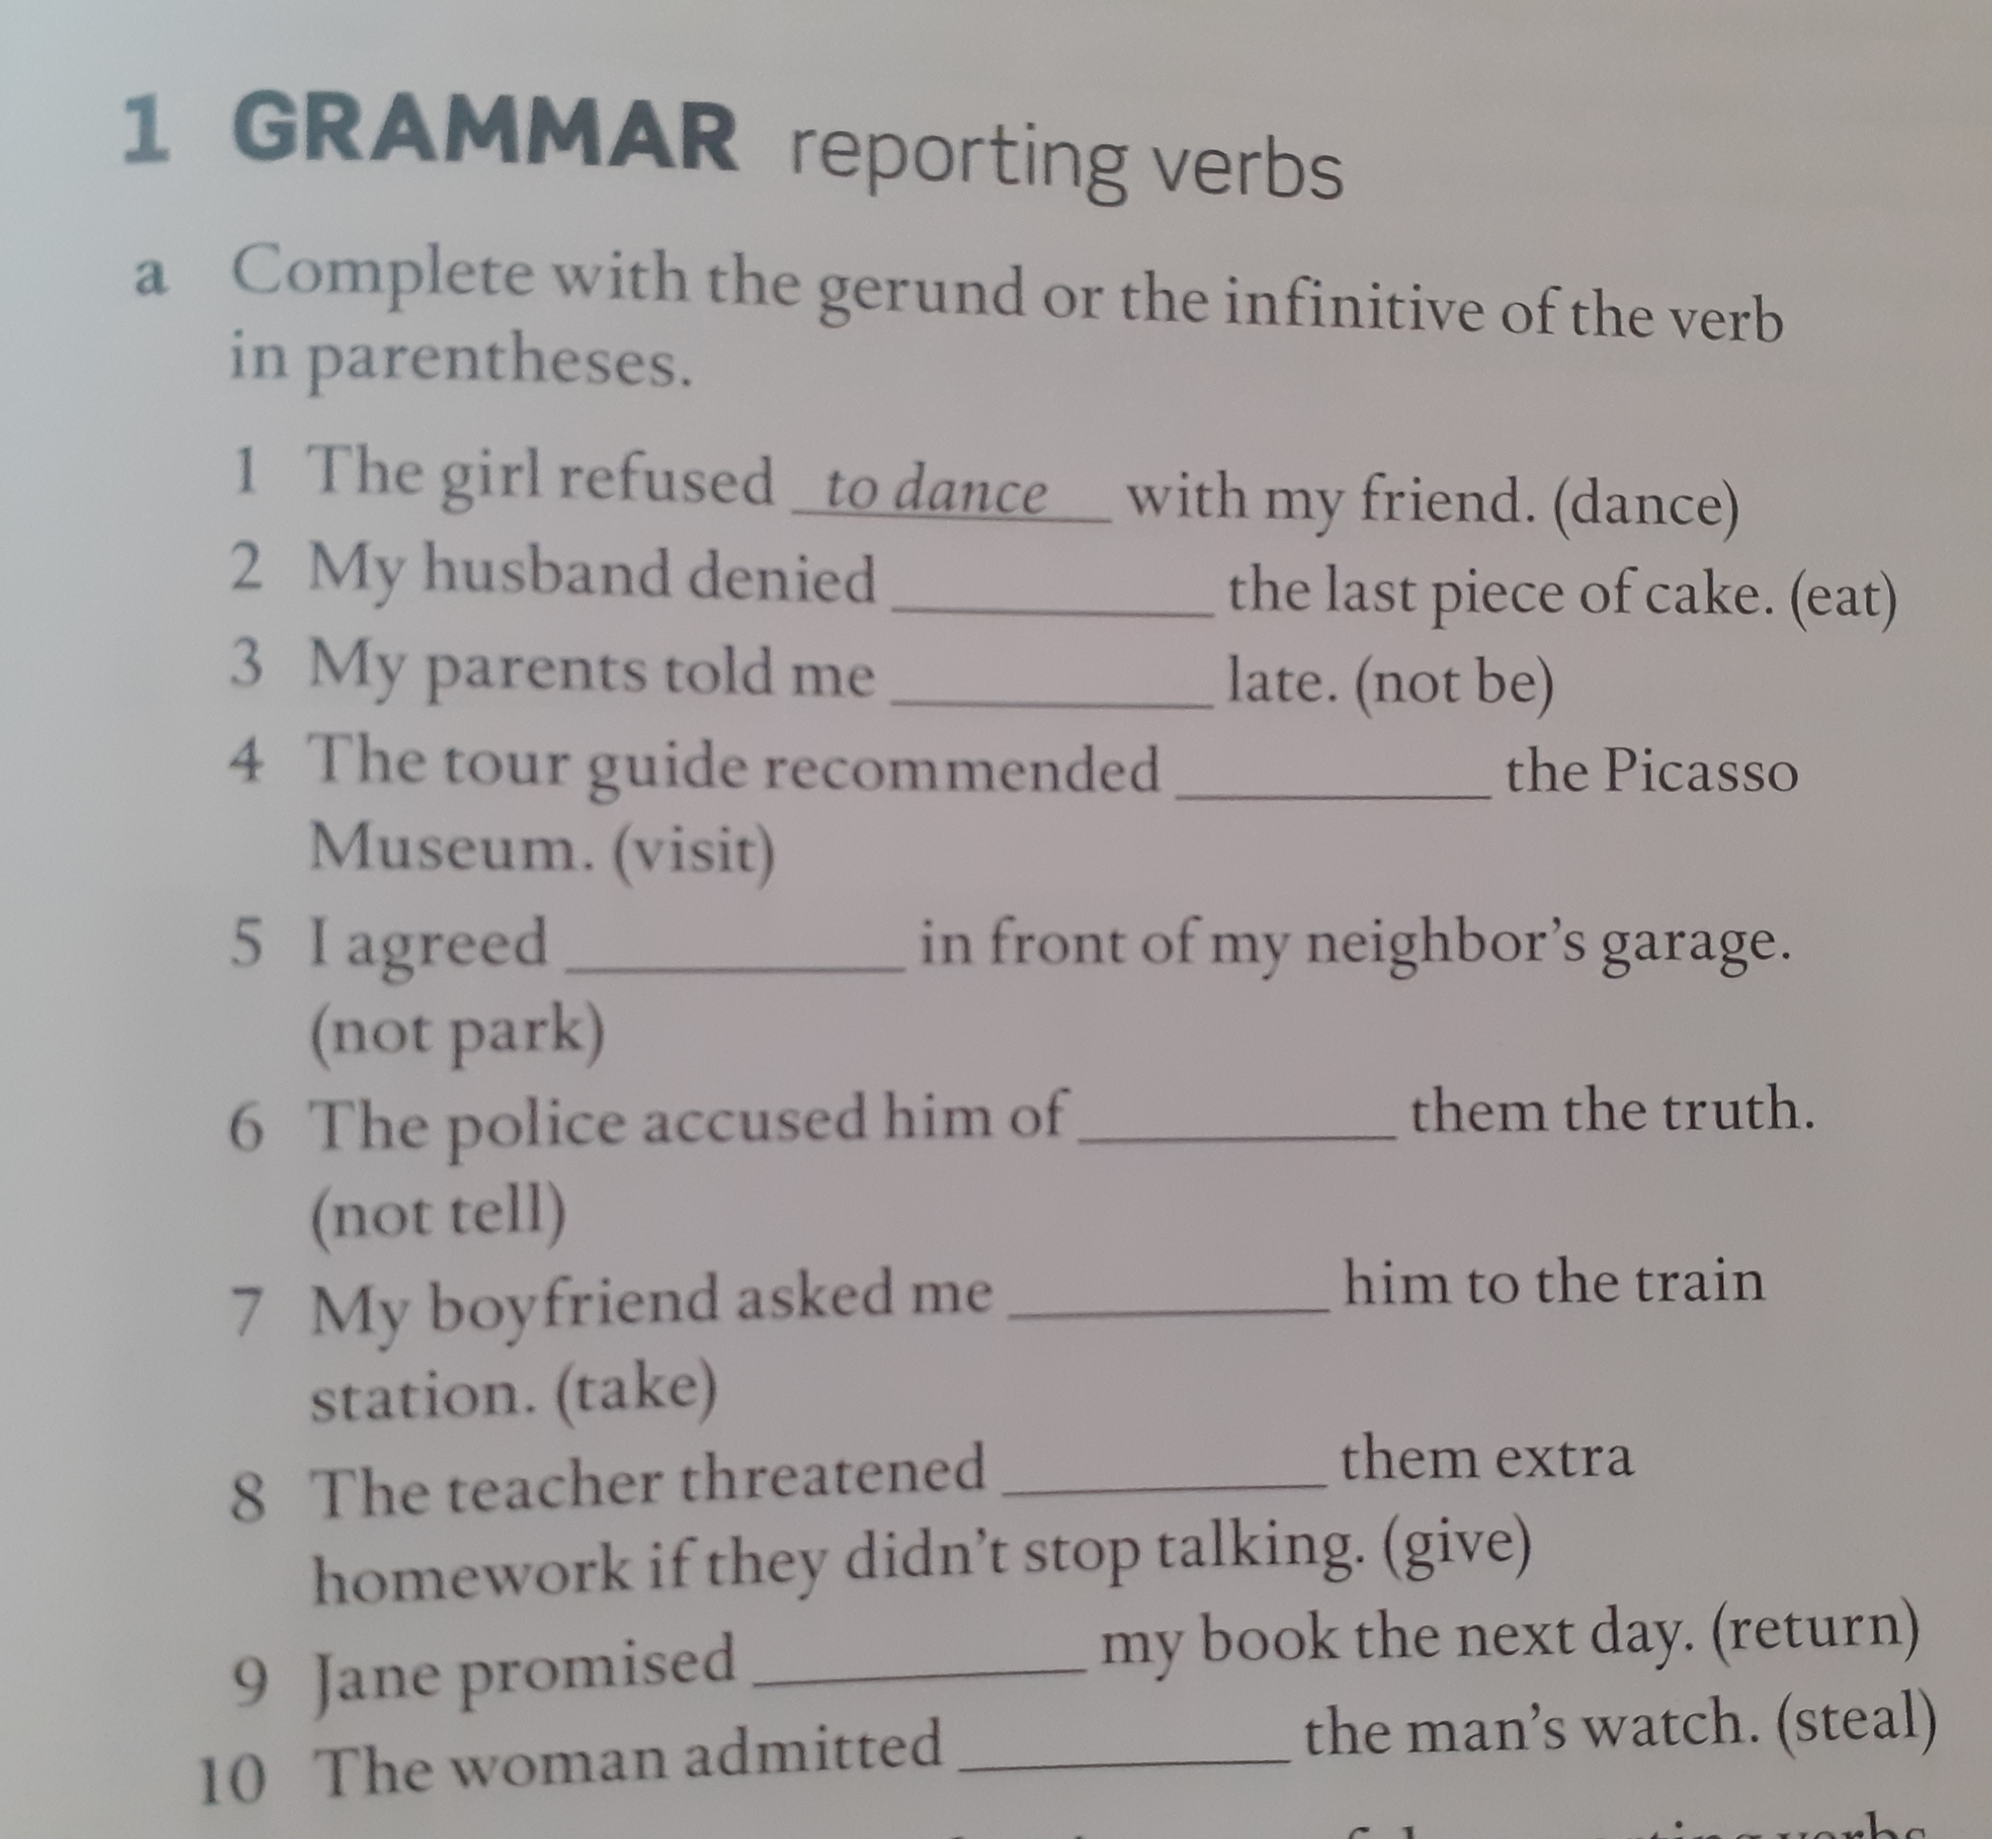
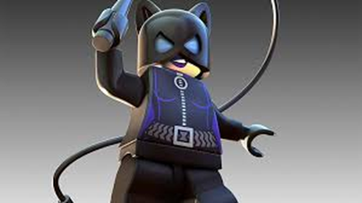
Reporting verbs
Let´s practice!

Slide 11
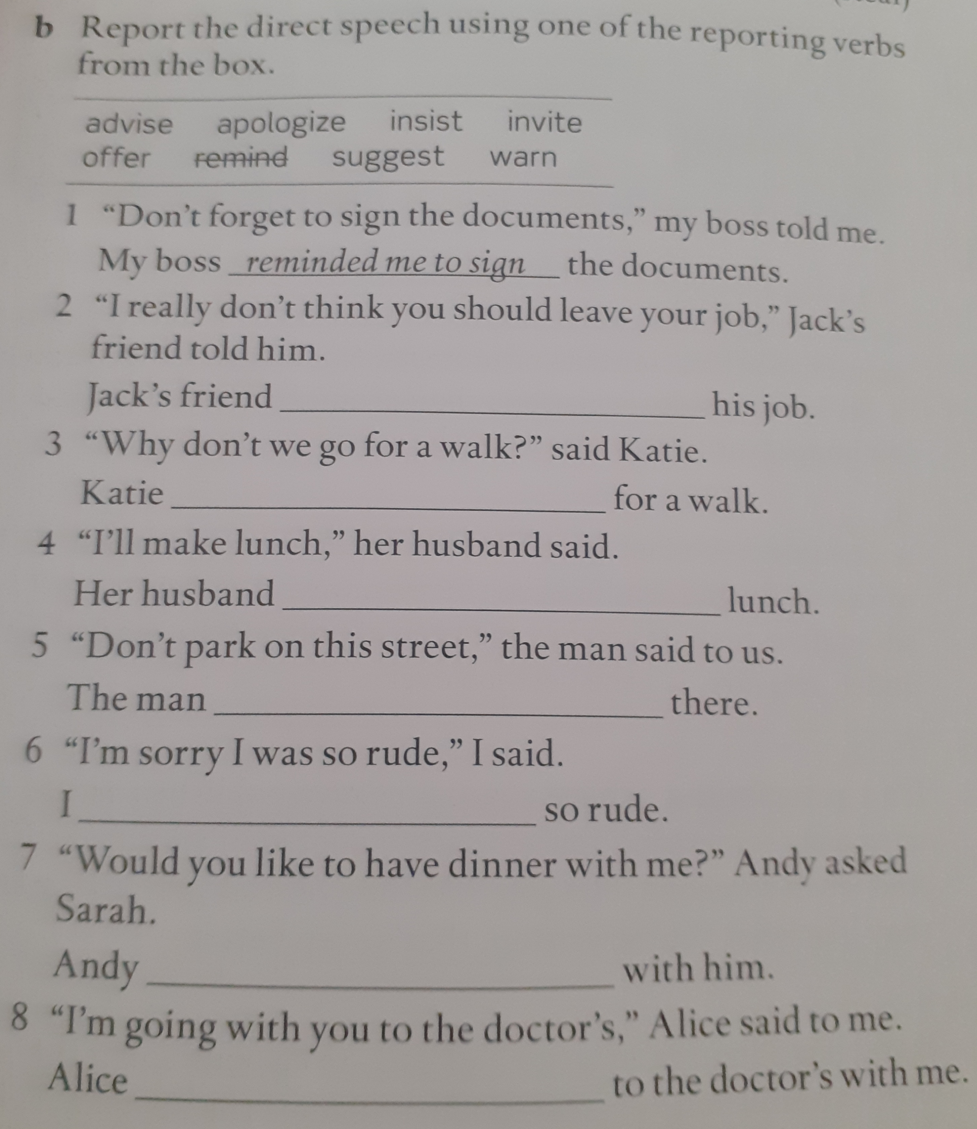

Reporting verbs
Let´s practice !

Slide 12
Homework

Slide 13
ANSWER KEY
1. PAYING
2. TO WORK
3. NOT TO WALK
4. STEALING
5. TO GIVE UP
6. NOT TO LEAVE
7. TRYING
8. NOT REMEMBERING
9. TO COME
10. DAMAGING

Slide 14
homework

Slide 15
ANSWER KEY
B.
1. suggested going
2. accused him of copying
3. threatened to call
4. refused to go
5. invited me to have
6. reminded jack to call
7. promised never to do
8. recommended trying

Slide 16
VOCABULARY

Slide 17


Slide 18
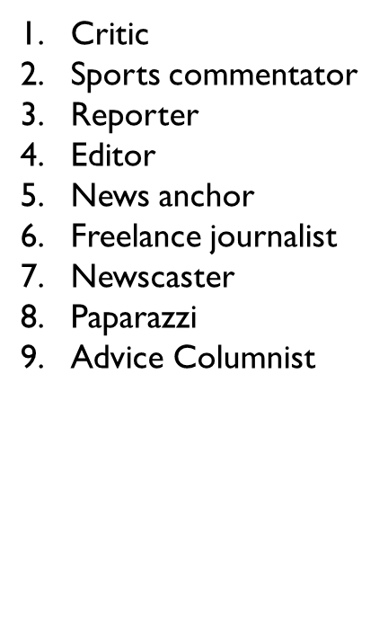

ANSWER KEY

Slide 19



Slide 20
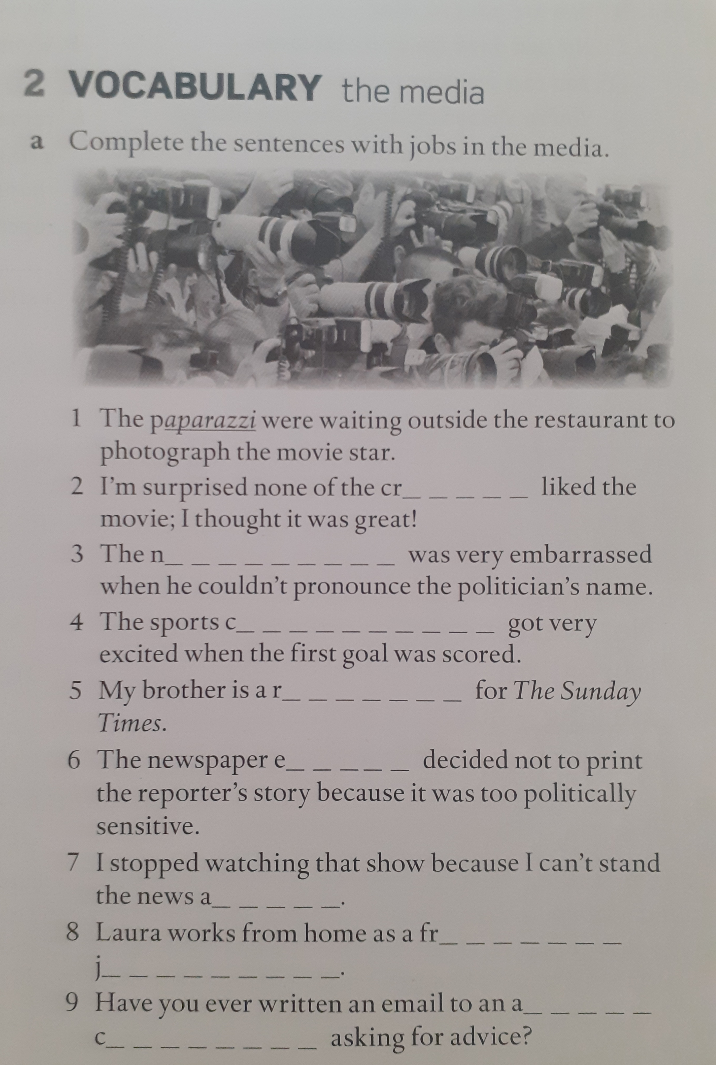
The media
Let´s practice

Slide 21


Slide 22
Step 1 : Listen to the video carefully
Step 2 : Report the conversation using the reporting verbs reviewed in class. (Verbs can be used once)
Step 3: Get together with your group and write as many sentences as possible (Choose a secretary)
Step 4 : The secretary reports the sentences to the class. The group with more correct sentences is the winner

Slide 23
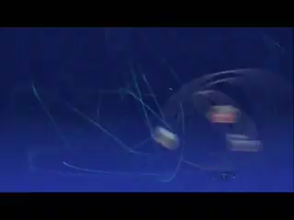

Slide 24
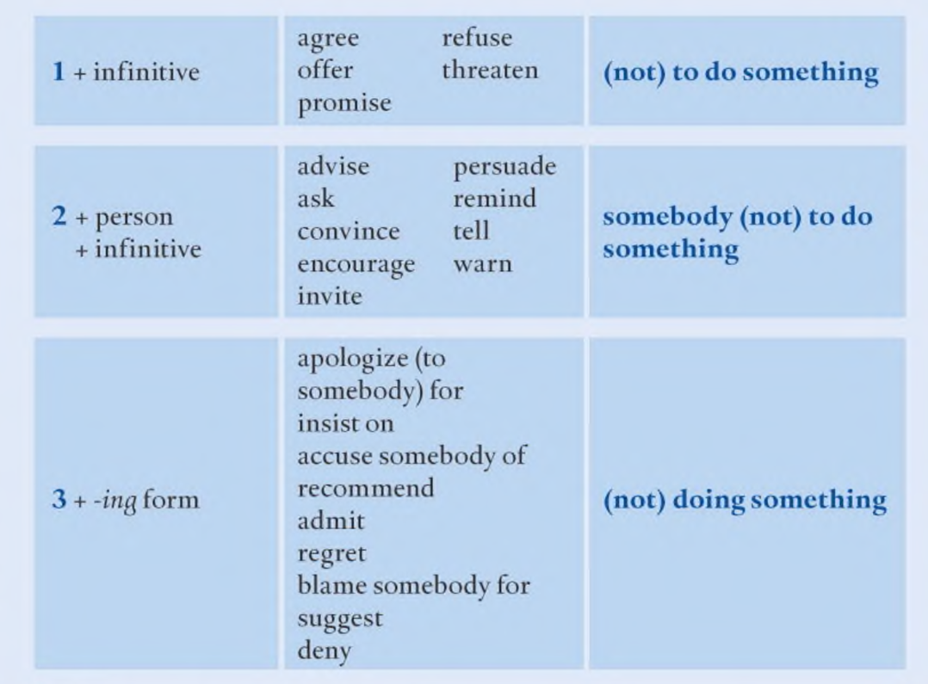
Verbs you can use

Slide 25

Spock encouraged Sheldon to open the box and play with the Transporter.

Slide 27
Step 1 : Guess the correct word for each picture
Step 2 : Raise your arms and say “I love my English class”
Step 3 : The first student in providing the correct answer gets the point

Slide 28
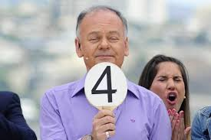
ROUND 1
Italo Passalacqua was a very popular Chilean ______

Slide 29
CRITIC

Slide 30
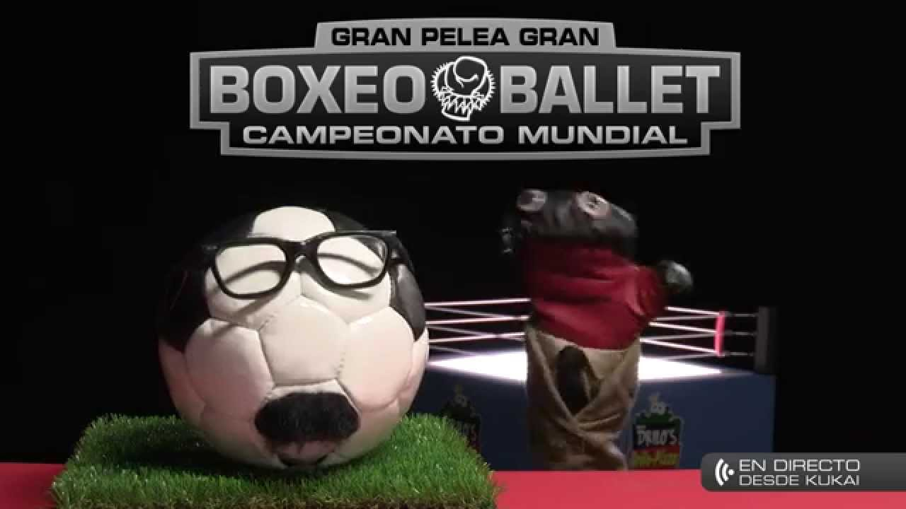
ROUND 1
Balon Bombola is 31 minutos´________

Slide 31
SPORTS COMMENTATOR

Slide 32

ROUND 1
For some people La Cuarta might be considered as a ________ type of newspaper.

Slide 33
SENSATIONAL

Slide 34

ROUND 1I
Rotten Tomatoes reviews are almost all the time really ________

Slide 35
ACCURATE

Slide 36
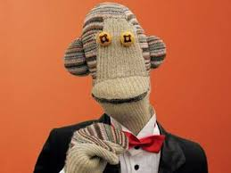
ROUND 1I
Tulio Triviño is 31 minutos´___________

Slide 37
NEWS ANCHOR

Slide 38
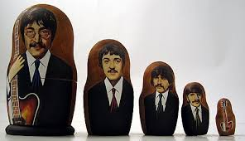
ROUND 1I
Back in the 1960´s the Beatles were ____________ by The Soviet government.

Slide 39
CENSORED

Slide 40


BONUS
CHILEAN TV
Many ________ used to work in the TV shows portrayed in the pictures above.

Slide 41
PAPARAZZI

Slide 42


CHILEAN TV
Perdona nuestros pecados and Pacto de Sangre have been the most successful ____________ from the last years.

Slide 43
SOAP OPERAS/TELENOVELAS

Slide 44
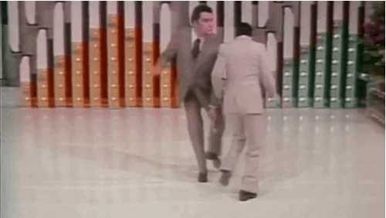
CHILEAN TV
Mario Kreutzberger aka Don Francisco is Channel 13´s _____________and the most popular ______________ in South America.

Slide 45
ANCHORMAN /TV PRESENTER

Slide 46

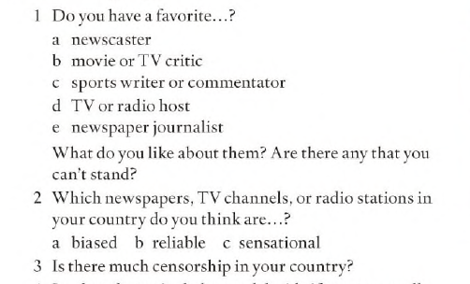
SPEAKING 1

Slide 47

SPEAKING 2

Slide 48


Slide 49
ANSWER KEY
1. To dance
2. Eating
3. Not to be
4. Visiting
5. Not to park
6. Not telling
7. To take
8. To give
9. To return
10. stealing

Slide 50
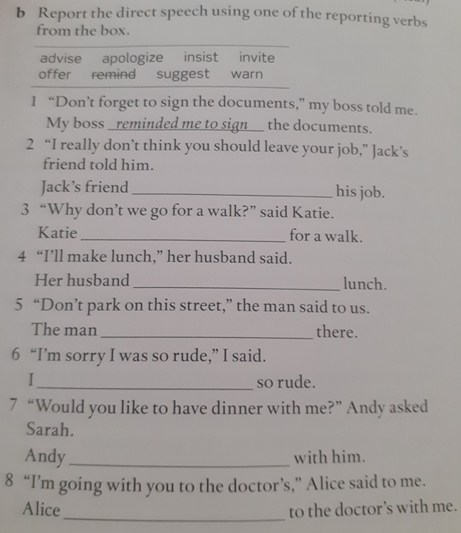

Slide 51
ANSWER KEY
reminded me to sign
advised him not to leave his job
suggested going for a walk/invited her to go for a walk
offered to make lunch
told us not to park on this Street
apologized for being so rude
invited her to have dinner
suggested going to the doctor with me

Slide 52


Slide 53
ANSWER KEY
critics
newscaster
commentator
reporter
editor
anchor
freelance journalist
advice columnist

Slide 54

Vietnam!

Slide 55

Objective
TV show
Tv channel
Journalist
Censorship
Free lance
Tv host/hostess
Accurate
Critic
Biased
To be censored
Sports commentator
editor
The media
Headline
Panels
Reliable
Anchor man/ woman
To be banned
Panelist
Anchor man/woman
Interviews
A piece of news
Front page
Journalist
Review
Reporters
Breaking news

Slide 56
