Slide 1
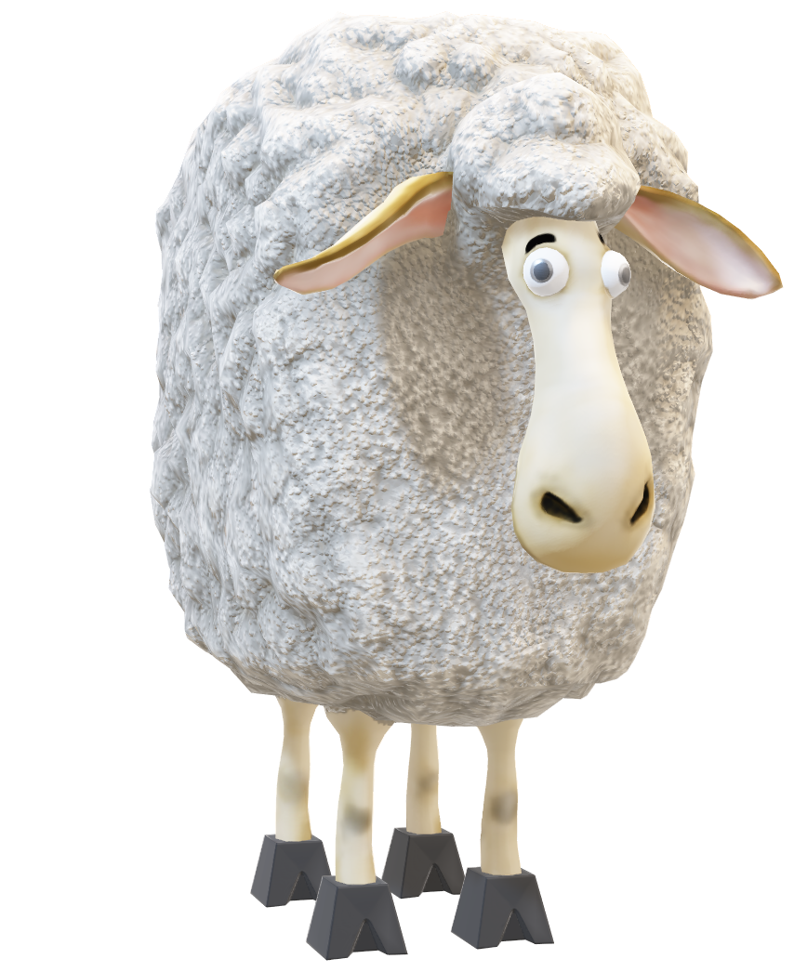
UNIT 2 UNIT 6B
Sleep
By @misscarosama

Slide 2

Speaking
Do you like sleeping?
How much do you sleep?
Did the pandemic affect your sleep time/quality?

Slide 3


Listening

Slide 4
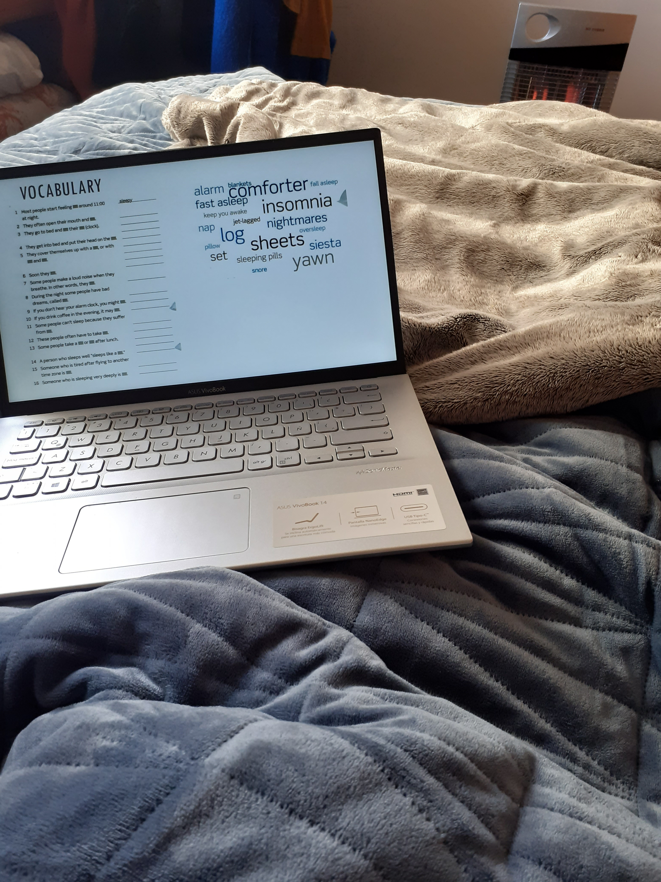
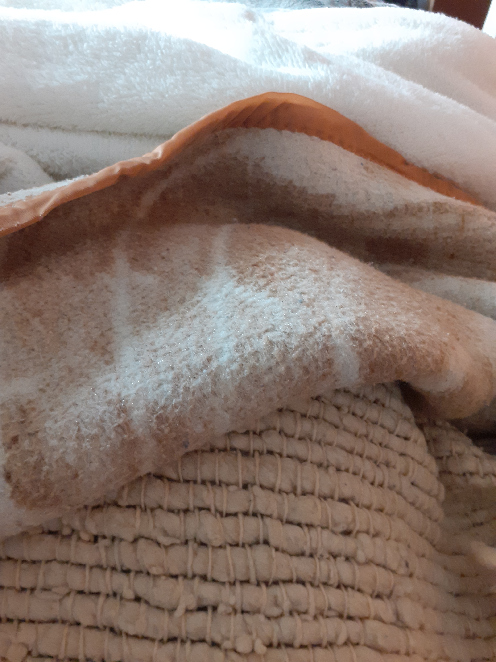

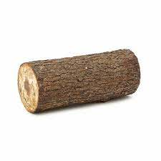
Vocabulary

Slide 6
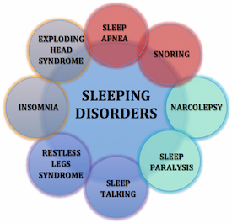

Slide 7
“I have recently found out that my daughter suffers from four sleep disorders”
Before I found out, I USED TO SLEEP like a log
Now I AM USED TO STAYING alert while asleep
I AM GETTING USED TO SLEEPING badly every night

Slide 8
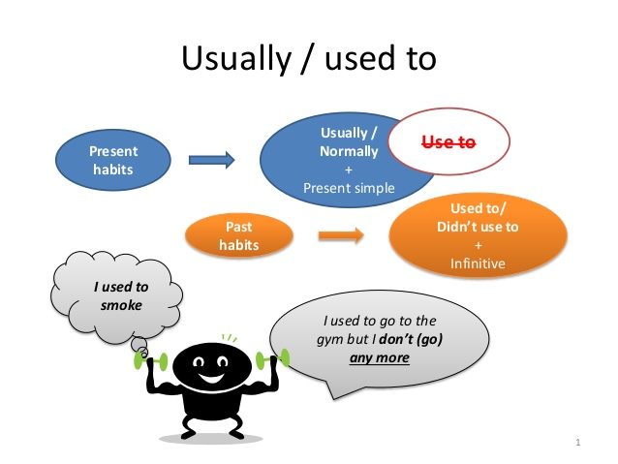
Before I found out, I used to sleep like a log

Slide 9

Now I am used to staying alert while sleeping
BE USED TO + V (ing)
To talk about actions/things we are familiar with
Beauchef students are used to having a vacation week in May.
Beauchef students are not used to attending all their clases.
Beauchef students were used to having a swimming pool.
Beauchef students were used to having Zoom meetings every day during the pandemic.

Slide 10


I am getting used to sleeping badly every night
GET USED TO + V (ing)
To talk about actions/things we are in the process of becoming familiar with.
Beauchef students are getting used to having English classes at the DII.
Beauchef students are not getting used to the new campus rules.
Beauchef students have not got used to having to work autonomosly yet.

Slide 11
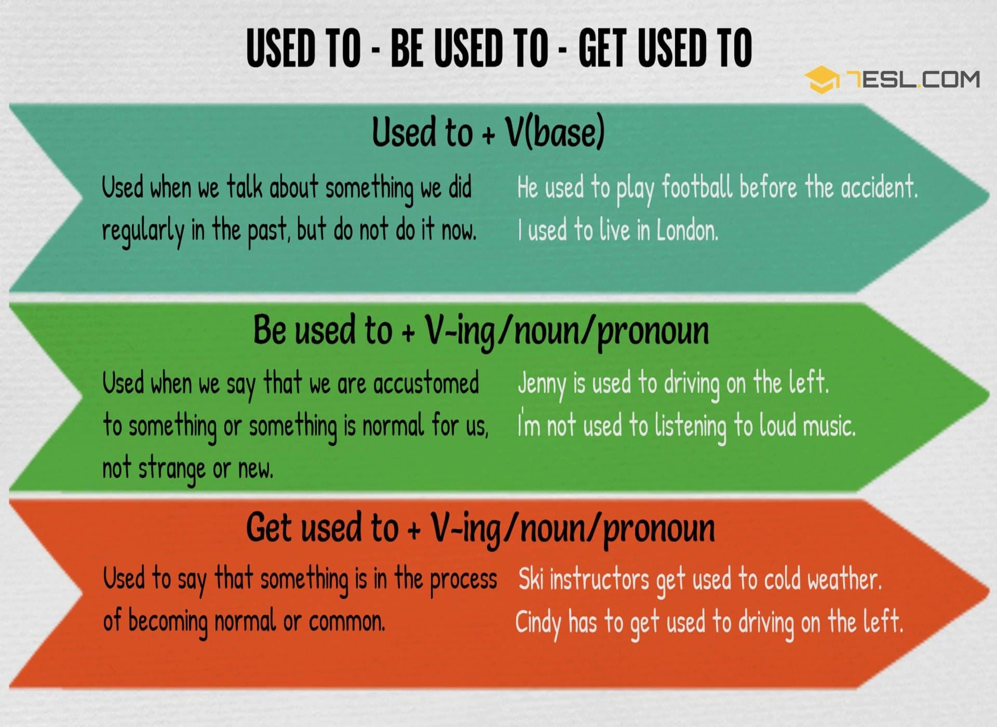

Slide 12
LET´S PRACTICE

Slide 13
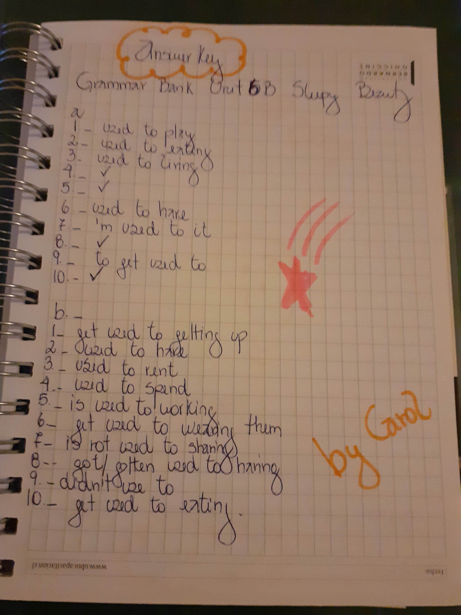

Slide 14

Still not sure about the meaning?

Slide 15


Slide 16
Let´s play
I have recently got a Tinder girlfriend/boyfriend
I used to
I am used to
I am getting used to

Slide 17

No more prende Beauchef are allowed in campus.
I used to
I am used to
I am getting used to

Slide 18
I have just changed my cell phone´s language to English.
I used to
I am used to
I am getting used to

Slide 19
I have recently started my last English course with Miss Caro.
I used to
I am used to
I am getting used to

Slide 21
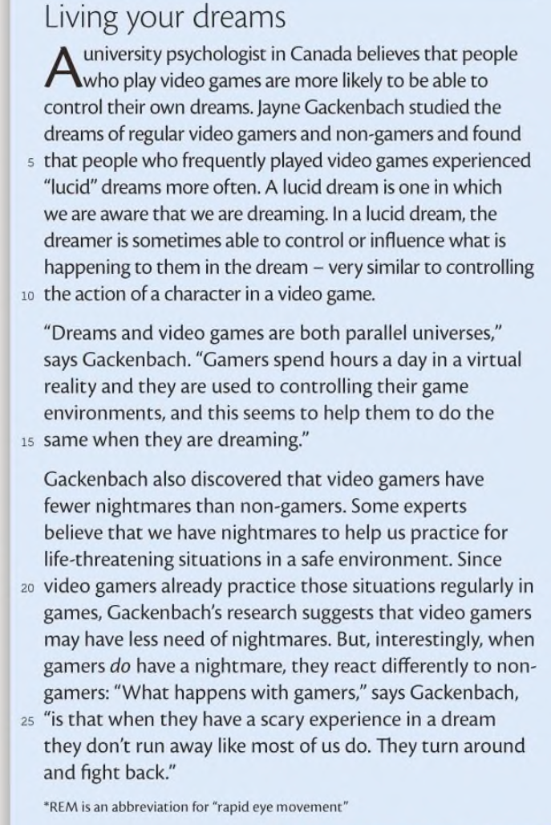

Slide 22
THE FLU:
A common infectious illness that causes fever and headache

Slide 23
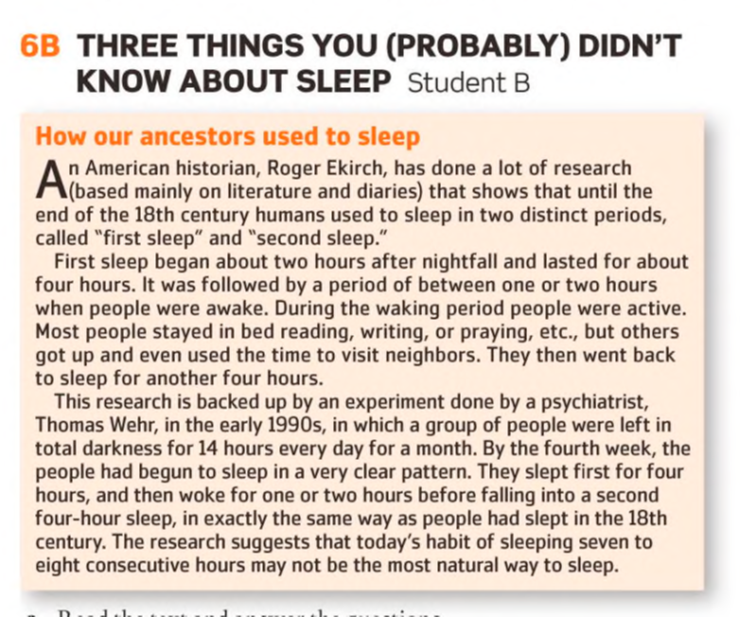



Slide 25
TO WANDER V/S TO WONDER
To Wander: To walk without a destination or purpose.
To Wonder: To ask yourself questions or express a wish to know about something.
TO HEAD FOR: To go in a particular direction.
TO SPILL: (Spilt) To flow, move, fall, or spread over the edge or outside the limits of something.

Slide 26
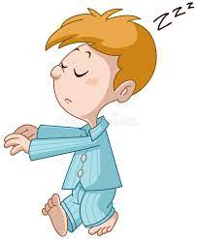
True or False

Slide 27

VIETNAM!

Slide 28
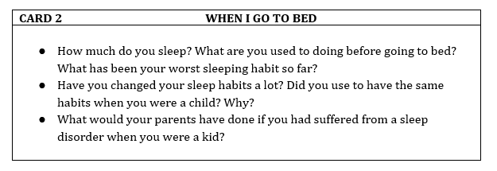

Slide 29
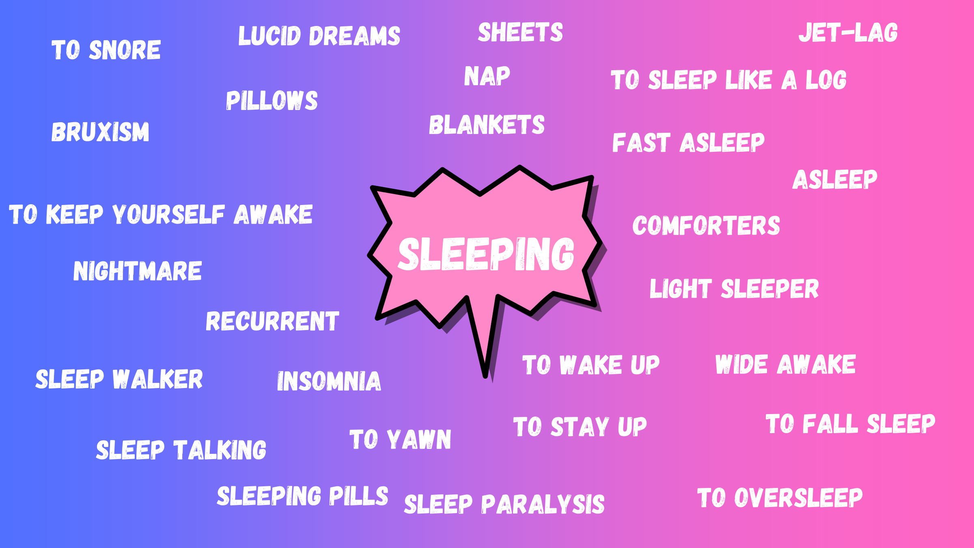

Slide 30
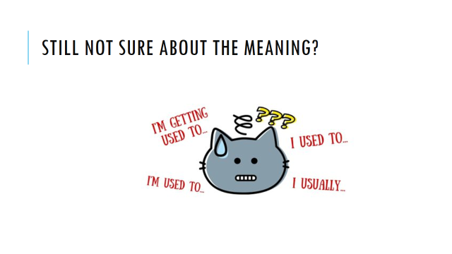

Slide 31
Further help
https://www.youtube.com/watch?v=PIYb6O-j51o
https://test-english.com/grammar-points/b1/usually-used-to-be-used-to-get-used-to/
https://speakspeak.com/english-grammar-exercises/intermediate/used-to-be-used-to-get-used-to

