Slide 1

Mixed conditionals
Miss Carosama

Slide 2


In our last chapter…
If/When I have the money, I travel abroad
ZERO CONDITIONAL

Slide 3
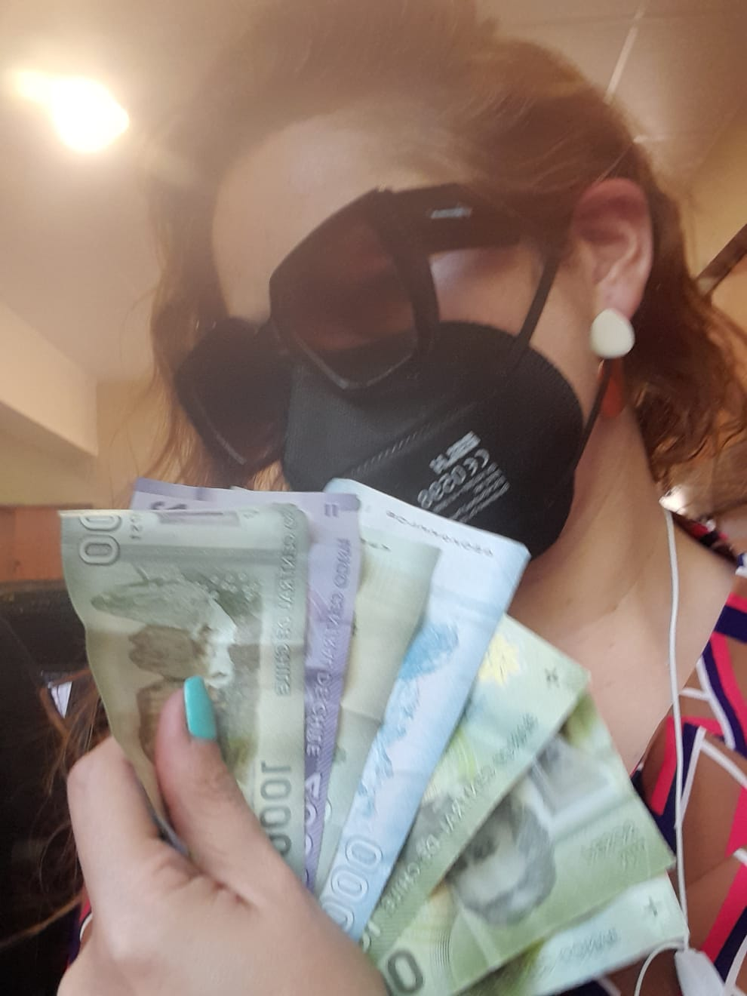
If I have the money, I will travel abroad this summer
FIRST CONDITIONAL

Slide 4

If I had the money, I would travel abroad this summer
SECOND CONDITIONAL
REGULAR
BEAUCHEFIAN

Slide 5
If I had had the money, I would have traveled abroad last summer
THIRD CONDITIONAL

Slide 6

Mixed Conditionals for you

Slide 7


Slide 8
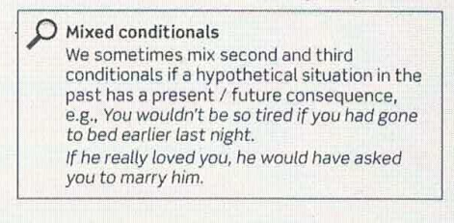

Slide 9
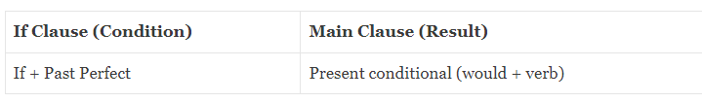
Unreal Past condition-Present result
If I had listened to my mom I wouldn´t be in trouble now

Slide 10
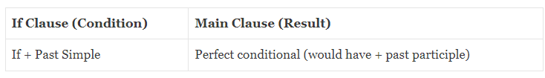
Past result- Unreal Present situation
If they knew about his problem, they would have helped him

Slide 11
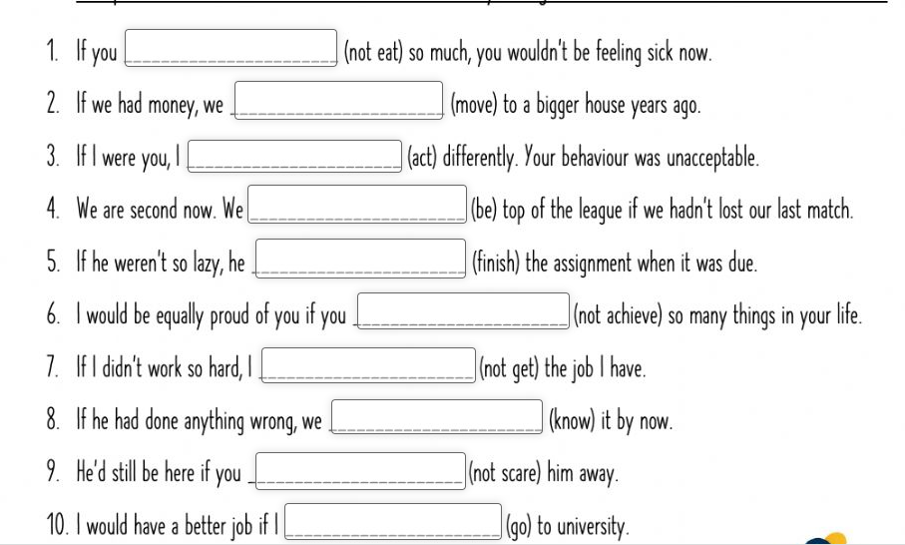
Let´s Practice

Slide 12
ANSWER KEY
1. HADN´T EATEN
2. WOULD HAVE MOVED
3. WOULD HAVE ACTED
4. WOULD BE
5. WOULD HAVE FINISHED
6. HADN´T ACHIEVED
7. WOULDN´T HAVE GOTTEN /GOT
8. WOULD KNOW
9. HADN´T SCARED
10. HAD GONE

Slide 13
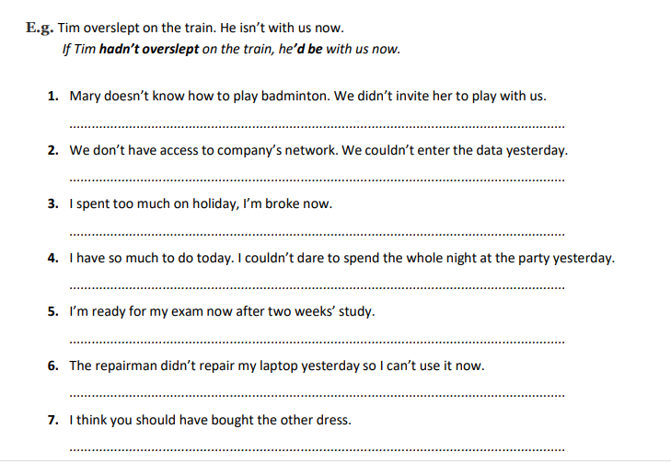
CHAMPIONSHIP
THREE GROUPS
ONE WINNER

Slide 14
ANSWER KEY
1 If Mary knew how to play Badminton, we would have invited her to play with uas.
2 If we had access to the company network, we could have entered the data yesterday.
3. If I hadn´t spent too much on holidays, I wouldn´t be broke now.
4. If I didn´t have so much today , I would have dared to stay the whole night at the party
5. If I hadn´t studied for two weeks, I wouldn´t be ready for the exam right now.
6. If the repairman had repaired my laptop yesterday
7.If I were you, I would have bought the other dress.

Slide 15
Still don´t get it?
https://grammartop.com/mixed-conditionals-2/
https://www.youtube.com/watch?v=LBvXjZmpraU
https://www.youtube.com/watch?v=_Mv7fBqauvc}
https://www.englishpage.com/conditional/conditional10.htm
https://www.usingenglish.com/quizzes/226.html
https://www.grammarism.com/mixed-conditionals-exercises/
https://www.mmmenglish.com/2020/06/11/mixed-conditionals/
https://es.liveworksheets.com/worksheets/en/English_as_a_Second_Language_(ESL)/Conditionals/Mixed_Conditionals__km7222na
https://www.examenglish.com/grammar/mixed_conditionals.htm

