Slide 1
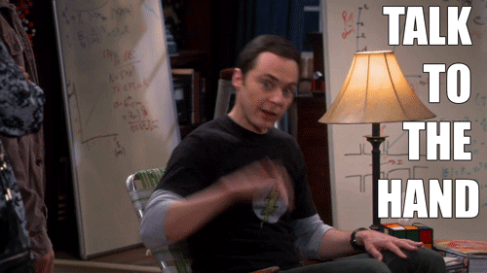
Unit 3
7A Arguments
By @misscarosama

Slide 2
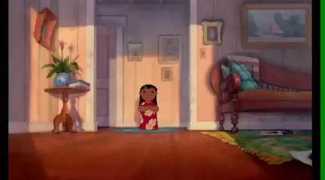

Slide 3
Carol loves watching animated movies and anime.
She must have free time to watch the movies
She may/might watch the movies while cooking
She can´t watch the movies when preparing her classes
Possible
Impossible
Modal verb + Base form

Slide 4
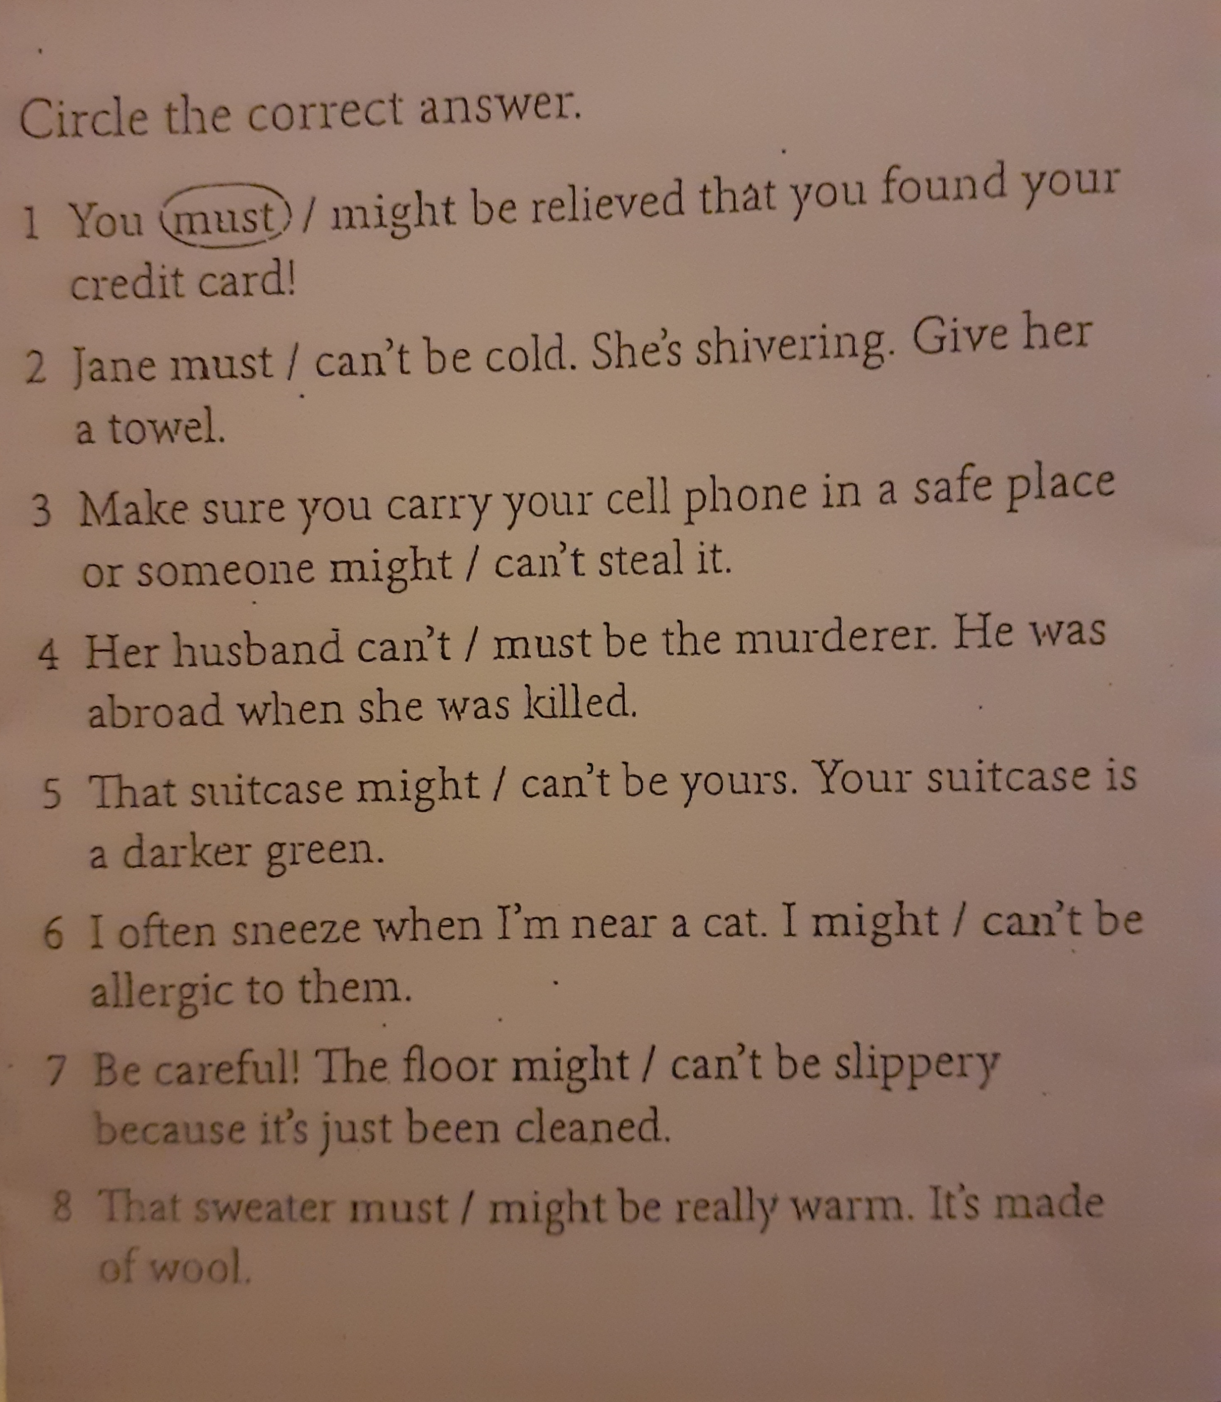
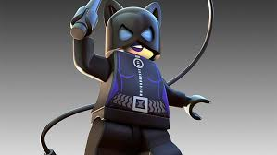
Let´s practice!

Slide 5

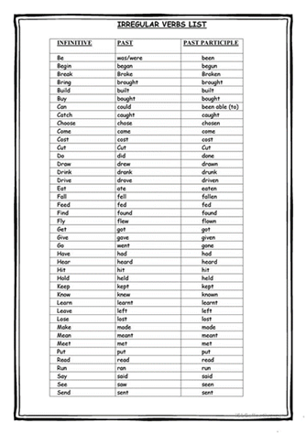
Carol didn´t watch any anime last weekend.
She must have been very busy doing other things.
She may/might not have had any computer available
She couldn´t have been watching another thing.
Possible
Impossible
Modal verb + have +Participle

Slide 6

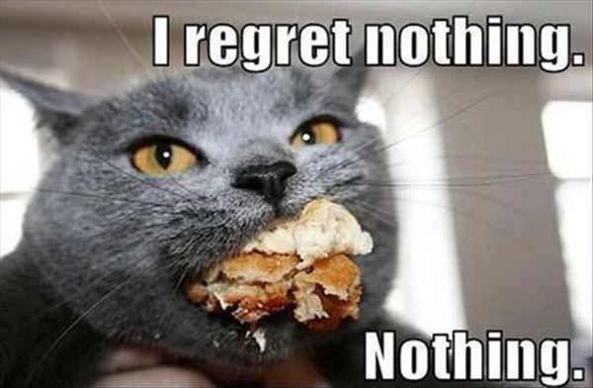
Carol felt sad because she couldn´t watch any anime last weekend.
She should have worked harder during the week.
Should + have + Participle

Slide 7

ARGUMENTS

Slide 8

LET´S PRACTICE

Slide 9
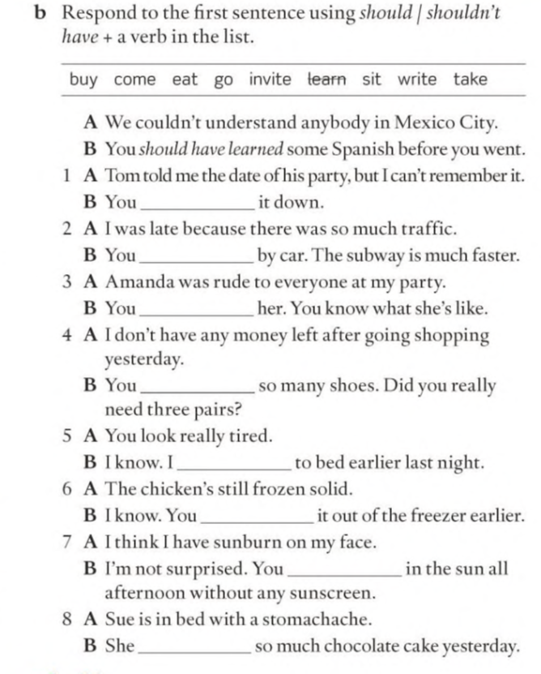

Slide 10
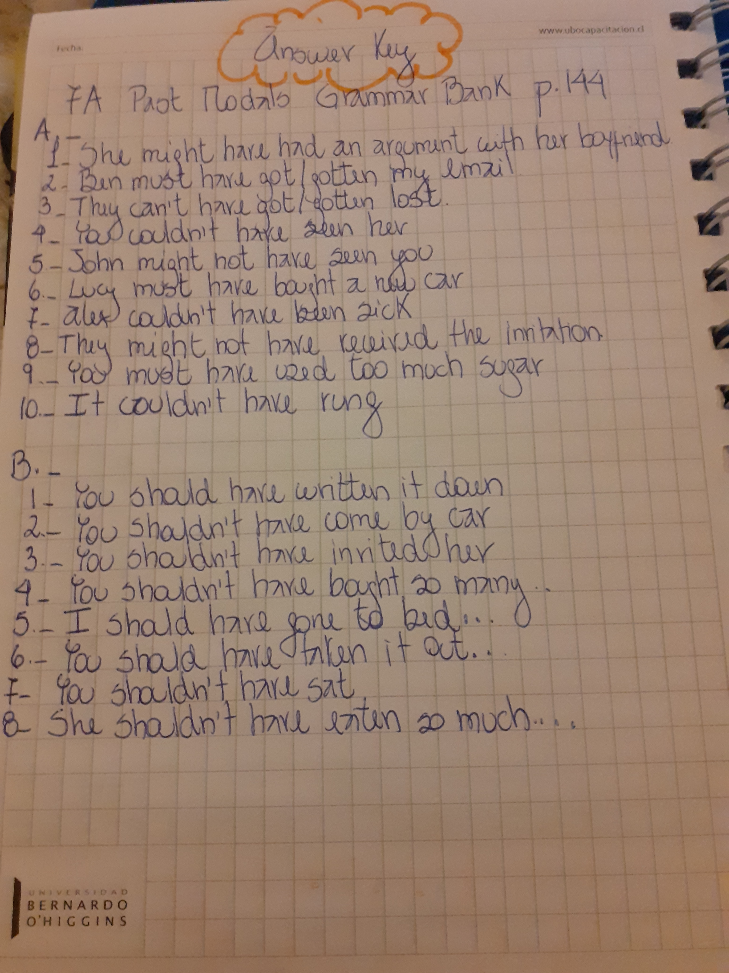

Slide 11
LISTENING

Slide 12
Let´s speak
What are the best tips?
Why?
What are the worst tips? Why?

Slide 13
LISTENING

Slide 14
USEFUL EXPRESSIONS
TO BE EASIER SAID THAN DONE
TO BE IN THE WRONG
TO KEEP THINGS UNDER CONTROL
TO LOSE YOUR TEMPER
TO TAKE A DEEP BREATH
TO STICK TO THE POINT
TO REACH AN AGREEMENT
TO DEAL WITH CONFLICT

Slide 15


Slide 16
Step 1:Your teacher will show a picture.
Step 2: You have to identify the picture with one of the expressions reviewed in the listening exercise and create a beautiful sentence
Step 3: Once you have your sentence, stand up say “I love my English class” and enjoy your victory!

Slide 17
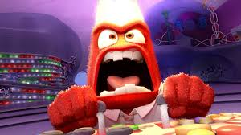

Slide 18
To keep things under control
To lose your temper

Slide 19
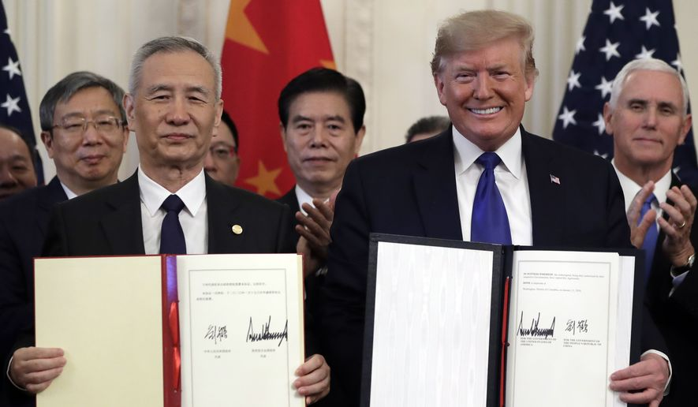

Slide 20
To reach an agreement

Slide 21
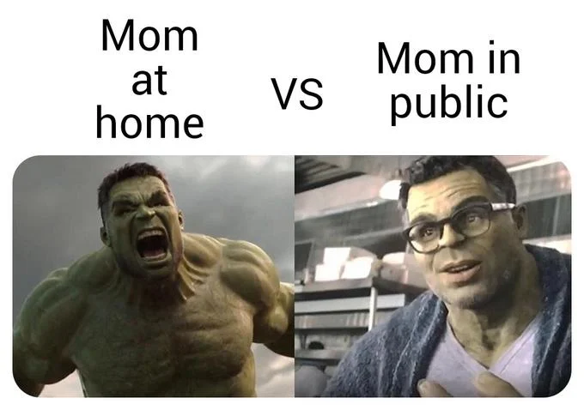

Slide 22
To lose sb’s temper

Slide 23
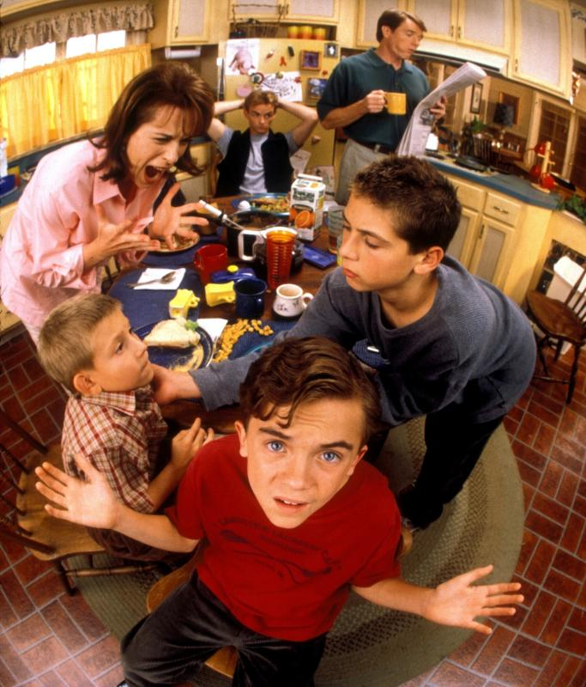

Slide 24
To deal with conflict

Slide 25
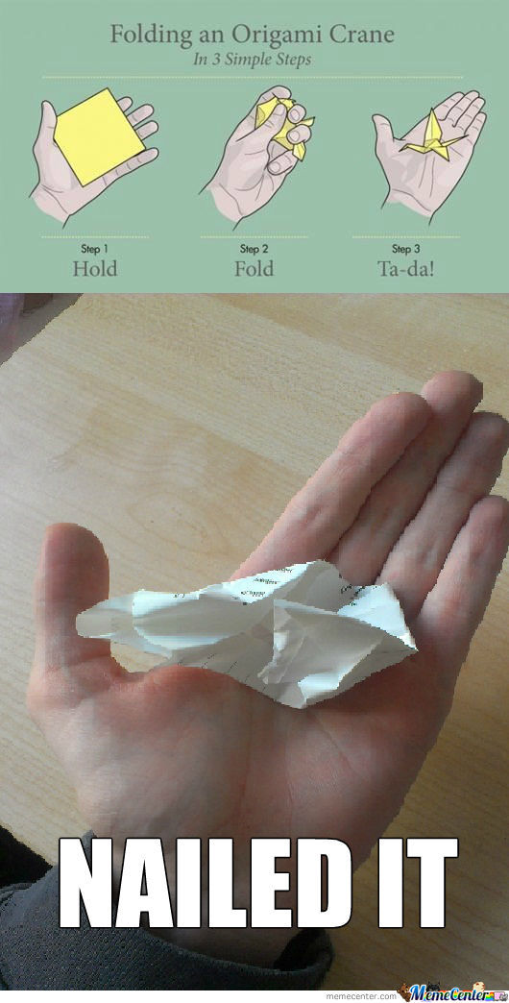

Slide 26
To be easier said than done

Slide 27
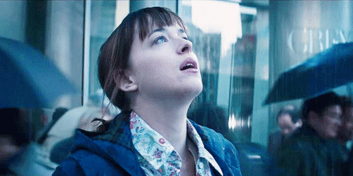

Slide 28
To take a deep breath

Slide 29
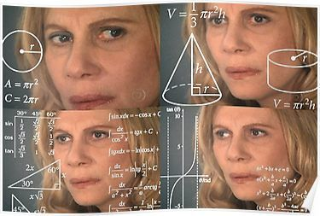
Confusing verbs

Slide 32
Avoid/Prevent
Avoid
Miss. If you avoid something you miss it, or try to make it miss you. You can avoid something or avoid something happening.
Prevent
I avoided the slap easily.
I avoided being discovered by hiding.
His hand prevented the cup falling.
Preventing something means stopping it, often before it has happened.
The arrival of the police prevented crime.

Slide 33
Wait/Expect
Wait
We use wait when we refer to letting time pass because we are expecting that something is going to happen.
Expect
We use expect to say that we believe that something will happen.
Don’t worry. I’ll wait for you.
We expect to move into our new flat next week.

Slide 34
Hope/Wish
Hope
We use hope when we do not know whether something will happen or not but we want it to happen.
Wish
We use wish when we regret or are sorry that things are not different. We imagine a different past or present:
I think you were hoping to see your family next week.
I wish I had his mobile phone number; we could tell him the good news.

Slide 35
They expect to pass the exam
They hope to pass the exam
They wish they could pass the exam

Slide 36
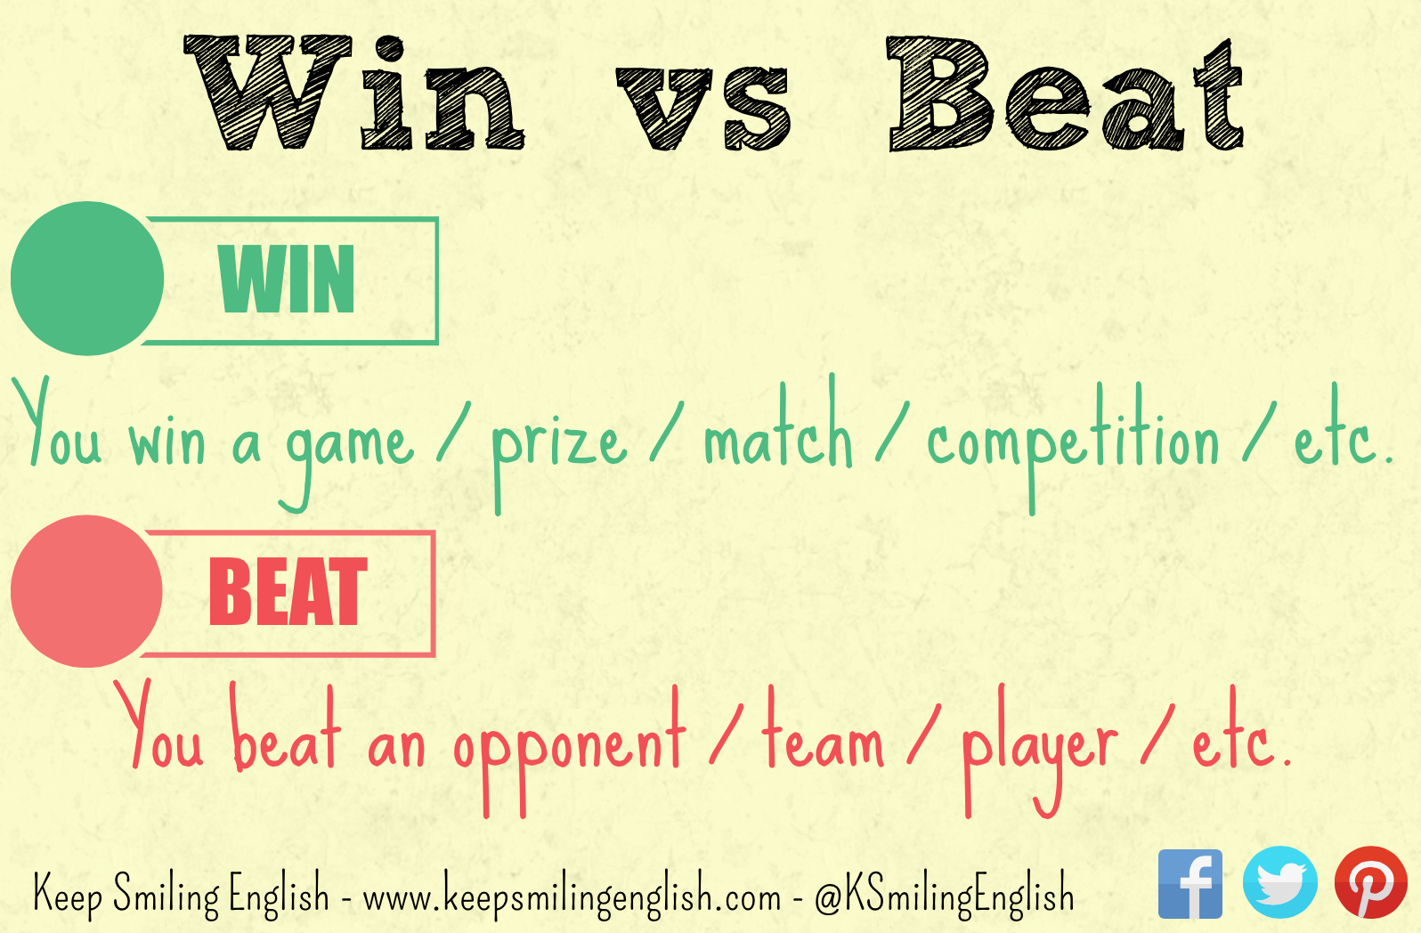
Win /Won/Won
Beat/Beat /Beaten

Slide 37
Mind/Matter
Mind
It means 'dislike, be annoyed by or object to'. If someone says I don't mind, it means that they have no preference or that they are happy for something to happen.
Matter
The verb matter can mean 'be important'. If we say 'it doesn't matter', it means that the thing that we are talking about is not important or not significant.
I don't mind having tea or coffee.
Does he mind you arriving a little late?
It doesn't matter what we have for dinner.
It doesn't matter where you go. I will always be with you.

Slide 38
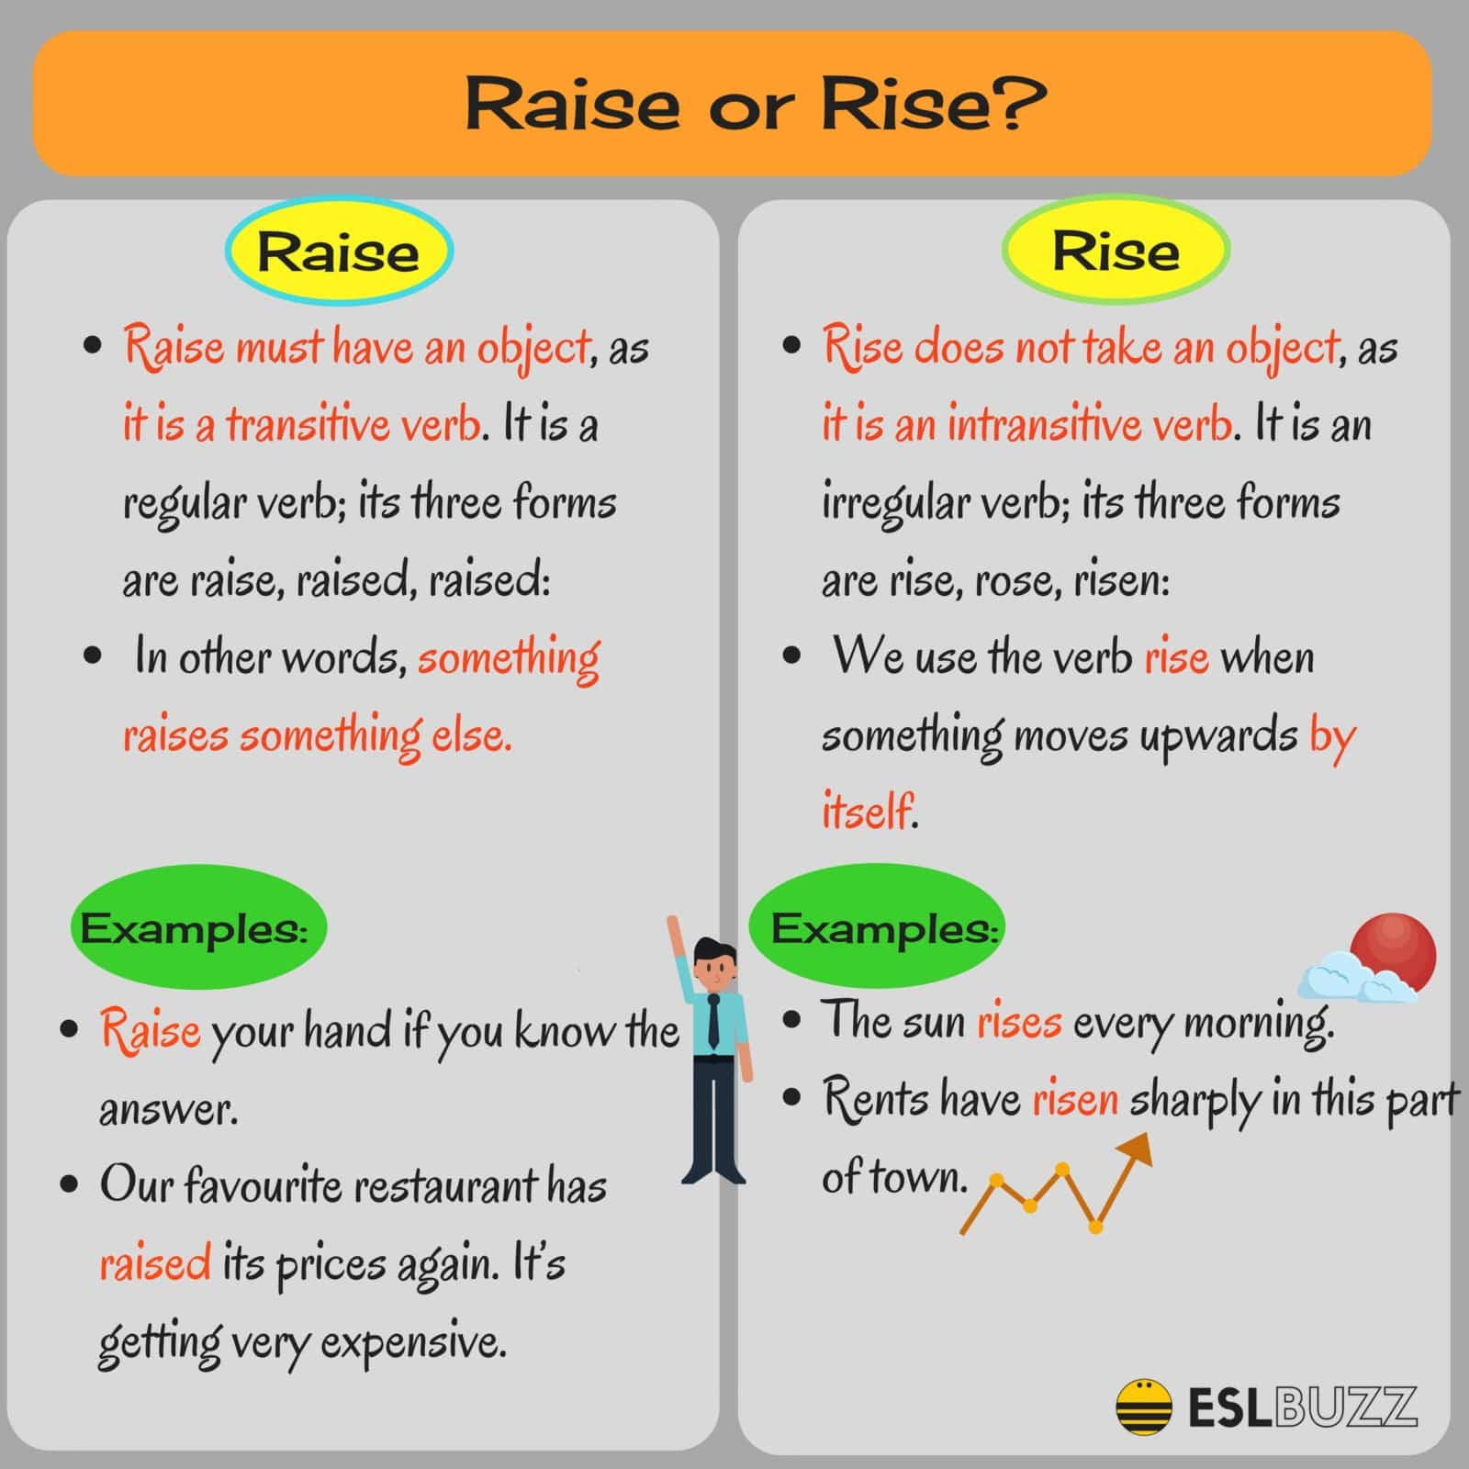

Slide 39


Raise /Rise

Slide 40
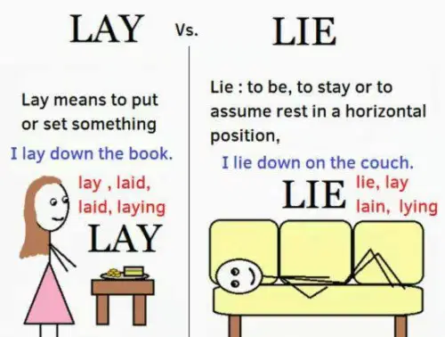
Lay/Lie

Slide 41
LET´S PRACTICE

Slide 42
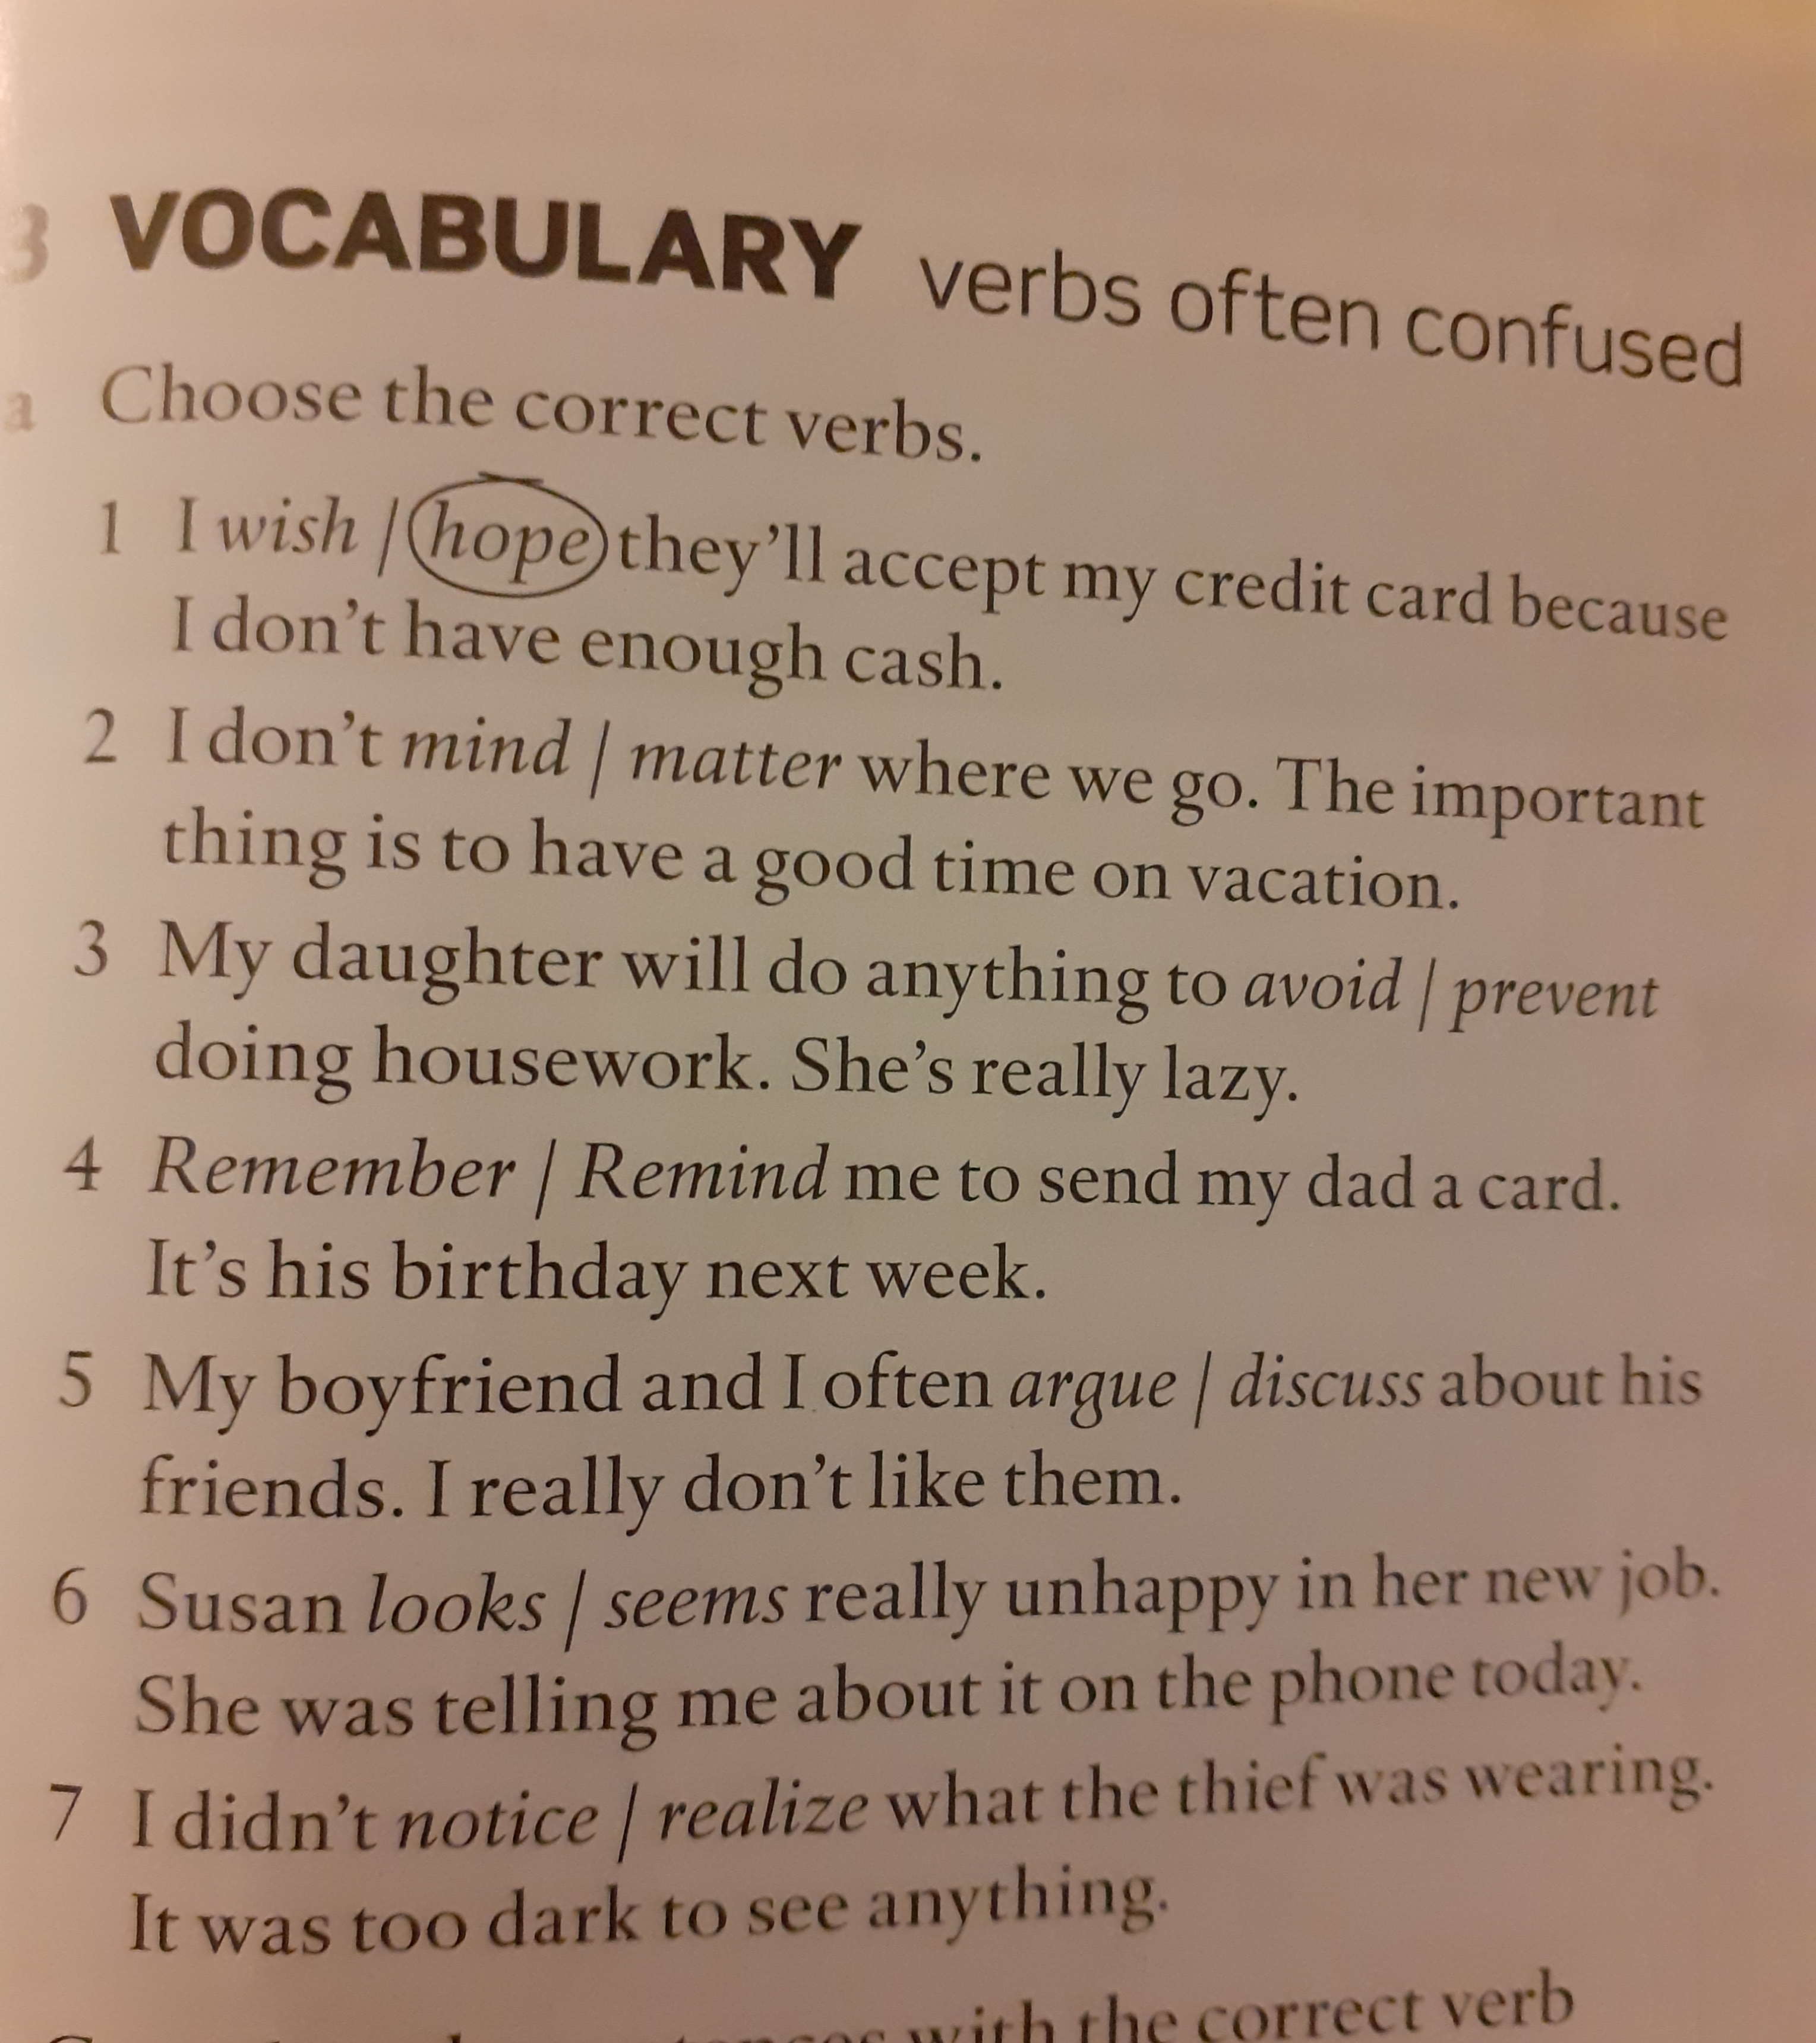
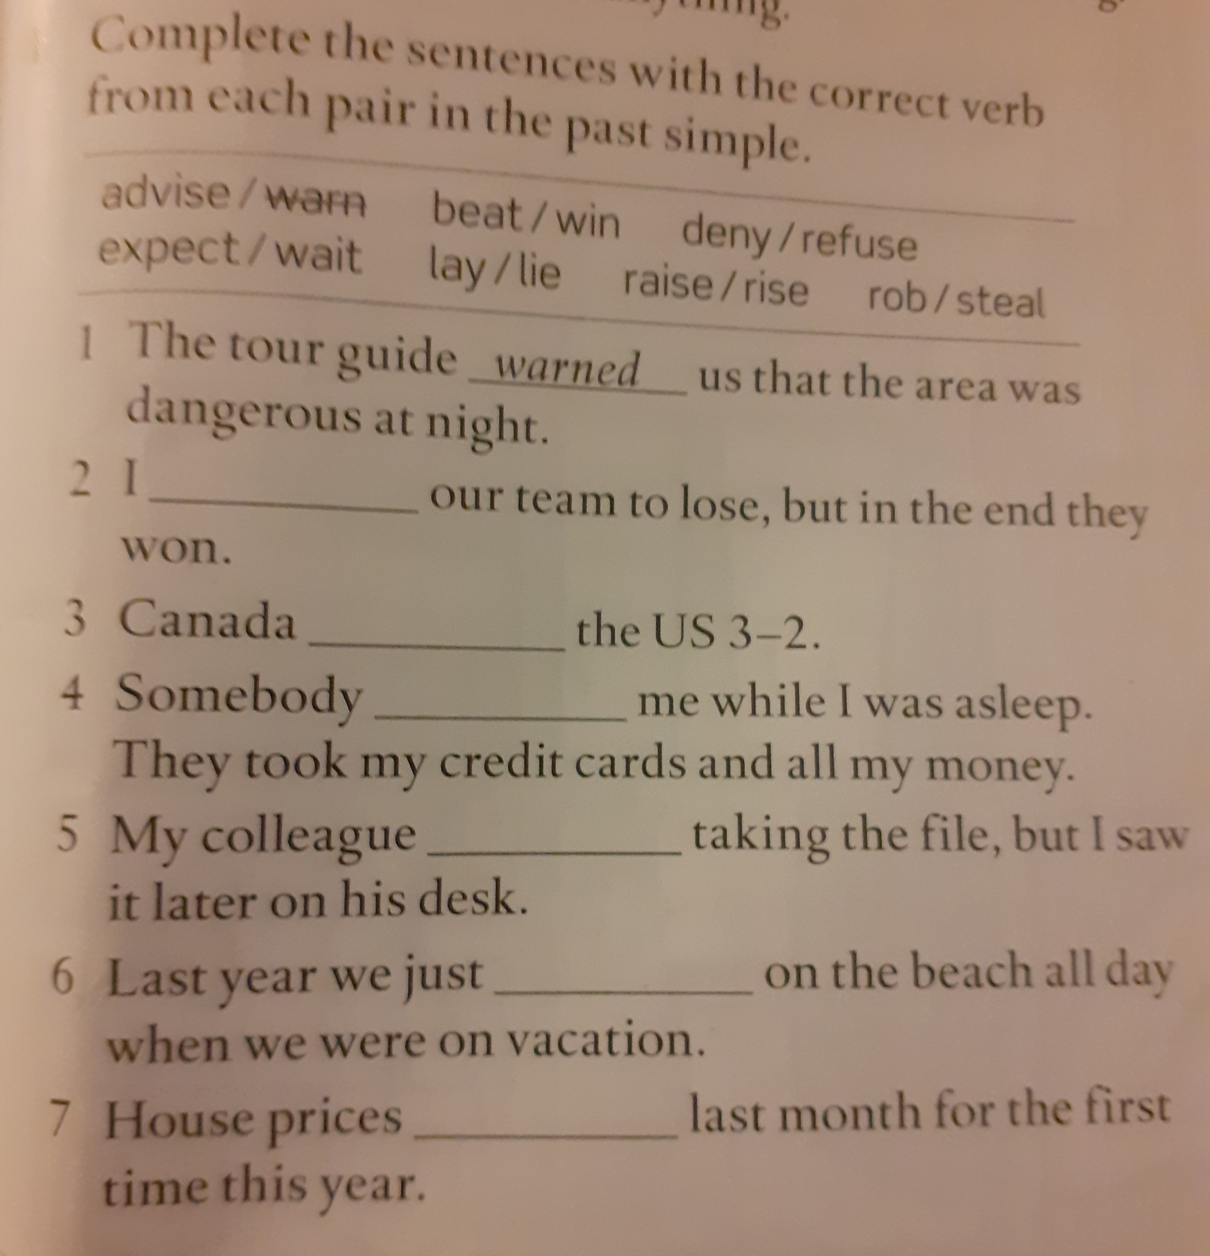
LET´S PRACTICE

Slide 43
Speaking!
Answer the questions. Include the following words/expressions in your answers
To avoid – easier said than done – to stick to the point – To realize – to advise - to refuse – to matter – to remind

Slide 44
Speaking
Which member of your family do you argue with most? Why? Do you think you would argue less often if you did not live with this person?
What was the last thing you argued about with your parents? Explain. Do you think you could have avoided the confrontation?
Did you use to argue with your parents more often before you started university?
When did you last argue with a friend or classmate? What would you have done if the argument had escalated?
Have you ever regretted saying something in an argument you wish you had not said? Explain.

Slide 45
SPEAKING
When was the last time you lost your temper in an argument? Why do you think that happened?
Try to remember the last argument you had with your girlfriend/boyfriend or with a friend. Is there anything you or the other person should not have said? Give details.
Do you think the following are good tips to help people deal with arguments?
do not raise your voice.
apologize if something is your fault.
use a mediator.
postpone the argument if you think you will not reach an agreement.
When was the last time you followed the tips above? Was it a good idea to follow them? Why (not)?
In your opinion, what is important to remember in order to argue constructively or respectfully?

Slide 46

Vietnam!

Slide 47
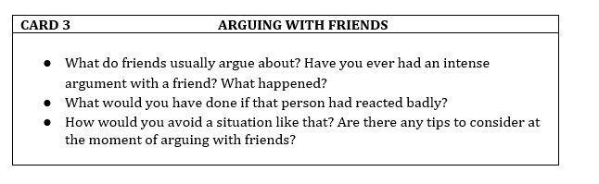

Slide 48

To keep things under control
To reach an agreement
To bring up
To argue
To blame
To take a deep breath
To win
To shout
To avoid
Arguments
To lose your temper
To be easier said than done
Furious
Mad at sb
To postpone
To calm down
Angry
Fault
To stick to the point
To deal with conflict
To be IN the wrong

Slide 49
REFERENCES
https://www.bbc.co.uk/learningenglish/course/eiam/unit-1/session-30
https://keepsmilingenglish.com/2015/05/confusing-verbs-9-win-vs-beat/
https://www.bbc.co.uk/learningenglish/course/eiam/unit-1/session-43
https://www.eslbuzz.com/confusing-words-raise-vs-rise-job-vs-work/
http://editing.xterraweb.com/writing-tips/lay-vs-lie
https://safenglish.wordpress.com/2017/09/26/lay-vs-lie/

