Slide 1
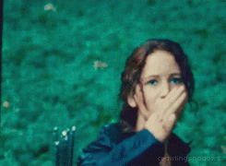
PAST Modals game!

Slide 2
Step 1: Your teacher will show a message with a situation.
Step 2: You will create a sentence about the situation using one of the modal verbs for speculation in Past: must+have, may+have, might+have or can´t+have.
Step 3: Once you have your sentence, raise your hand, say I love my English class and enjoy your victory!

Slide 3
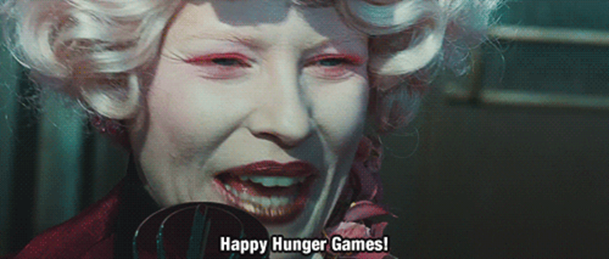

Slide 4
Possible answers: They must have celebrated the end of the semester.
They may have partied in campus.
They might have drank Kevin.
They can´t have done a a party on Mondays.
The party was legendary

Slide 5
Situation 1
“You are falling asleep in the English class.”

Slide 6
Situation 2
“I´m getting thinner and thinner.”

Slide 7
Situation 3
“She got really sick last night.”

Slide 8
Situation 4
“Nicolas is broke…again.”

Slide 9
Situation 5
“Felipe crashed his car.”

Slide 10
Situation 6
“Students do not want to open U-cursos.”

Slide 11
Situation 7
“There is a funny smell in the classroom.”

Slide 12
Situation 8
“Camila didn´t tell her parents the secret.”

Slide 13
Situation 9
“Your teacher is wearing sunglasses in the classroom.”

