Slide 1
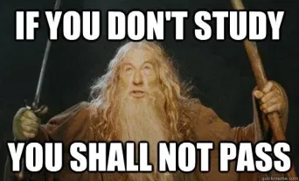
UNIT4
7A EDUCATION
By misscarosama

Slide 2
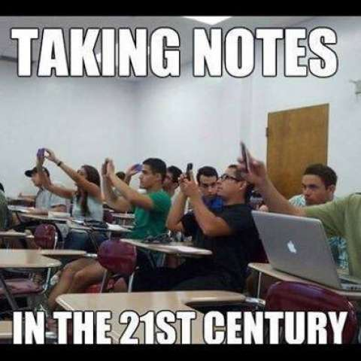

Slide 3
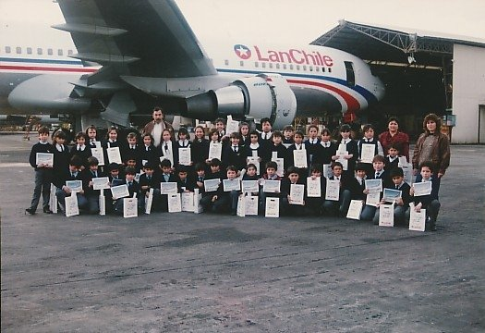
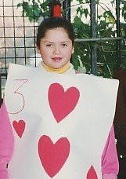
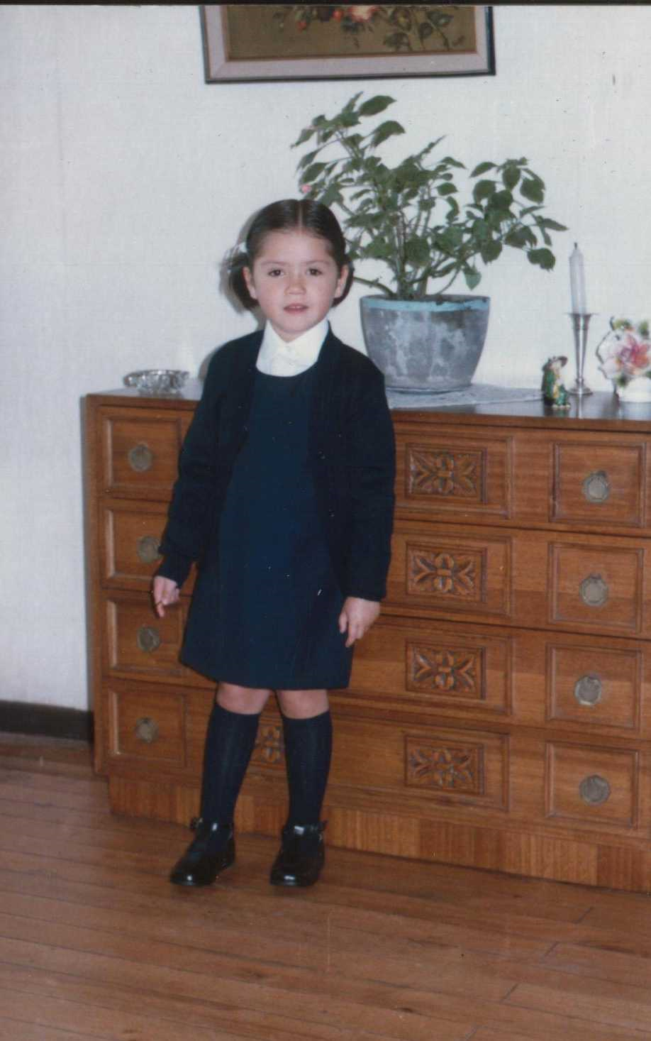
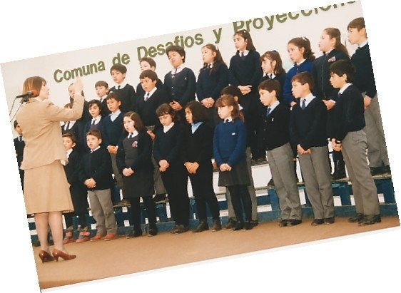
When carol was at school…

Slide 4
vocabulary

Slide 5
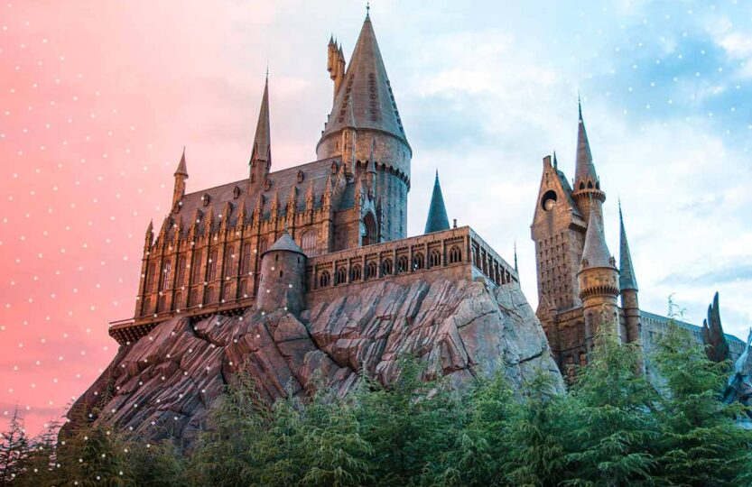
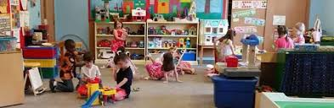
vocabulary

Slide 6
vocabulary

Slide 7
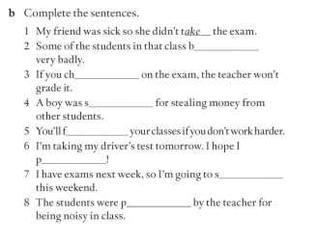
Vocabulary practice

Slide 8
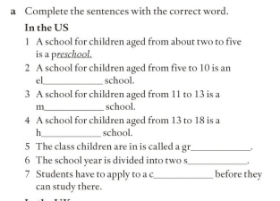
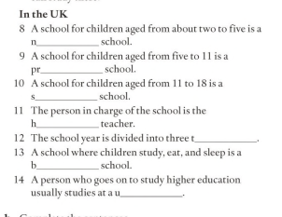
Vocabulary practice

Slide 9
Debate time
Boys and girls both learn better in single sex schools
Schools should let children wear whatever they want at school
Cooking and housework should be taught at school
Schools don´t teach children the important things they need to know to be an adult
Physical education should be optional

Slide 10
Debate time
School summer vacations should be shorter
Children spend too much time at school on math and IT and not enough on things like music, art and drama
Private schools are usually better than public schools

Slide 11
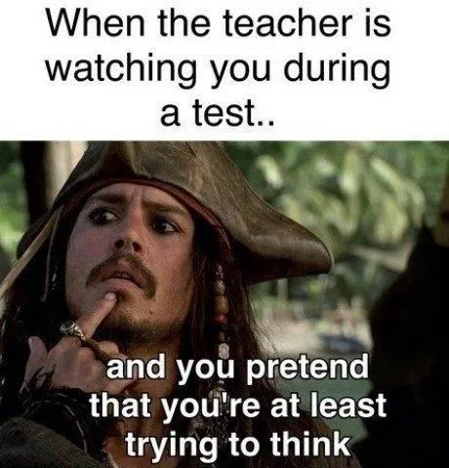
Tests
When was the last time you took an exam? Did you pass or fail?
How do you feel before you take an exam?
What do you usually do the night before an exam?
Have you ever failed an important exam you thought you had passed (or vice versa)?
What is the most important test you have ever taken?

Slide 12

tests

Slide 13


If I don´t pass the test, my parents will kill me.
My parents will kill me if I don´t pass the test
FIRST CONDITIONAL
Present Simple
Will-can-may/Imperative

Slide 14
As soon as I pass the test, I will celebrate.
FUTURE TIME CLAUSES
Time markers
Present Simple
Will
When
Until
Before
After

Slide 15
Let´s practice

Slide 16
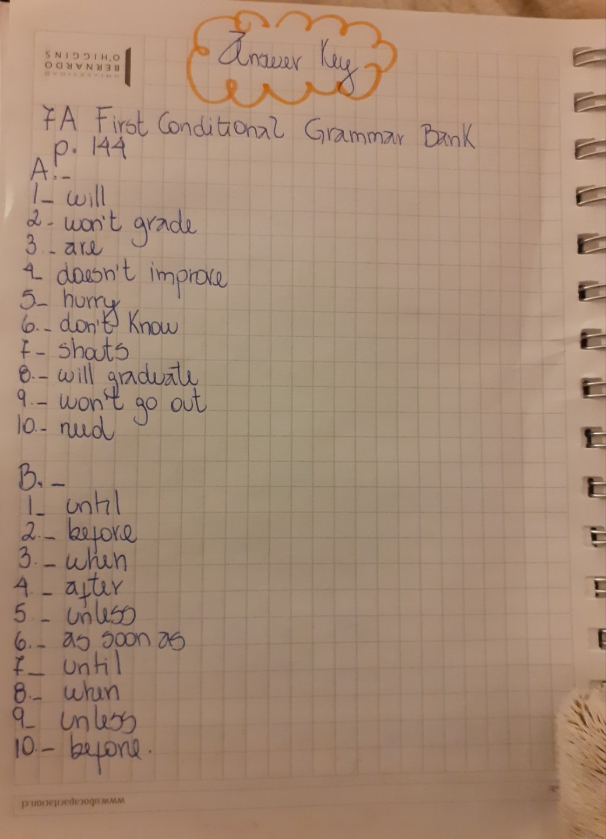

Slide 17
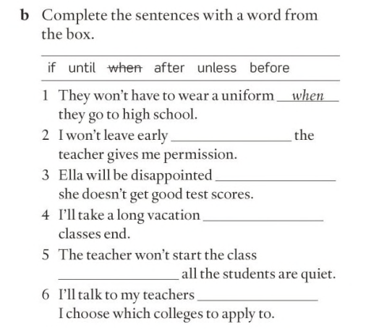
Let´s practice

Slide 18
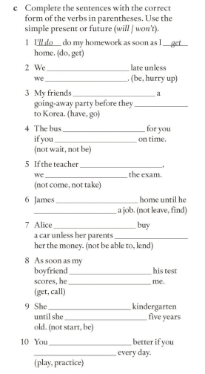
Let´s Practice

Slide 19
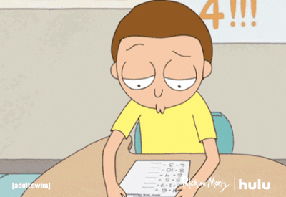
What would you study if you didn´t
study in Beauchef?

Slide 20



If I didn´t study in Beauchef, I would study cooking.
I would study cooking, If I didn´t study in Beauchef.
SECOND CONDITIONAL
Past Simple
Would/Could/
Might

Slide 21

HEY! WATCH OUT
BE CAREFUL

Slide 22



SPECIAL CASE IN SECOND CONDITIONAL
If I was younger, I would travel to live in another country.
If I were younger , I would travel to live in another country.
Both are correct!!
WAS
INFORMAL
SPOKEN ENGLISH
WERE
FORMAL
WRITTEN ENGLISH

Slide 23
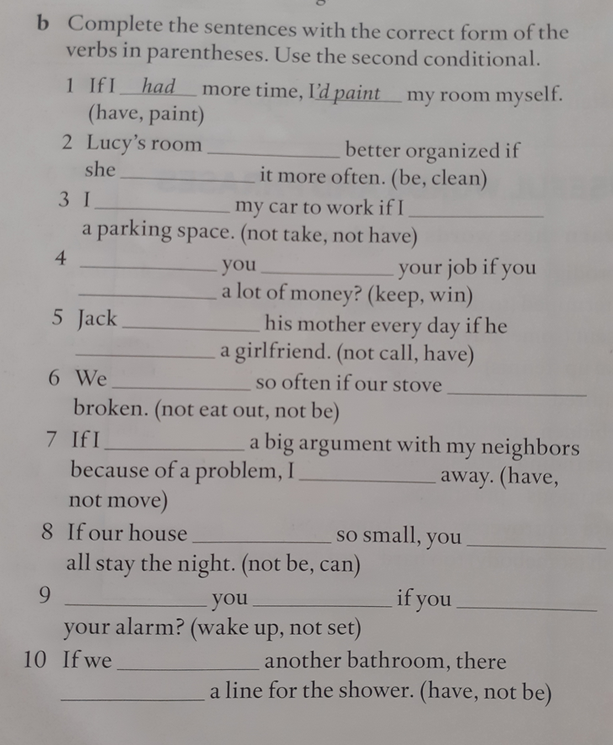
LET´S PRACTICE

Slide 24
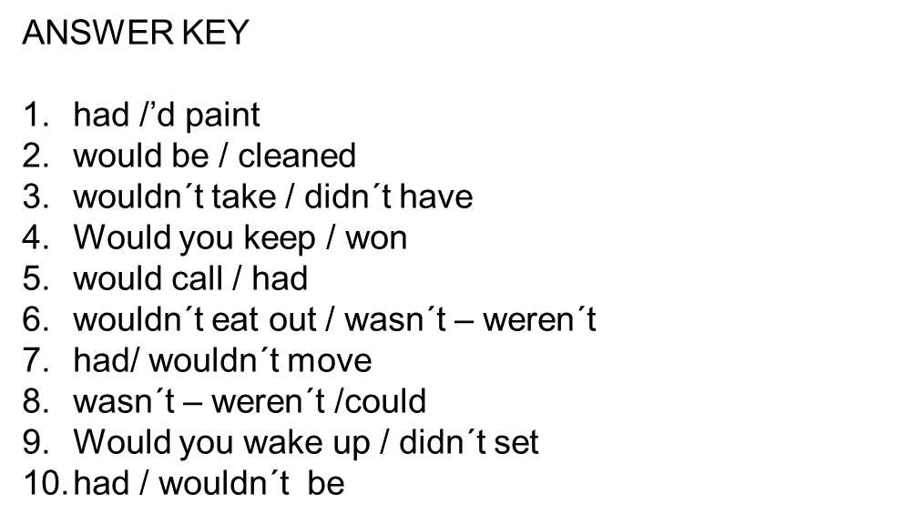

Slide 25


First conditional v/s Second Conditional
Have you seen this guy?

Slide 26

IN CONDITIONALS EVERYTHING IS ABOUT…
SO, HOW DOES JASON MOMOA CONNECT WITH ENGLISH CONDITIONALS?

Slide 27
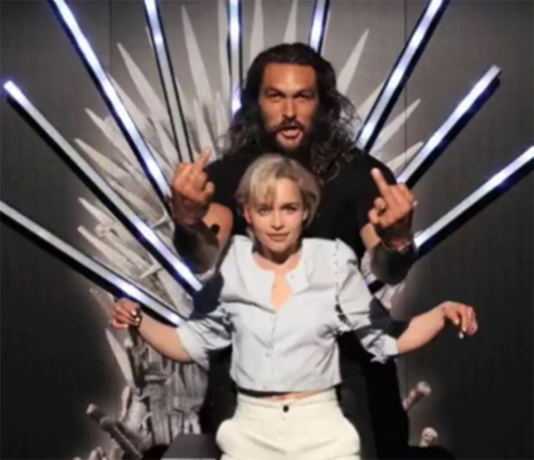
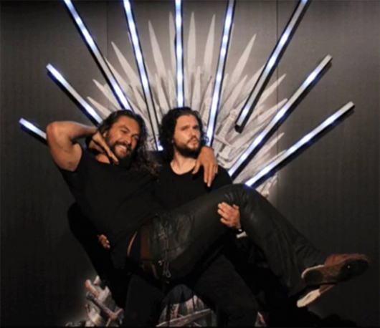
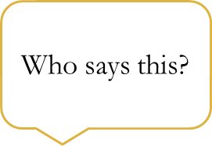

First Conditional
If Jason forgets his part of the script, I will help him memorize it.

Slide 28
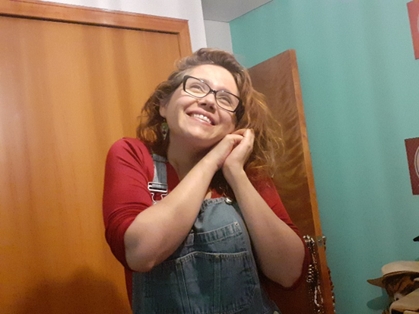
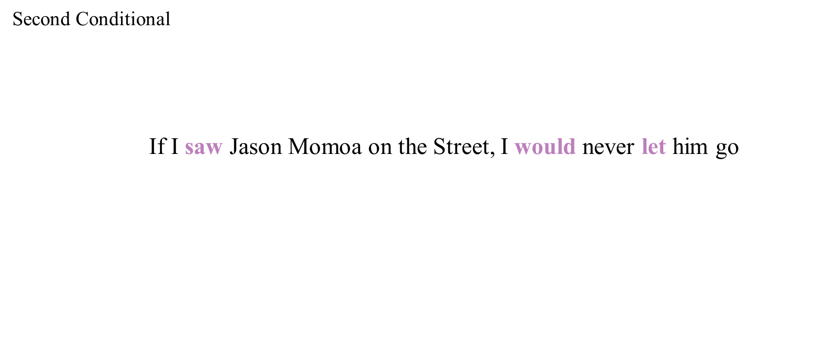
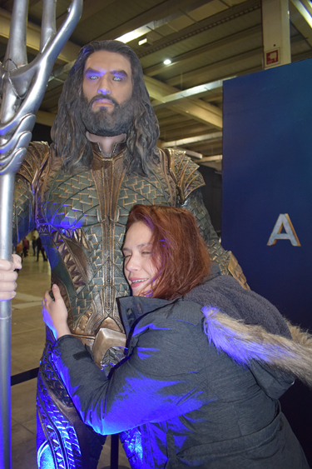

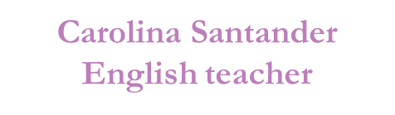

Slide 29
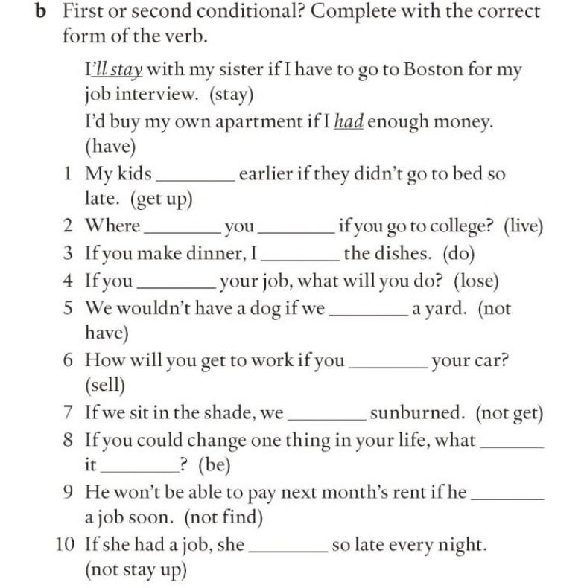
LET´S PRACTICE

Slide 30

If you had to choose one thing , only one thing
to change from the Chilean
educational system, what would you change?

Slide 31
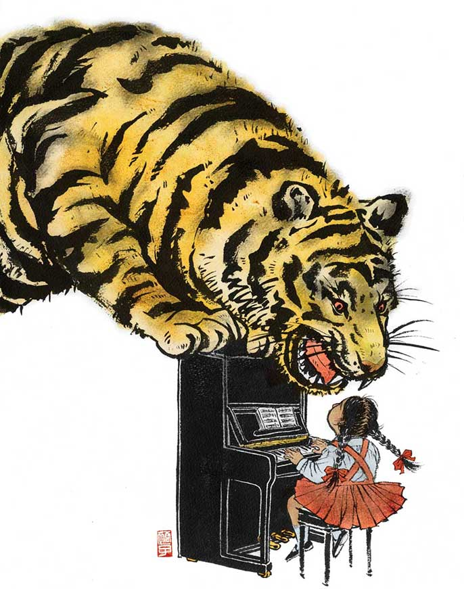
Reading : What is a tiger mother?

Slide 32
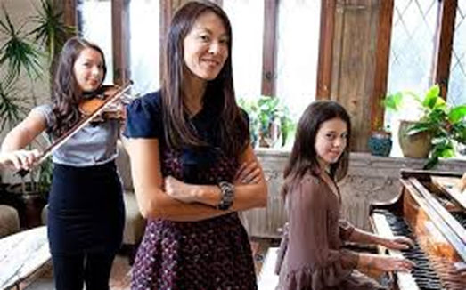

Slide 34
The Tiger Mother
Delighted
Prodigy
To forbid
To wonder
To excel in
Outstanding
To rebel
To give up
To take up
To resent
To bring up

Slide 35

VIETNAM!

Slide 36


Classmates
Senior
Students
To Raise
Student Union
Teaching Assistant
Degree
Library
Professor
Homework
College
To attend
Exams
Private
To apply
Program
Lab
Freshmen/women
Relief
Education
Grands
To be suspended
Desks
Schedule
Subsidized
Principal
Classrooms
To bring up
Lecturer
To be expelled
Public
To fail/ To pass
To be in charge of
To behave: Well/Badly
Tutors
Subjects

Slide 37
