Slide 1


MONEY $$$$
UNIT 1 2A
BY @MISSCAROSAMA

Slide 2
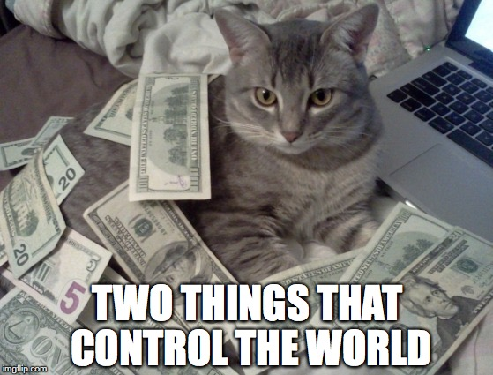
GET IN GROUPS AND ANSWER THE QUESTIONS
Where do you get your money from?
What do you do with it?
Are you good at making money?

Slide 3
Vocabulary

Slide 4

Vocabulary
To spend ON
To invest IN

Slide 5
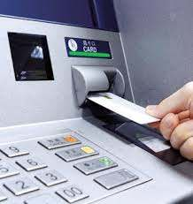
Vocabulary

Slide 6


Slide 7
Activity

Slide 8
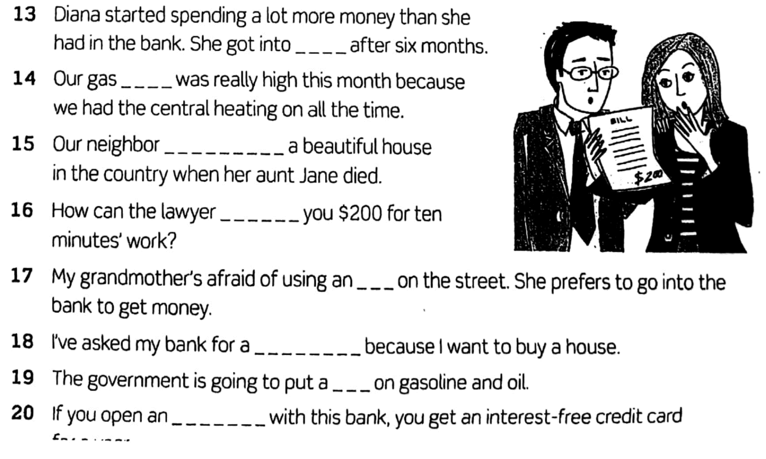

Slide 9

VIETNAM!

Slide 10
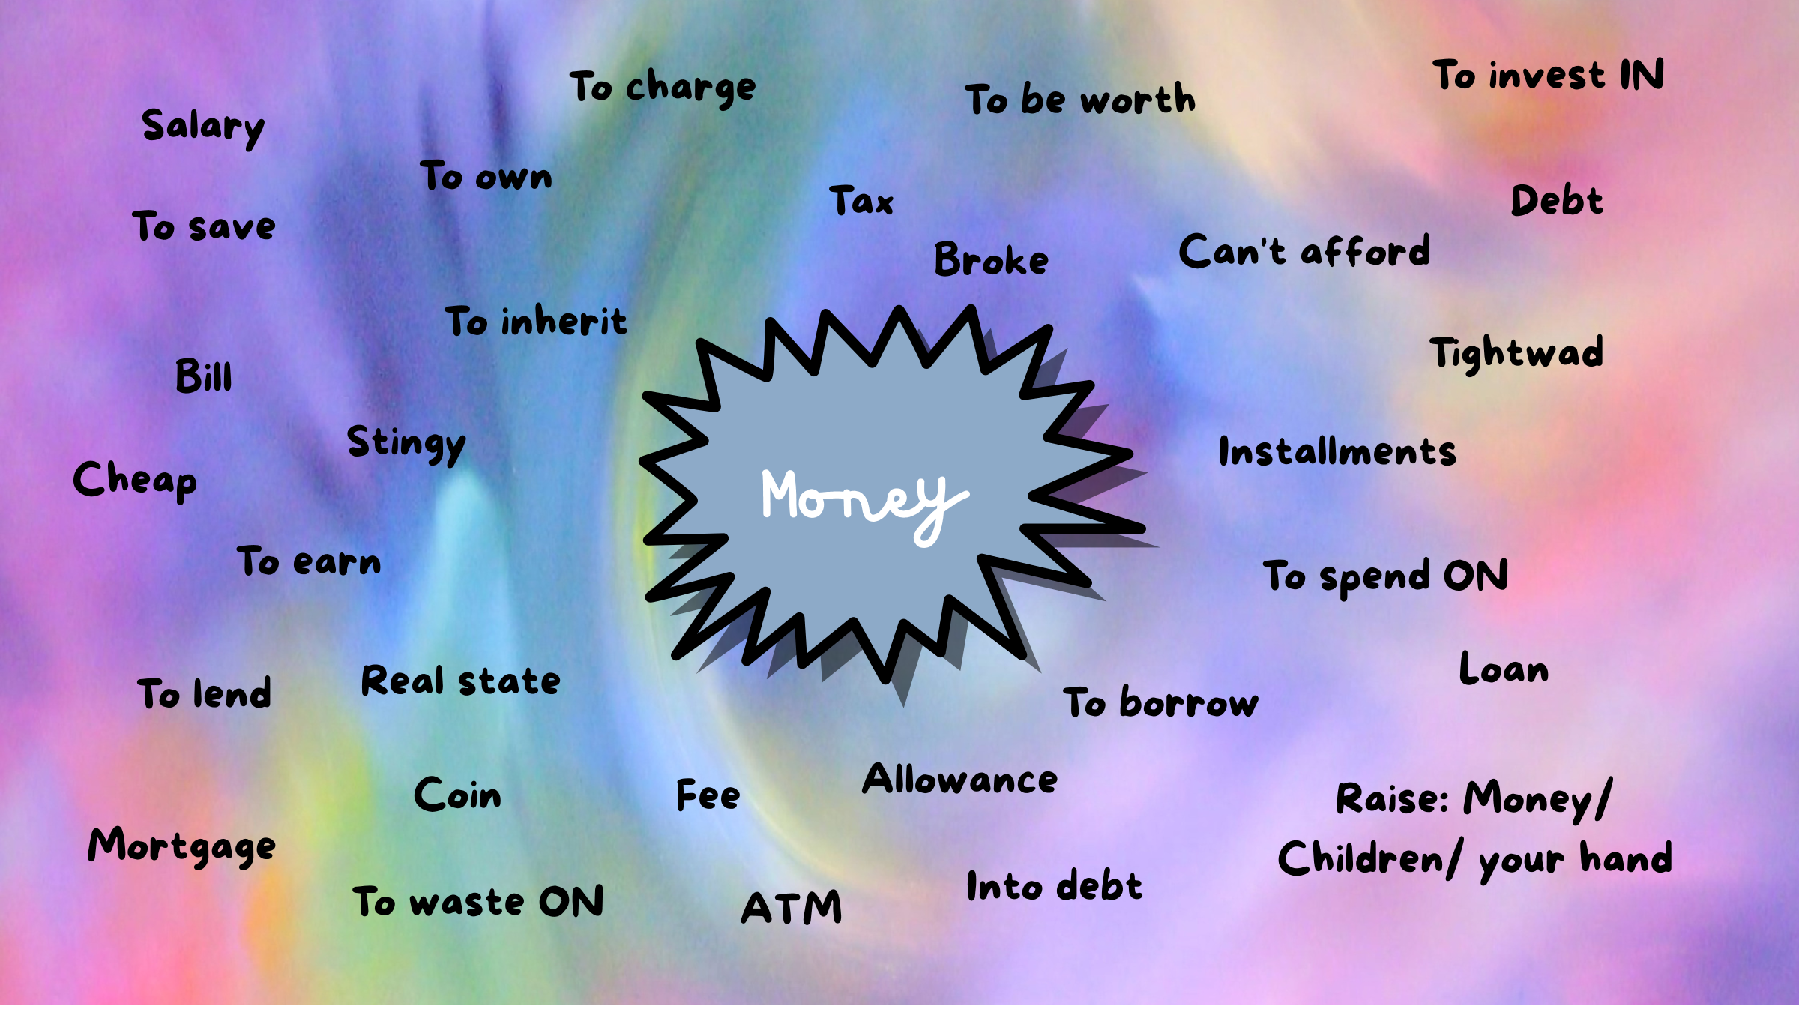

Slide 11
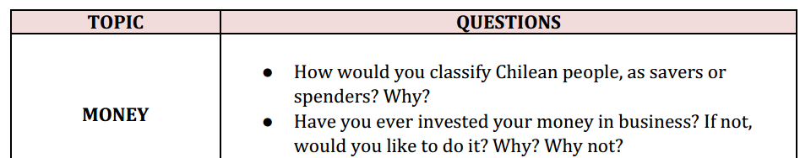

Slide 12





Speaking

Slide 13





Slide 14

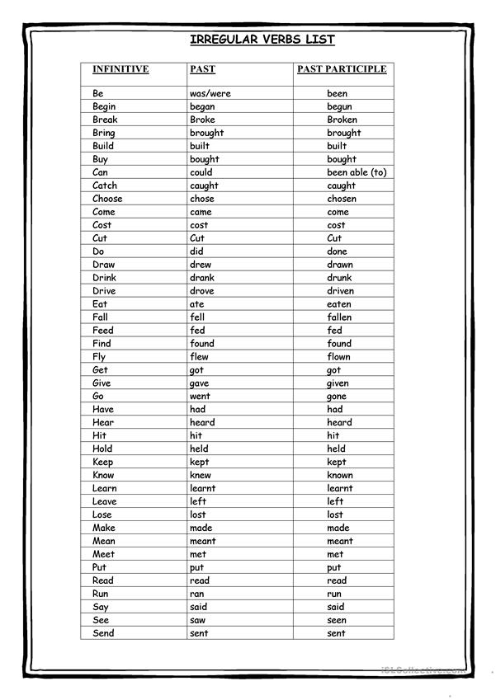
THE PRESENT PERFECT
I have worked at Beauchef for 18 years
have/haven´t + past participle
has/hasn´t (she, he, it)

Slide 15

Watch out!
Be cautious
The Present Perfect is your enemy

Slide 16
Use 1 : Ongoing action from the past
I have worked AT beauchef for 18 years
I have worked at Beauchef since 2006
2006
now

Slide 17


Use 2: Indefinite past
I have visited La Serena twice
I visited La Serena in 2018 (You know when)

Slide 18
Use 3: Recent past
I have washed my hair
v/s
I washed my hair

Slide 19
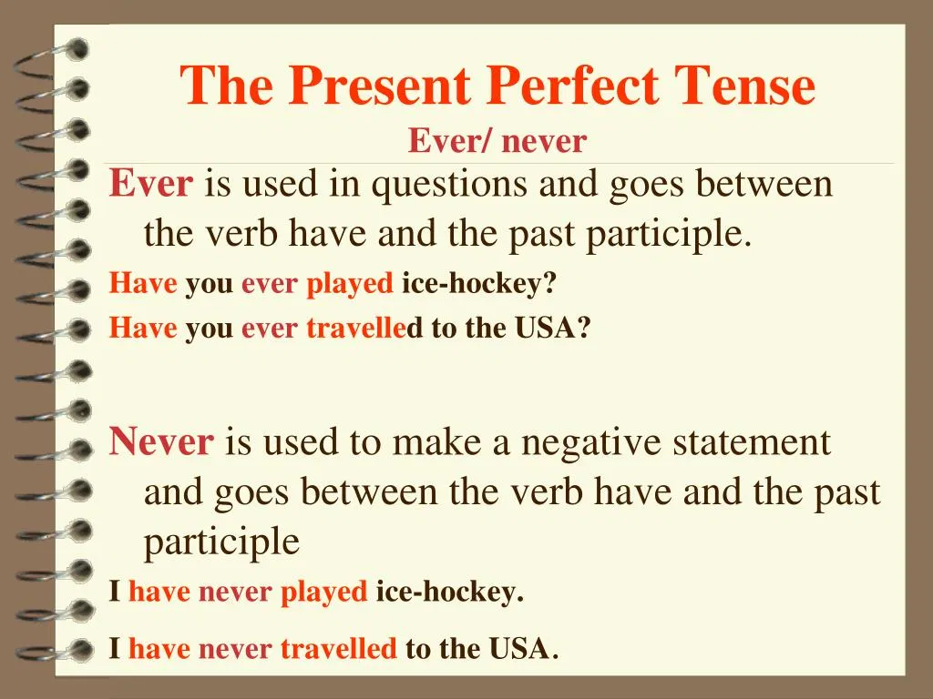
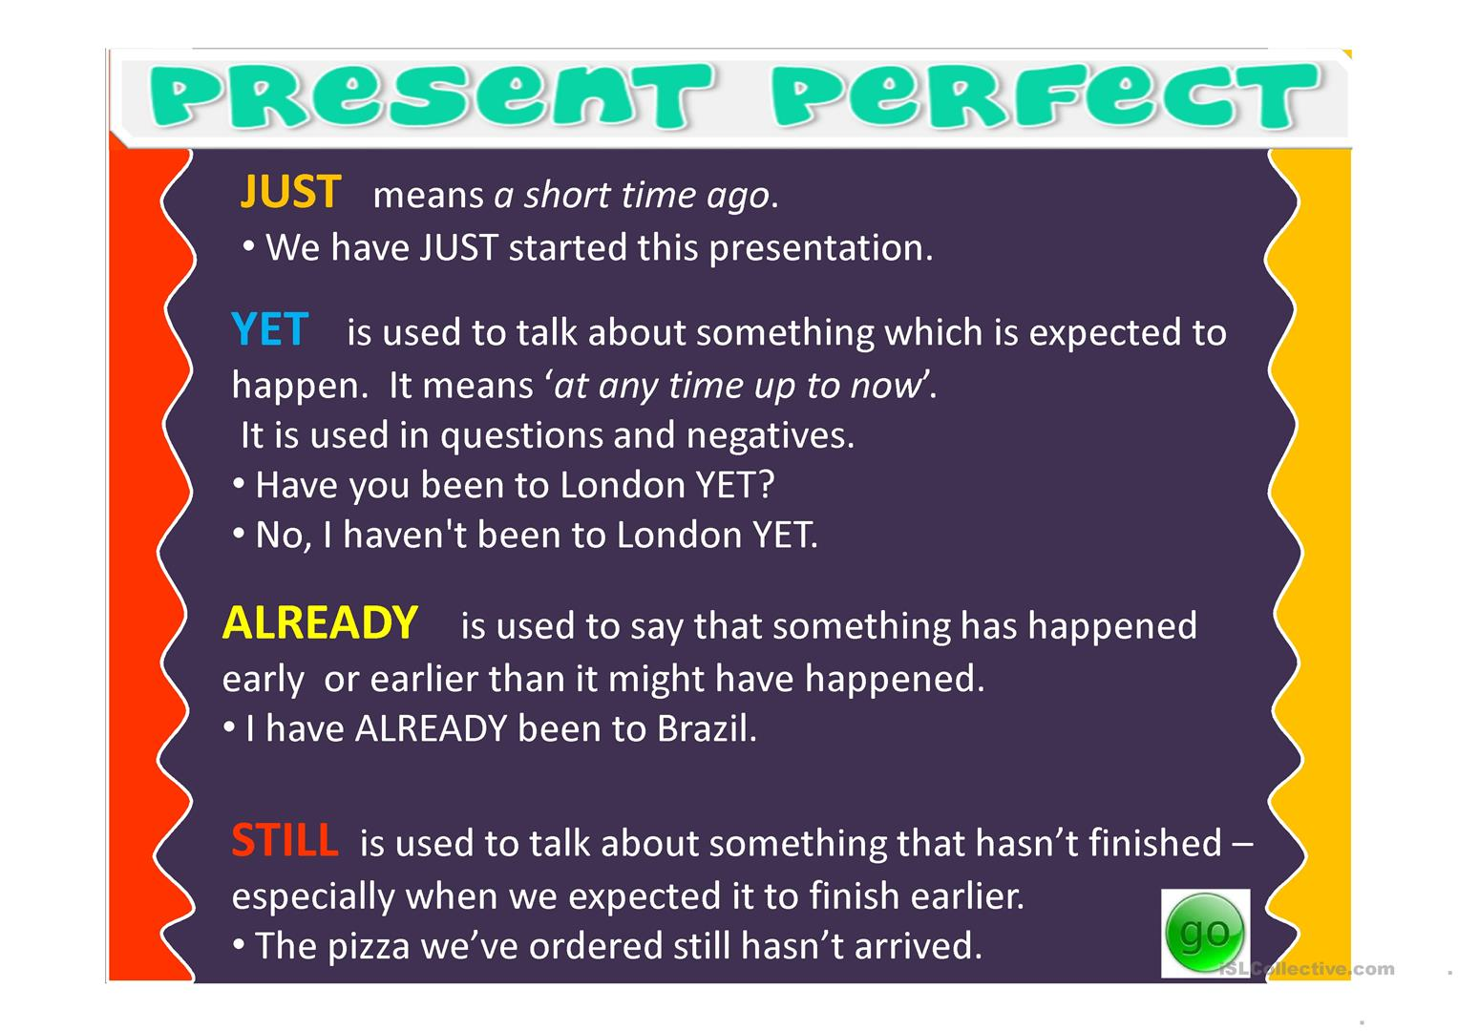

Slide 20

PAY ATTENTION…
He has been TO Atacama
(Twice in my life but not now)
He has been in Atacama
(For 5 years, I´m still there)
He has gone to Atacama
(He is visiting Atacama and is still there)

Slide 21
Let´s practice

Slide 22
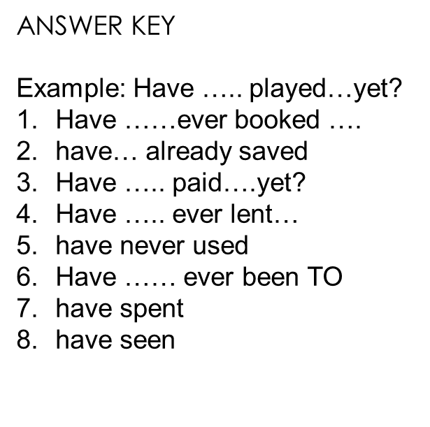

Slide 23
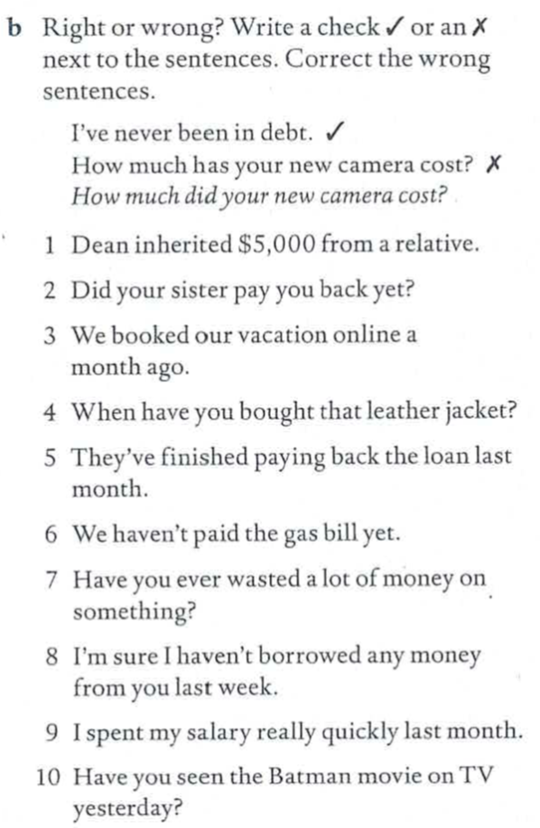
Let´s practice

Slide 24
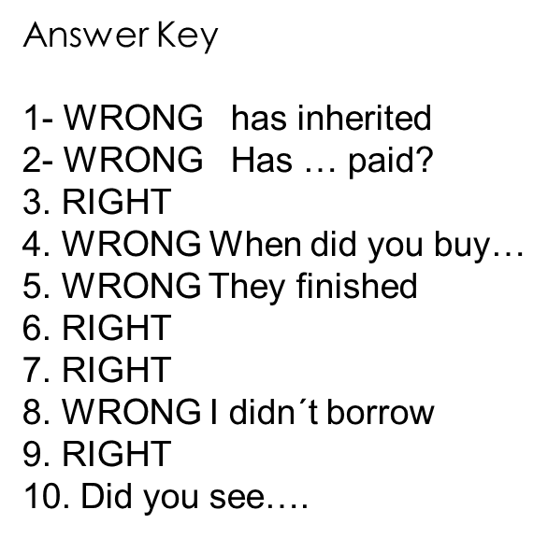

Slide 25
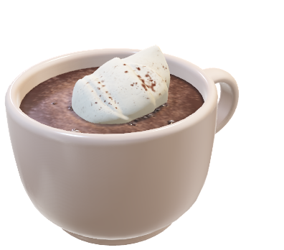
Let´s play…
Never have I ever
The first player starts by saying a simple statement about what they have never done before starting with "Never have I ever".
Anyone who at some point in their life has done the action that the first player says, must drink.
Then the game continues around the circle, and the next person makes a statement.

Slide 26
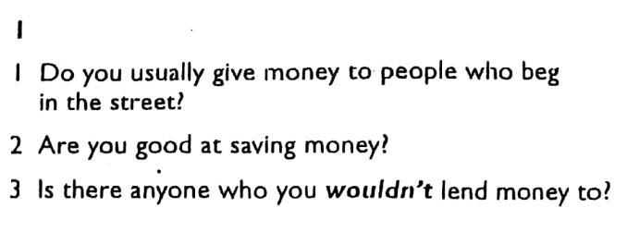
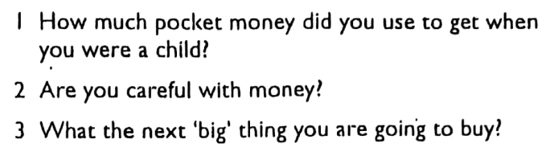
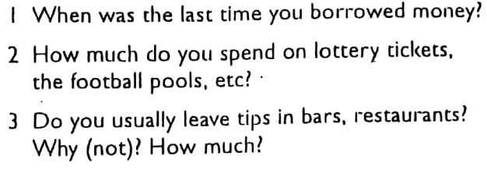
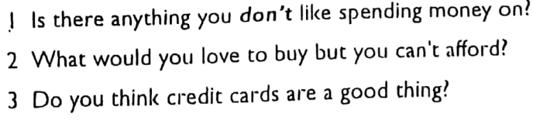
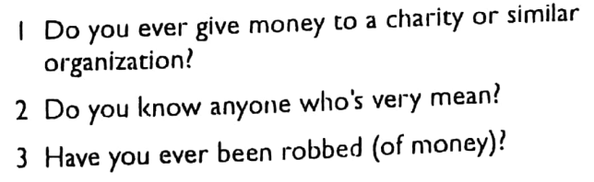

Speaking

Slide 27
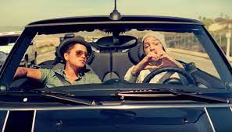
KARAOKE TIME
https://www.youtube.com/watch?v=TWWc7YnOojU&ab_channel=MusisiKarao

