Slide 1
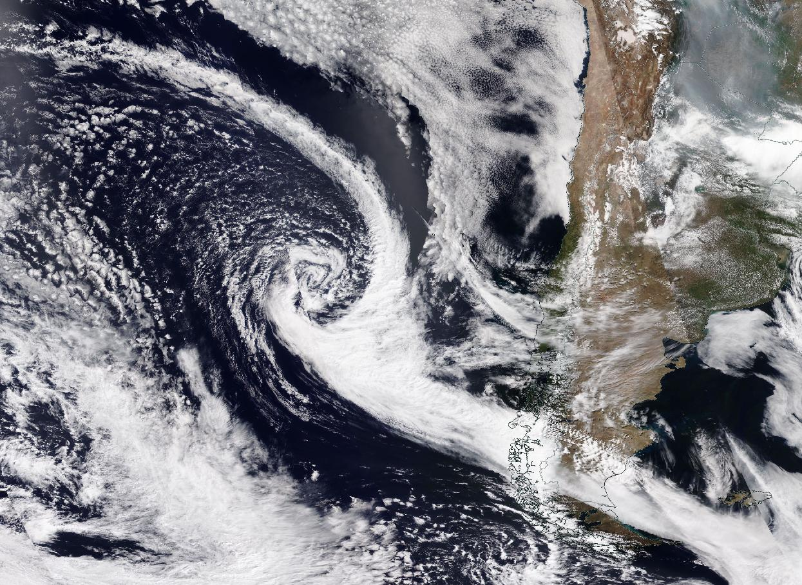

Slide 2
Oeste
Centro
Este
T, Td
T, Td
T, Td
u,v
u,v
u,v

Slide 3


Slide 4
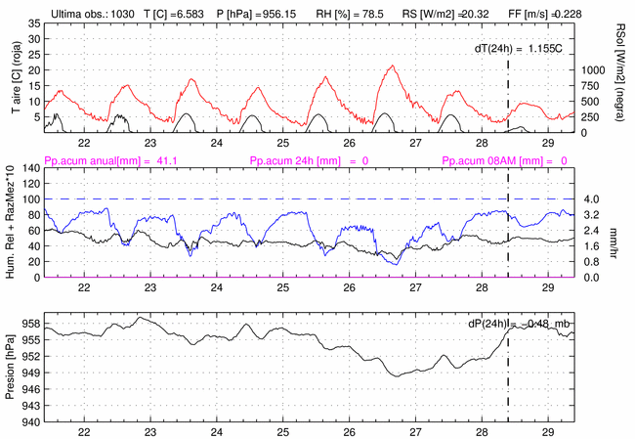
Figura 2

Slide 5
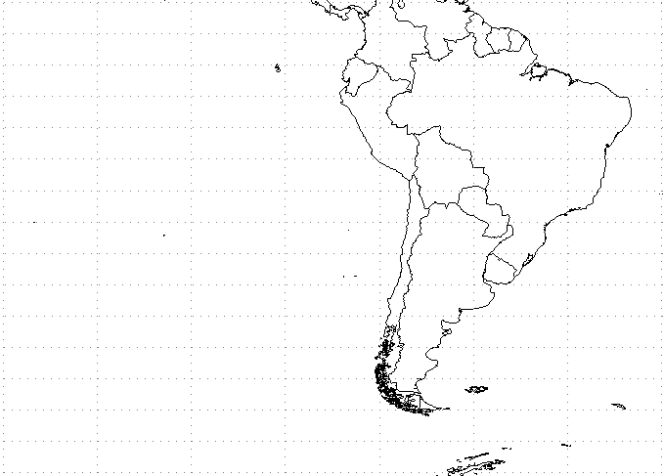
Mapa de apoyo P2

Slide 6
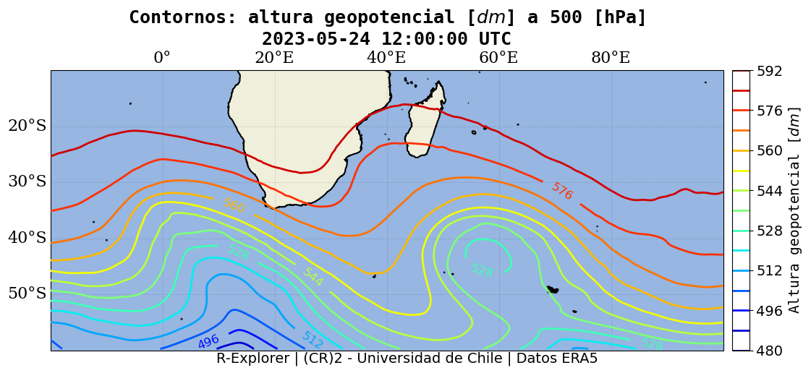
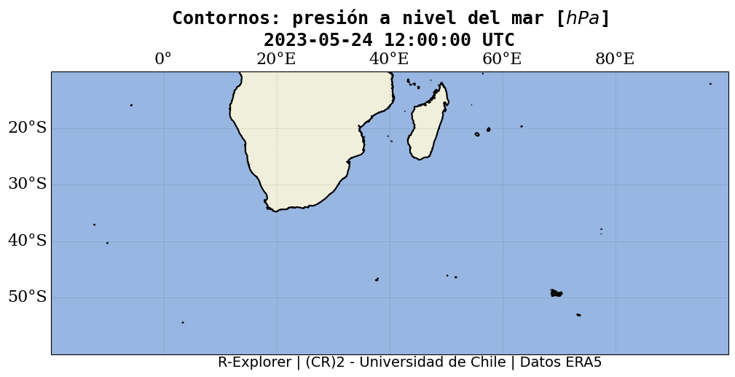
Figura 3

Slide 7
Figura 4

Slide 8
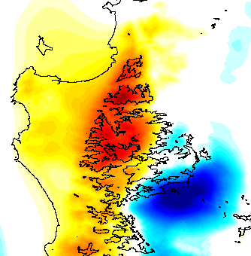
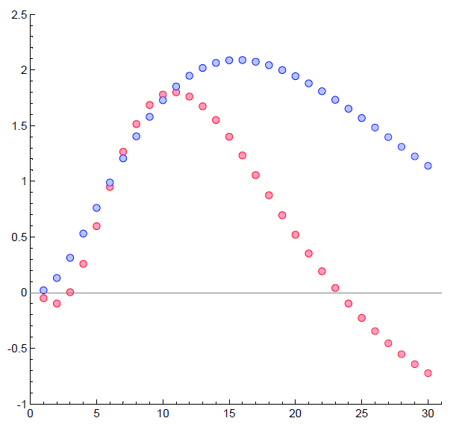
Figura 5
LT model over actual topography
forced by NW flow
Upstream
enhancement
P_{upstream} and -P_{downstream} [mm/hr]
Downstream
suppression
Downstream
Enhancement!
Wind speed [ms⁻¹]

