Slide 1
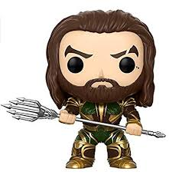
UNIT 5A
The survivors´club or the unit about Jason Momoa
By @misscarosama

Slide 2
What about you?

Slide 3
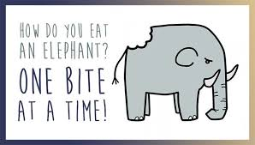
So, What is the best way to deal with this type of situations?

Slide 4


Slide 6
How would you react/feel in a life-or-death situation?

Slide 7
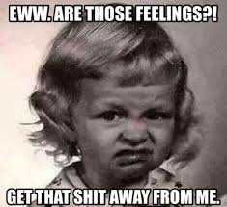
FEELINGS
IN BEAUCHEF

Slide 8
Vocabulary bank

Slide 9


Slide 10



Slide 12
SLANG
1. TO BE SCARED STIFF
2. TO LOOK/BE DOWN
3.TO BE WORN OUT
4. CAN´T /COULDN´T BELIEVE SB´S EYES
5. TO BE SICK AND TIRED OF
6. TO BE JUMPING FOR JOY

Slide 13
Let´s practise

Slide 14
Answer key
Thrilled
Bewildered
Horrified
Astonished
Stunned
Delighted
Devastated

Slide 16
ANSWER KEY
SCARED STIFF
SICK AND TIRED OF
DOWN
WORN OUT
COULDN´T BELIEVE HIS EYES
JUMPING FOR JOY

Slide 17

Get in groups.
2. Use the two expressions assigned by Carol and create a sentence with the SECOND CONDITIONAL.
3. The group that finishes first must stand up and say “i love my English Class” to get the point

Slide 18
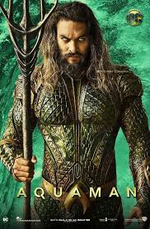
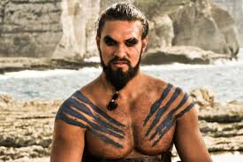
Have you seen this guy?

Slide 19

Now you may be wondering…
How does Jason Momoa relate with
English conditionals?
The level of probability of the events to happen depends on the Speaker

Slide 20
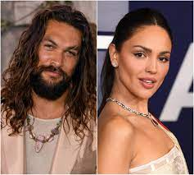

Zero Conditional
If/When Jasón wakes up, I kiss him on the cheek
PRESENT PRESENT
Who says this?
Jason Momoa´s bae

Slide 21
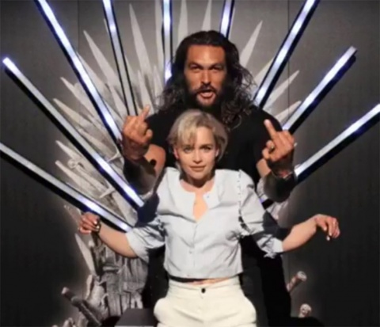
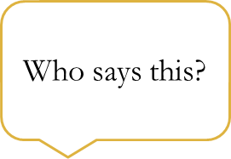
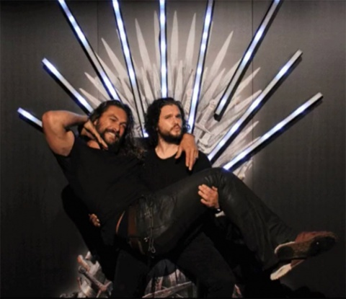
First Conditional
If Jason forgets his part of the script, I will help him memorize it.
PRESENT
WILL/CAN/MAY/IMPERATIVE
Emilia Clarke
Kit Harington
Jason Momoa´s coworkers

Slide 22
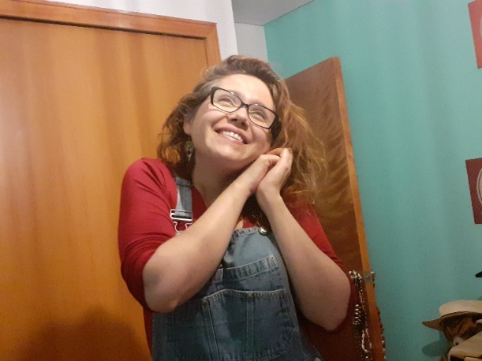

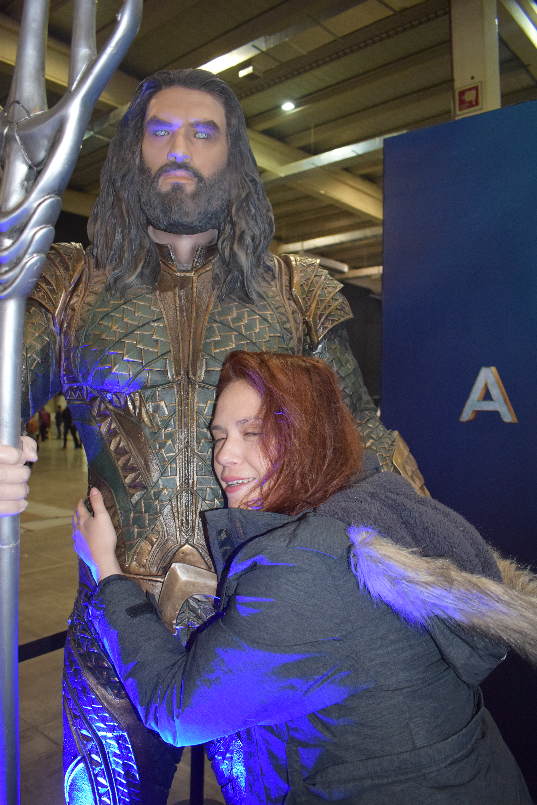
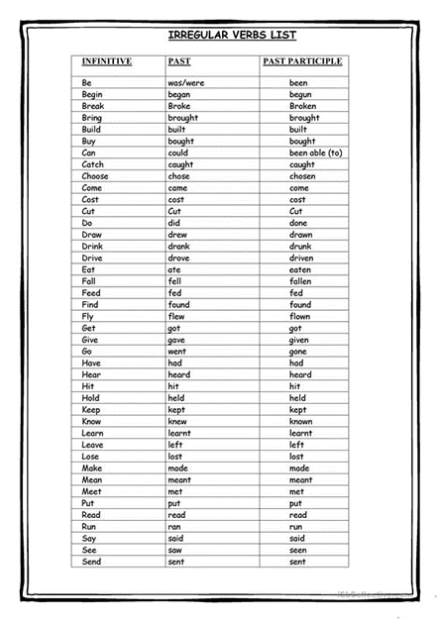
Second conditional
If I saw Jason Momoa on the Street, I would never let him go
PAST
WOULD/COULD/MIGHT
+
INFINITIVE
Carolina Santander
English teacher

Slide 23

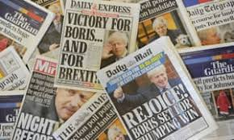

Third Conditional
If Jason had rejected Kal Drogo´s part, he wouldn´t have become a star.
PAST PERFECT WOULD+HAVE+PAST PARTICPLE
HAD+ PAST PARTICIPLE COULD
MIGHT
The Media

Slide 24
Let´s practice
-

Slide 25
The answer

Slide 28
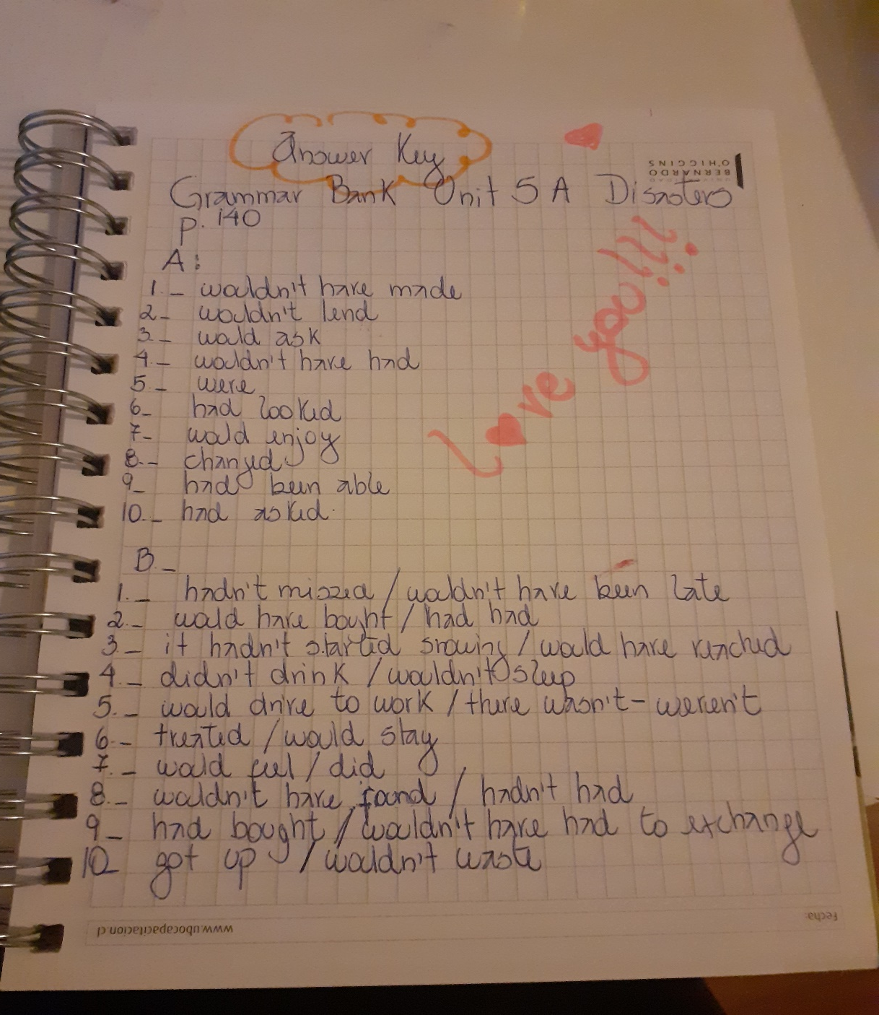

Slide 29
Additional explanations
Conditionals are very well explained in the following link:
https://www.ef.com/ca/english-resources/english-grammar/conditional/
Miss Caro explain conditionals in detail in the following video in case you missed that class:
https://drive.google.com/file/d/1-JcL0FJQ652aMMqGqvOxA2v9cImstGFx/view?usp=sharing

Slide 30


Slide 31
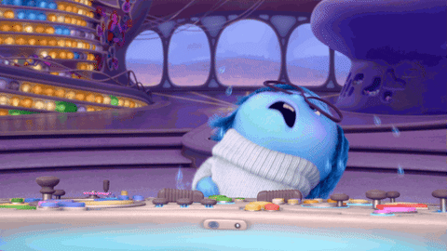
Feelings and Emojis Game!

Slide 32
Step 1: Your teacher will show a picture with an emoji.
Step 2: You have to identify the Emoji with one of the feelings reviewed in the class and create a beautiful sentence
Step 3: Once you have your sentence, stand up and say “I love my English class” to get the point.

Slide 33

Bonus is you use the slang
SET 1
BEWILDERED
Can/couldn´t believe my eyes

Slide 34


DELIGHTED
Jumping for joy

Slide 35


Worn out

Slide 36

SET 2
STUNNED

Slide 37

SET 2
THRILLED

Slide 38
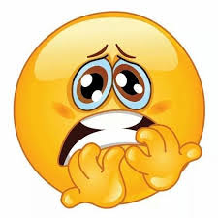

FRIGHTENED
To be scared stiff

Slide 39
And the winner is…

Slide 40
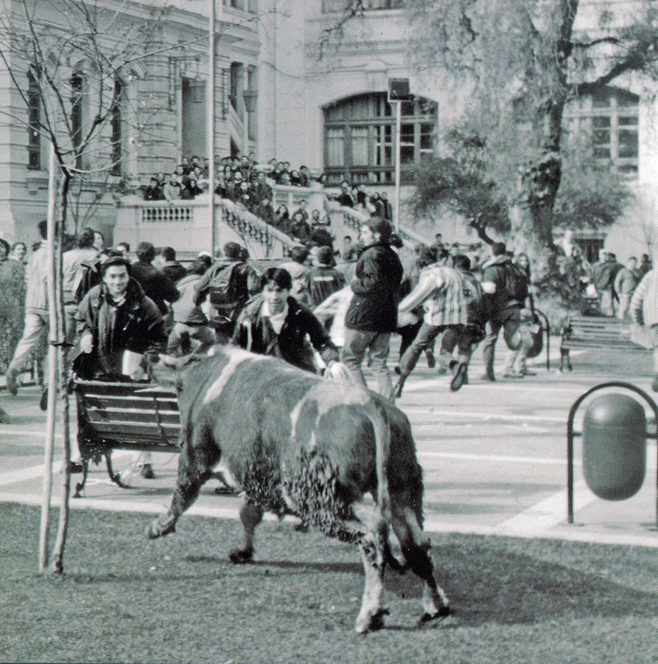
What would you have done if you had been a Beauchefian when….
A cow broke into 850’s gardens in 1997?
https://twitter.com/UChile_Beauchef/status/757599536030285824

Slide 41

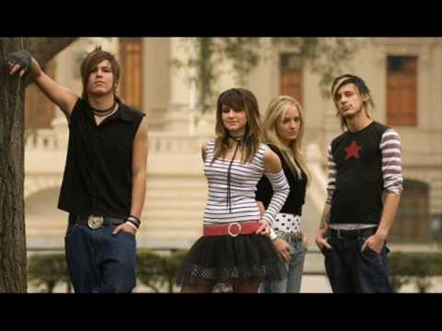
Kudai recorded “Sin despertar” at Beauchef´s gates ?
https://www.youtube.com/watch?v=KxlIYwQH6IY

Slide 42
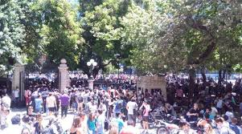
What would you have done if you had been a Beauchefian when….
A bomb threat was sent in 2016?

Slide 43
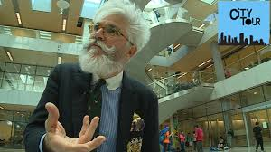
What would you have done if you had been a Beauchefian when….
A whole chapter of the TV show City Tour was recorded in Beauchef 851?
https://www.youtube.com/watch?v=uFvuVopJzu0

Slide 44
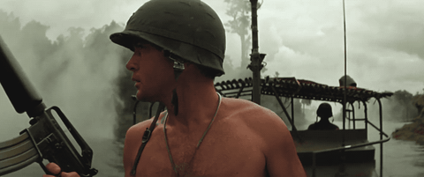
VIETNAM !

Slide 45
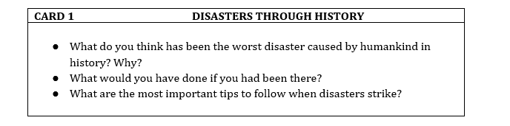

Slide 46

To freeze
Still
To panic
Quiet
Emergency drill
Plane crash
Earthquake
Flood
Rescue team
To hit
To steal
Storm
To Shout
Hysterical
Drought
Bewildered
Tsunami
Disasters
Avalanche
Hurricane
Scared stiff
Tornado
To get lost
To rescue
Volcanic eruption
Stunned
To keep calm
Relieved
Shocked
Overwhelmed

