Slide 1
Grammar review
Academic Writing and Oral Skills 2
Prof. Jorge Carroza

Slide 2
Grammar
rules
meaning
Semantics
Syntax
structure
Phonology
sounds
Morphology
words

Slide 3
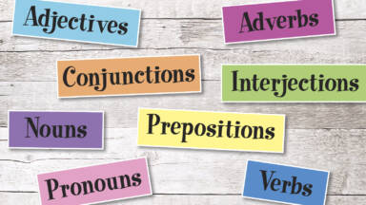
Parts of speech

Slide 4
Adjectives
Adjectives modify or describe a noun. These words ascribe an attribute to the noun being modified.
The sleepy bear hibernated all winter.
It's a long drive, but it's worth the trip.
Should I buy the blue jeans or purple sweater?

Slide 5
Adverbs
Joe grumpily got out of bed.
Sara ran very quickly to school.
That's quite expensive, don't you think?
Adverbs modify or describe a verb, adjective, or another adverb or word group. This modification provides information relating to time, place, manner, cause, degree, or circumstance.

Slide 6
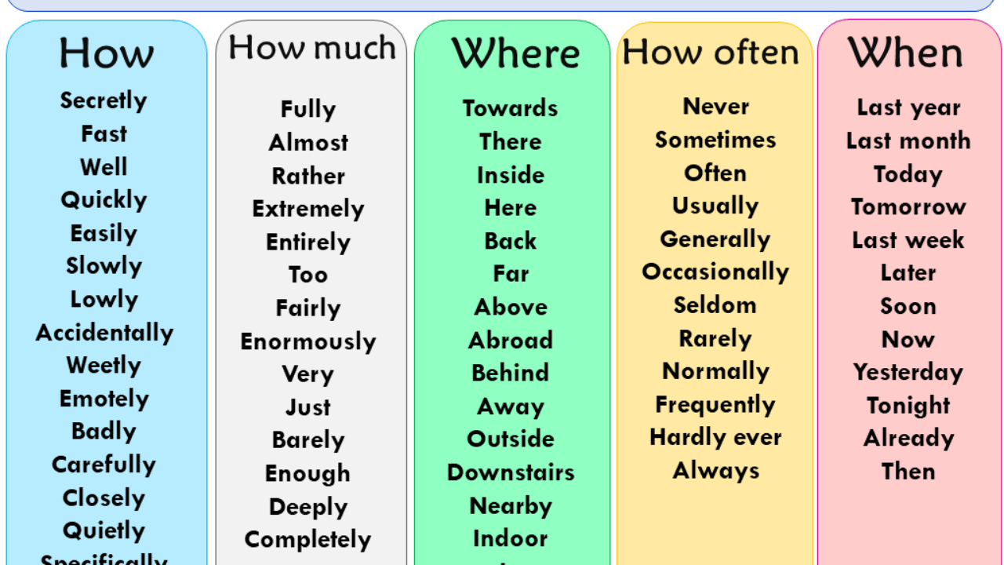

Slide 7
Conjunctions
Conjunctions are used to connect words, phrases, and clauses. They coordinate the words together, so they make sense as a cohesive thought, sentence, or paragraph.
You'll need to study all night if you want to pass tomorrow's test.
Go to the store and buy some milk.
Kristopher doesn't have enough experience. Therefore, we will not hire him.

Slide 8
Interjections
Interjections are words used as exclamations to show feelings. They're usually abrupt, interrupting the speech for emotional effect.
Bah, who cares what they think anyway?
If Cody asked me out on a date, gosh, that'd make my day.
I spilled the coffee everywhere. Oops!

Slide 9
Nouns
Nouns name a person, place, thing idea, or quality. They can act as the subject or the object of a sentence.
Send in the clowns.
Brazil is beautiful this time of year.
His love of music really shows.

Slide 10
Prepositions
Prepositions are used to indicate relationships, often spatial, between nouns and pronouns. They indicate how one noun, noun phrase, or pronoun relates to another.
Between you and me, I wouldn't trust Andy.
The coffee shop is across the street.
Put the carrots in the refrigerator, please.

Slide 11
Pronouns
Pronouns take the place of nouns to simplify speech and writing. They can otherwise function in the same way as nouns, serving as subjects and objects in sentences.
She is the smartest kid in class.
George took the book from him.
Who is coming to the party tonight?

Slide 12
Verbs
Verbs express action or a state of being. It is because of the former that verbs are often called "action verbs," but non-action verbs can be used to represent a state of being, need, sense, or preference.
Let's walk to the park.
Janine lives in Minneapolis.
The air conditioning unit desperately needs repair.

Slide 13
Articles
In English, articles are used in sentences as an adjective to modify a noun. The two types of articles are called definite and indefinite. The three indefinite articles include ‘a’, ‘an’, and ‘some’. ‘The’ is the only definite article.
The tall man took the car to the shop.
I gave my brother an umbrella.
He found a book to read.
Do you want some milk?

Slide 14
Syntax
In addition to understanding the eight basic parts of speech in English, it's also helpful to know how they work together to form all the working parts of a sentence. Each part of a sentence has a particular job or purpose in your writing, though not all parts must appear in every sentence for it to be complete. So what are the different parts of a sentence?

Slide 15
Subject
Kelly walked down the street.
They went to school.
The black cat is sleeping.
While "Kelly" and "They" are single-word subjects, "The black cat" is a noun phrase that includes an adjective to provide additional information about the subject.
In general, the subject refers to the part of the sentence that tells who or what the sentence is about. The subject is a noun, pronoun or noun phrase. For example:

Slide 16
Types of subjects.
Simple subject: Kate is a thin girl.
Complete subject: Jeffrey's poem about his mother made the class cry.
Compound subject: Paul and Tommy joined the soccer team at the same time.
A simple subject is just one word, without any modifiers, usually a noun or pronoun. A complete subject is the simple subject plus all modifiers. A compound subject is made up of more than one subject element.

Slide 17
Predicate
Kelly walked down the street.
In this sentence, "walked" is the action verb that tells the reader what Kelly is doing, and "down the street" is an adverb phrase that modifies the verb by describing where she walked. All these words make up the complete predicate of the sentence. The verb alone is the simple predicate.
The predicate of a sentence includes the verb and everything that follows it. This typically tells what the subject does with an action verb or describes the subject using a linking verb and a complement.

Slide 18
Compound predicate
Simple predicate: Harry cried.
Complete predicate: The mouse slowly ran towards the food.
Compound predicate: She laughed at the dog's tricks and decided to adopt him.
Predicates can contain a good deal of information and may be quite long. They may have several parts in addition to the verb, including objects and complements.
As with subjects, it's also possible to have a compound predicate that consists of two different actions.

Slide 19
Object
Susan bought the gift.
The dog caught the ball.
The boy spilled the milk.
In each of these sentences, there is a direct object in the predicate. It is the thing being acted upon; for example, the gift is the thing given by Susan.
Objects are noun phrases that are included in the predicate. They are the things being acted upon by the verb.

Slide 20
Indirect object
Susan bought him the gift.
He wrote them a long letter.
The man gave her an ultimatum.
In the sentence "Susan bought him the gift," "him" is an indirect object because he is not the item bought at the store, but rather the person for whom the action was completed.
It's also possible to have an indirect object that includes more information about the person or thing towards which the action is directed.

Slide 21
Complement
I am a teacher.
The cat was the laziest creature.
The woman seems smart.
In these cases, the words following the linking verb describe the subject, whether they are nouns, noun phrases or adjectives.
To write a complete sentence, you must include at least a subject and a predicate. If you only include one of these, you will have only a sentence fragment, which is grammatically incorrect.
In predicates that use linking verbs rather than action verbs, items following the verb are known as complements. Complements modify the subject by describing it further.

Slide 22
Sentence fragment
Discovered the cure for the disease.
Clothes and shoes scattered around the room.
To explain why that happened.
A sentence fragment can be very confusing for the reader, so usually, the best thing to do is to fix it by adding what is missing from the sentence or joining it to another sentence.

Slide 23
Adverbial
She exercised in the morning.
The boy reached out to the teacher for help.
I skipped school because I was sick.
Each adverbial above modifies the verb, therefore performing the function of an adverb in the sentence. The first two examples are adverbial phrases — groups of words that function as an adverb but don't contain a subject and a verb. The final example is an adverbial clause, which performs the same function but does contain a subject and a verb. Adverbial clauses are dependent clauses and are not complete sentences on their own.
Not all modifiers are single words. Sometimes they are groups of words that work together. When these words are in the predicate and explain how, when, where or why the action was performed, they are known as an adverbial.

Slide 24
Independent and Dependent Clauses
Building blocks of sentences.
A single independent clause can be a sentence, by itself.
Dependent clauses are used to make sentences more complete and more interesting.
Joined together by using conjunctions and/or proper punctuation.
Create interesting and complex compound sentences that are engaging to read.

Slide 25
Independent Clauses
Independent clauses have three components:
They have a subject - they tell the reader what the sentence is about.
They have an action or predicate - they tell the reader what the subject is doing.
They express a complete thought - something happened or was said.
An independent clause is a clause that can stand on its own, by itself. It does not need to be joined to any other clauses, because it contains all the information necessary to be a complete sentence.

Slide 26
An independent clause can be as simple as a subject and a verb:
Jim reads.
Jim is the subject. Reads is the action or verb. A complete thought was expressed - something was said, and the reader now knows that Jim likes to read.
Independent clauses can also be joined to other independent clauses, if the independent clauses are related. However, they MUST be joined using the proper punctuation.

Slide 27
Jim read a book; he really enjoyed the book.
The first clause is an independent clause. Jim is the subject, read is the action, book is the object.
The second clause is an independent clause. He is the subject, enjoyed is the action and the book is the object. The independent clauses are related, so they can be joined to create a complex sentence. They are correctly joined by a semicolon.
Jim read a book, he really enjoyed the book.
Again, we have two independent clauses, but the independent clauses are not joined properly. When two independent clauses are joined only by a comma, it is a grammatical error called a comma splice.
Independent clauses can be quite complex, but the important thing to remember is that they stand on their own and make sense alone.

Slide 28
Bear in mind
Like independent clauses, a dependent clause can also be complex.
The important thing to remember is that dependent clauses do not stand on their own as a complete thought.

Slide 29
Dependent Clauses
Marker Word (Before, after, because, since, in order to, although, though, whenever, wherever, whether, while, even though, even if).
Conjunction
(for, and, nor, but, or, yet, so) (FANBOYS)
A dependent clause does not express a complete thought.
A clause can be dependent because of the presence of a:

Slide 30
Complex dependent clauses
V
Jim, who likes to read, read a book.
S DC V O
Jim is the subject.
Who likes to read is a dependent clause that modifies Jim. It contains likes which is a verb.
Read is a verb.
A book is the object.
Dependent clauses can become more complex if we add subjects, objects, and modifying phrases:

