Slide 1
4204 Unit 6A Passive Voice (all tenses) & Movies
USE OF ENGLISH
AMERICAN ENGLISH FILE 3B. SECOND EDITION.

Slide 2
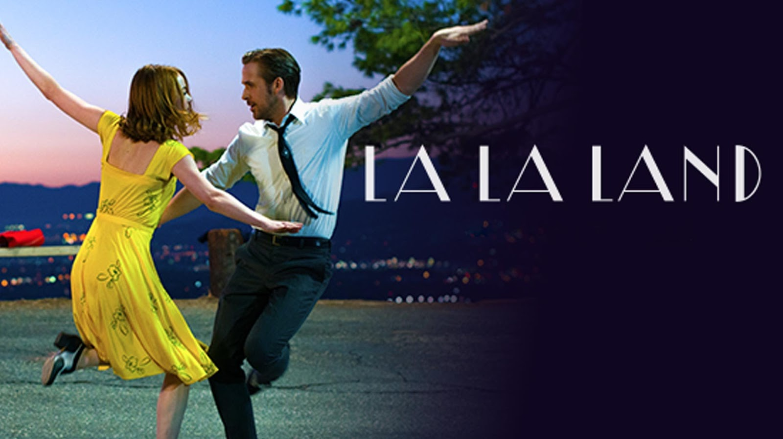
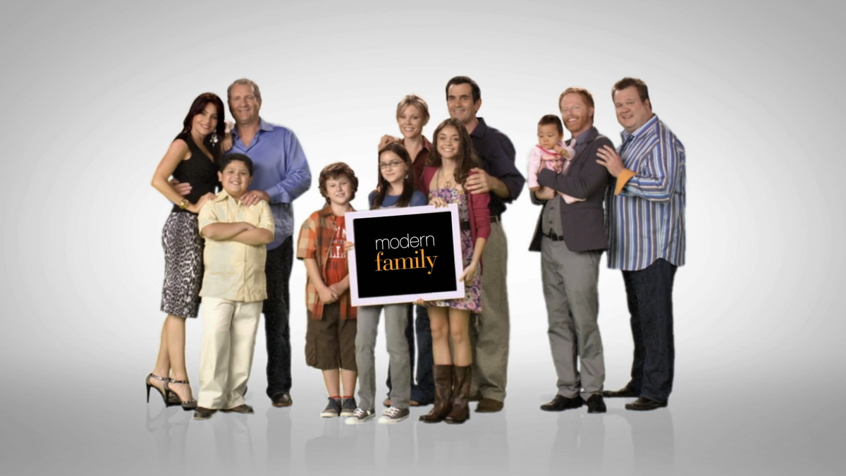
USE OF ENGLISH Choose the option that contains the word(s) that has/have been incorrectly used or none of the above from the ones in CAPITAL LETTERS.
1. La La Land WAS FILMED IN LOCATION back in 2015. It tells the love story of aspiring ACTRESS Mia and jazz pianist, Sebastian. It IS SET in Los Angeles, USA.
a. was filmed
b. in location
c. actress
d. is set
e. None of the above
2. My favorite series is Modern Family. It is a COMEDY and was created BY Christopher Lloyd and Steven Levitan for ABC (American Broadcasting Company). The PLOT follows the lives of Jay, Claire and Mitchell Pritchett and their respective families. It WAS AWARDED several Emmys, Golden Globes and BAFTAs.
a. comedy
b. by
c. plot
d. was awarded
e. None of the above

Slide 3
3. One of the most famous audio-visual Chilean exports was the soap opera Machos. It DUBBED to several languages and WAS SHOWN all around the world. Héctor Noguera PLAYED THE PART of Ángel Mercader, the patriarch of the family, compound by his wife and their seven male children. It WAS SHOT in Viña del Mar.
a. dubbed
b. was shown
c. played the part
d. was shot
e. None of the above
4. The controversial movie The Passion of the Christ had to be SUBTITLED everywhere because the dialogues were entirely in Latin, Hebrew and Aramaic. That meant that the CAST had to learn the SCRIPT in those languages, even though they couldn’t speak them. The controversy was about the violence shown in the movie, which for some CONSIDERED to be anti-semitic propaganda.
a. subtitled
b. cast
c. script
d. considered
e. None of the above

