Slide 1
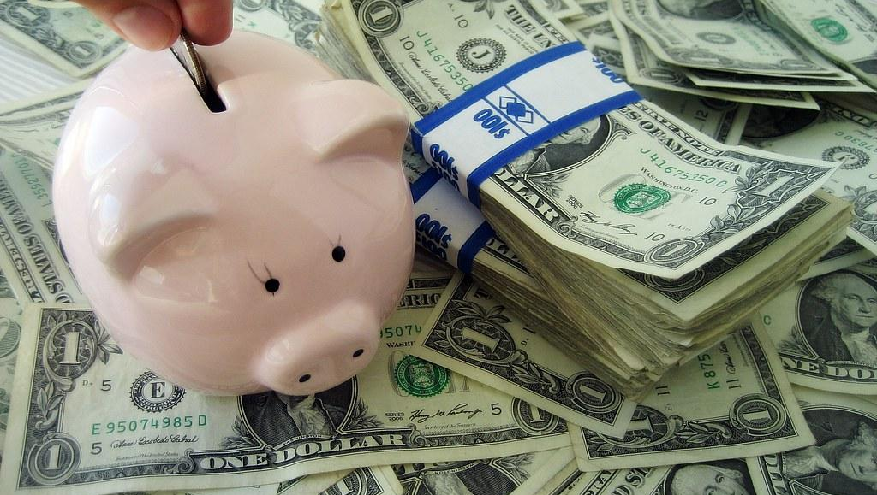
4204 Unit 2A Present Perfect vs Simple Past & Money
USE OF ENGLISH
AMERICAN ENGLISH FILE 3A. SECOND EDITION.

Slide 2
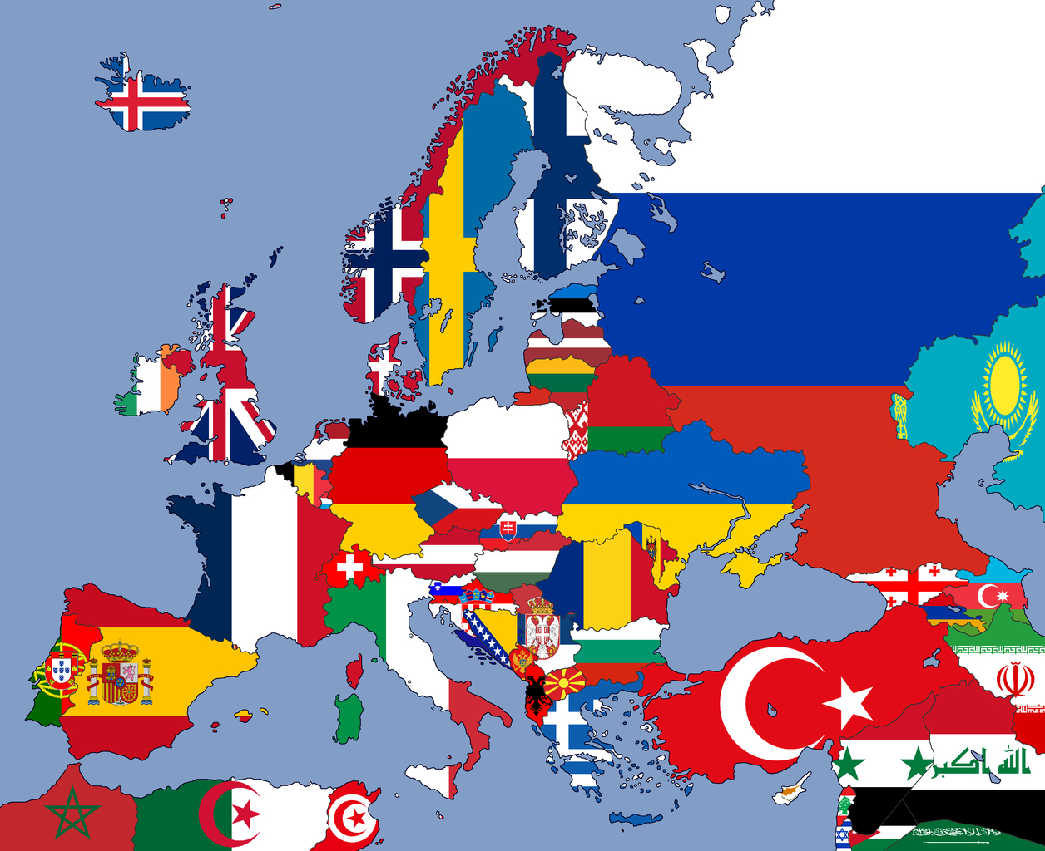
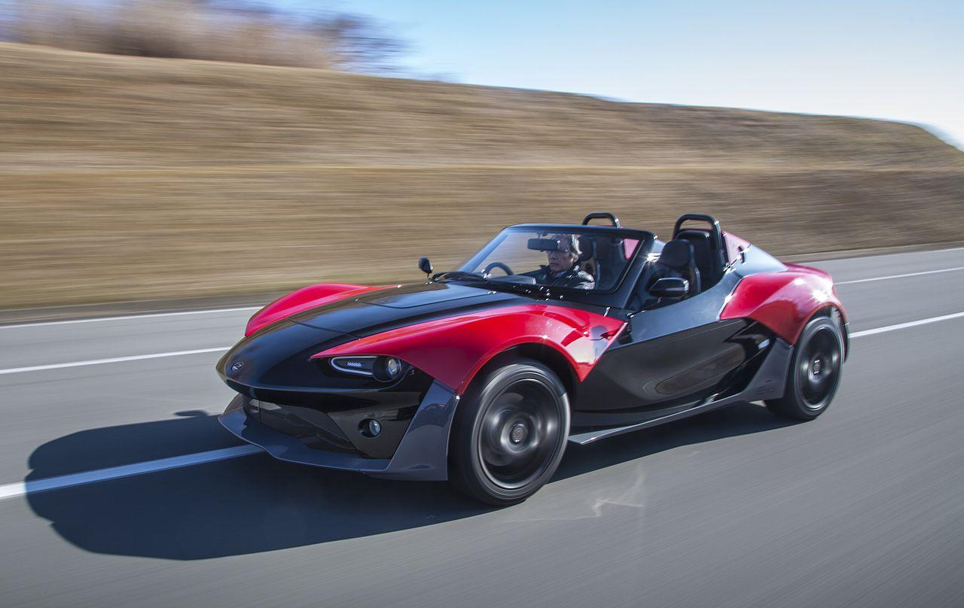
USE OF ENGLISH Decide which word(s) has/have been incorrectly used or none of the above from the ones in CAPITAL LETTERS.
1.
A: Have you EVER visited Europe?
B: Yes, I’ve ALREADY GONE there twice. I’m SAVING money to go again next summer.
a. ever
b. already
c. gone
d. saving
e. None of the above
2. Peter HAS FINALLY BOUGHT the car he wanted. He INHERITED some money from a relative who DIED last month and his brother paid back the money he had LENT from him.
a. has finally bought
b. inherited
c. died
d. lent
e. None of the above

Slide 3
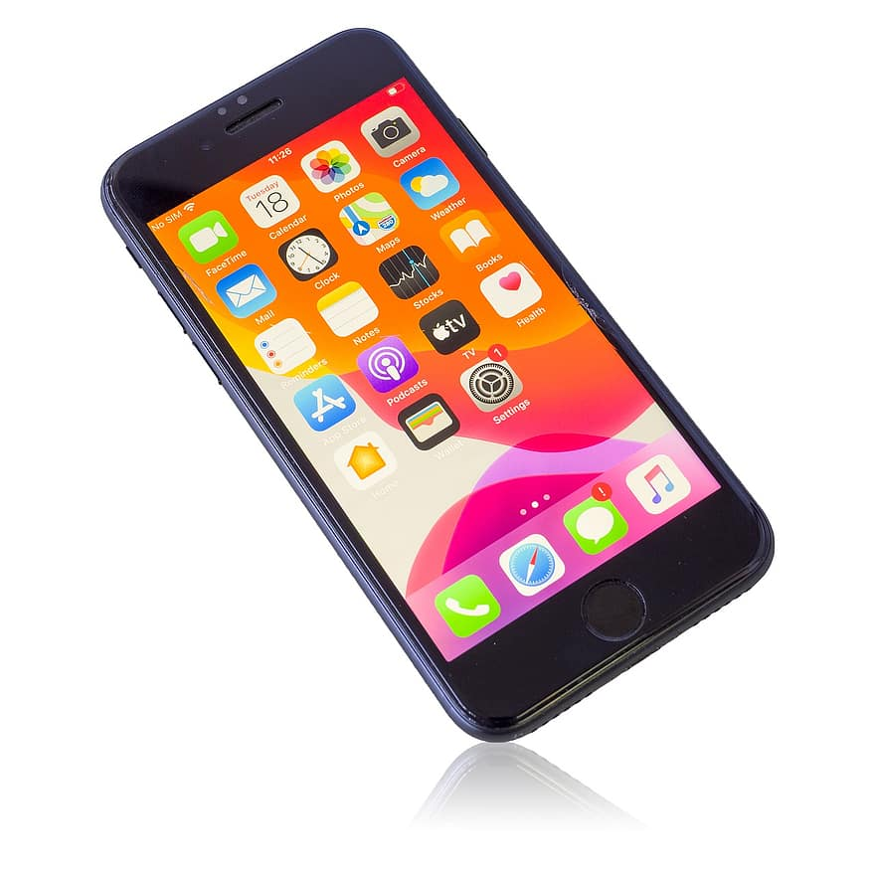
3. As I DIDN’T HAVE enough money to buy the cell phone I wanted, I DECIDED to ask my mom for a LOAN which I’ll pay in small INSTALLMENTS for six months.
a. didn’t have
b. decided
c. loan
d. installments
e. None of the above
4. Emily TOOK OFF $100 from an ATM to pay for the smartwatch she NEEDED. Unfortunately, it ended up being a SCAM and she was left with no money and no watch.
a. took
b. off
c. needed
d. scam
e. None of the above

