Slide 1
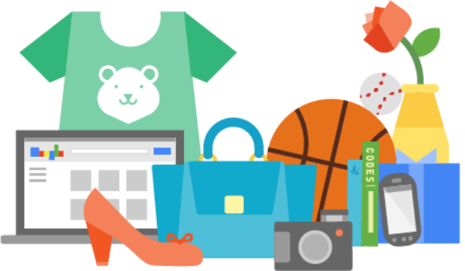
4204 Unit 8A Reported Speech & Shopping
USE OF ENGLISH
AMERICAN ENGLISH FILE 3B. SECOND EDITION.

Slide 2
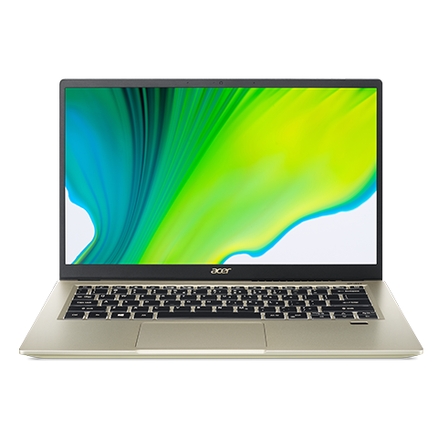
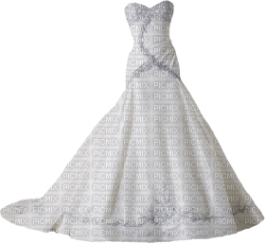
USE OF ENGLISH Decide which option contains the word(s) that has/have been incorrectly used or none of the above from the ones in CAPITAL LETTERS.
1. The salesperson asked him when he HAD BOUGHT the computer. When the customer SAID HIM that he didn’t remember, the salesperson TOLD HIM that it was impossible to give him a REFUND without that information.
a. had bought
b. said him
c. told him
d. refund
e. None of the above
2. When the bride entered the church, everybody started clapping and shouting. The groom got closer to her and SAID THAT SHE LOOKED beautiful. Even though, she told us she HADN’T HAD time to TRY IT ON, her wedding dress FITTED her perfectly.
a. said that she looked
b. hadn’t had
c. try it on
d. fitted
e. None of the above
said to him / told him

Slide 3
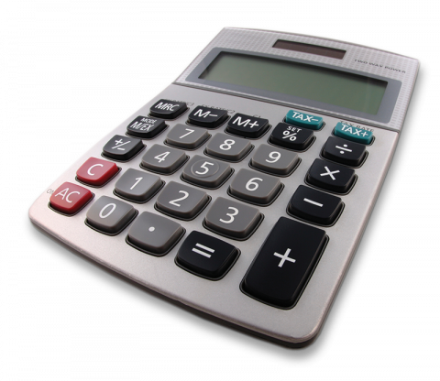
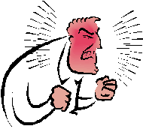
3. The person on Mercado Libre told me the calculator was a BARGAIN. It was the first time I was SHOPPING ONLINE, so I was a bit doubtful. He said I HAD TO trust him because he HAD BEEN SELLING on the Internet for a long time.
a. bargain
b. shopping online
c. I had to
d. had been selling
e. None of the above
4. My boss told me I SHOULDN’T SHOUT at the customer. I said I KNEW the customer was always right, but this person was really aggressive and kept COMPLAINING loudly. I know I LOST MY TEMPERAMENT.
a. shouldn’t shout
b. knew
c. complaining
d. lost my temperament
e. None of the above
lost my temper

Slide 4
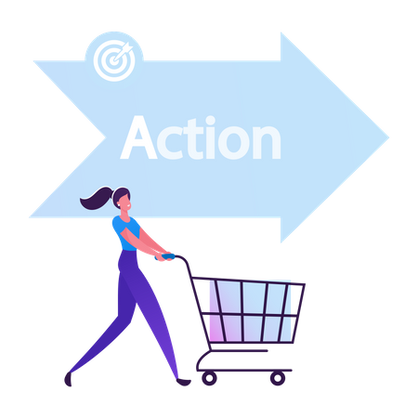
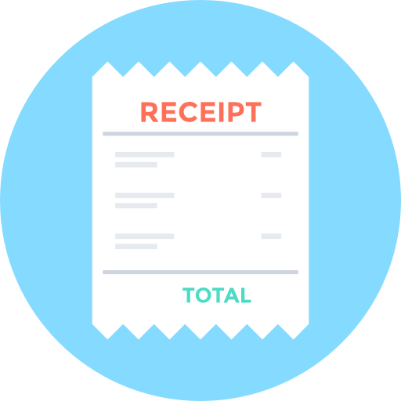
5. A co-worker told me THERE WERE some useful TIPS to be the King of Complainers. For example, use FLATTER to reduce the level of tension and show you still trust the company, never SWEAR and make it clear you will not hesitate to change to another company.
a. there were
b. tips
c. flatter
d. swear
e. None of the above
6. I asked my dad HOW MUCH HE HAD SPENT at the Black Friday’s sale. He told me he had never seen PRICE TAGS or the RECEIPT when he went shopping. He has always been an OBSESSIVE buyer. That’s too bad!
a. how much he had spent
b. price tags
c. receipt
d. obsessive
e. None of the above
flattery

