Slide 1
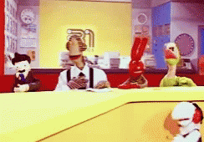
Breaking news
OR THE UNIT WHERE WE TALK ABOUT 31 MINUTOS

Slide 2
Stupid news
Group1
Lost Tourist
Group 2
Dog calls for help
Group 3
Chicken fight

Slide 3
LOST Tourist FINDS herself

Slide 4
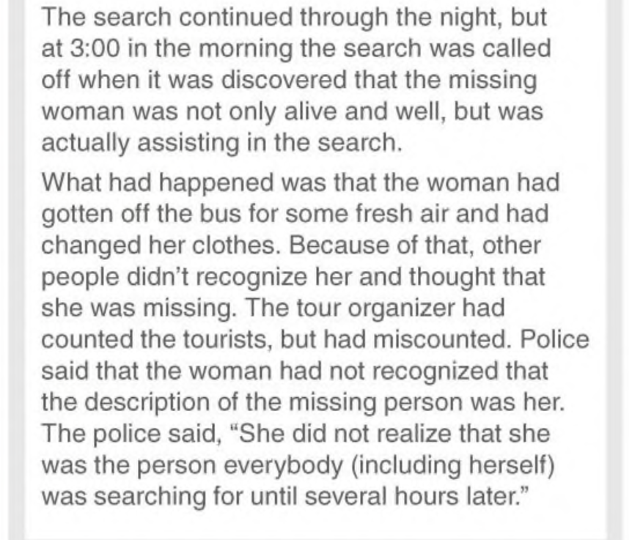
LOST Tourist FINDS herself

Slide 5
Chicken fight

Slide 6
Dog calls for help

Slide 7
Reporting verbs

Slide 8
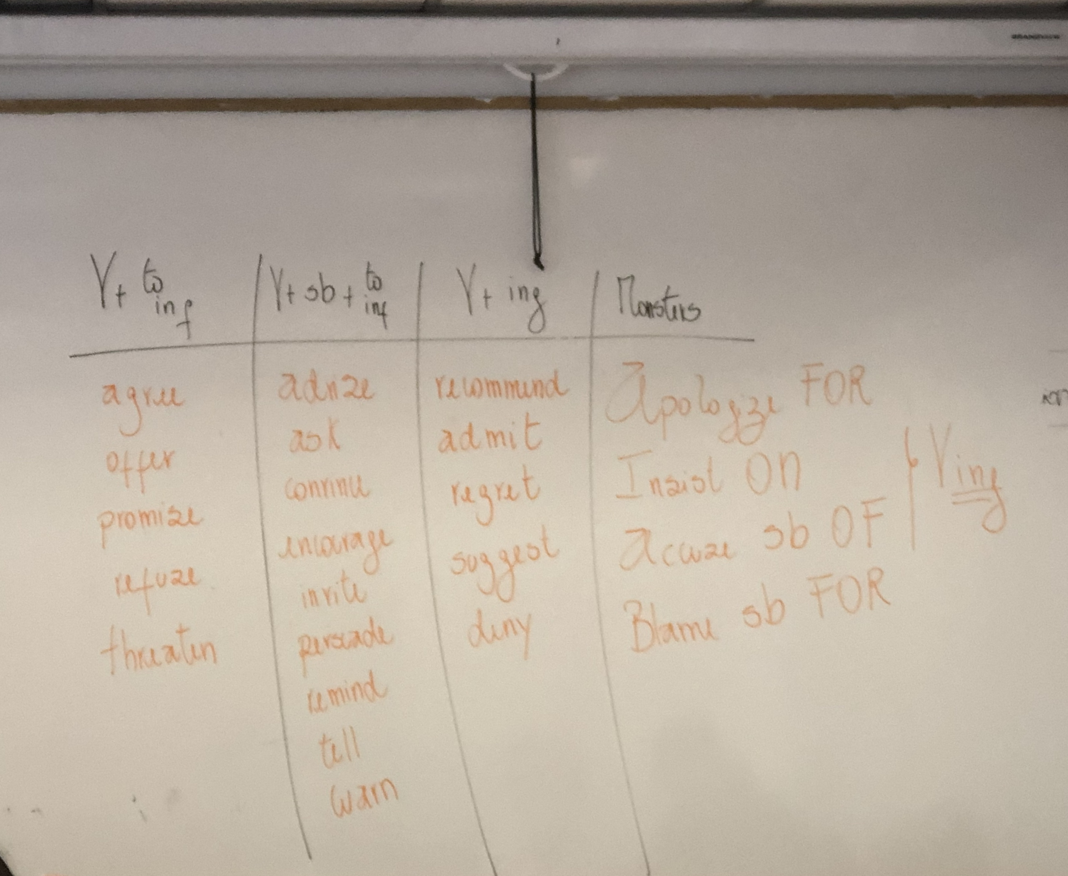

Slide 9
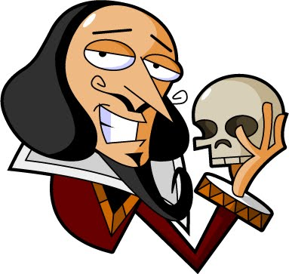
Reporting verbs
She reminded me NOT to be late
She regretted NOT going to the party
To be or NOT to be

Slide 10
Reporting verbs

Slide 11
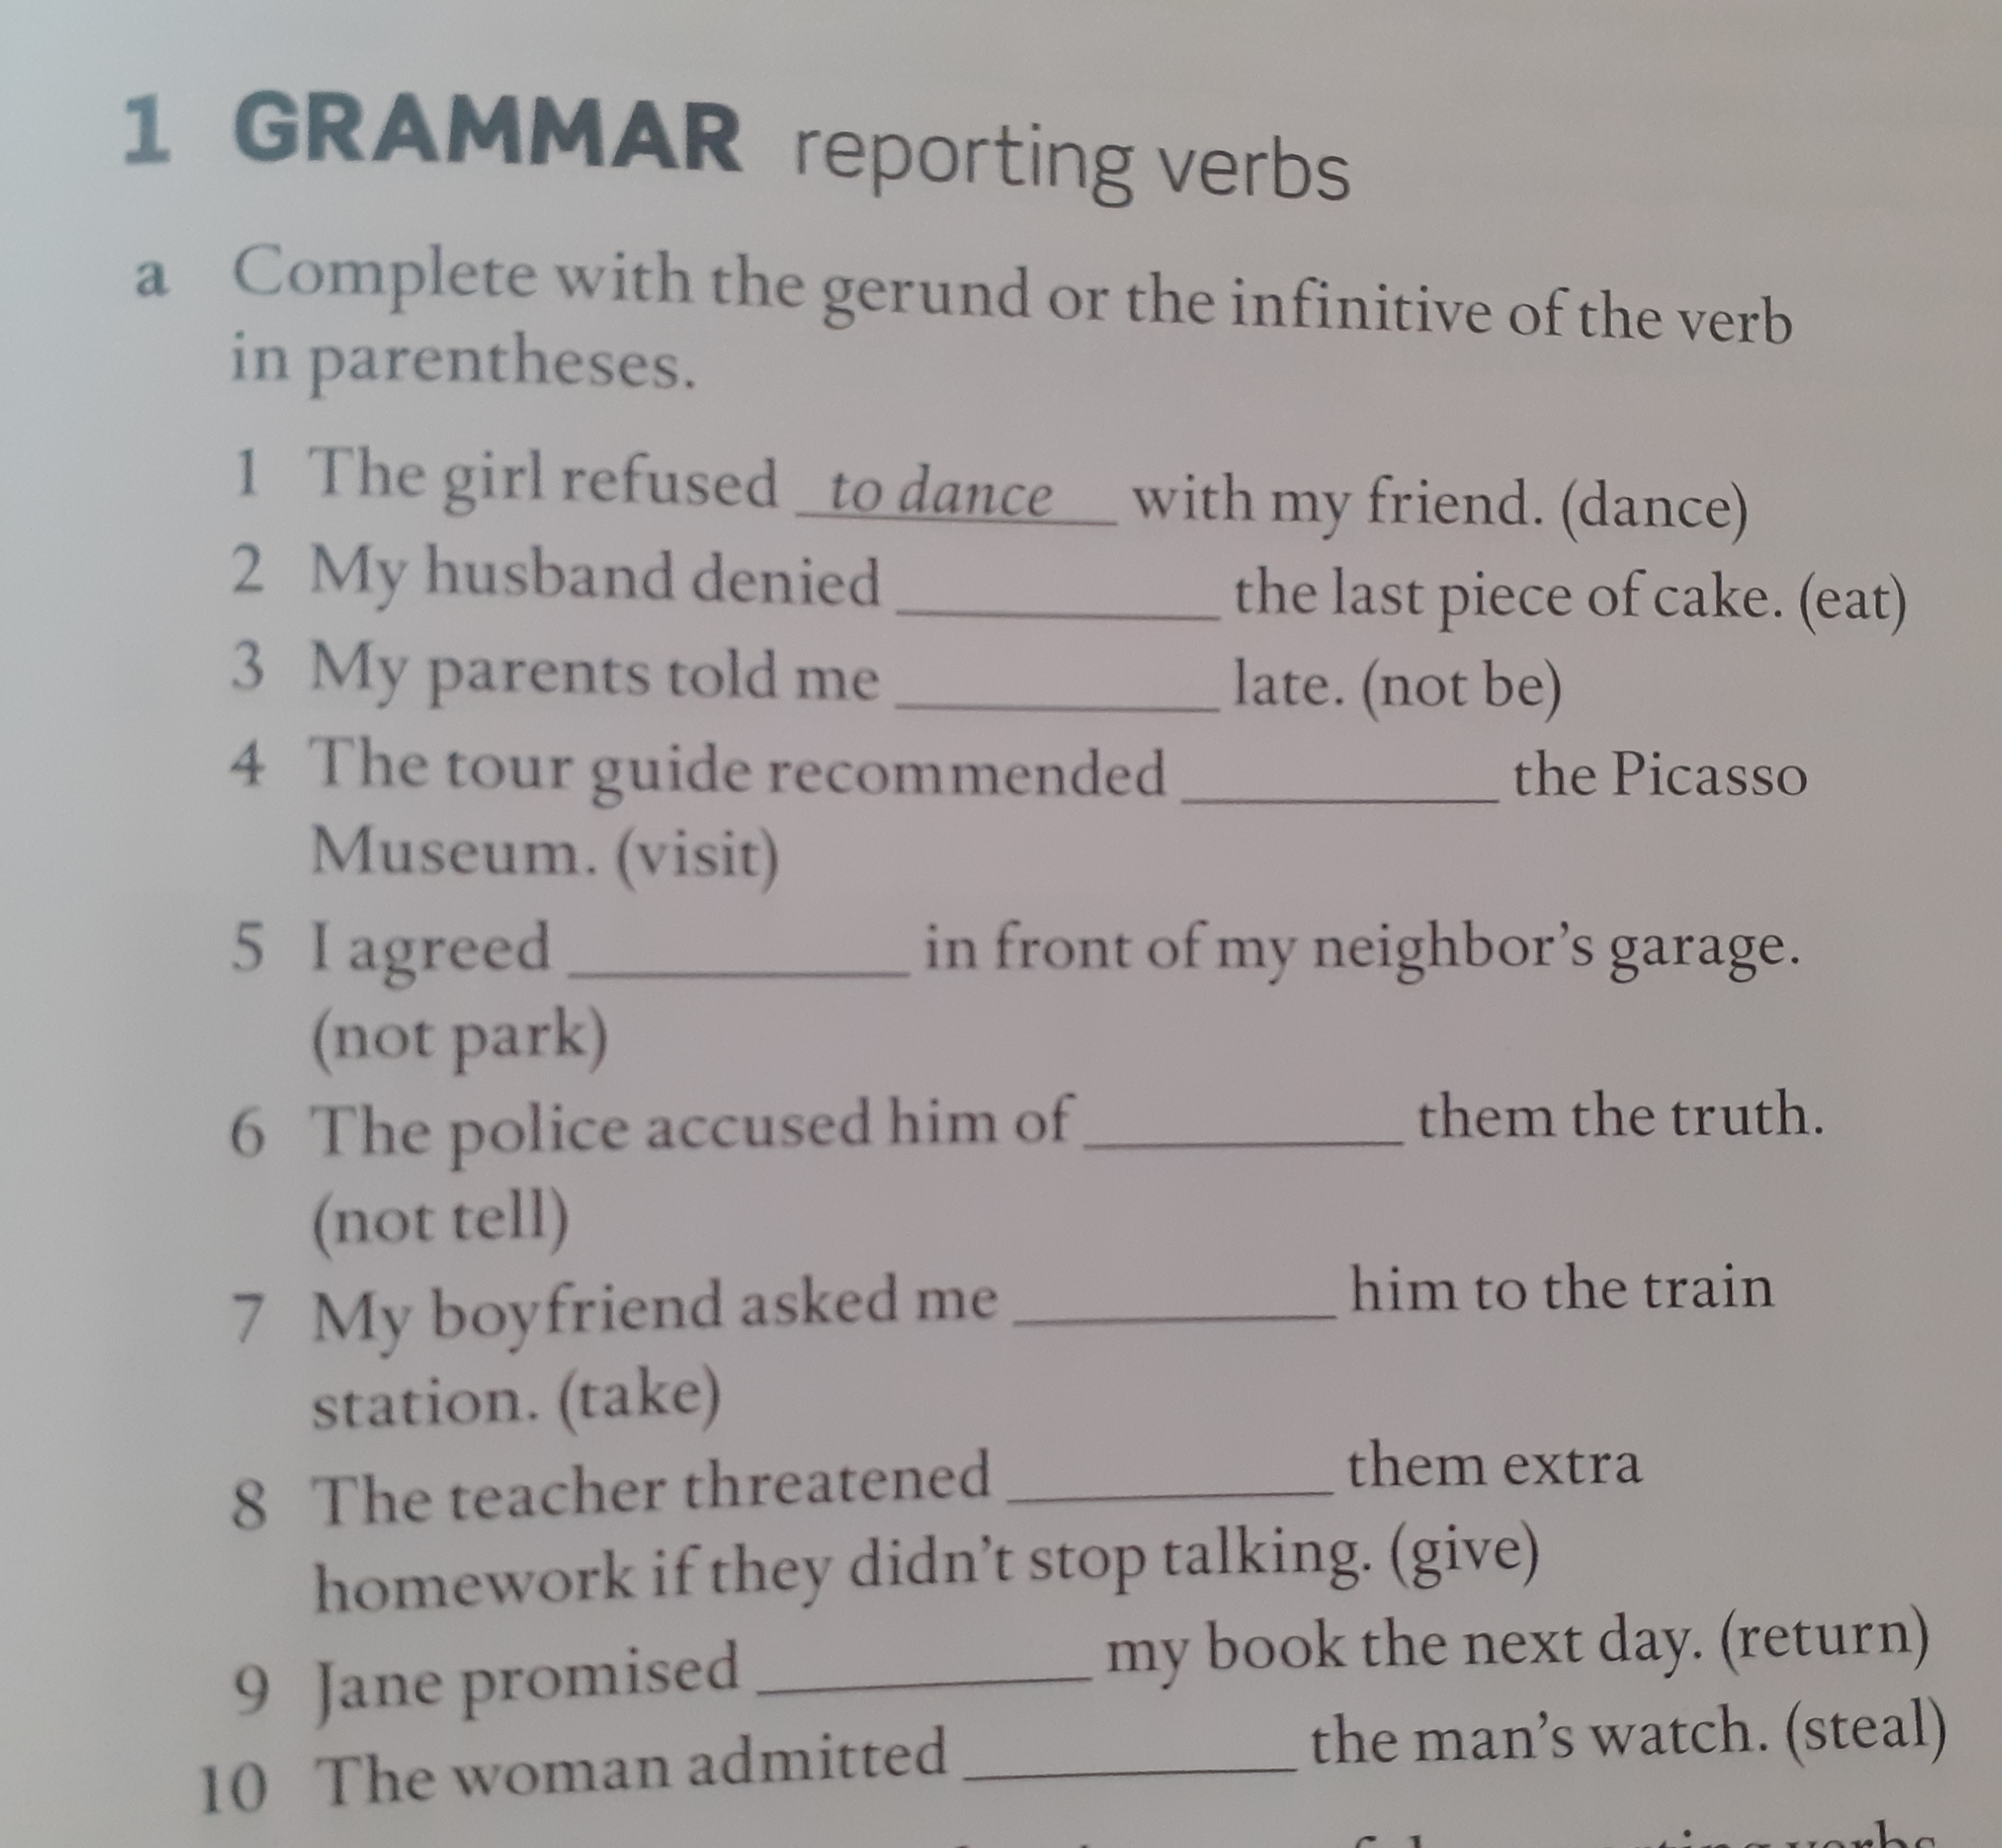

Reporting verbs
Let´s practice!

Slide 12
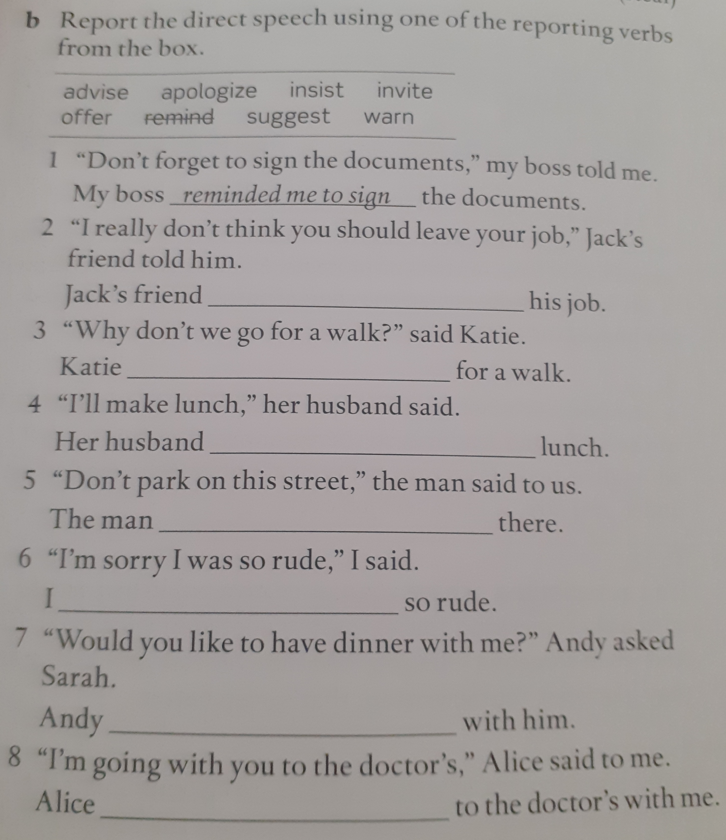
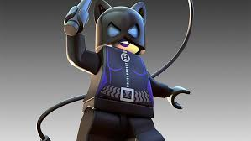
Reporting verbs
Let´s practice !

Slide 13
Homework
A.
1. PAYING
2. TO WORK
3. NOT TO WALK
4. STEALING
5. TO GIVE UP
6. NOT TO LEAVE
7. TRYING
8. NOT REMEMBERING
9. TO COME
10. DAMAGING

Slide 14
homework
B.
1. suggested going
2. accused him of copying
3. threatened to call
4. refused to go
5. invited me to have
6. reminded Jack to call
7. promised never to do
8. recommended trying

Slide 15
VOCABULARY

Slide 16
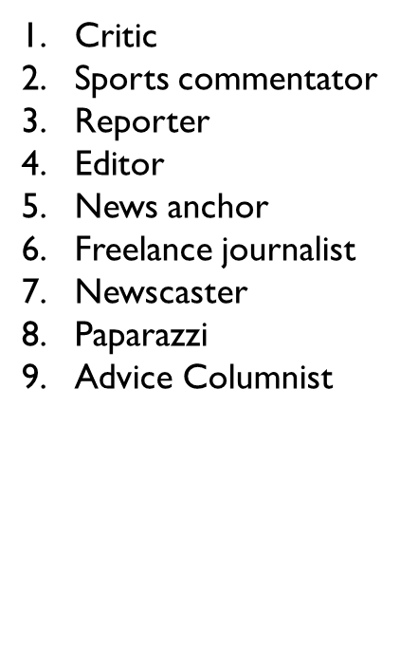



Slide 17



Slide 18


Slide 19
Step 1 : Listen to the video carefully
Step 2 : Report the conversation using the reporting verbs reviewed in class. (Verbs can be used once)
Step 3: Get together with your group and write as many sentences as possible (Choose a secretary)
Step 4 : The secretary reports the sentences to the class. The group with more correct sentences is the winner

Slide 20
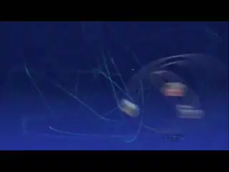

Slide 21
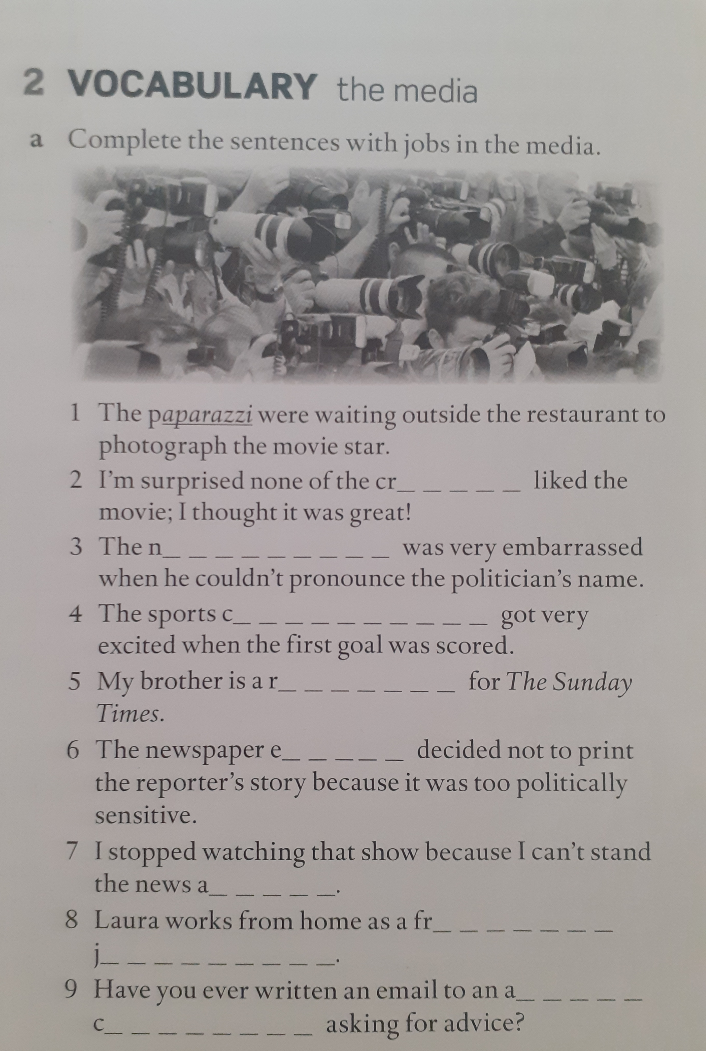
The media
Let´s practice

Slide 23
Step 1 : Guess the correct word for each picture
Step 2 : Raise your arms and say “I love my English class”
Step 3 : The first student in providing the correct answer gets the point

Slide 24
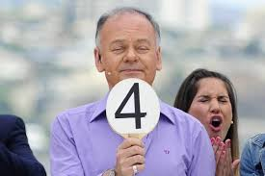
ROUND 1
Italo Passalacqua was a very popular Chilean ______
CRITIC

Slide 25
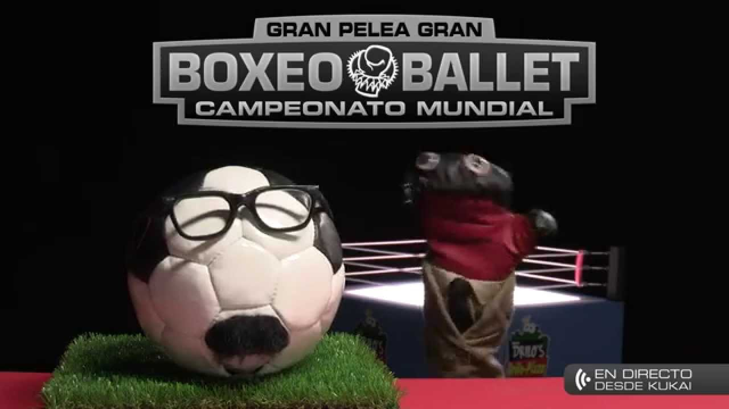
ROUND 1
Balon Bombola is 31 minutos´________
SPORTS COMMENTATOR

Slide 26
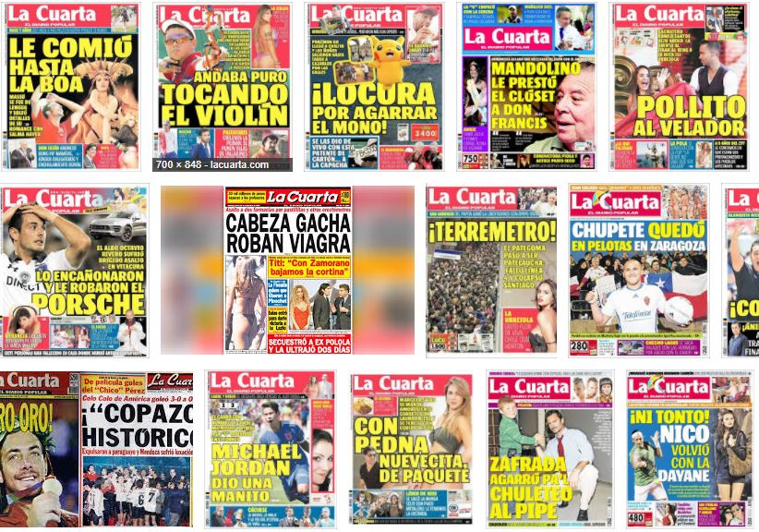
ROUND 1
For some people La Cuarta might be considered as a ________ type of newspaper.
SENSATIONAL

Slide 27

ROUND 1I
Rotten Tomatoes reviews are almost all the time really ________
ACCURATE

Slide 28
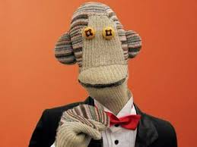
ROUND 1I
Tulio Triviño is 31 minutos´___________
NEWS ANCHOR

Slide 29
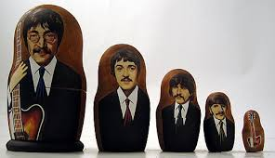
ROUND 1I
Back in the 1960´s the Beatles were ____________ by The Soviet government.
CENSORED

Slide 30


BONUS
CHILEAN TV
Many ________ used to work in the TV shows portrayed in the pictures above.
PAPARAZZI

Slide 31

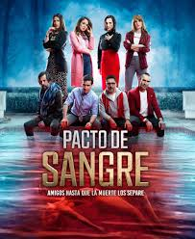
CHILEAN TV
Perdona nuestros pecados and Pacto de Sangre have been the most successful ____________ from the last years.
SOAP OPERAS/TELENOVELAS

Slide 32
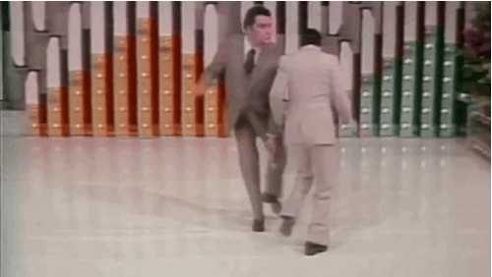
CHILEAN TV
Mario Kreutzberger aka Don Francisco is Channel 13´s _____________and the most popular ______________ in South America.
ANCHORMAN /TV PRESENTER

Slide 33
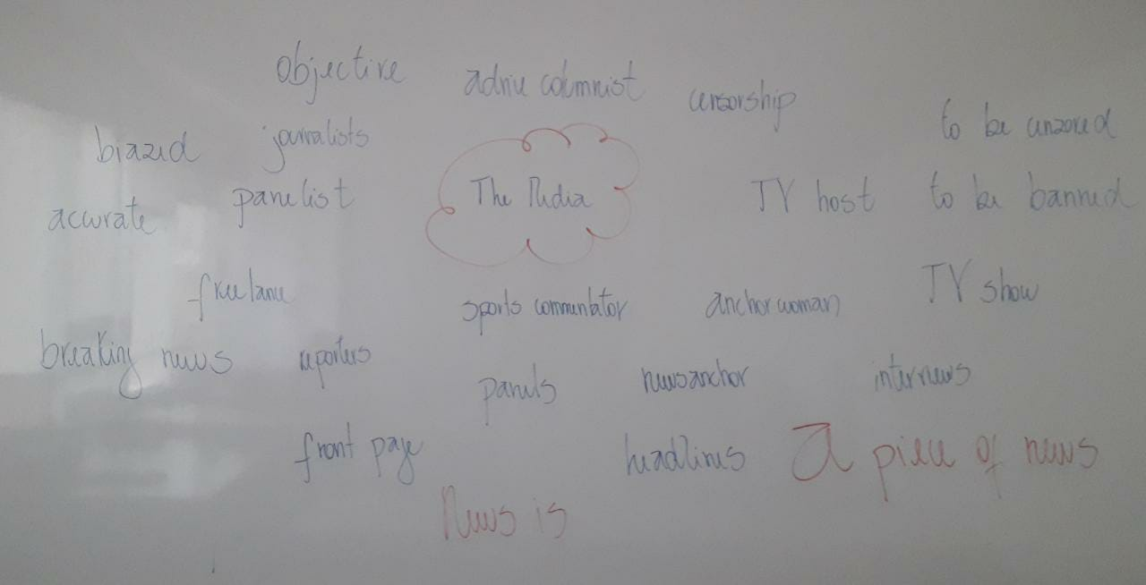
Let´s practice

Slide 34

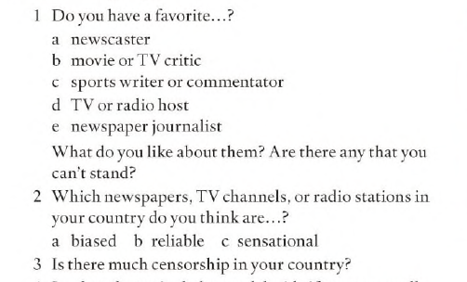
SPEAKING 1

Slide 35

SPEAKING 2

Slide 36

ANSWER KEY
1. To dance
2. Eating
3. Not to be
4. Visiting
5. Not to park
6. Not telling
7. To take
8. To give
9. To return
10. stealing

Slide 37

ANSWER KEY
reminded me to sign
advised him not to leave his job
suggested going for a walk/invited her to go for a walk
offered to make lunch
told us not to park on this Street
apologized for being so rude
invited her to have dinner
suggested going to the doctor with me

Slide 38

ANSWER KEY
critics
enwscaster
commentator
reporter
editor
anchor
freelance journalist
advice columnist

