Slide 1
Spend or save?
Unit 2A

Slide 2
Musical warm-up
In pairs, try to match the lyrics with their corresponding singers/bands and song titles. You CANNOT use the Internet, no cheating!!! You can download the file from Material Docente (under “Speaking” category).
Madonna | Abba | Gwen Stefani | Bruno Mars | Jessie J | The Beatles
Money, Money, Money | Billionaire | Can’t Buy Me Love | Rich Girl | Material Girl | Price Tag
Lyrics | Song title | Singer/Band
No man could test me, impress me, my cash flow would never ever end Cause I'd have all the money in the world, if I was a wealthy girl Think what that money could bring, I'd buy everything Clean out Vivienne Westwood in my Galliano gown…

Slide 3
Musical warm-up
Lyrics | Song title | Singer/Band
I wanna be on the cover of Forbes magazine Smiling next to Oprah and the Queen Oh every time I close my eyes I see my name in shining lights A different city every night, oh I I swear the world better prepare…
I work all night; I work all day to pay the bills I have to pay Ain't it sad? And still there never seems to be a single penny left for me That's too bad In my dreams I have a plan If I got me a wealthy man I wouldn't have to work at all, I'd fool around and have a ball…

Slide 4
Musical warm-up
Lyrics | Song title | Singer/Band
I'll buy you a diamond ring my friend if it makes you feel alright I'll get you anything my friend if it makes you feel alright 'Cause I don't care too much for money For money…
Some boys kiss me, some boys hug me, I think they're ok If they don't give me proper credit, I just walk away They can beg and they can plead But they can't see the light (that's right) 'Cause the boy with the cold hard cash is always Mister Right…

Slide 5
Musical warm-up
Lyrics | Song title | Singer/Band
Seems like everybody's got a price, I wonder how they sleep at night When the sale comes first, and the truth comes second just stop for a minute and smile Why is everybody so serious? Acting so damn mysterious Got shades on your eyes and your heels so high that you can't even have a good time Everybody look to their left, everybody look to their right Can you feel that, yeah, we're paying with love tonight
Did you know these songs? What do all of them have in common?

Slide 6
Vocabulary Bank
Go to page 154 in your book and complete activities 1, 2 & 3 in pairs. We’ll check your answers together when you finish it.

Slide 7
Spend or save?
What do you usually spend your money on?
Do you save money for a certain purpose?
Do you consider yourself a saver or a spender? Answer this test (p. 15) and let’s find out together if you were right.

Slide 8
Spend or save?
What do people who live together usually argue about? Is money an issue? Why?
Read the conversation (p. 16) and complete the dialogue putting the verbs in parenthesis in the past simple or the present perfect.

Slide 9
Present Perfect vs Simple Past
Simple Past
(+) verb conjugated in the simple past (-ed for regular verbs) (-) didn’t + base form (?) did + subject + base form…?
Present Perfect
(+) have/has + past participle (-) haven’t/hasn’t + past participle (?) have/has + subject + past participle…?
Structure

Slide 10
Present Perfect vs Simple Past

Slide 11
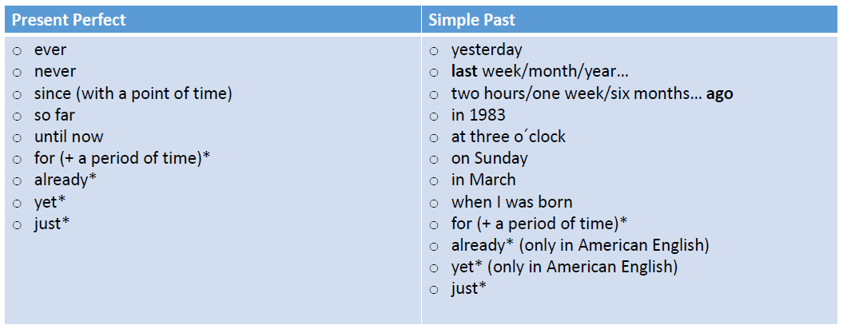
Present Perfect vs Simple Past
Time expressions

Slide 12
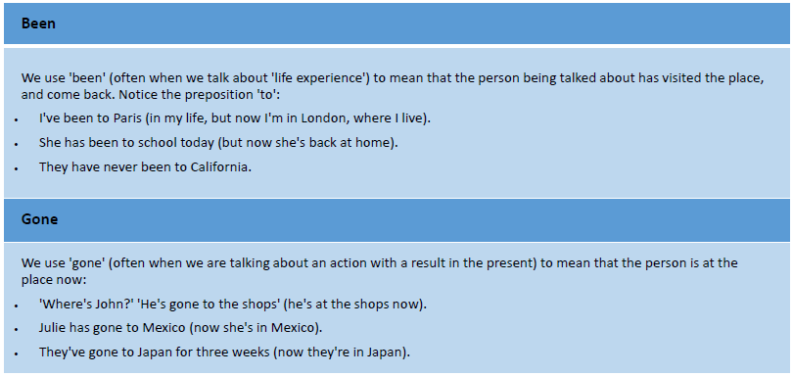
Present Perfect: been & gone
In present perfect we use both “been” and “gone” as the past participle of the verb “”go” but in different circumstances:

Slide 13
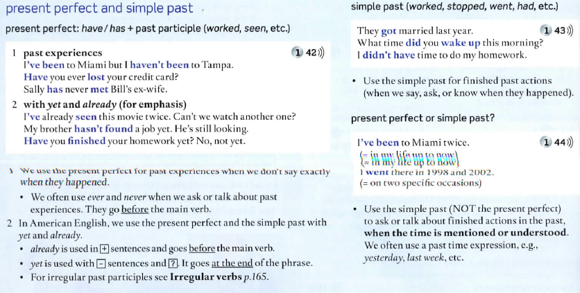
Present Perfect vs Simple Past

Slide 14
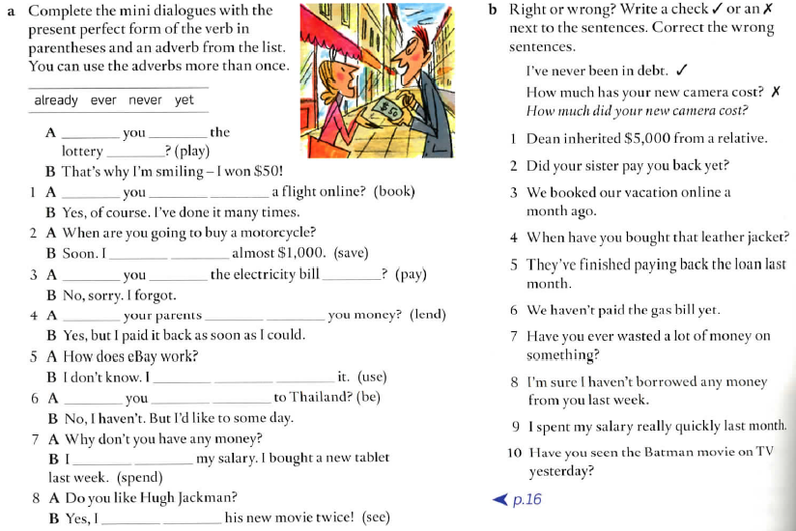
Present Perfect vs Simple Past
Now, let’s work on the Grammar Bank exercises on page 134. Work in pairs and once you are done, we will check them all together.

Slide 15
Now, let’s talk!
Work with a partner and interview each other with the following questions. Give as many details as possible.

