Slide 1

UNIT 8B
The right job for you

Slide 2

Job interview
https://www.princetonreview.com/quiz/career-quiz#!q17thru20

Slide 3

SPEAKING TIME

Slide 5

SPEAKING TIME

Slide 6
VOCABULARY

Slide 7
VOCABULARY

Slide 8
VOCABULARY

Slide 9
Let´s practice
overtime
resign
applied
shifts
promoted
downsized
training
set
self-employed
retire

Slide 10

in/part-time
In/temporary
for/in/of
in/well qualified
full-time/permanent
unemployed/self-employed

Slide 12
Gerunds and Infinitives (and base form)
LOVE
LOVING
TO LOVE
LOVE
GERUND
INFINITIVE
BASE FORM

Slide 13
GERUNDS
Sentences
Rules
I am good at LISTENING to people
TAKING risks doesn´t worry me
I enjoy IMPROVISING
After prepostions (At/of//for/with/ without, etc.)
Verb as a Noun (Initial position or as an Object)
After some verbs. Ex: enjoy

Slide 14
INFINITIVES
Sentences
Rules
It is hard TO STUDY at night
I drink coffee TO STAY awake
I want TO LIVE in Paris
1. After Adjectives
2. To express purpose
3. After some verbs. Ex: want

Slide 15
BASE FORM
Modal verbs
After LET and MAKE
Will Would
May Might
Can Could
Shall Should
Must
My parents didn´t LET me go to the party
Carol MAKES me watch series in English

Slide 16

After some verbs

Slide 17
V+INFI
Can´t afford, agree, decide, expect, help, hope, learn, need, offer, plan , pretend, promise, refuse, seem, want, would like
V+INF/GER
= MEANING
Hate, like,love, start, begin, continue
V+INF/GER
≠ MEANING
Forget, Remember, Try, Stop
Admit, avoid, deny, dislike, enjoy, feel like, finish ,keep, mind, miss, practice, prefer, recommend, spend time, suggest
V+GER

Slide 18
When the meaning changes
Verb | Gerund | Meaning | Infinitive | Meaning
STOP | He stopped smoking | He smoked for a time but then he quit. | He stopped to smoke. | He took a break from something else he was doing to have a cigarette (e.g. He stopped walking in order to smoke).
TRY | I tried eating less fat and it worked! | We probably tried other options as well, this is just one of the options. To experiment with sth. | I tried to eat less fat but I couldn´t. I have no willpower. | To make the effort

Slide 19

Verb | Gerund | Meaning | Infinitive | Meaning
REMEMBER | She remembers calling her friend. | She called her friend and she remembers that she did. | She remembered to call her friend. | She had a list of things to do, calling her friend was one of them, and she did it.
FORGET | She forgot locking the door. | She did lock the door, but then she forgot she had done it. | She forgot to lock the door. | She did not lock the door because she forgot.

Slide 20
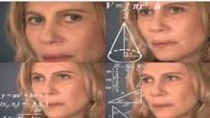
Still confused?
https://drive.google.com/file/d/1v9Gor963ZJ4canuB0G-pyTszPBUzaVsF/view?usp=sharing
Carol explaining Gerunds and Infinitives for you

Slide 21



Slide 22
ANSWER KEY
1. TO RETIRE
2, COMMUTING
3. NOT TO WORRY
4. LOCKING
5. NOT TO BUY
6. LEAVE
7. WEAR
8. NOT TO MAKE
9. WORKING

Slide 23

giving
making
to pay
to fire
not going
having
working
to sign

Slide 24

W to find
C
W to get
W taking
C
W playing
C
Filling out

Slide 25
to tell
to meet
Lifting
to find
getting
applying
helping
accepting

Slide 26
LET´S READ
https://www.youtube.com/watch?v=o0etimvtD74&ab_channel=ABC

Slide 27
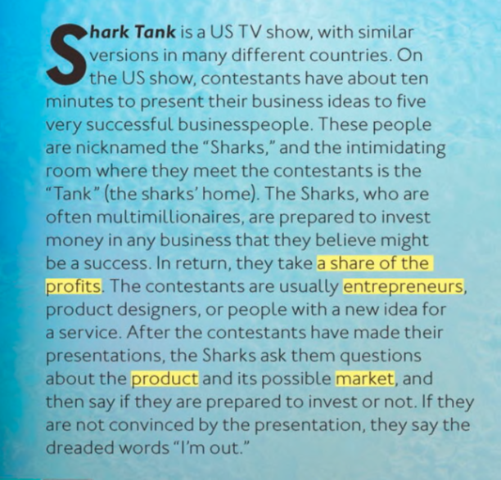
LET´S READ
ENTREPENEUR: one who organizes, manages,
and assumes the risks of a business or enterprise
PROFIT: a valuable return
Dreaded: feared

Slide 28
LET’S READ

Slide 29

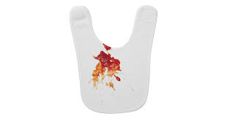
LET´S READ

Slide 30
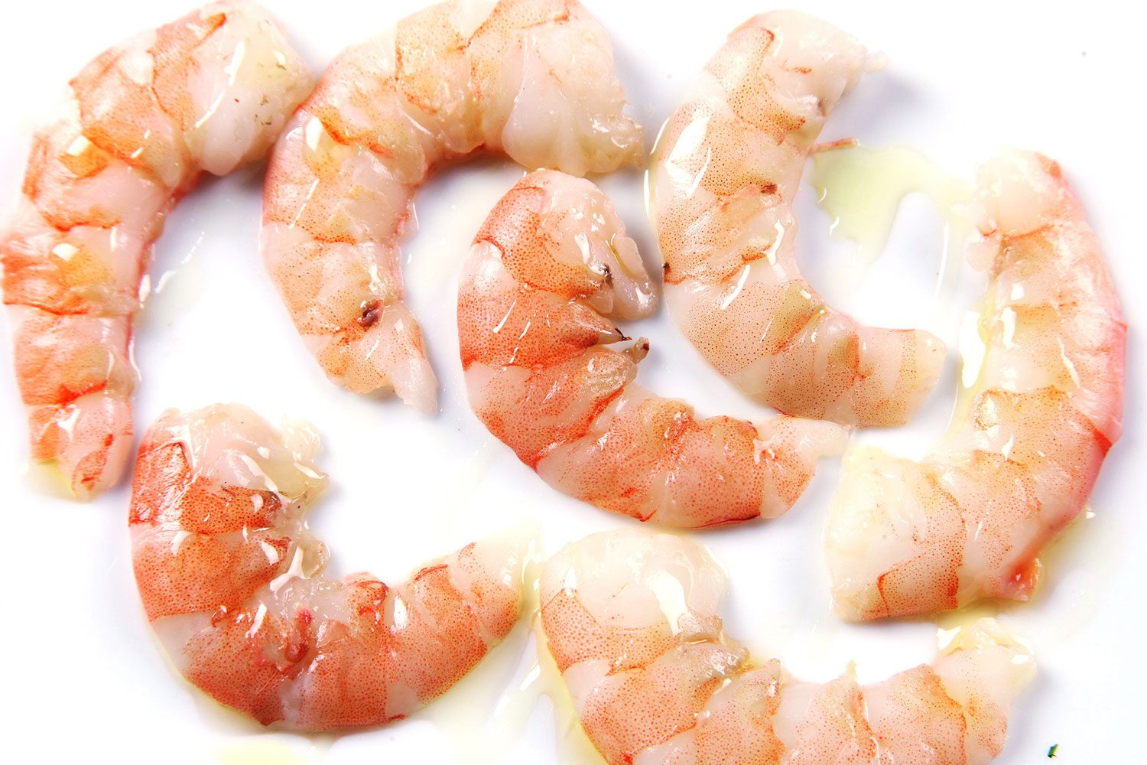
LET´S READ

