Slide 1
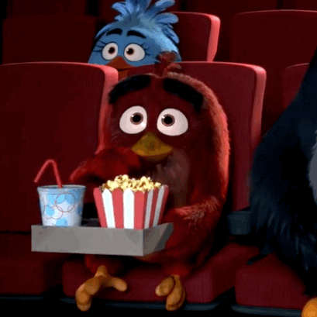
Unit 6A
Movies
By Carol

Slide 2
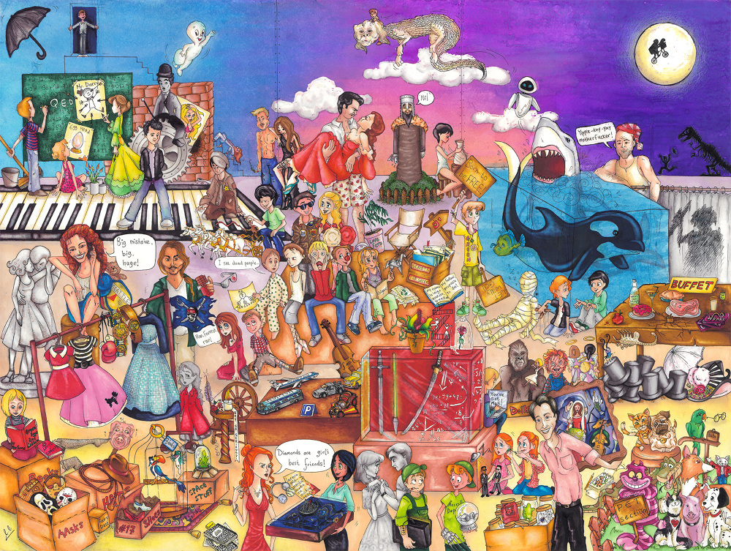

Slide 3

Some questions before we continue…
What is your favorite movie genre ?

Slide 4
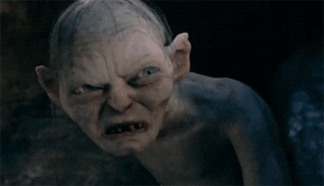
What is your favorite movie?
My favorite movie is …

Slide 5
The Lord of the Rings
The movie was adapted from Tolkien´s books.
It is set in the Middle Earth.
It has been dubbed to more than 30 languages.
Passive Voice
TO BE + PARTICPLE

Slide 6
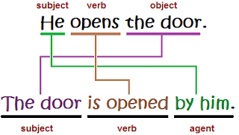
Passive Voice

Slide 7
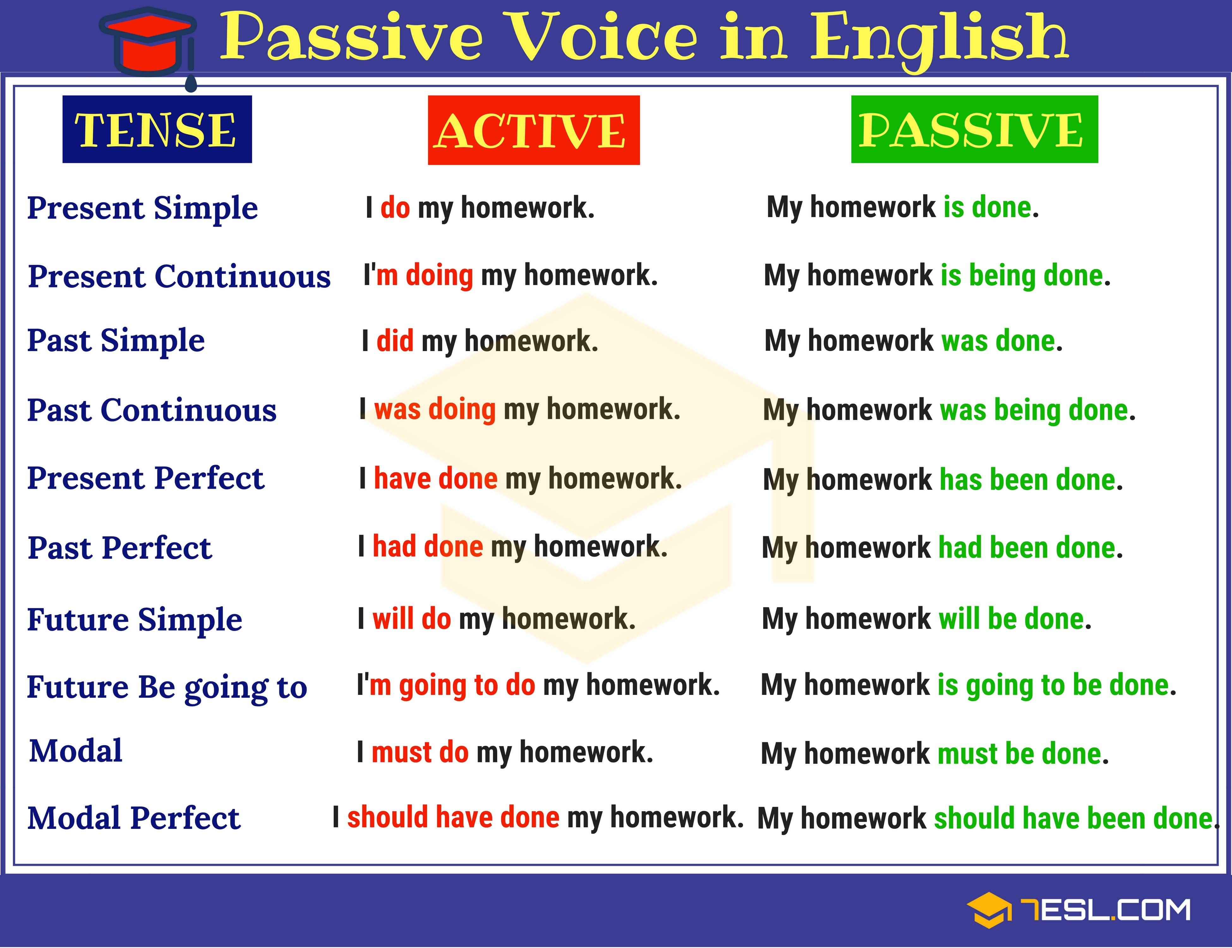

Slide 8
Let´s try together
1. Indians film more than 1000 movies per year.
More than 1000 movies are filmed BY Indians every year.
2. Sally is repairing the car right now.
The car is being repaired right now.
3. The band stole the painting in ten minutes.
The painting was stolen in 10 minutes

Slide 9
Let´s try together
4. He was dubbing the movie when it was cancelled.
The movie was being dubbed when it was cancelled.
5. The fans will give the cast of the series a surprise at the airport.
The cast of the series will be given a surprise at the airport.
6. The screenwriters have changed the last season.
The last season has been changed by the screenwriters

Slide 10
HOMEWORK

Slide 11
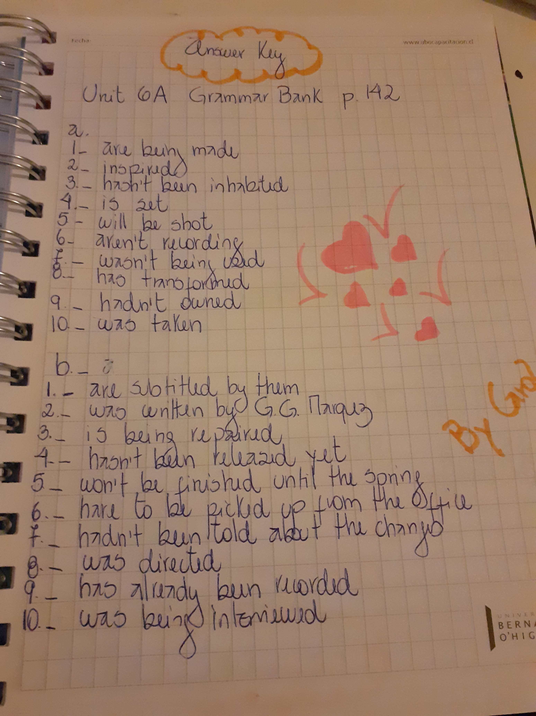

Slide 12
FURTHER PRACTICE
https://www.youtube.com/watch?v=nkAyggAM1q4
https://www.perfect-english-grammar.com/passive-exercise-5.html
https://agendaweb.org/exercises/verbs/passive-write-1

Slide 13
VOCABULARY!

Slide 14
VOCABULARY

Slide 15
VOCABULARY

Slide 16
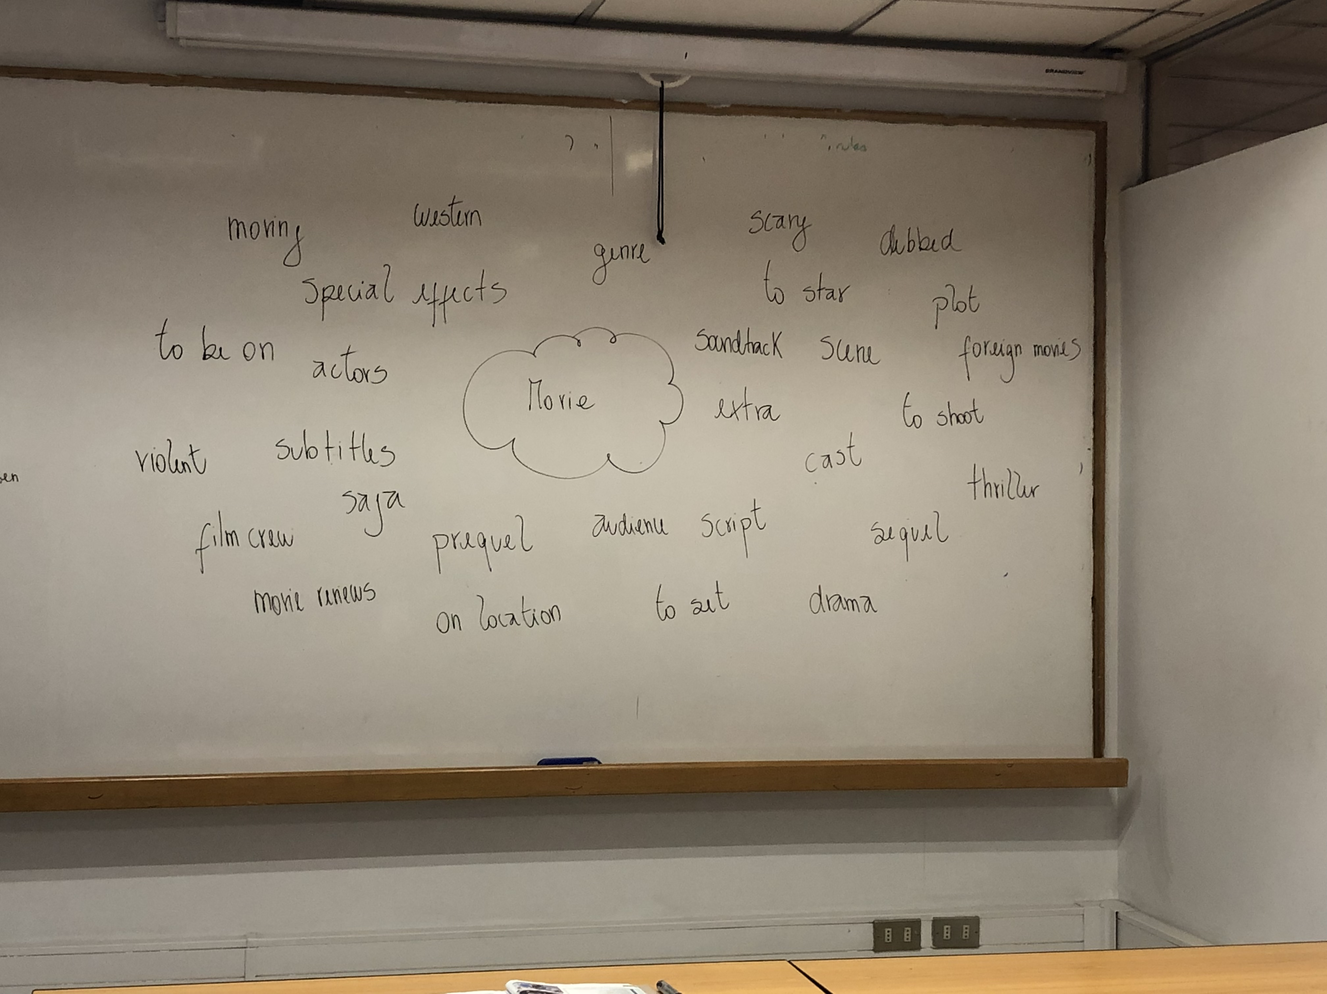

Slide 17
-

Slide 18
MOVIES
1. What is your favorite genre of movie?
2. Who is your favorite actor?
3. What kind of movie is best for a date?
4. Do you ever cry during movies?
5. What is the best movie you have ever seen?
6. What is the scariest movie you have ever seen?
7. How often do you see movies?
8. Do you usually watch movies at the theater or watch them at home?
9. Do you buy DVDs or download movies?
10. What is the best snack to eat during a movie?
11. What do people do during movies that really annoys you?
12. Which is more important, acting or special effects?
13. If you could make a movie, what would it be about?
14. If someone made a movie of your life, what kind of movie would it be?-

Slide 19
REFERENCES
https://www.shakedsheinman.com/Movies-game
http://theblogofseconda.blogspot.com/2018/01/the-passive-voice.html

