Slide 1
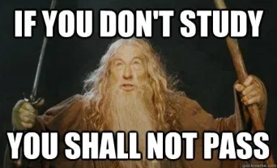
UNIT7A EDUCATION
By Misscarosama

Slide 2
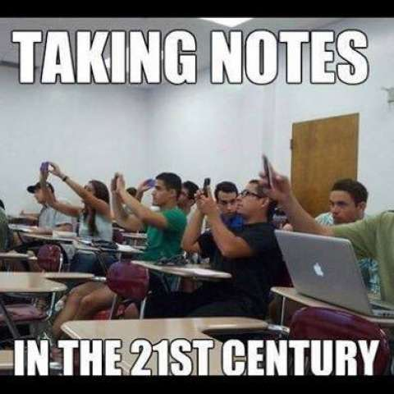

Slide 3
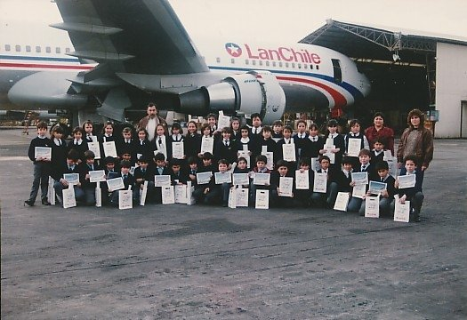
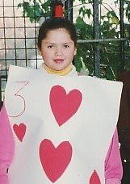
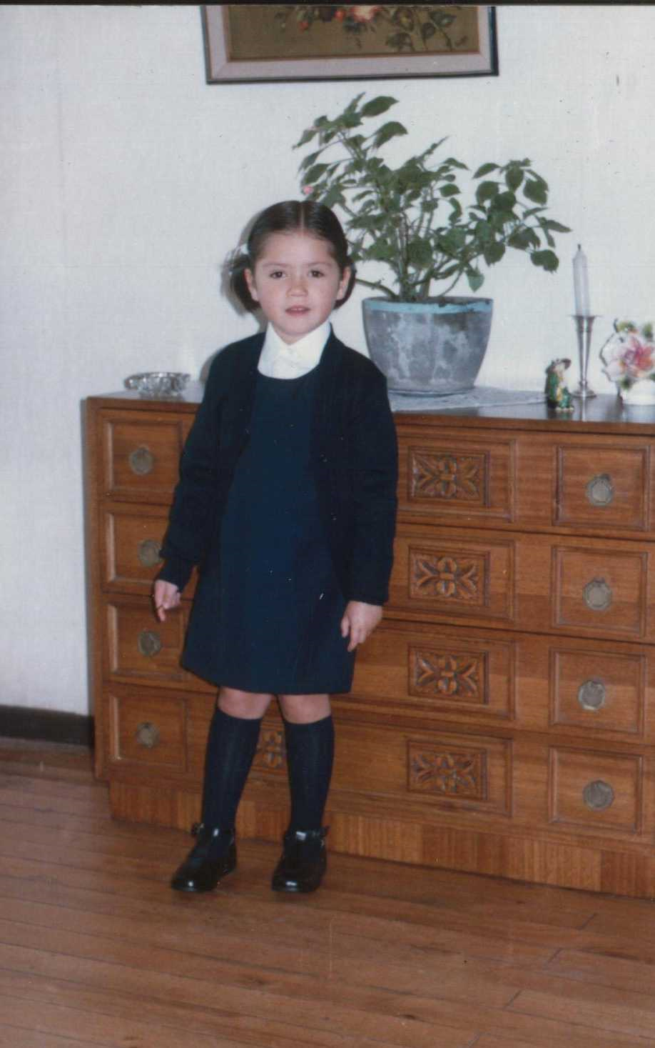
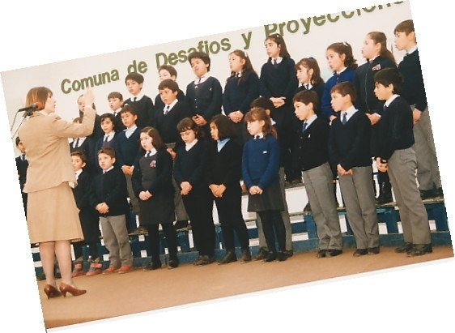
When carol was at school…

Slide 4
vocabulary

Slide 5

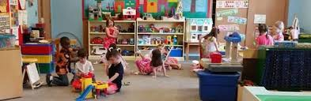
vocabulary

Slide 6
vocabulary

Slide 7
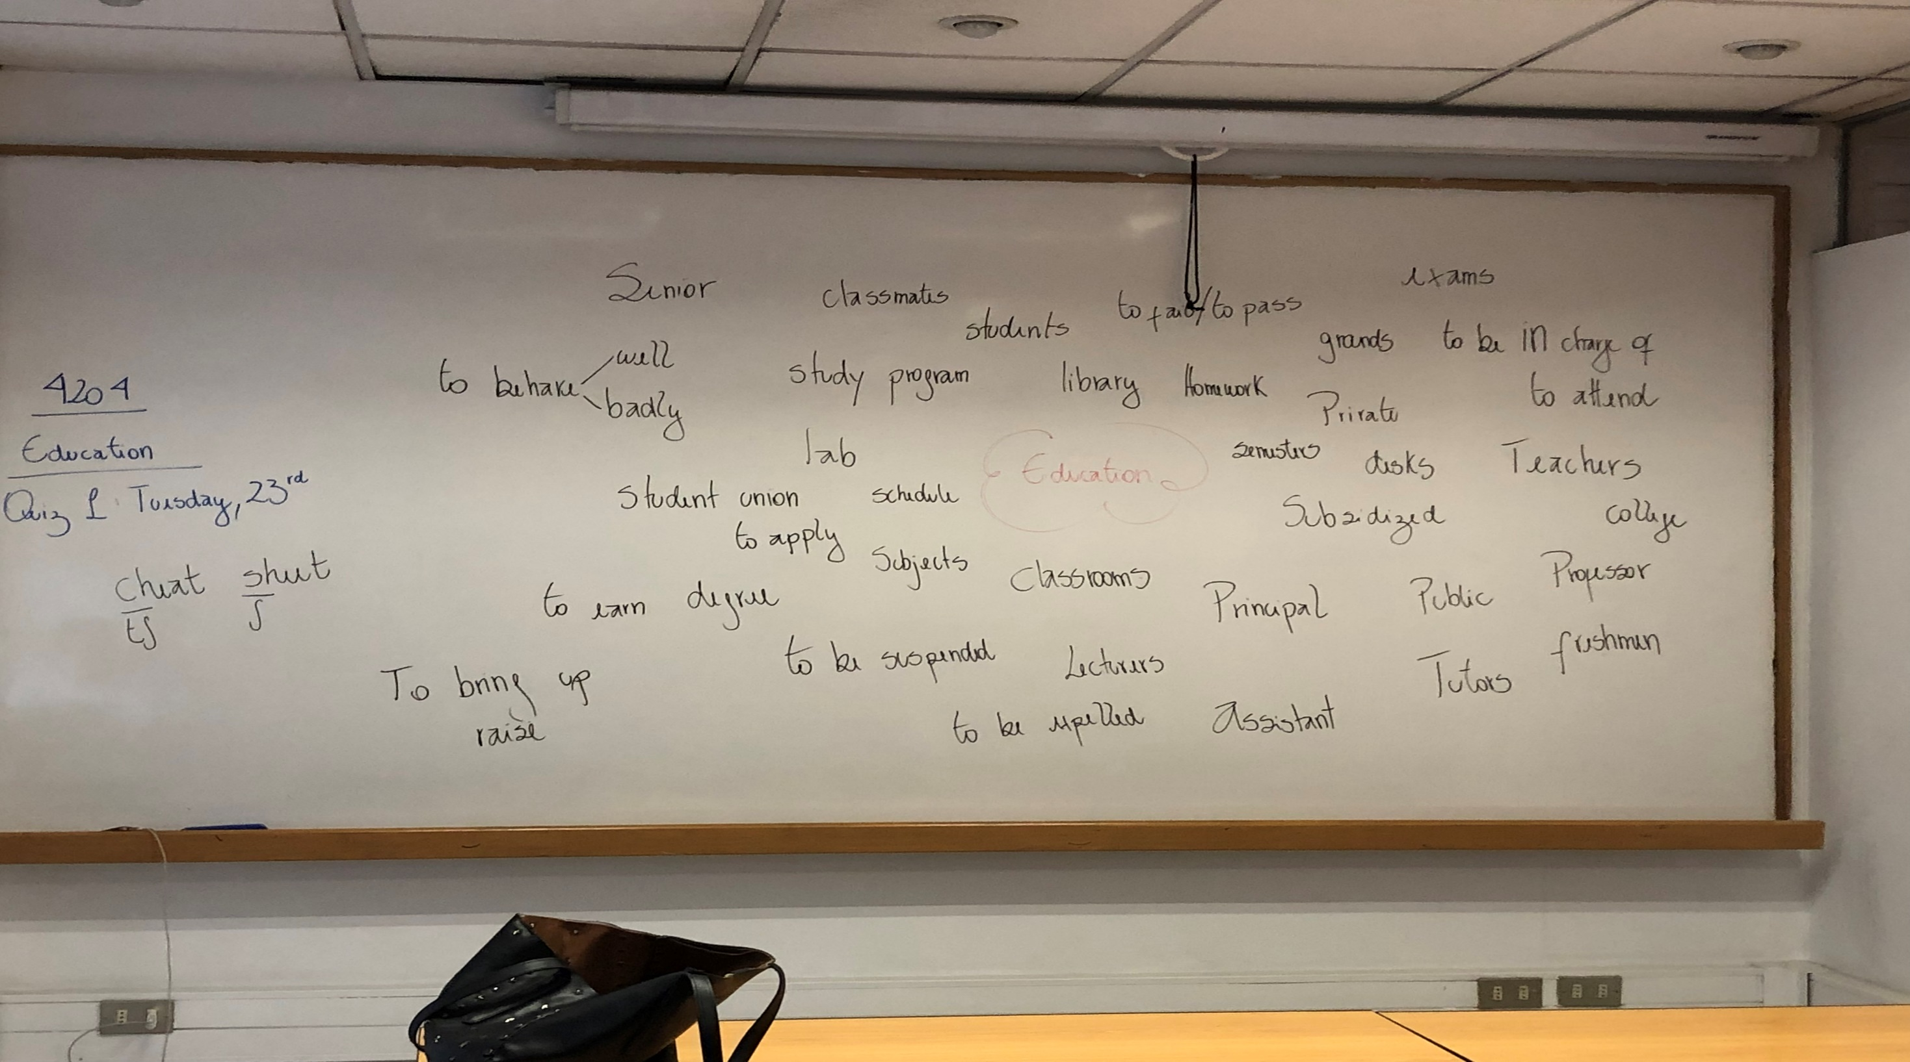

Slide 8
Debate time
Boys and girls both learn better in single sex schools
Schools should let children wear whatever they want at school
Cooking and housework should be taught at school
Schools don´t teach children the important things they need to know to be an adult
Physical education should be optional

Slide 9
Debate time
School summer vacations should be shorter
Children spend too much time at school on math and IT and not enough on things like music, art and drama
Private schools are usually better than public schools

Slide 10
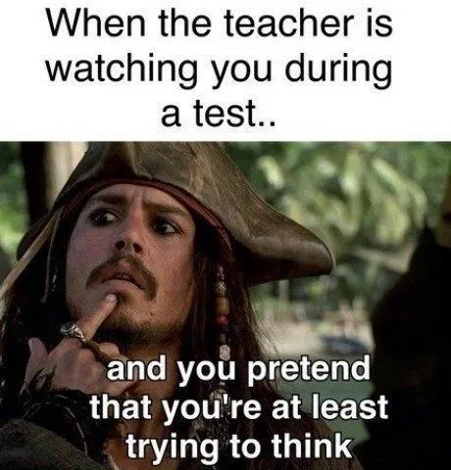
Tests
When was the last time you took an exam? Did you pass or fail?
How do you feel before you take an exam?
What do you usually do the night before an exam?
Have you ever failed an important exam you thought you had passed (or vice versa)?
What is the most important test you have ever taken?

Slide 11

tests

Slide 12


If I don´t pass the test, my parents will kill me.
My parents will kill me if I don´t pass the test
FIRST CONDITIONAL
Present Simple
Will-can-may/Imperative

Slide 13
As soon as I pass the test, I will celebrate.
FUTURE TIME CLAUSES
Time markers
Present Simple
Will
When
Until
Before
After

Slide 14
Let´s practice

Slide 15
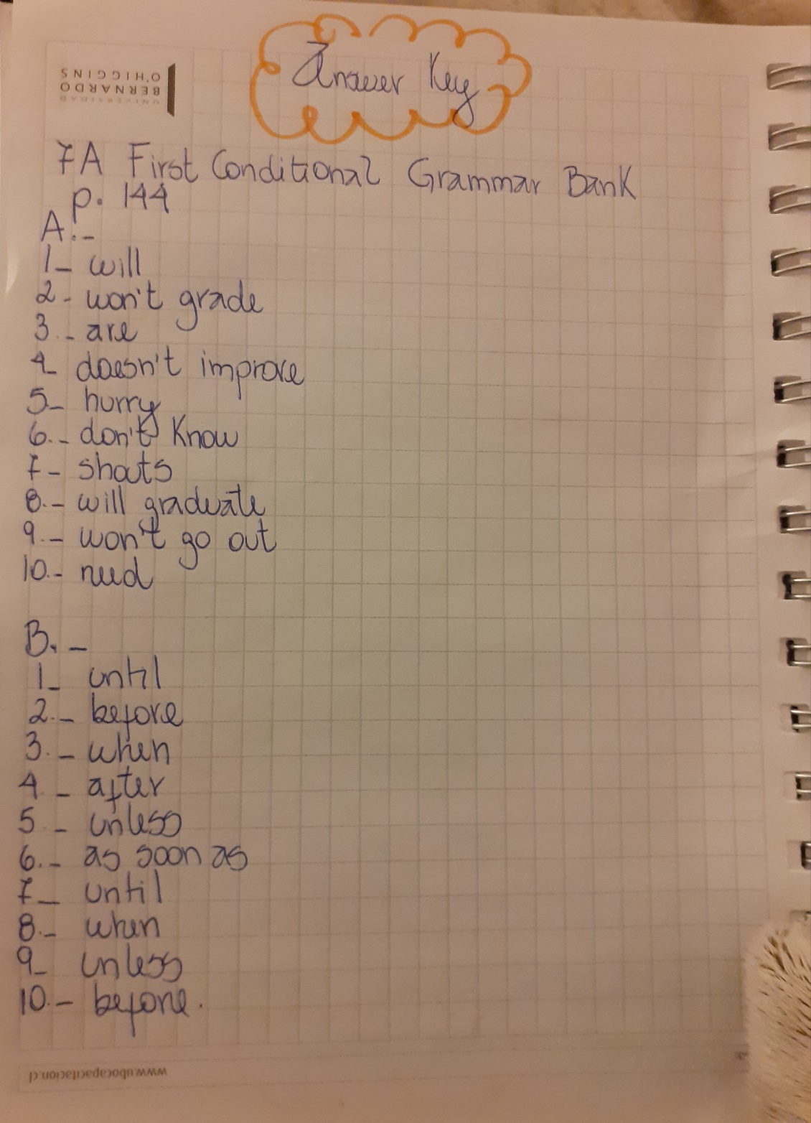

Slide 16
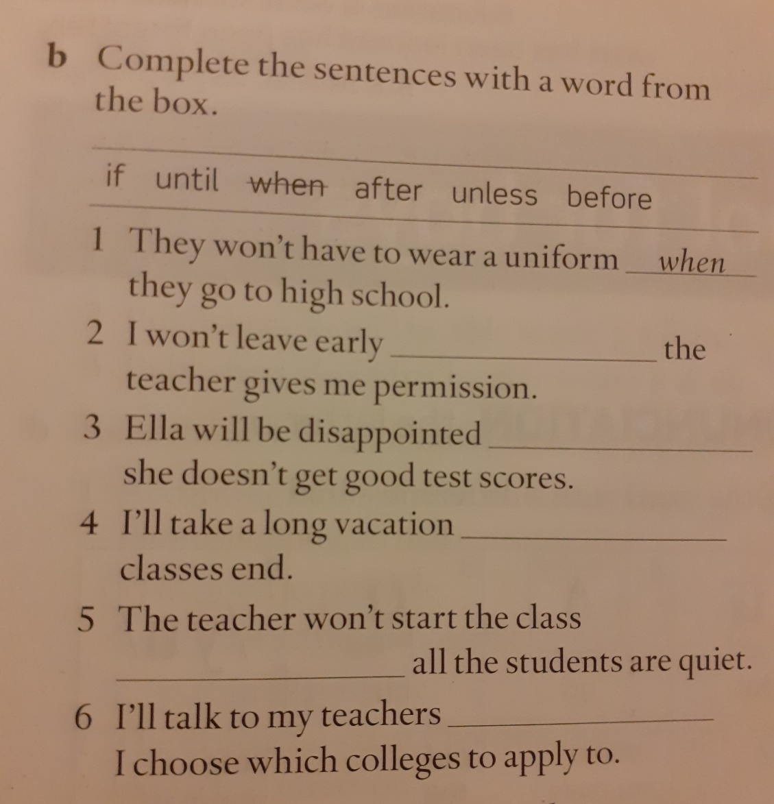
Let´s practice

Slide 17
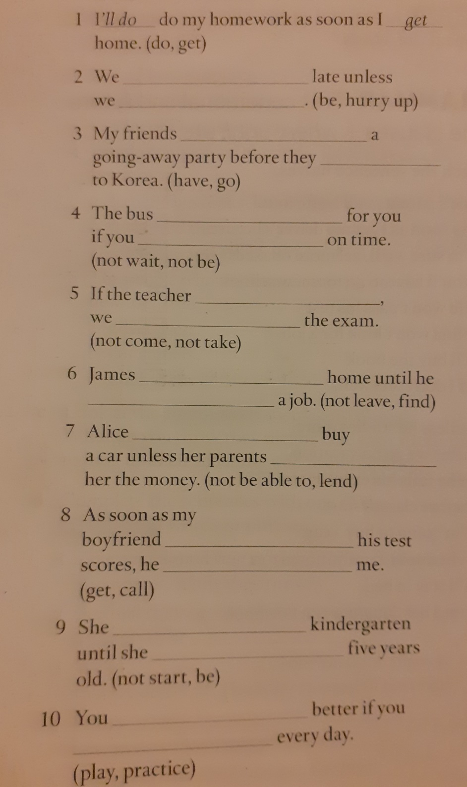
Let´s Practice

Slide 18
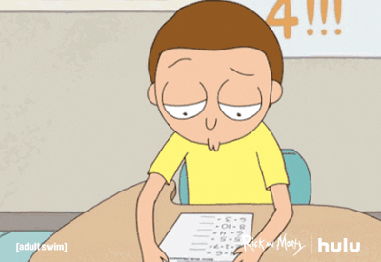
What would you study if you didn´t
study in Beauchef?

Slide 19



If I didn´t study in Beauchef, I would study cooking.
I would study cooking, If I didn´t study in Beauchef.
SECOND CONDITIONAL
Past Simple
Would/Could/
Might

Slide 20

HEY! WATCH OUT
BE CAREFUL

Slide 21



SPECIAL CASE IN SECOND CONDITIONAL
If I was younger, I would travel to live in another country.
If I were younger , I would travel to live in another country.
Both are correct!!
WAS
INFORMAL
SPOKEN ENGLISH
WERE
FORMAL
WRITTEN ENGLISH

Slide 22
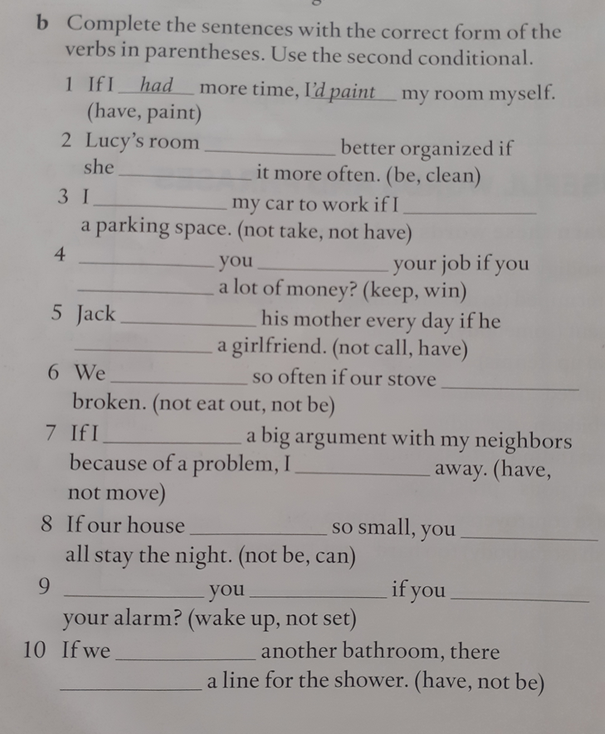
LET´S PRACTICE
ANSWER KEY
had /’d paint
would be / cleaned
wouldn´t take / didn´t have
Would you keep / won
would call / had
wouldn´t eat out / wasn´t – weren´t
had/ wouldn´t move
wasn´t – weren´t /could
Would you wake up / didn´t set
had / wouldn´t be

Slide 23


First conditional v/s Second Conditional
Have you met this guy?

Slide 24

IN CONDITIONALS EVERYTHING IS ABOUT…
SO, HOW DOES JASON MOMOA CONNECT WITH ENGLISH CONDITIONALS?

Slide 25
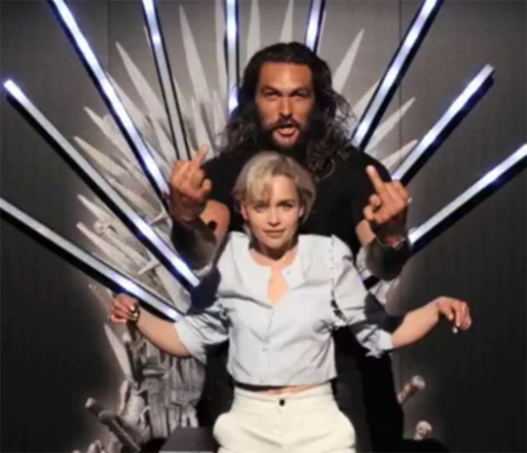
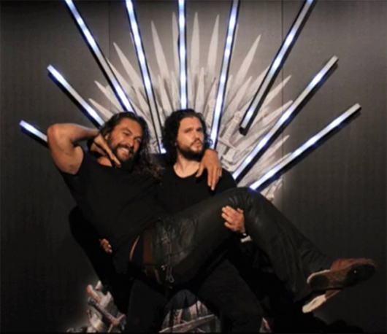
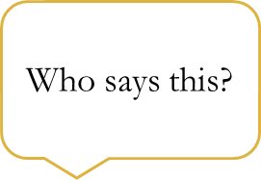

First Conditional
If Jason forgets his part of the script, I will help him memorize it.

Slide 26
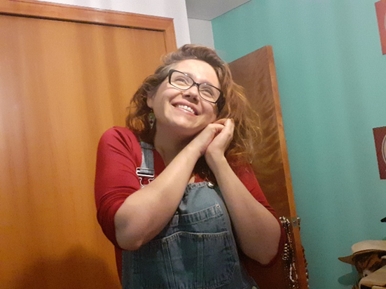
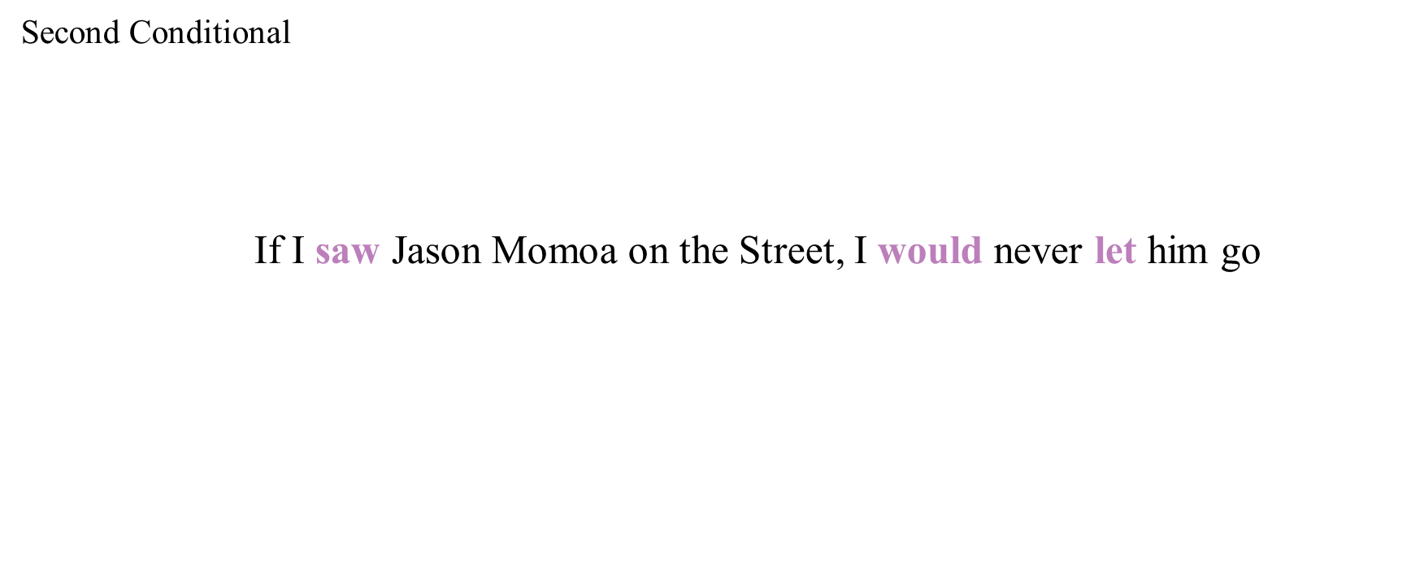
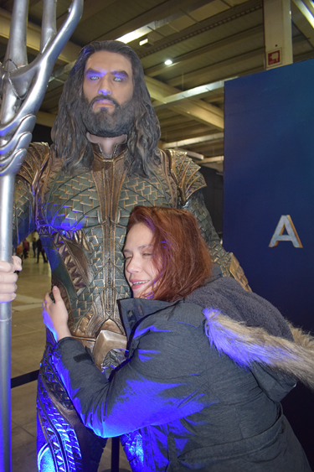



Slide 27
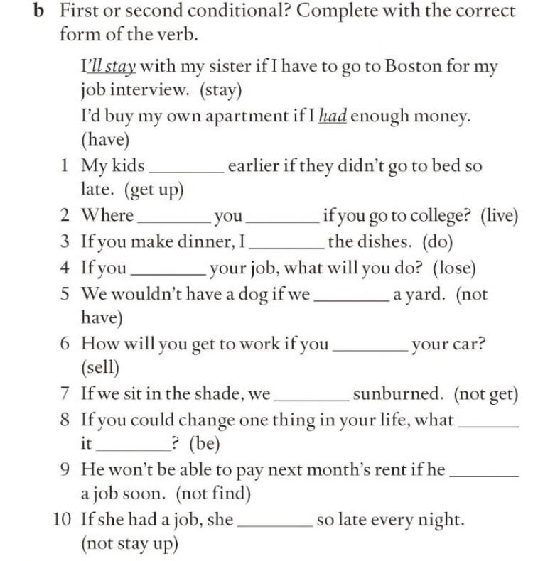
LET´S PRACTICE

Slide 28

If you had to choose one thing , only one thing
to change from the Chilean
educational system, what would you change?

Slide 29
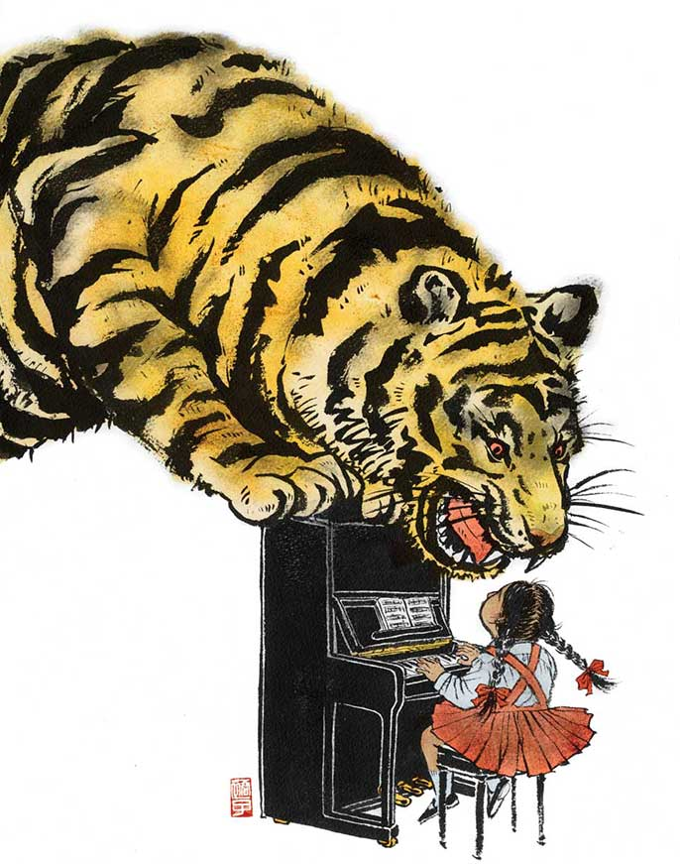
Reading : What is a tiger mother?

Slide 30
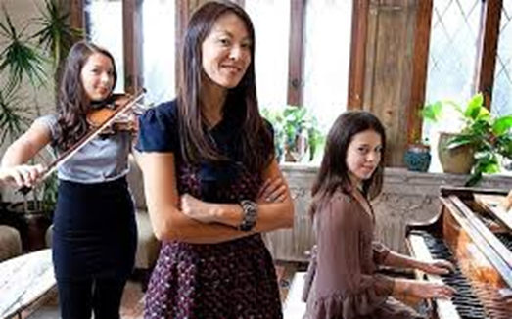

Slide 32
The Tiger Mother
Delighted
Prodigy
To forbid
To wonder
To excel in
Outstanding
To rebel
To give up
To take up
To resent
To bring up

Slide 33
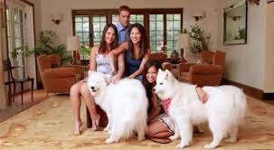
The tiger Mother
https://www.youtube.com/watch?v=yxybZpaJTP4

Slide 34
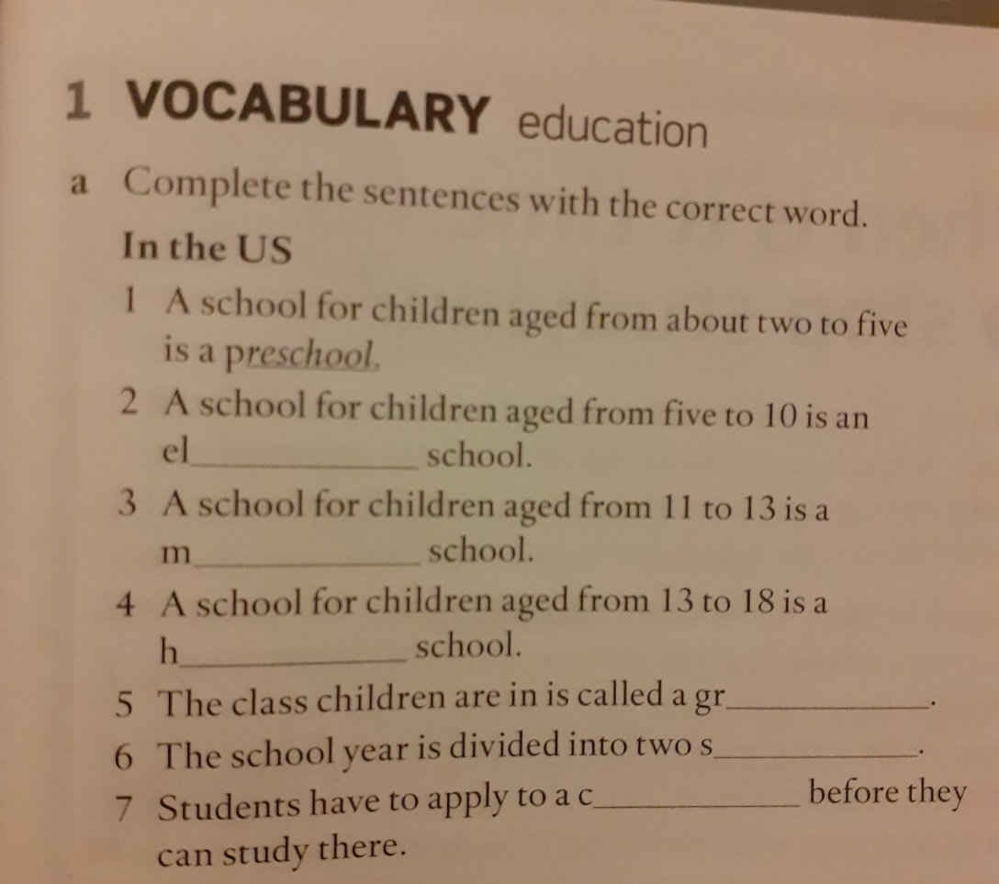
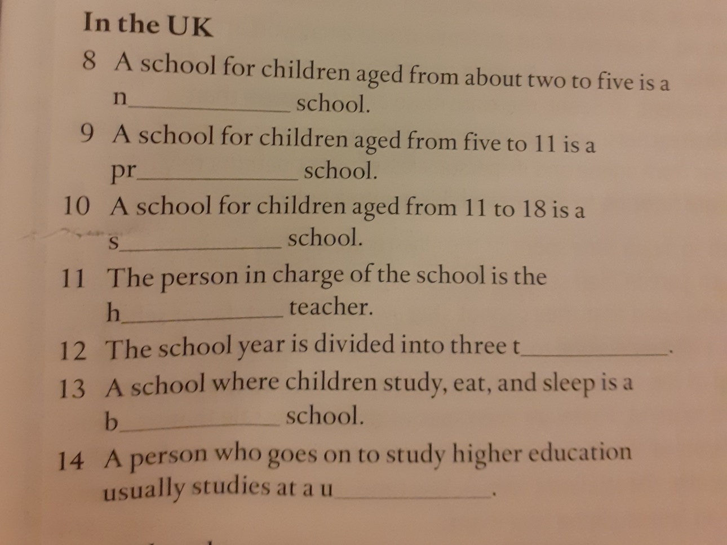
Vocabulary practice

Slide 35
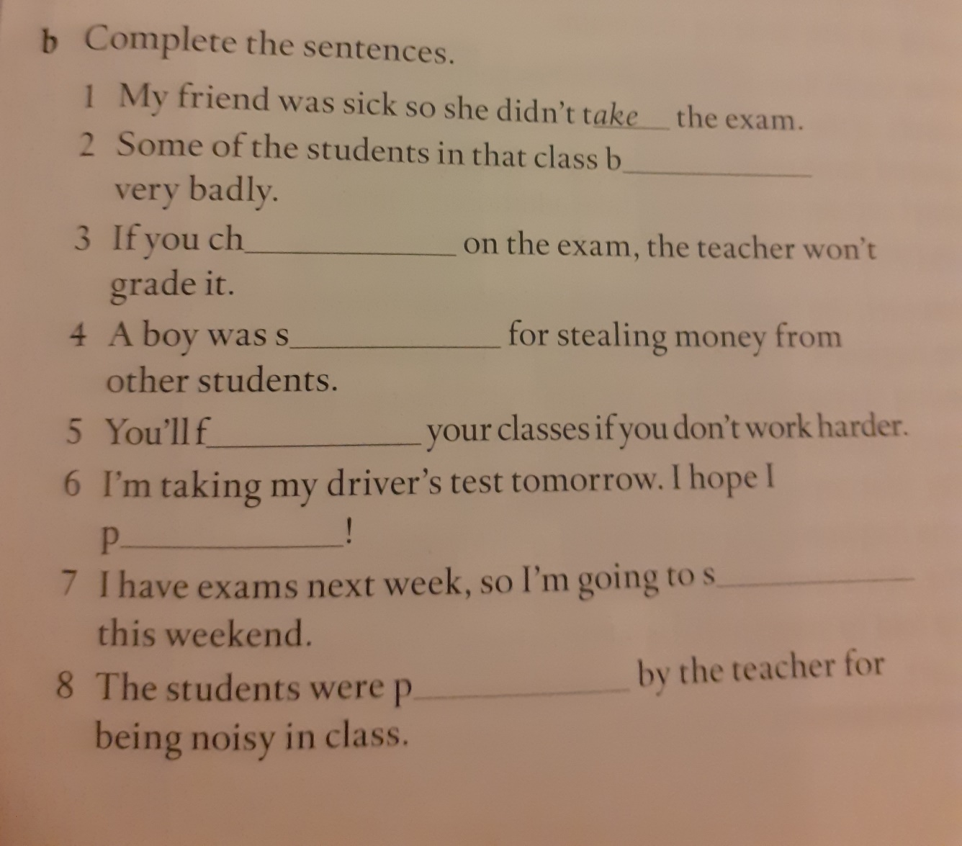
Vocabulary practice

