Slide 1
MONEY $$$$
4204 UNIT 2A

Slide 2
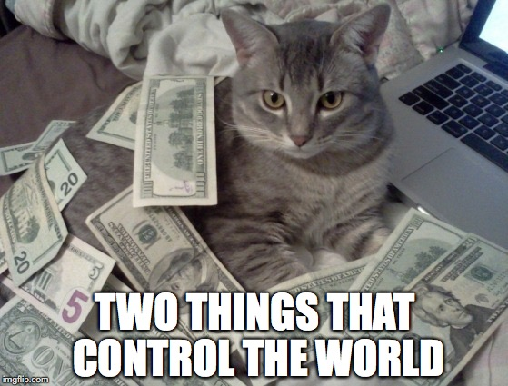
GET IN GROUPS AND ANSWER THE QUESTIONS
Where do you get your money from?
What do you do with it?
Are you Good at making money?

Slide 3
vocabulary

Slide 4

vocabulary
Spend ON
Invest IN

Slide 5
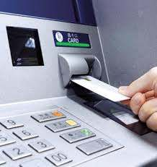
vocabulary

Slide 6


Slide 7
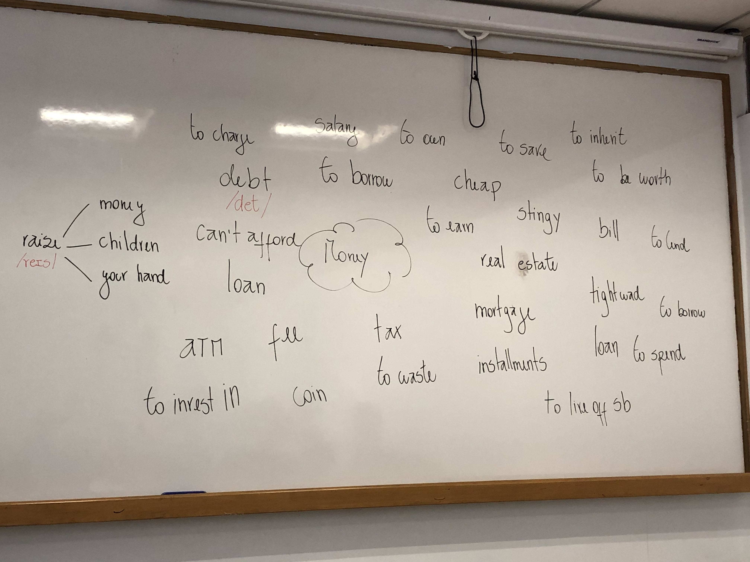

Slide 8
homework

Slide 9
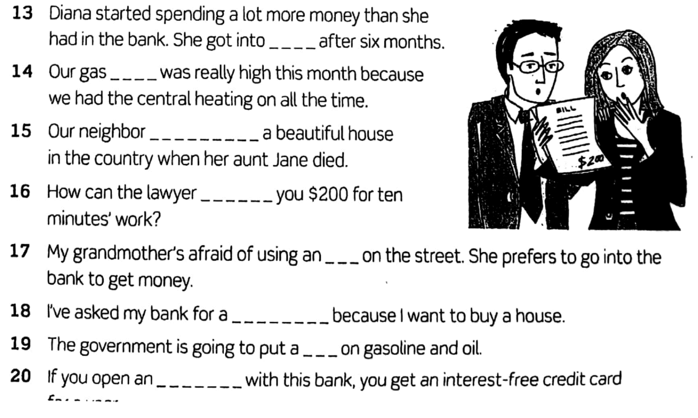
homework

Slide 10
speaking

Slide 11


Slide 12

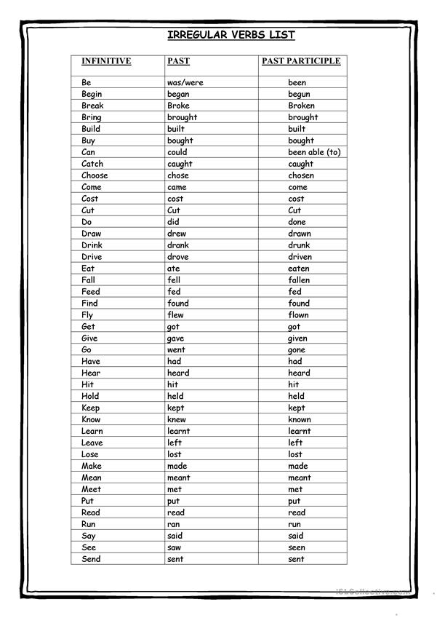
I have worked in beauchef for 12 years
Have/haven´t + past participle
has/hasn´t (she, he , it)

Slide 13

Watch out!
Be cautious
The Present Perfect is your enemy

Slide 14
Use 1 : ongoing action from the past
I have worked in beauchef for 12 years
I have worked in beauchef since 2008
2008
now

Slide 15


Use 2: indefinite past
I have visited la serena twice
I visited la serena in 2018 (you know when)

Slide 16
Use 3: recent past
I have washed my hair
v/s
I washed my hair

Slide 17
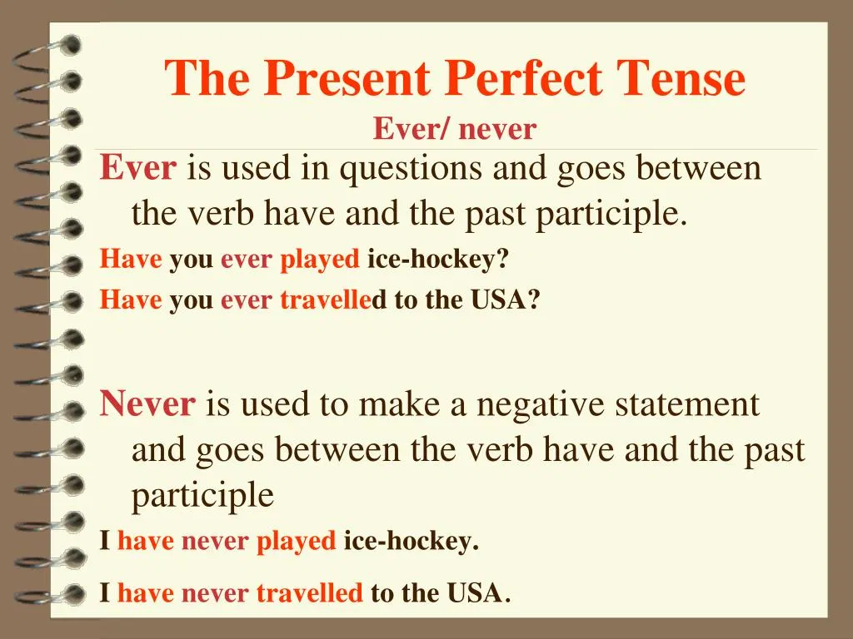
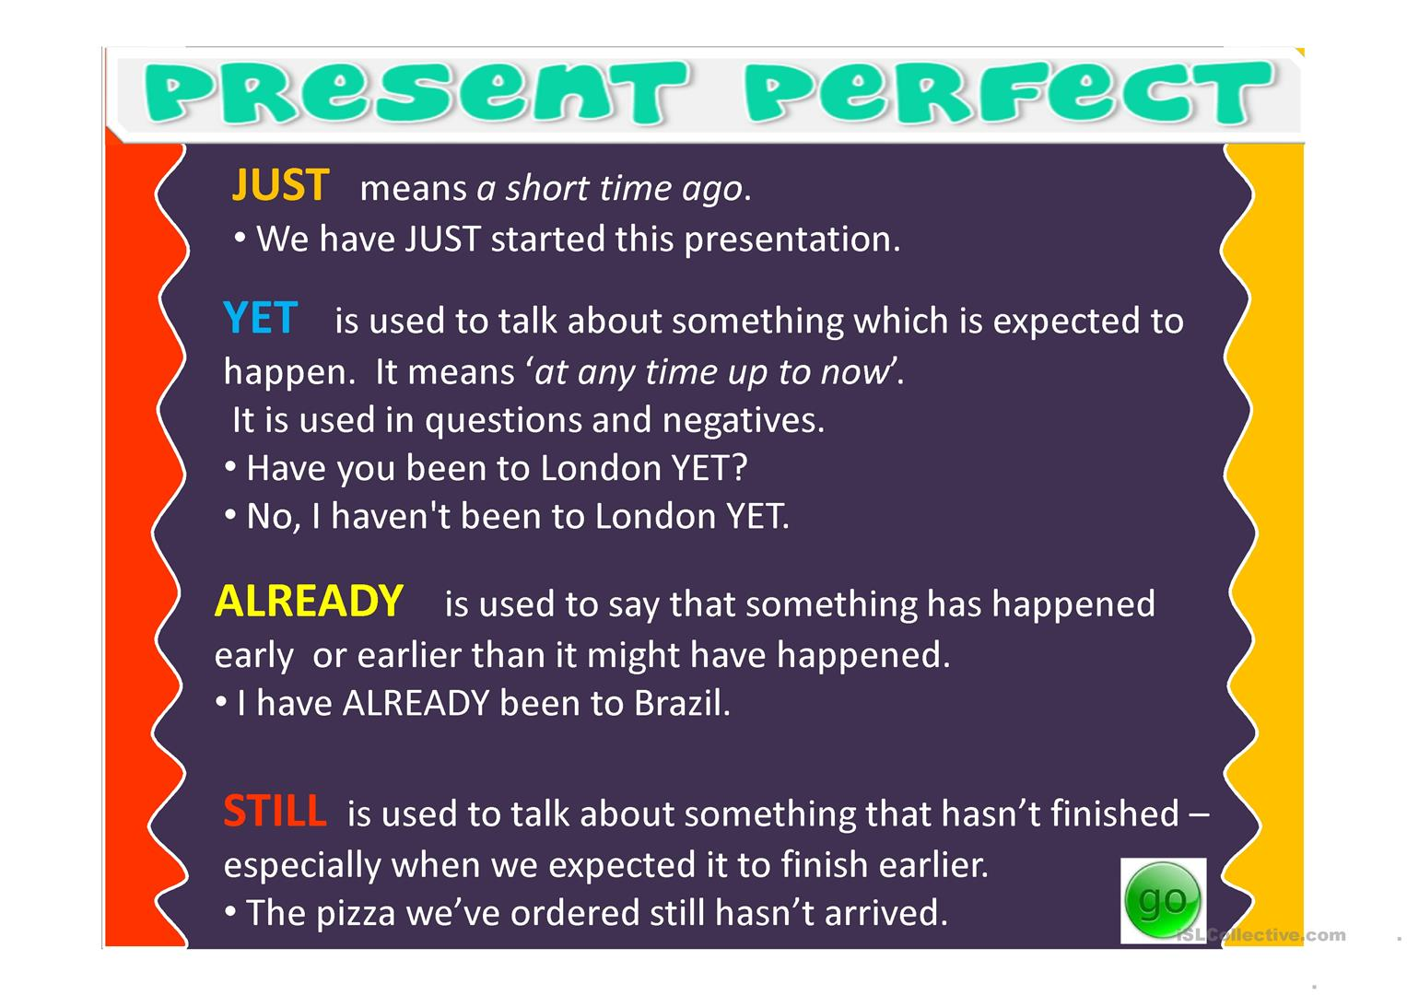

Slide 18

PAY ATTENTION…
He has been to atacama
(twice in my life but not now)
He has been in atacama
(for 5 years, I´m still there)
He has gone to atacama
(he is visiting atacama and is still there)

Slide 19
Let´s practice

Slide 20
speaking
Let´s play…
Never have I ever
The first player starts by saying a simple statement about what they have never done before starting with "Never have I ever". Anyone who at some point in their life has done the action that the first player says, must drink. Then the game continues around the circle, and the next person makes a statement.

