Slide 1
The perfect date
By Carol

Slide 2


Describing people

Slide 3
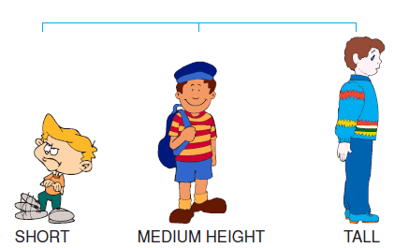
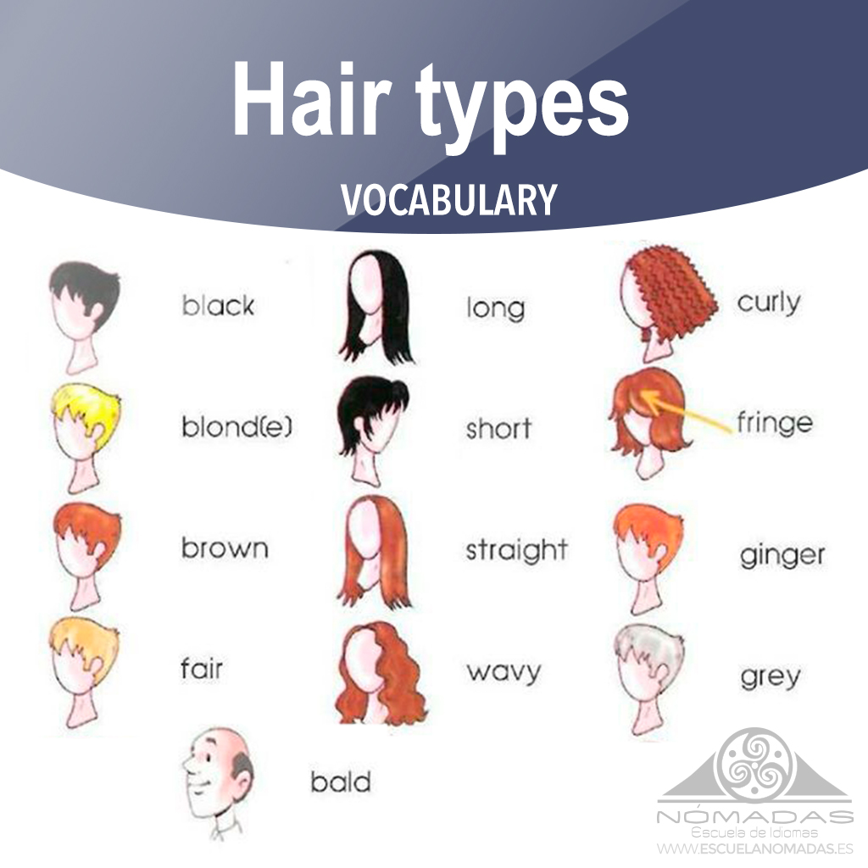
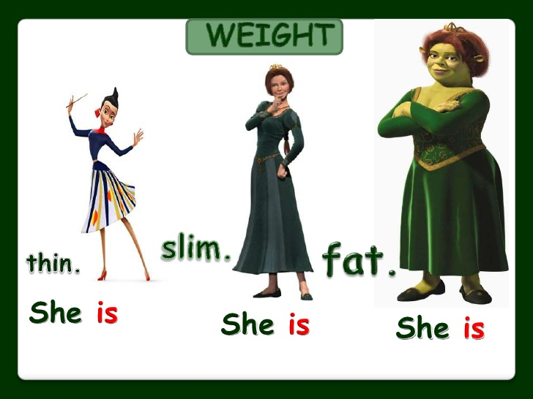
What do you look like?
Overweight

Slide 4
What are you like?

Slide 5


Some things to remember
Physical description
WHAT DO YOU LOOK LIKE?
WHAT ARE YOU LIKE?
Psychological description

Slide 6
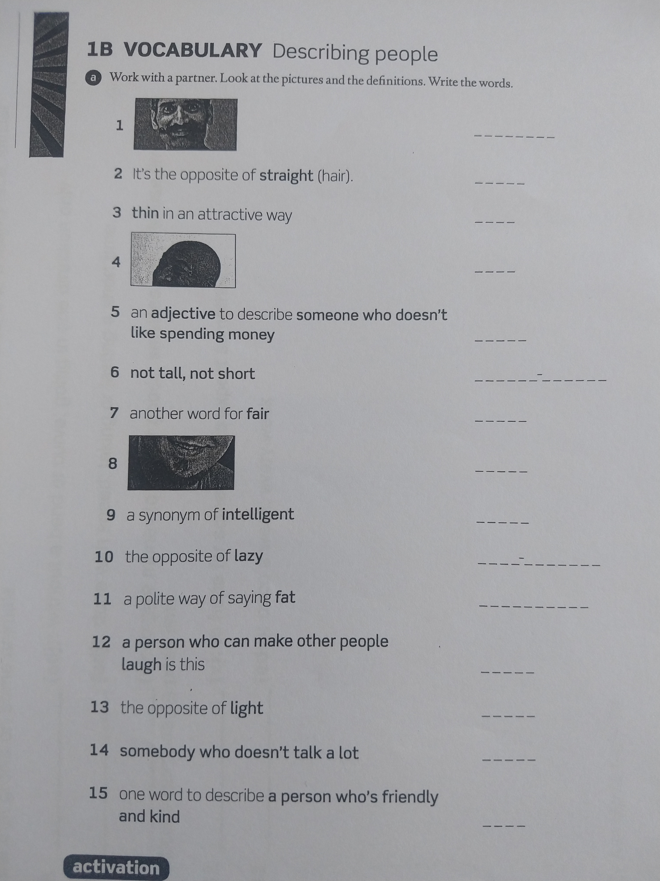
HOMEWORK

Slide 7
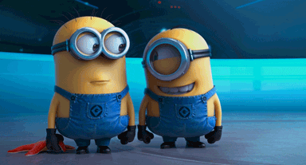
To Laugh /laf/

Slide 8

Alexander
Oliver

Slide 9
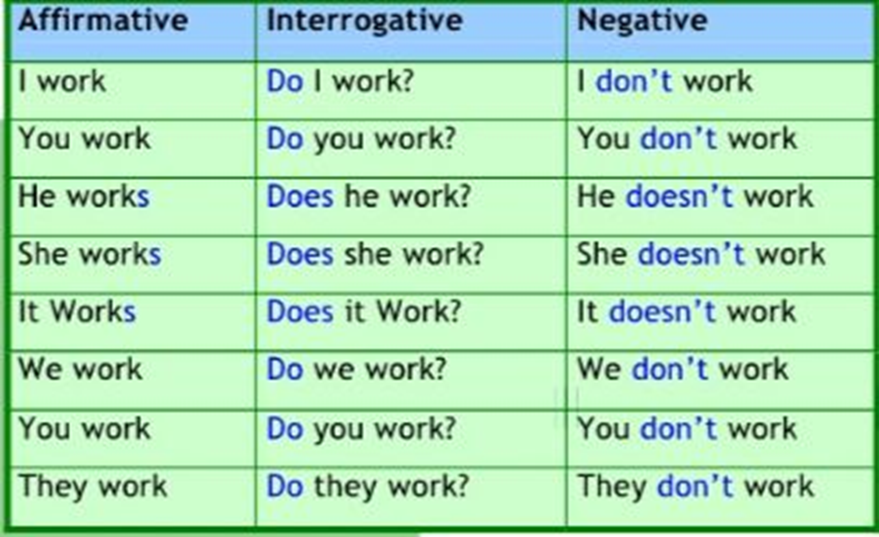

Slide 10
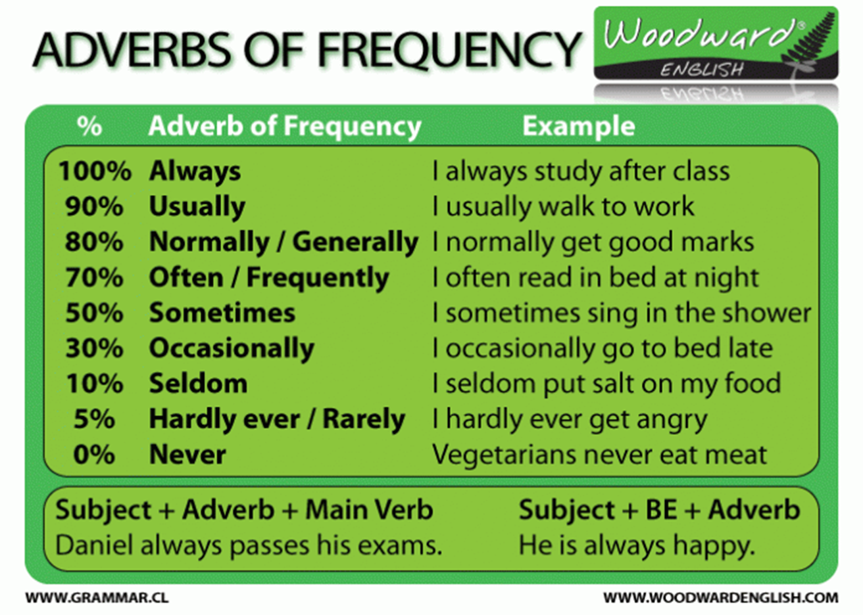

Slide 11
LET´S PRACTICE

Slide 12
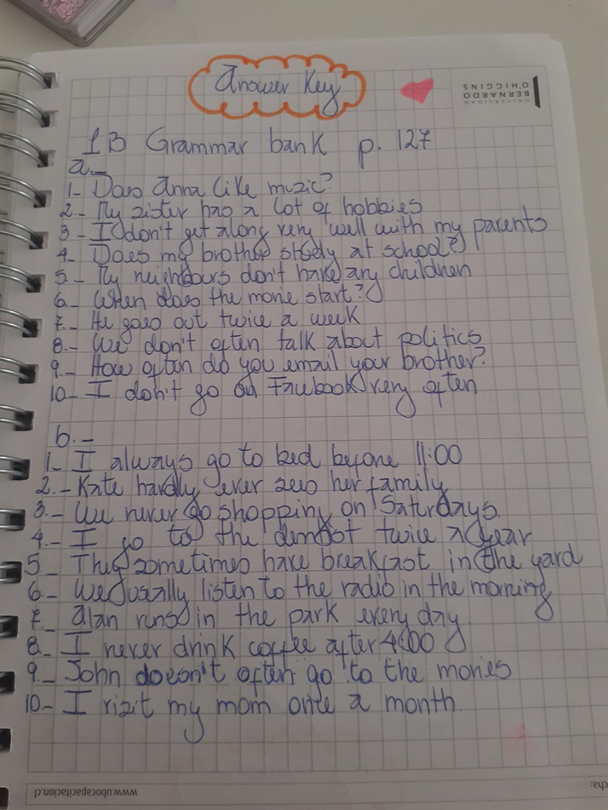


Slide 13
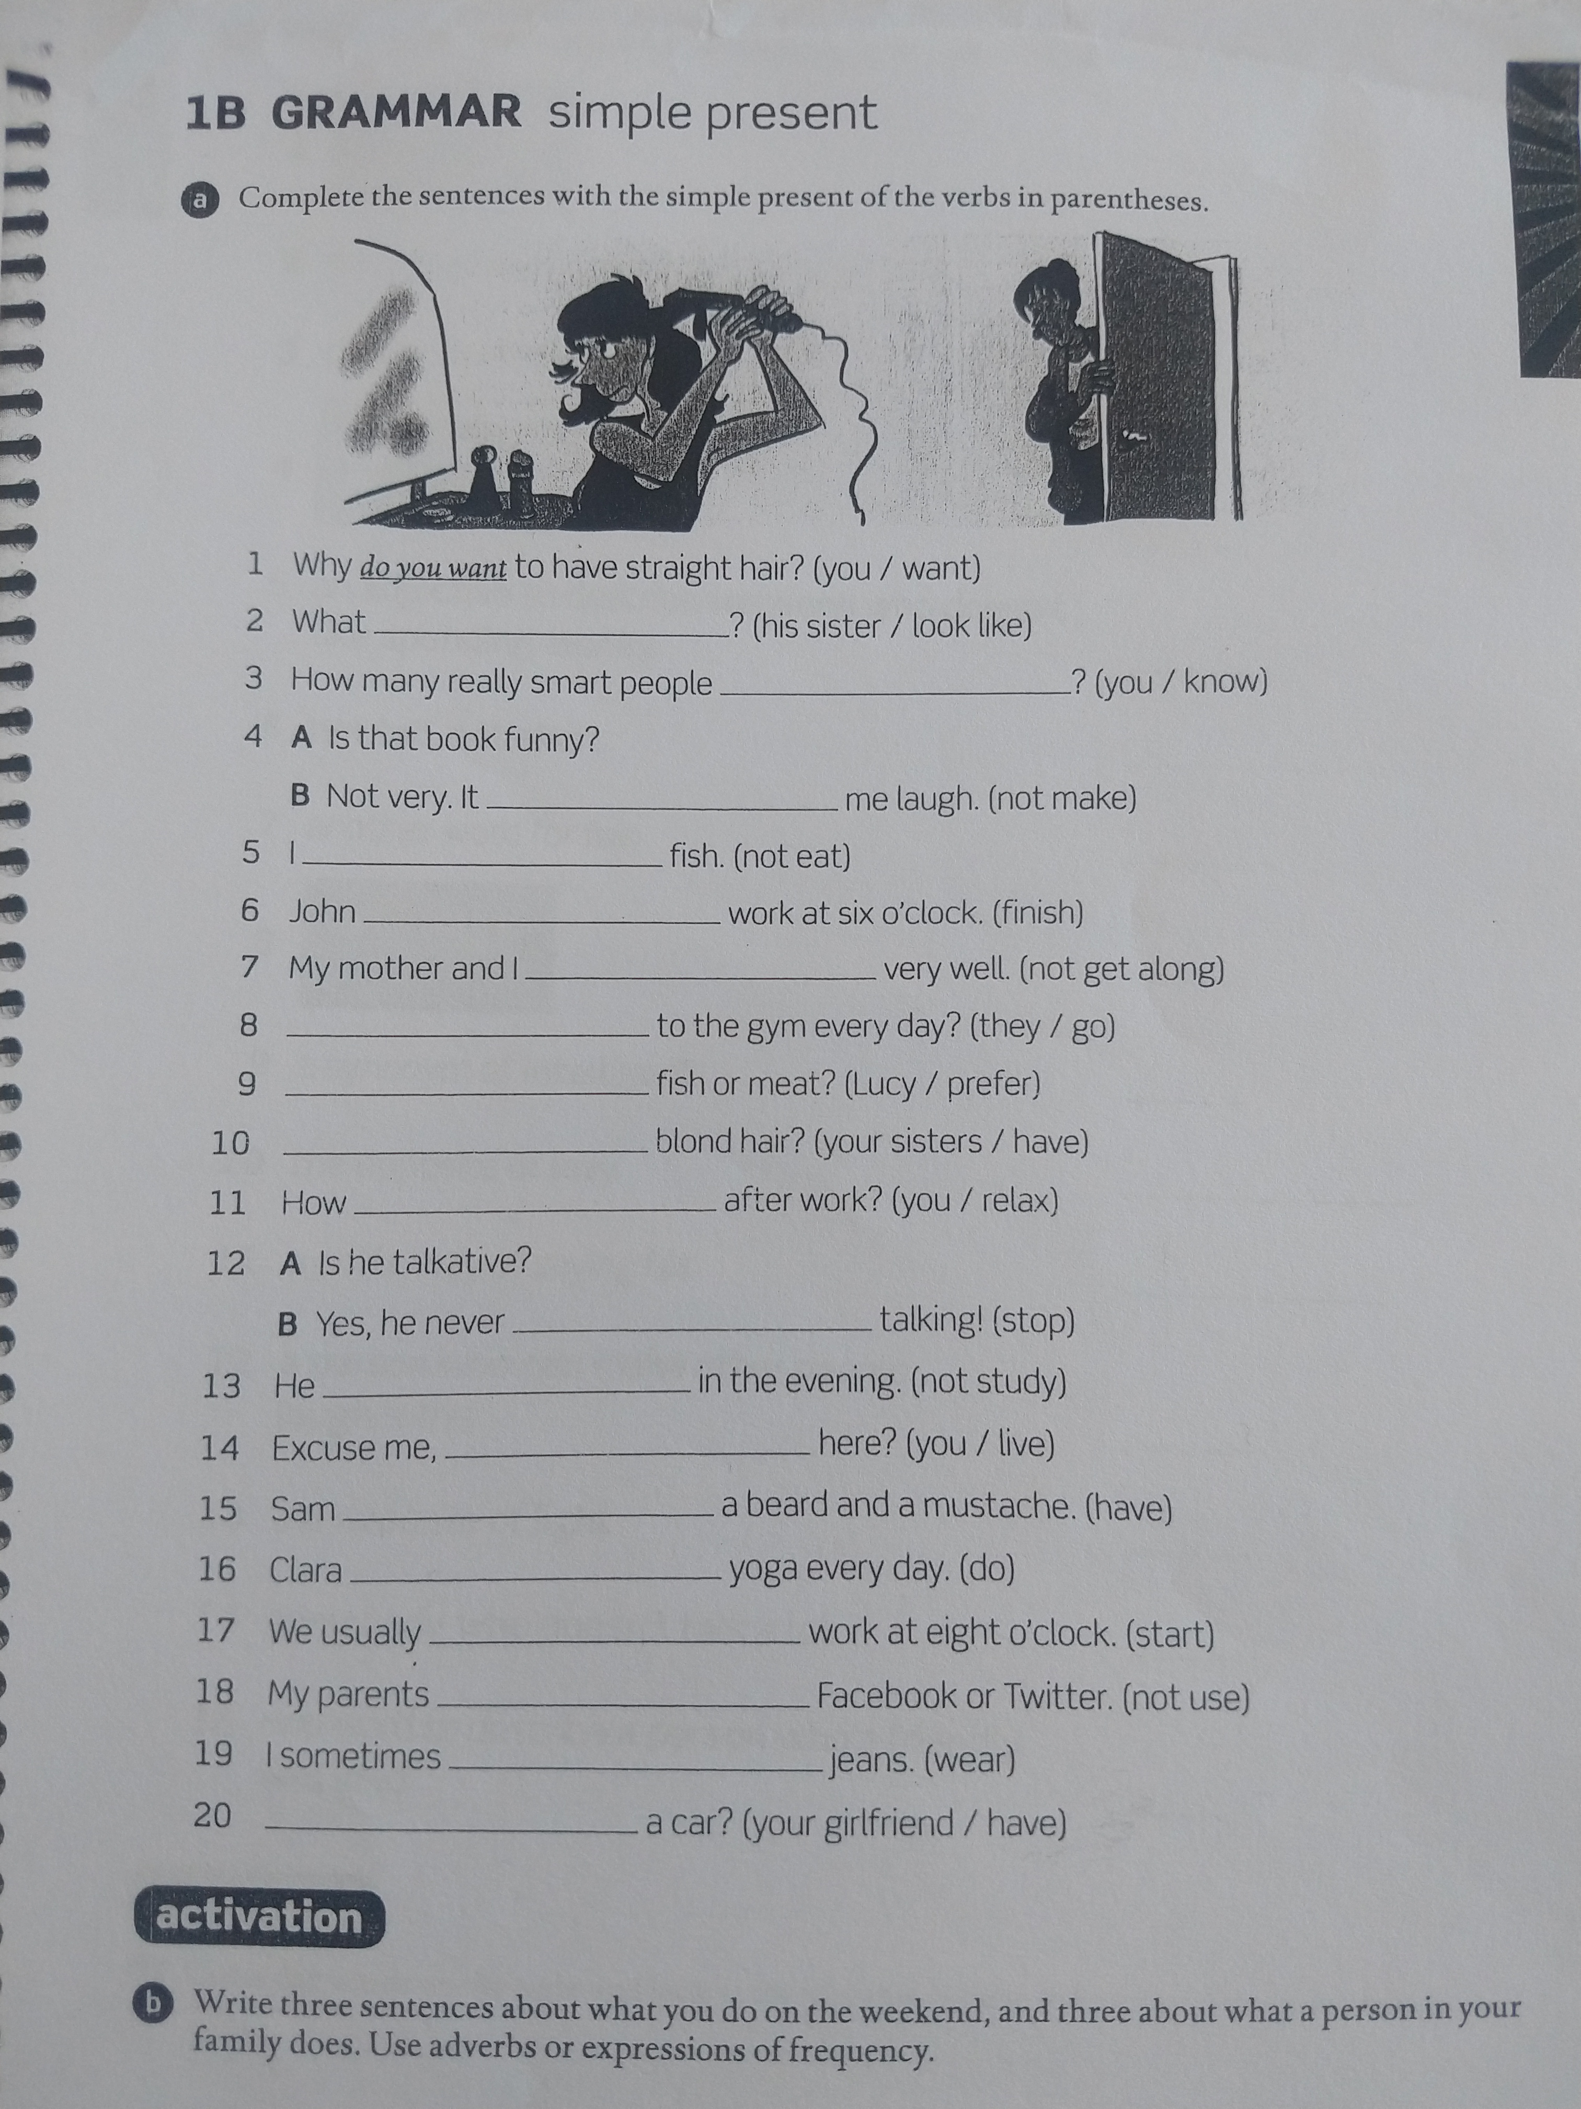
HOMEWORK

Slide 14
If you still do not understand…
https://www.youtube.com/watch?v=X4bhy5uDQUE
https://www.really-learn-english.com/simple-present-exercises.html#01

