Slide 1
UNIT 1C

Slide 3


Slide 4
CLOTHES

Slide 5
CLOTHES

Slide 6
CLOTHES

Slide 7
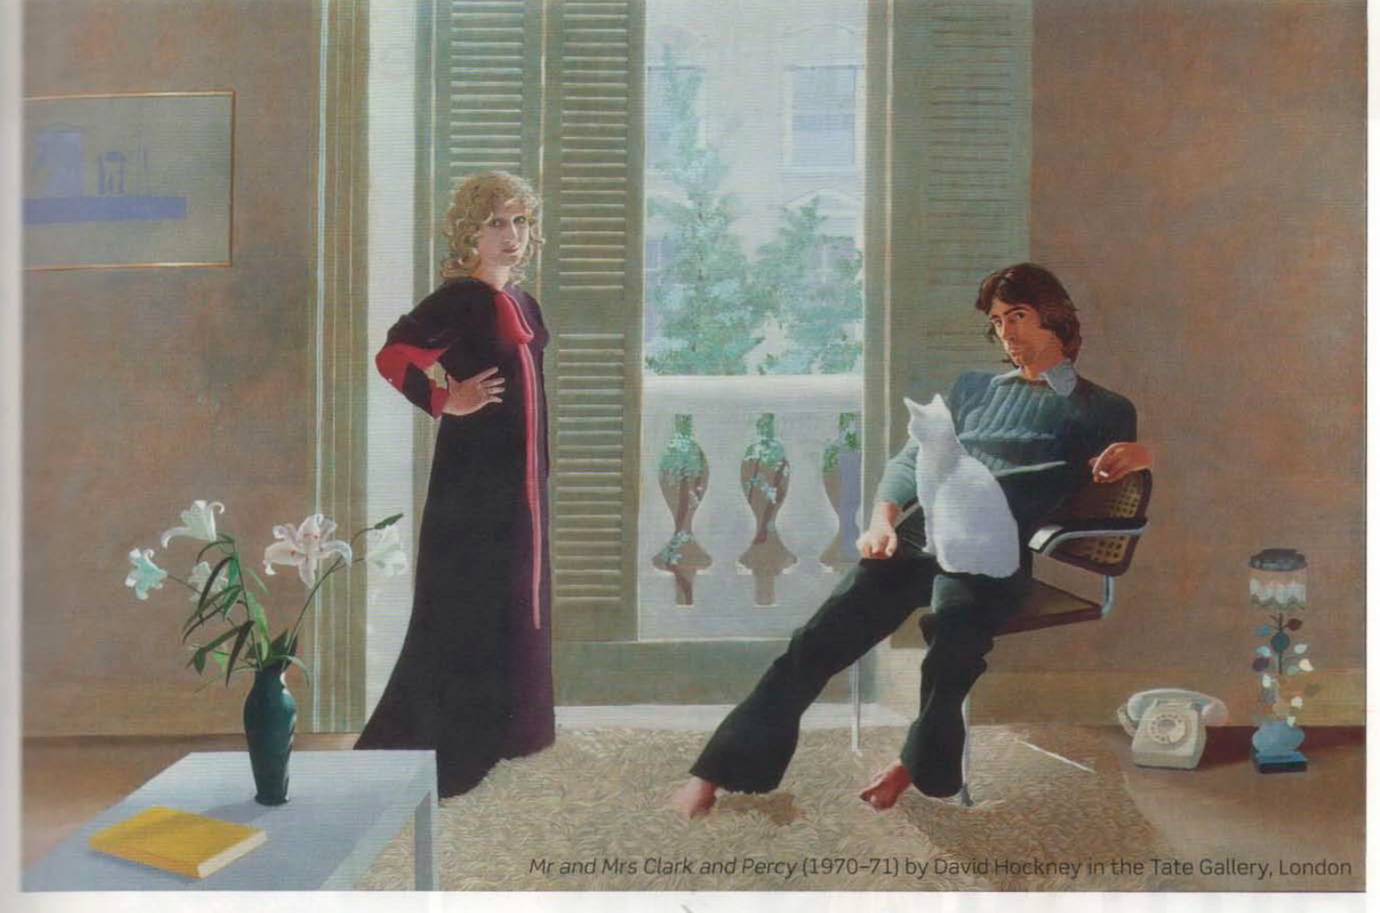
What are they wearing?
What are they doing?
PRESENT CONTINUOUS

Slide 8
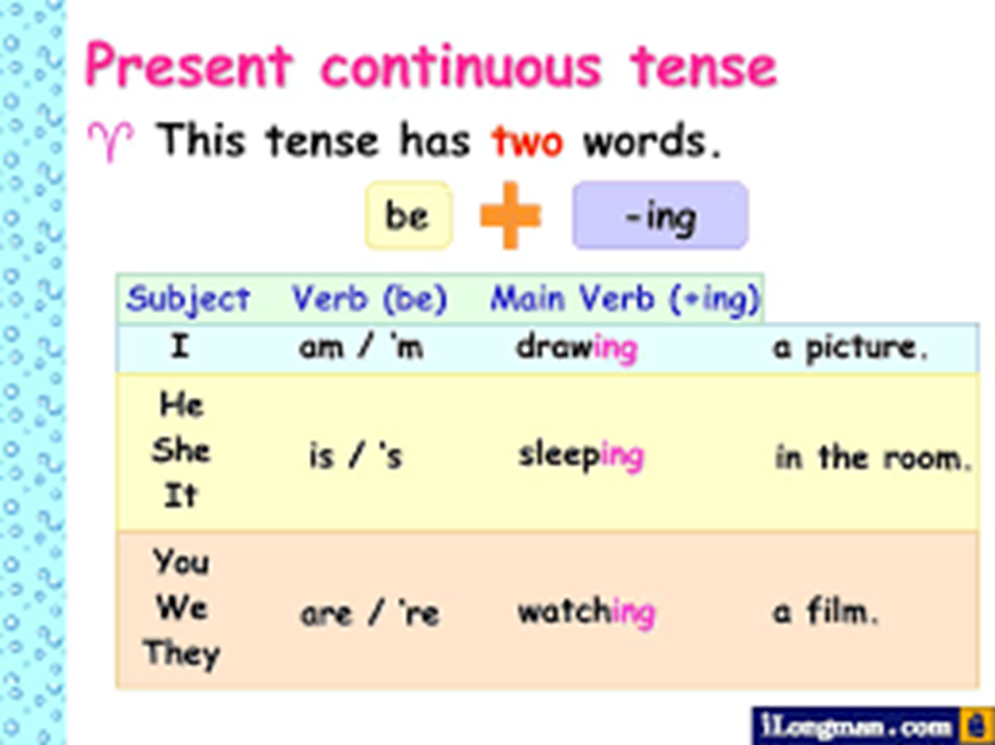

Slide 9
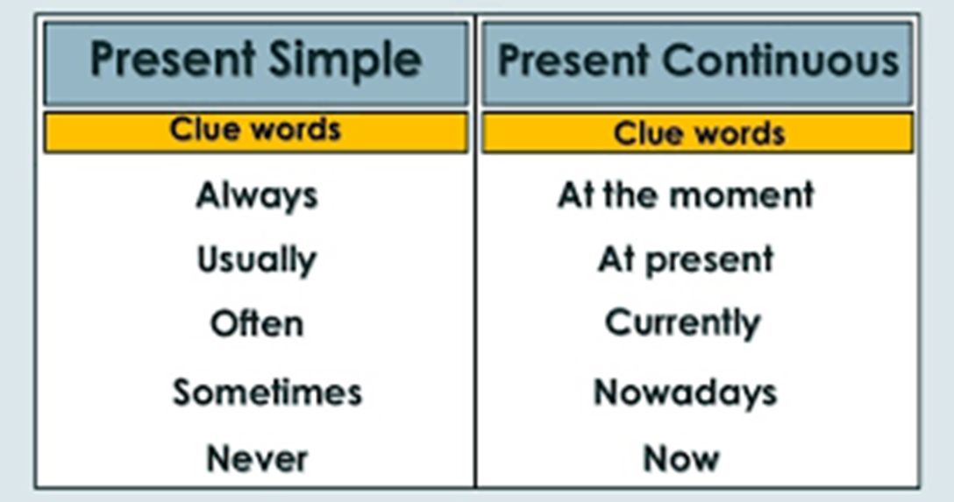
I study in Beauchef
I am studying English

Slide 10
LET´S PRACTICE

Slide 11
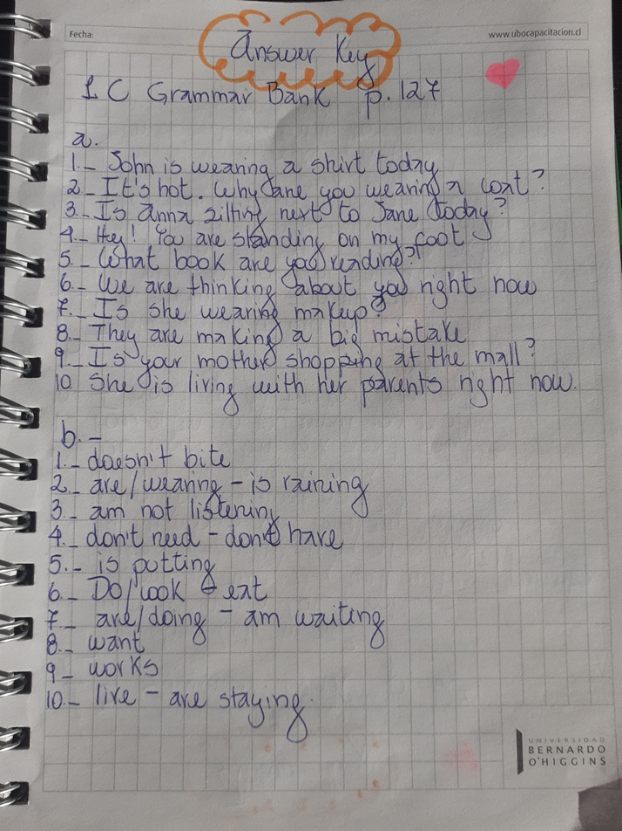

Slide 12
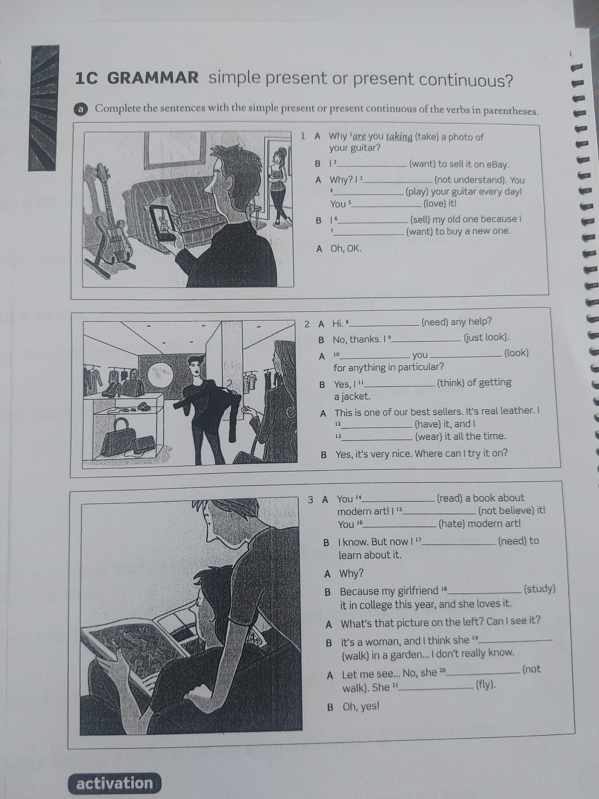
HOMEWORK

Slide 13
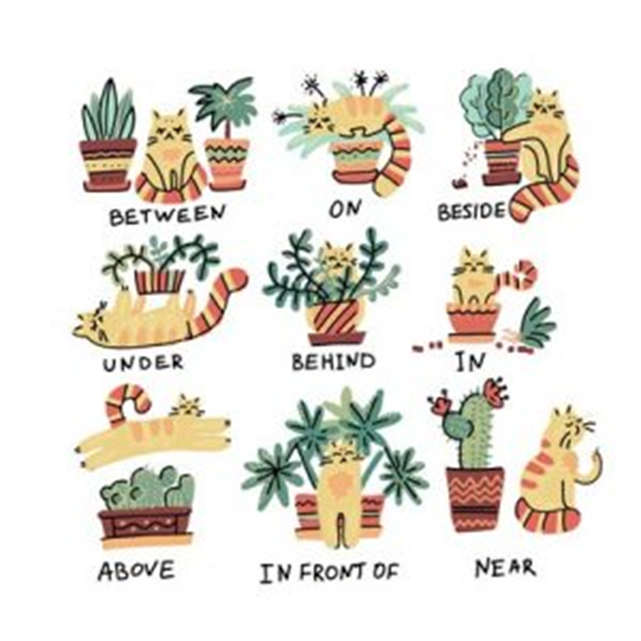


Slide 14
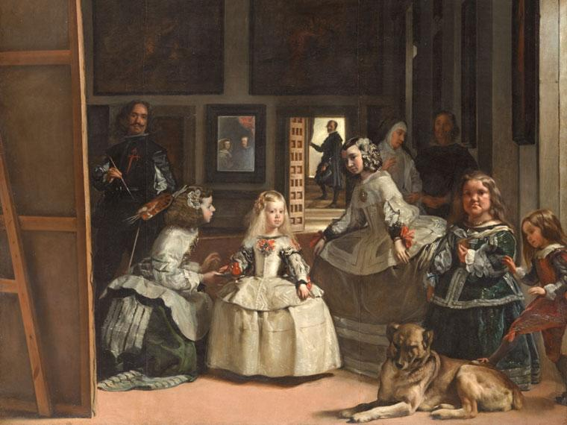

Slide 15
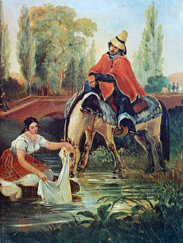

Slide 16
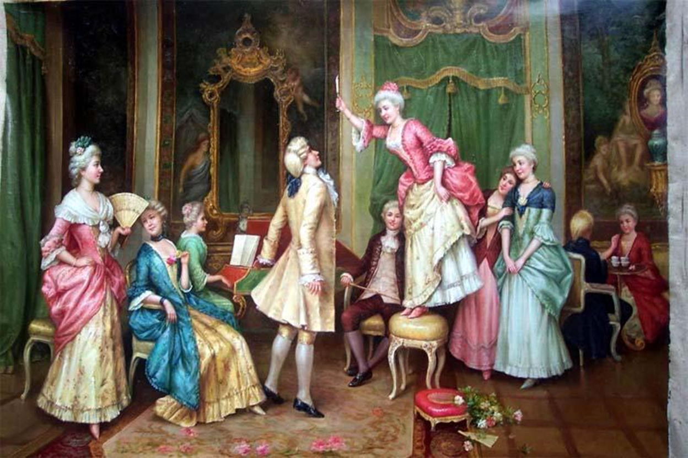

Slide 18
SPEAKING

