Slide 1
Unit 2b

Slide 2
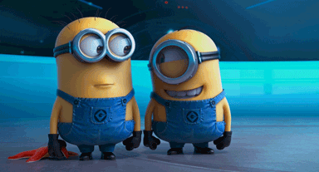
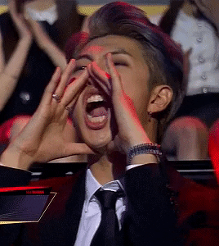
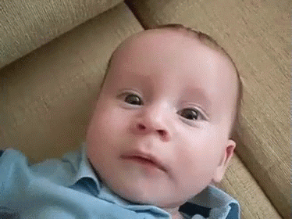

Slide 3
PAST CONTINUOUS

Slide 4
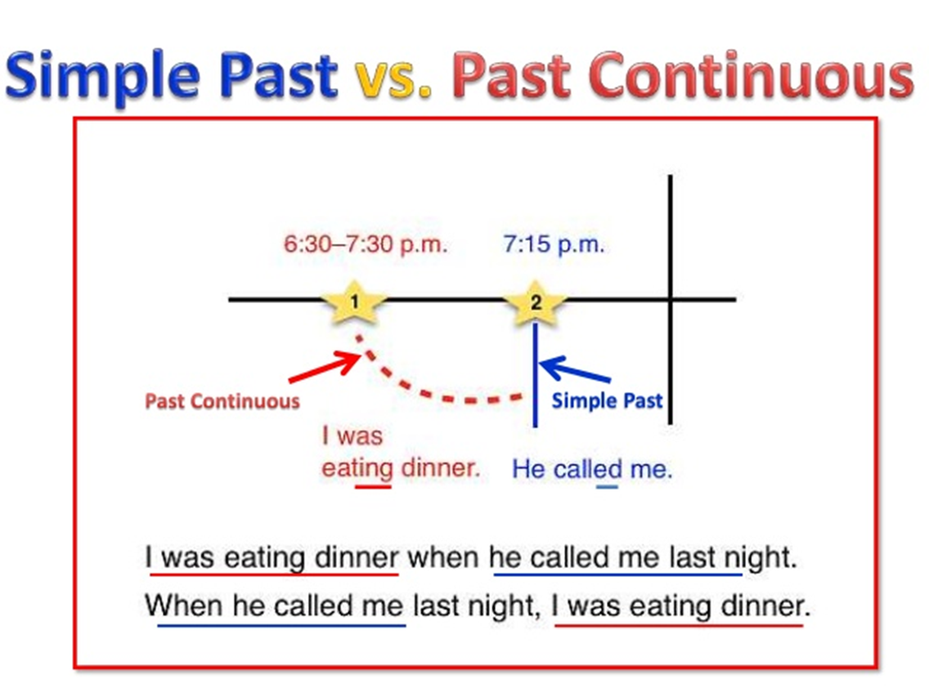

Slide 5
LET´S PRACTICE

Slide 6
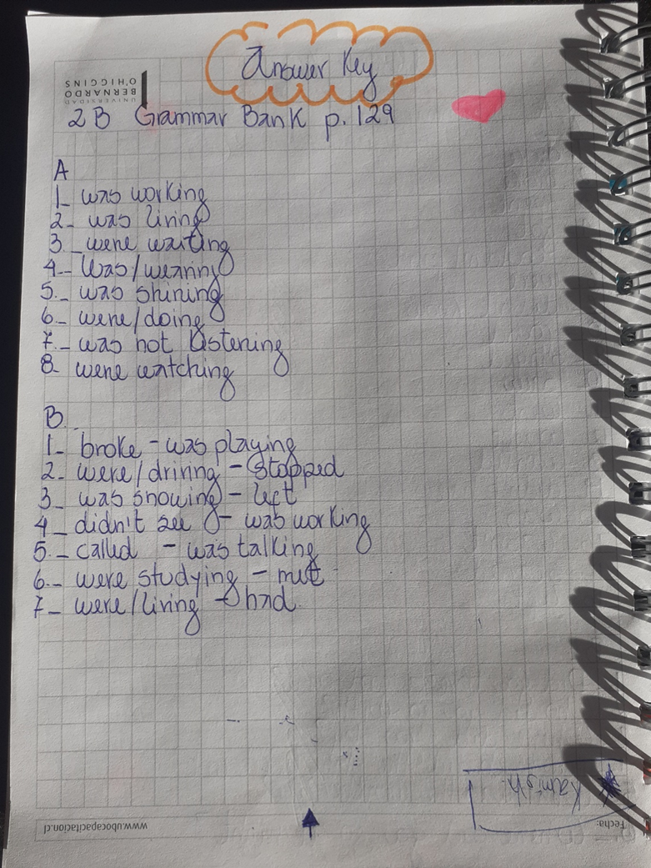

Slide 7
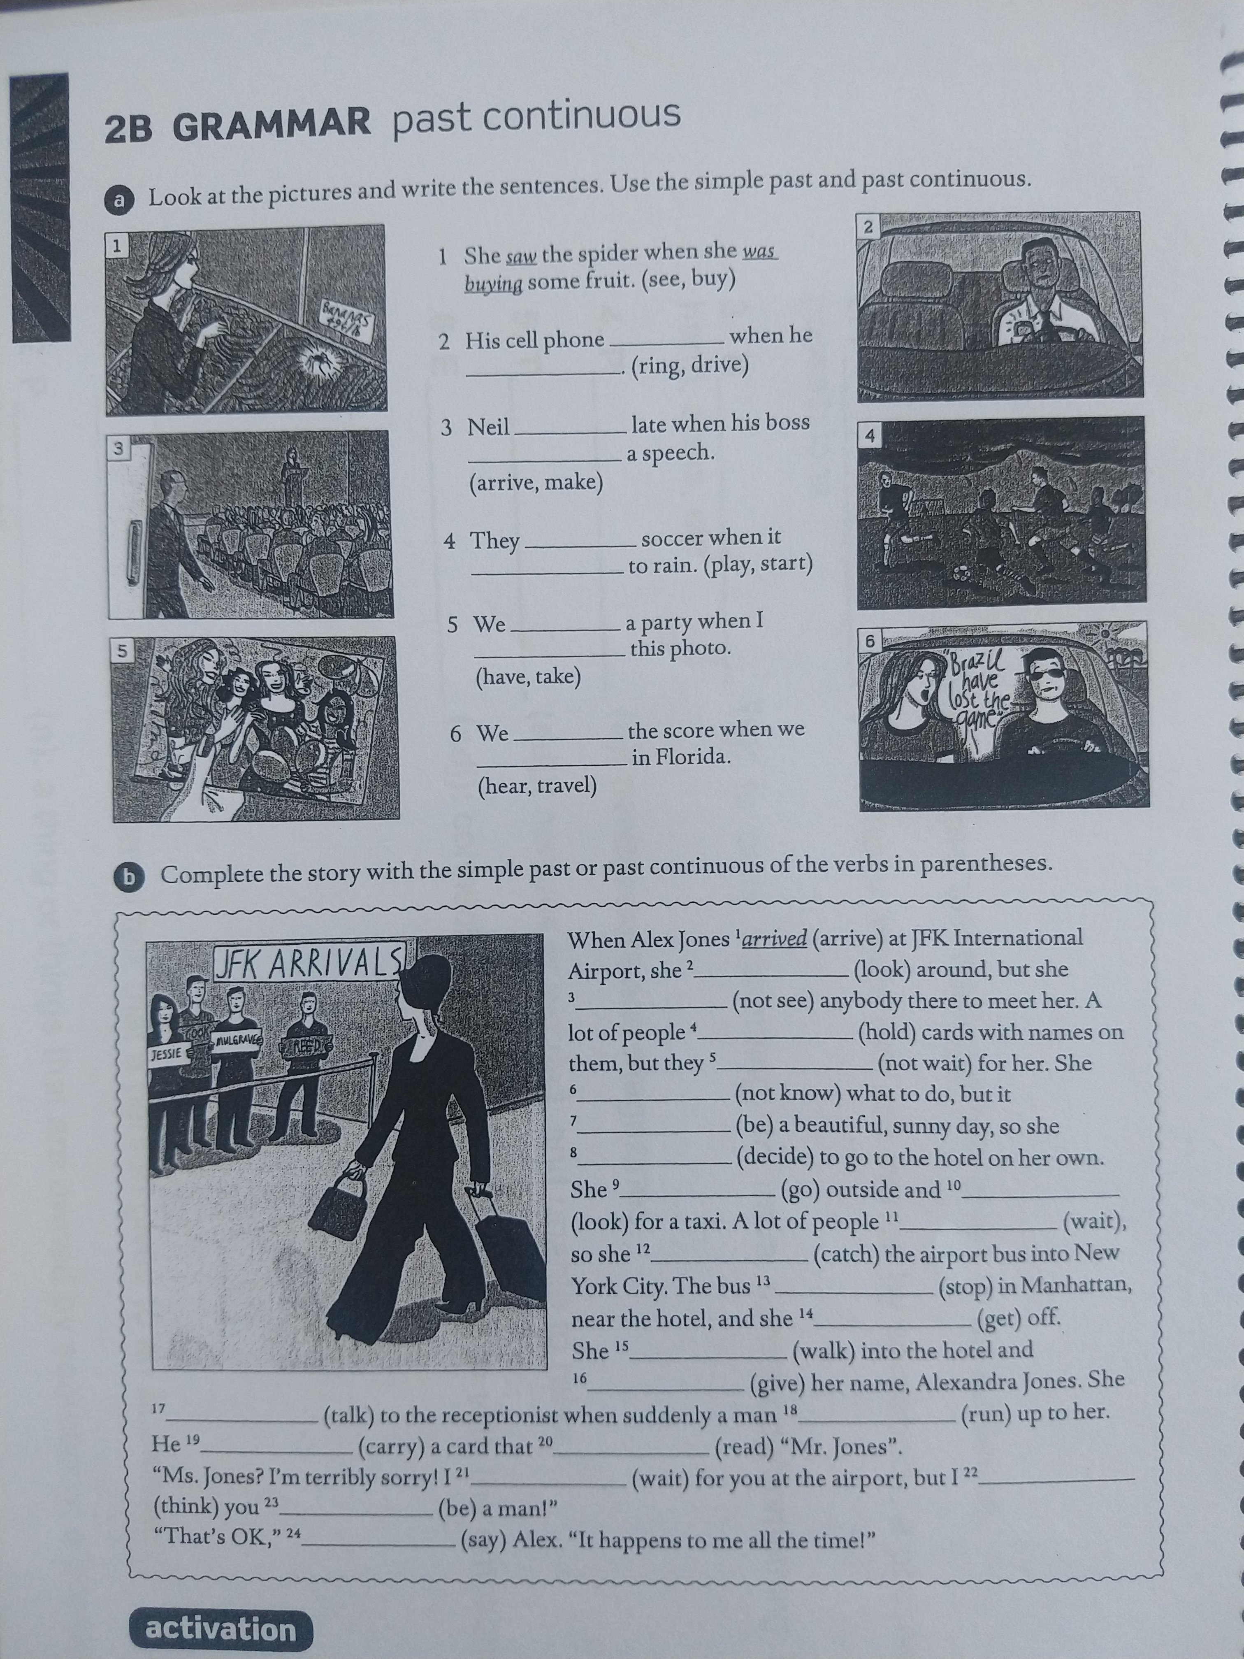
HOMEWORK

Slide 8
When did the journalist take the picture?

Slide 9

prepositions

Slide 10

prepositions

Slide 11

prepositions

Slide 12
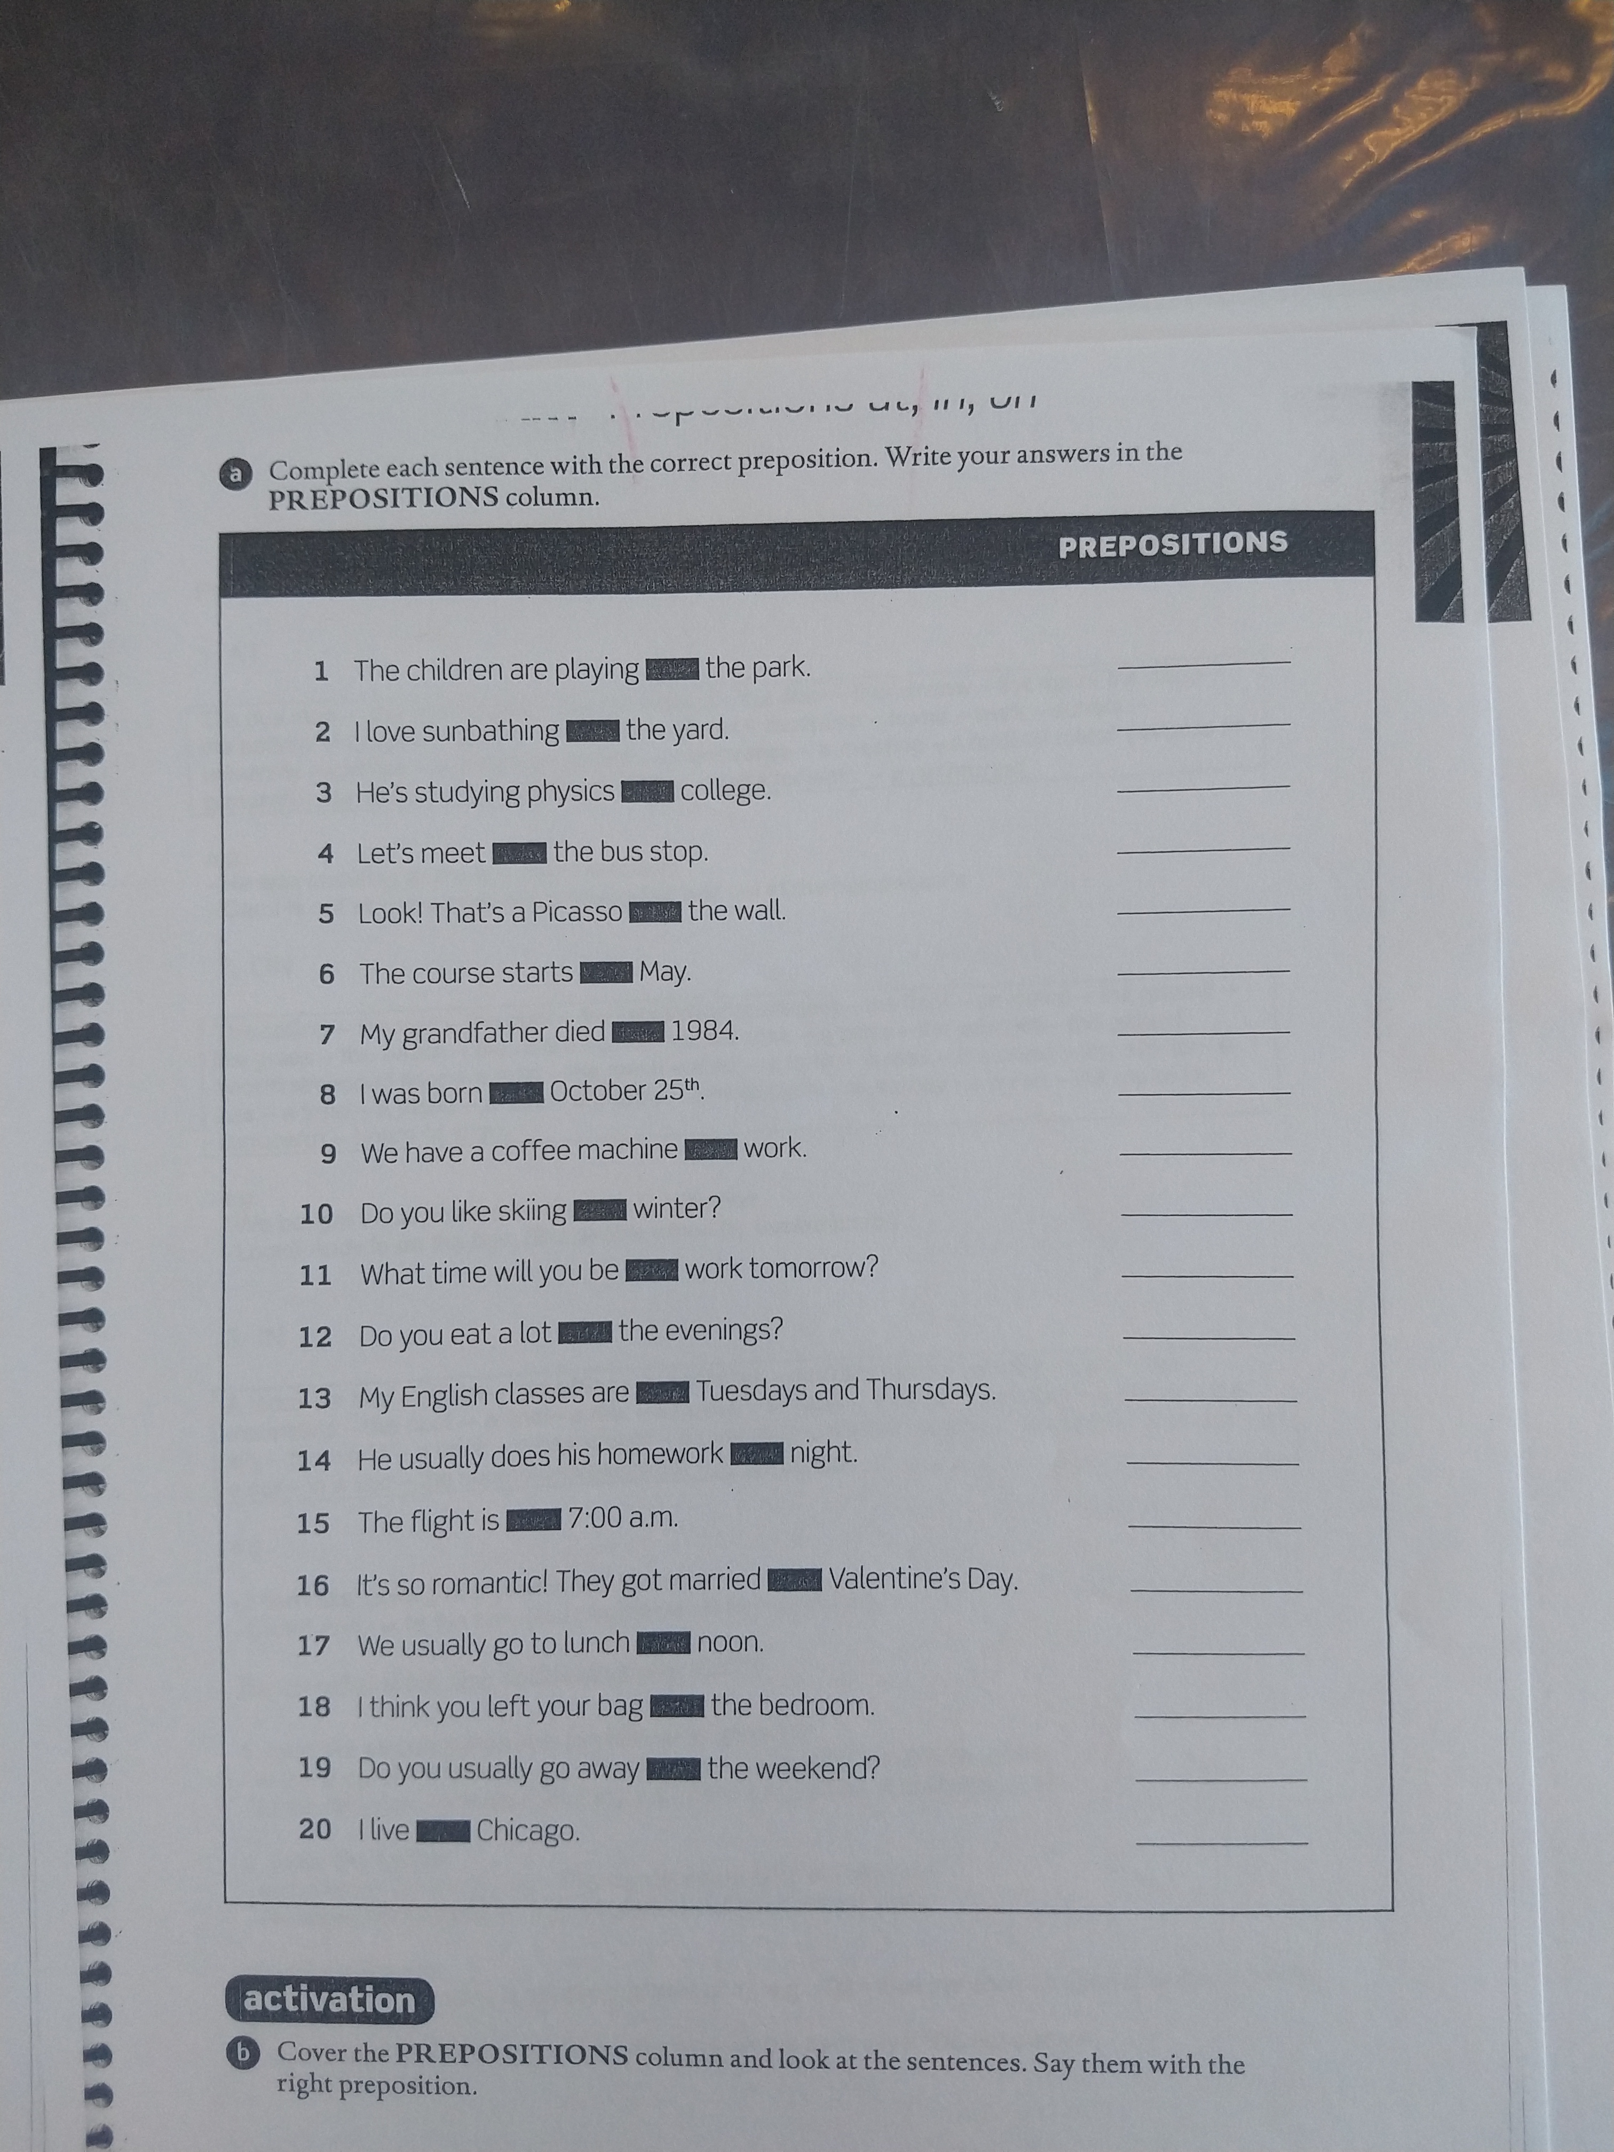
Let´s practice

Slide 13

Answer key

Slide 15


Slide 16
SPEAKING TIME

