Slide 1
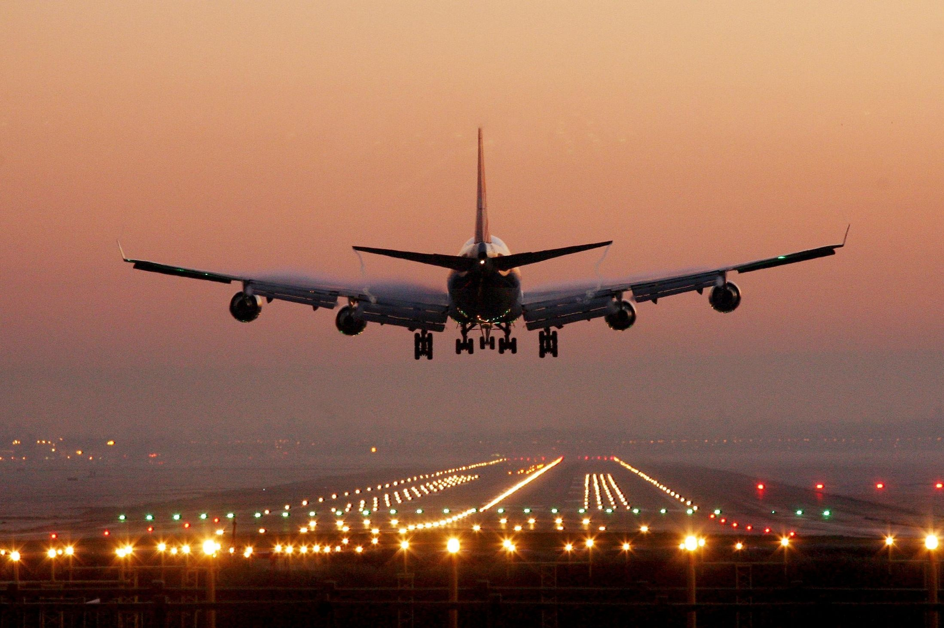
UNIT 3 A
Plans and Dreams

Slide 3


Slide 4
LET´S COMPLETE
PLAN
BE GOING TO
PREDICTION

Slide 5



She is going to travel to Peru next year.
Plans
The pen is going to fall
Predictions with evidence

Slide 6
LET´S PRACTICE

Slide 7
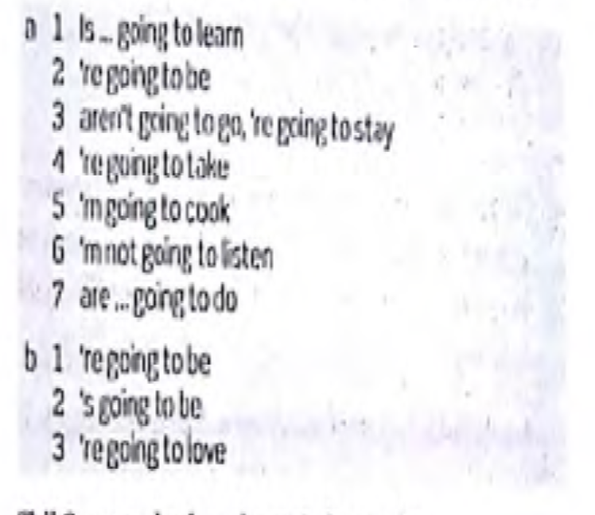

Slide 8
LET´S PRACTICE
2 Put the words in the correct order.
1 you / to / tell / him / going / are / ?
_________________________________________________________________________________________________________
2 going / him / I’m / tell / no, / not / to
_________________________________________________________________________________________________________
3 later / are / what / do / you / going / to / ?
_________________________________________________________________________________________________________
4 watch / I’m / a / to / DVD / going
_________________________________________________________________________________________________________
5 Steve / going / is / to / be / the / barbecue / at / ?
_________________________________________________________________________________________________________
6 going / to / what / wear / you / are / ?
_________________________________________________________________________________________________________
7 wear / I’m / jeans / going / a / T-shirt / to / and
_________________________________________________________________________________________________________
8 late / we / are / going / be / to
_________________________________________________________________________________________________________

Slide 9
Going to

Slide 10
Top airports in the world: Vocabulary
Word | Meaning | Example
To be delayed | To be late | The flight was delayed for more than one hour
Facilities | A place, amenity, or piece of equipment provided for a particular purpose . | Transportation facilities; educational facilities; a new research facility.
To drop sth off | To let out of a vehicle | Taxis can´t drop passengers off in here.
To board | To get on or into (a ship, aircraft, or other vehicle). | We boarded the plane for Oslo

Slide 11

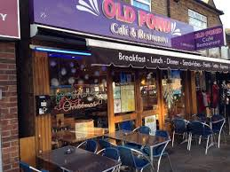

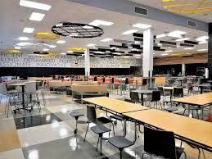
Café
Coffee
Cafeteria

Slide 12

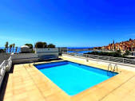
Top airports in the world: Vocabulary
Orchid
Rooftop swimming pool

Slide 13

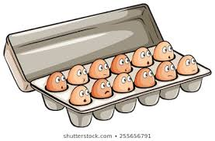
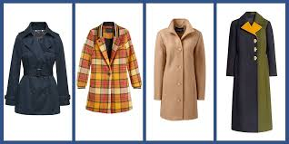
Dozens
Coats

Slide 14

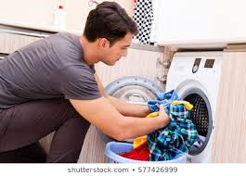
To do the laundry

Slide 15
Vocabulary
Abroad (adj): in or to a foreign country.
E.g. For a holiday abroad you need a valid passport.
Baggage/ (n): bags, cases, etc. that contain somebody’s clothes and things when they are travelling.
E.g. Drugs were found in his baggage.
Custom (n) : the place at a port or an airport where your bags are checked as you come into a country.
Departure (n) : the act of leaving a place; an example of this.
E.g. Flights are confirmed 48 hours before departure.

Slide 16

Gate (n) : a way out of an airport through which passengers go to get on their plane.
E.g. : BA flight 726 to Paris is now boarding at gate 16.
Meal (n) : an occasion when people sit down to eat food, especially breakfast, lunch or dinner.
E.g. Lunch is his main meal of the day.
Terminal (n) : a building or set of buildings at an airport where air passengers arrive and leave.
E. g. They are building a new terminal at the airport.

Slide 17
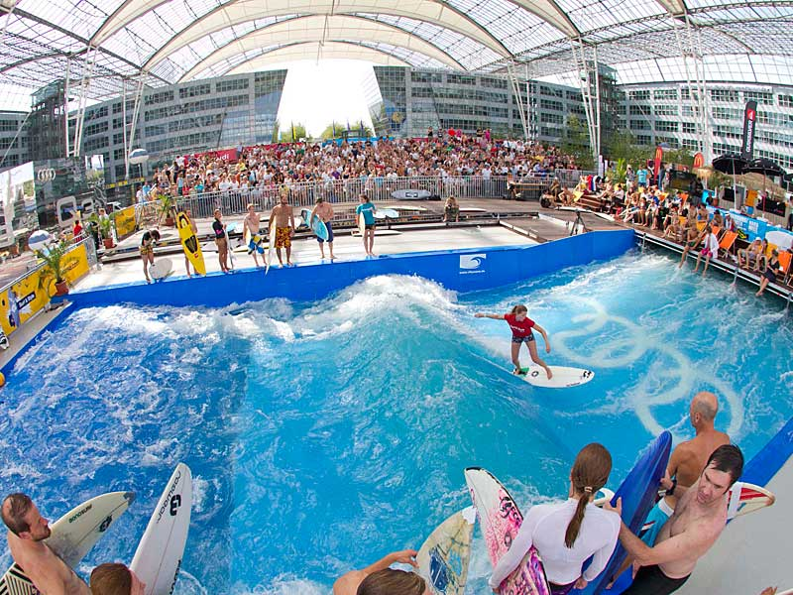
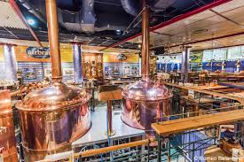
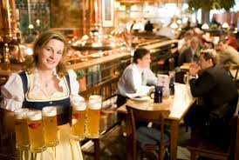
Munich airport

Slide 18
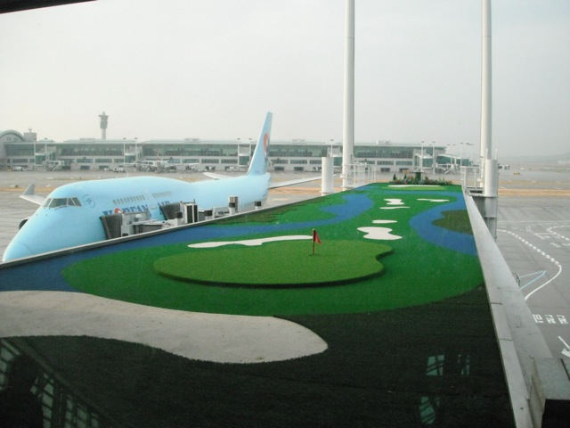
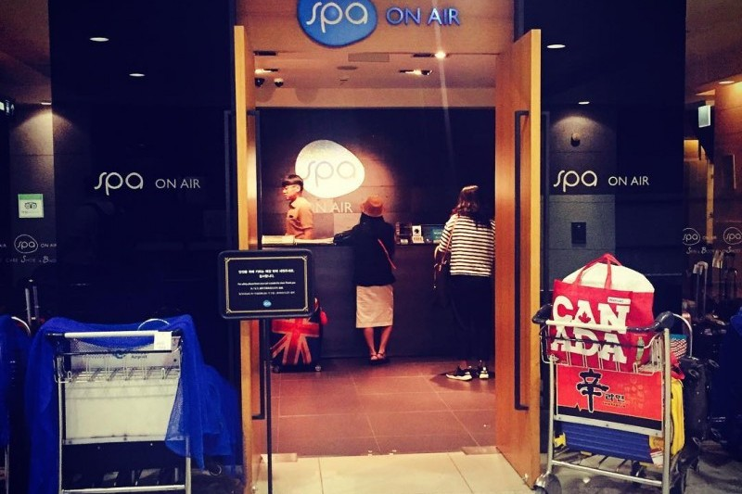
Incheon international airport

Slide 19
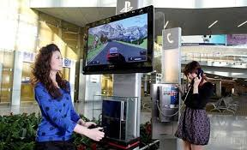
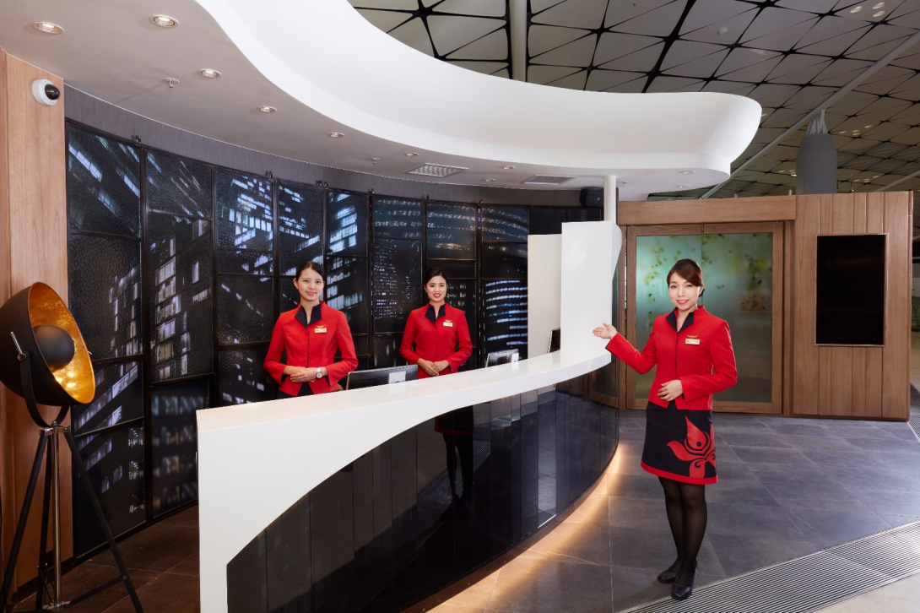
Hong Kong International Airport

Slide 20
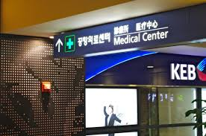
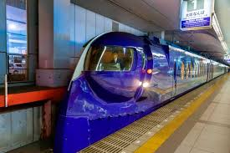
Osaka international airport

Slide 21
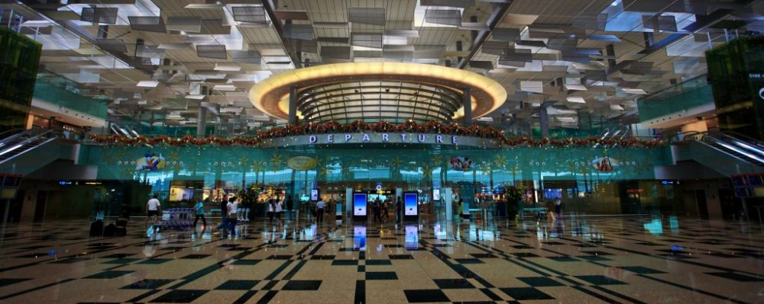
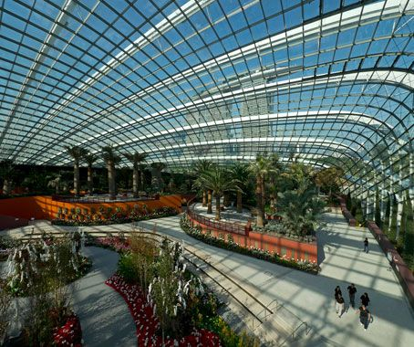
Singapore Changi airport

Slide 22
Speaking time
What about you? What are your plans for your next vacation?
What are you going to do?
What are you not going to do?

