Slide 1
UNIT 6 A
ARE YOU A PESSIMIST?

Slide 2
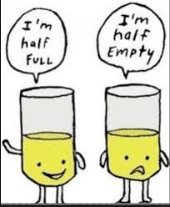

Describe the glass. Is it half full or half empty?
Are you an optimistic or a pessimistic person?

Slide 3
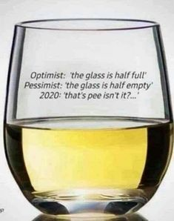
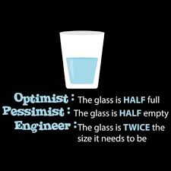
In the case of engineers…

Slide 4
OPPOSITE VERBS

Slide 5

WILL
PREDICTIONS
(-EVIDENCE)

Slide 6
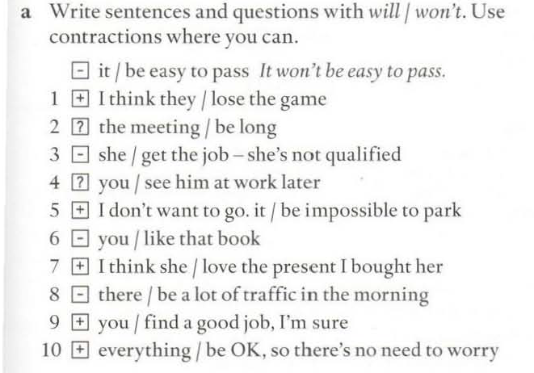

Slide 7
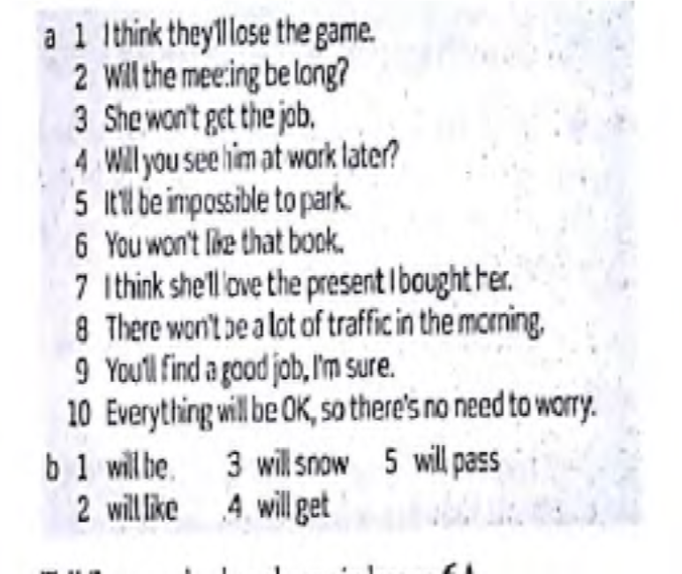

Slide 8

The fuuuutureee
GOING TO
PLANS
PREDICTIONS (+EVIDENCE)
PRESENT CONTINUOUS
ARRANGEMENTS
(+AGENDA)
WILL
PREDICTIONS
(-EVIDENCE)

Slide 9

LET´S LISTEN

Slide 10
LET´S SPEAK!

