Slide 1
I´ll never forget you
Unit 6B

Slide 2
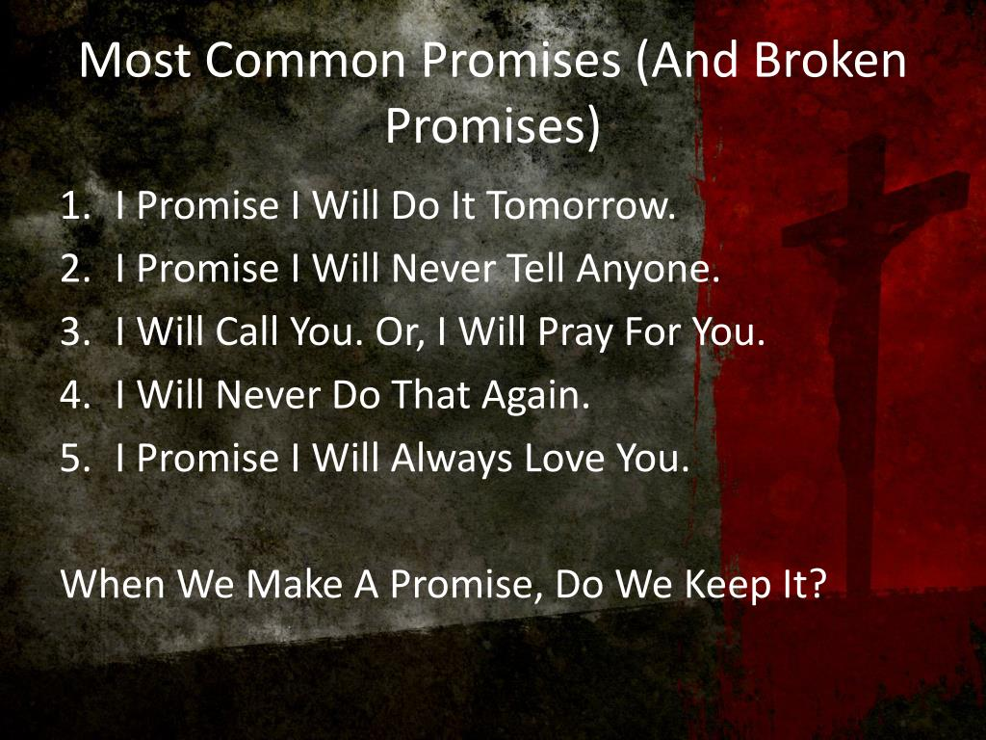

Slide 3
Let´S read

Slide 4

Let´s listen

Slide 7
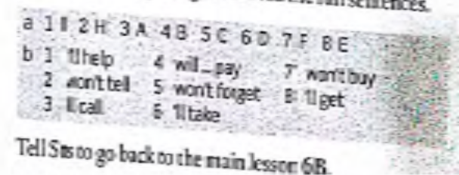
Answer key

Slide 8
The futureeee
GOING TO
PLANS
PREDICTIONS (+EVIDENCE)
PRESENT CONTINUOUS
ARRANGEMENTS
(+AGENDA)
WILL
PREDICTIONS
(-EVIDENCE)
PROMISES
OFFERS
DECISIONS

Slide 9
vocabulary

Slide 10
SPEAKING

