Slide 1
DREAMS
UNIT 6C

Slide 3

LET´S LISTEN

Slide 7
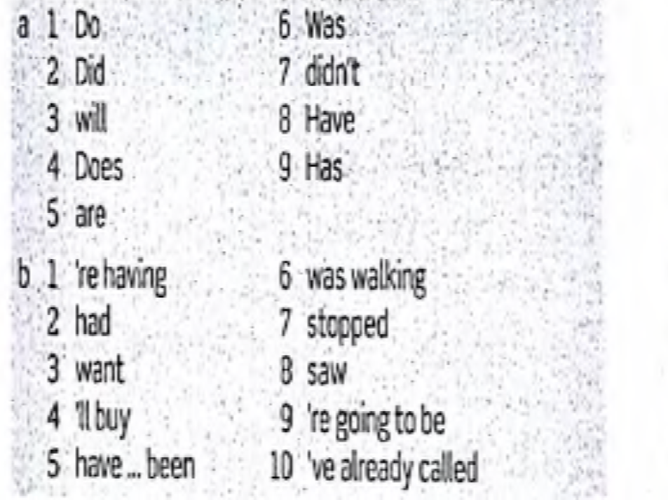
ANSWER KEY

Slide 8
SPEAKING

