Slide 1
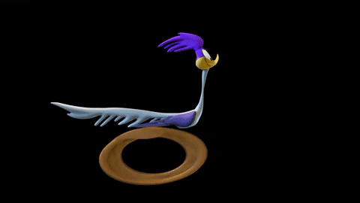
Unit 5A
No time for anything

Slide 2

SPEAKING TIME

Slide 3

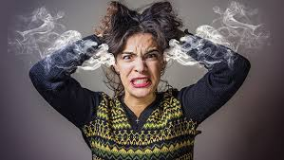
Irritable

Slide 4

Characteristics
Frustrated

Slide 5
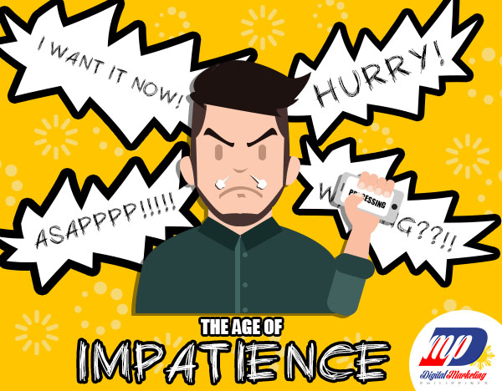
Characteristics
Impatient

Slide 6
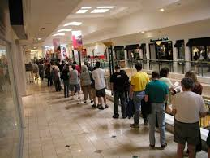
Line

Slide 7
Let´s read

Slide 8
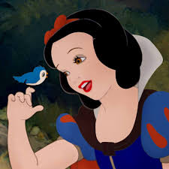
Vocabulary
Snow White

Slide 9
Let´s read

Slide 10
Let´s read

Slide 11
Let´s read

Slide 12
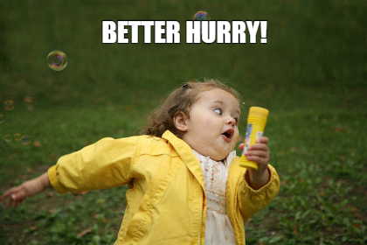
vocabulary
In a hurry
“More quickly than usual”

Slide 13
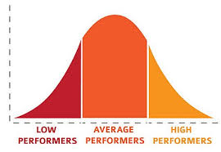
vocabulary
Average

Slide 14
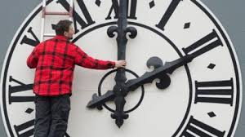
Time expressions
To save time
To waste time
To be IN a hurry
To spend time
To be ON time

Slide 15

CHECK THIS OUT

Slide 16
COMPARATIVES

Slide 17


Slide 18
ANWER KEY
faster than
taller than
busier____ than
further than
worse than
better than
harder than
more boring than
bigger than
more slowly

Slide 19
ANSWER KEY
as short as
as nice as yours
as big as Tokyo
as popular as tennis
learn as fast as children
work as hard as I
play as well the Lakers

Slide 20
LET´S PRACTICE!

Slide 21
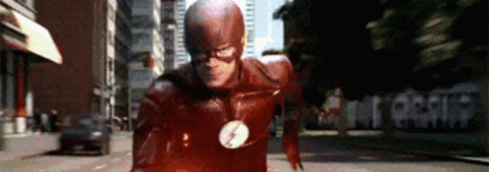
SPEAKING TIME

