Slide 1
Unit 5 b
My favorite city

Slide 2
What is your favorite city/town in the world?
Why do you like them?
What is your favorite city/town in Chile?
What is your favorite imaginary city?

Slide 3
My favorite city
PTO VARAS
LORIEN
BAIRES

Slide 4
SUPERLATIVES
Puerto Varas is the cleanest city in Chile
Buenos Aires people are the friendliest from Argentina
Lorien is the most magical place in the Middle Earth
Puerto Varas has the most delicious food
Buenos Aires has the best theaters

Slide 5
CHICAGO
WASHINGTON
NEW ORLEANS
MIAMI
MINNEAPOLIS
WHAT ABOUT CHILE?

Slide 6
Explanation

Slide 7
ANSWER KEY
the most polite
the hottest
the worst
the friendliest
the most important
The best
the most polluted
The farthest
the funniest
the prettiest

Slide 8
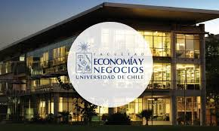
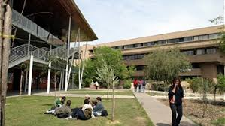
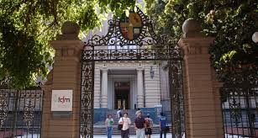
Let´s practice

Slide 10
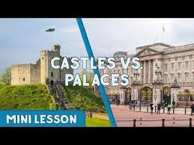
Vocabulary

Slide 11

Department Store

Slide 12
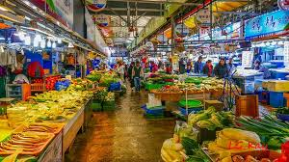
Market

Slide 13
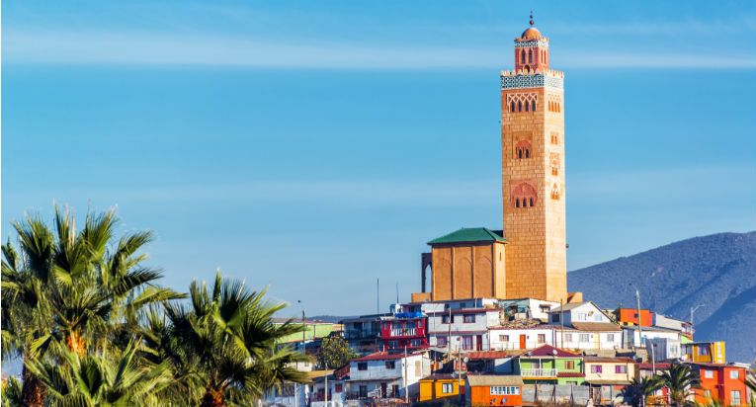
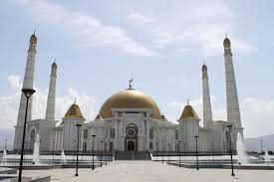
Mosque

Slide 14
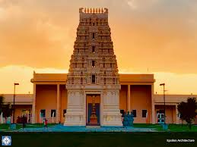
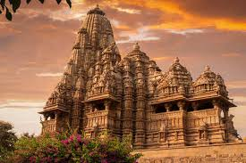
Temple

Slide 15
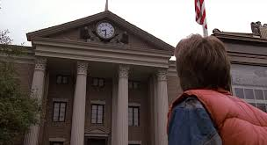
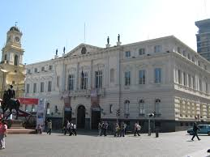
Town hall

