Slide 1
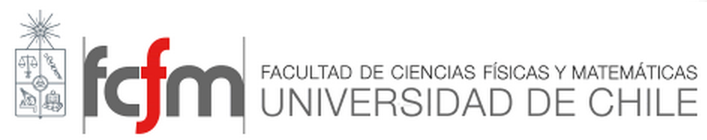

Advanced materials for energy conversion solid cells
Electrodes

Slide 2
Feul electrode
Requirements
High electronic conductivity under fuel cell operating conditions.
Excellent catalytic activity toward the oxidation of fuels.
Good chemical and thermal stability during fuel cell fabrication and operation.
Manageable mismatch in coefficient of thermal expansion (CTE) with adjacent cell components.
Sufficient mechanical strength and flexibility.
Tolerance to carbon deposition, sulfur and silicon poisonings, and reoxidation.
Low cost.

Slide 3
Materials for fuel electrode
Anode materials studied in the early stage of SOFC development include:
Graphite
Platinum
Iron
Cobalt
Nickel
Advantages of Nickel
Excellent catalytic activity toward hydrogen oxidation and reforming of hydrocarbon fuels.
Good chemical stability
Low cost
Pure nickel suffers from:
Considerable mismatch in thermal expansion with electrolyte
Significant coarsening during operation
Poor binding to the electrolyte.

Slide 4
Cermet materials
As an alternative to a single-phase metallic electrode material, the accepted compromise has been the use of a porous composite of metal and ceramic, a ‘cermet’.
Metal phase
provides the required electronic conductivity.
Ceramic phase:
Lowers the coefficient of thermal expansion for the anode to match that of the electrolyte
Prevents the metal phase from coarsening
Offers a conduction path for oxide ions and thus may extend the active zones for anode reactions.

Slide 5
Ni-YSZ
Functions of the YSZ particles:
Supply oxide ions to the TPBs
Suppress the sintering of Ni particels
Match the thermal expansion coefficients between the cermet and the YSZ electrolyte
The concept of three-phase boundary (TPB)
The electrochemical reaction of gaseous reactants in solid state cells involves three phases:
Gas phase
Ceramic electrolyte
Metallic electrode.
Three reactants meet each other at TPB: (1) Fuel gas
(2) O²⁻ ion in the electrolyte
(3) Electron in the Ni

Slide 6
Electron Conductivity of Cermets
For the flat plate design:
Lateral current path length of about 1 mm
Specific electronic conductivity:100 S/cm
Fine YSZ particles must be evenly distributed around the Ni particles in order to keep both a stable TPB length and electronic conductivity over long periods of time.
The porosity of the simple cermet with 40 vol % Ni (of the solids) must be lower than about 30–35% after the reduction of the NiO to Ni in order to keep the connectivity between the Ni particles.

Slide 7
Thermal Expansion Coefficient Matching
CTE of YSZ : 10.5ˣ10⁻⁶ K⁻¹
CTE of Nickel: 17ˣ10⁻⁶ K⁻¹
CTE of NiO: 14ˣ10⁻⁶ K⁻¹
particle size ratio of NiO/8YSZ = 3:2.

Slide 8
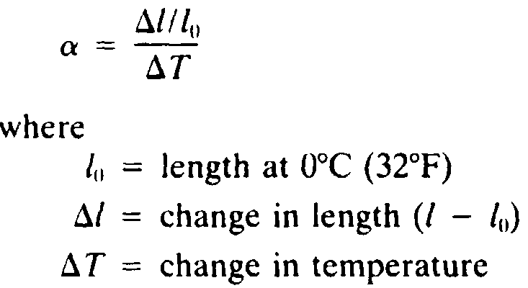
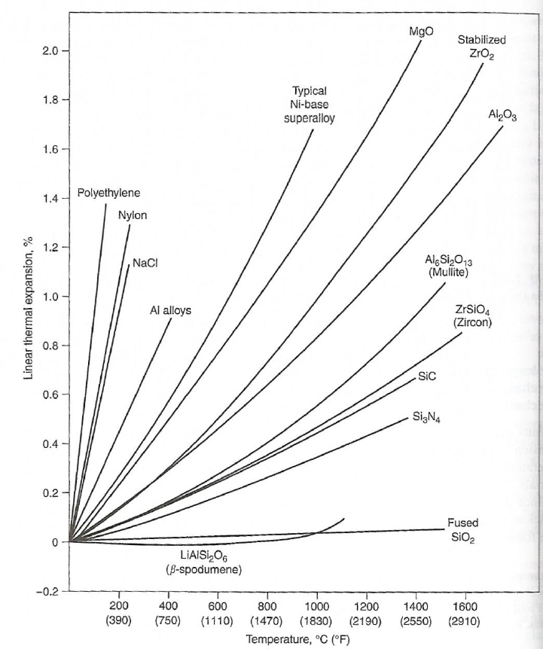
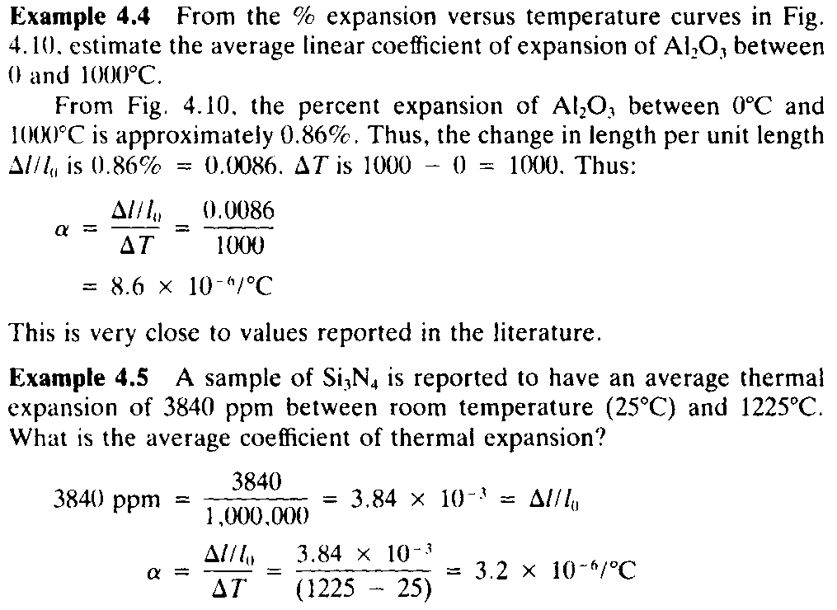
Thermal Expansion
The change in dimentions as the temperature is changed

Slide 9
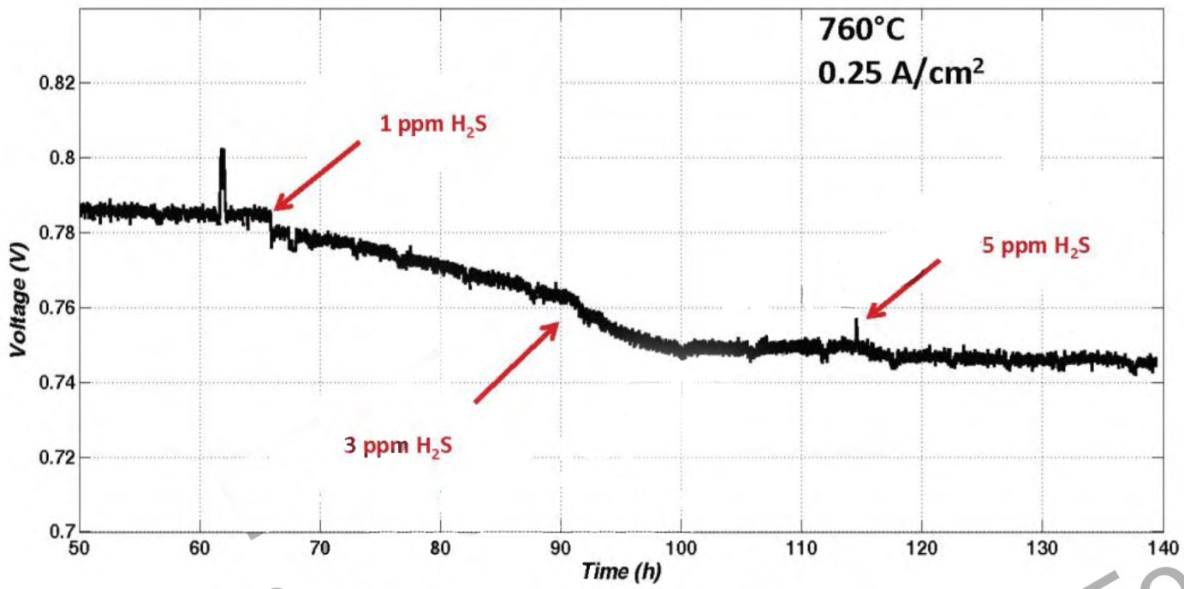
Chemical Compatibility
In general the Ni–YSZ cermet is very stable towards other stack components.
Sensitivity Towards Fuel Impurities
Sulphur Poisoning
Sulphur is present in most fuels derived from fossil sources either by nature or added as odorant.
The cell performance decreases quickly as soon as sulfur poison in the form of H₂S is introduced into the fuel stream. Then, after some time, which depends on the H₂S concentration and the cell structure, the rate of cell performance degradation will decrease dramatically or even stop completely.

Slide 10
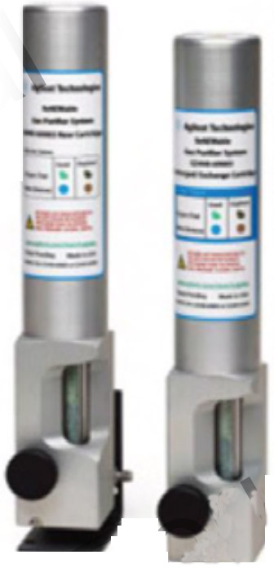
Desulphurization
Absorption of H₂S by ZnO (to ZnS at 350-400 ºC)
Notes:
http://ac.els-cdn.com/S0378775315000658/1-s2.0-S0378775315000658-main.pdf?_tid=462a4d9c-a031-11e6-a841-00000aab0f27&acdnat=1478004597_59e425c19bcd8514e1eb53a5324ffd9b

Slide 11
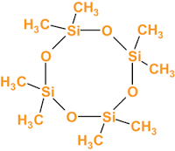
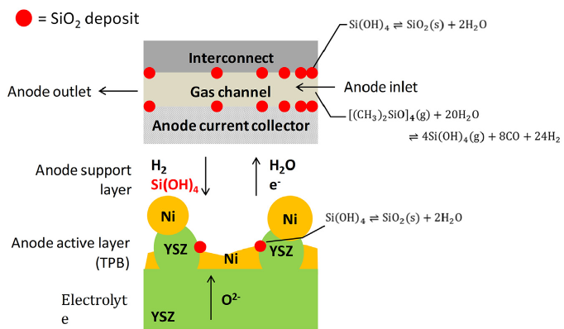
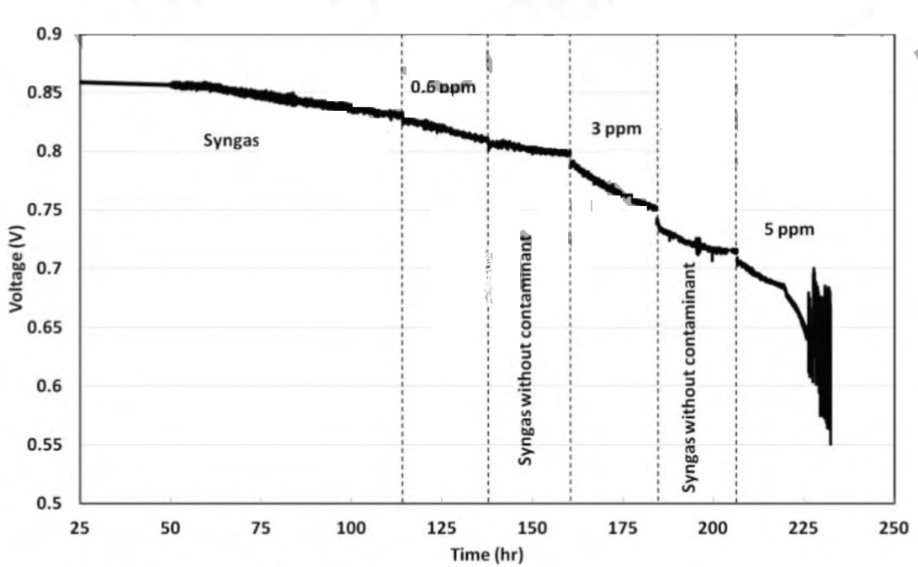
Effect of cyclic siloxane
(Octamethylcyclotetrasiloxane, C₈H₂₄O₄Si₄)
Organic silicon compounds are often found in WWTP (waste water treatment plants) and land fill biogas.
The clean-up of biogas has been reported to be difficult due to competitive adsorption of different biogas contaminants.
Several studies have been carried out on the poisoning by siloxanes in the
fields of gas turbines and gas engines.
Notes:
Combus-tion of siloxanes leads to the formation of gas microcrystalline silica, a very firm substance which has similar properties to that of
glass. This material coats and grazes metal surfaces, e.g., the spark plugs, cylinders, valves and emission catalyst with white deposits
and acts as a thermal insulator.

Slide 12
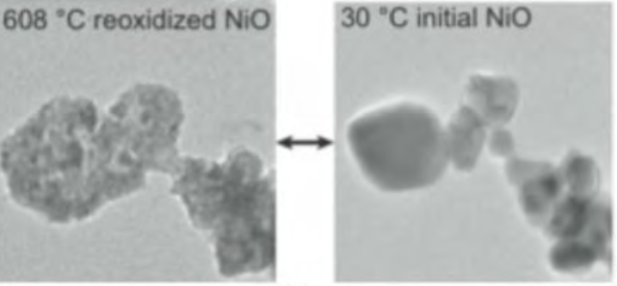
Nickel reoxidation
It has been shown that in the case of reoxidation the particles increase in size with a sponge-like microstructure, which leads to strains because the porosity is limited.
Notes:
Journal of Power Sources 195 (2010) 5452–5467.

Slide 13
Alternate Anodes for SOFCs
The major advantage of SOFCs over other types of fuel cells is the potential for the direct utilization, or through internal reforming, of a wide variety of fuels including fossil, biomass, and other renewable fuels.
In recent years, there have been numerous studies on alternate anode materials.
Sulfur-tolerant anode materials
Carbon-tolerant anode materials
Redox-stable anode materials
Re-oxidation of the reduced Ni–YSZ cermet electrode is found to be detrimental.
The molar volume of Ni and NiO is 6.6 cm³ mol⁻¹ and 11.1 cm³ mol⁻¹

Slide 14
Perovskite fuel electrode materials
Quite promising results were reported for chromite- and titanate-based perovskite compositions, since their tolerance to A- and B-site substitution enables the optimization of anode functional properties
Perovskite-type materials, typically doped strontium titanates (SrTiO₃), are one of the most promising alternative anode materials for SOFCs because of their excellent structural stability in a reducing atmosphere.
Doping with trivalent atoms, such as Y³⁺ and La³⁺, in place of the divalent Sr²⁺ allows SrTiO₃ to become an n-type semiconductor, while doping with Fe, Cr, Co, etc., results in a p-type semiconductor.

Slide 15
Cathode
Requirements
High temperature thermal and chemical stability in the oxidizing atmosphere,
High chemical stability in relation to used electrolyte and interconnector,
High total electrical conductivity (100 S cm⁻¹),
High mixed ionic–electronic conductivity (MIEC)
High catalytic activity for the oxygen reduction reaction,
Adequate thermomechanical properties, TEC matched with adjacent layers
Low cost

Slide 16
Oxygen electrode Materials
In classical SOFC with YSZ electrolyte, working at 1000°C
La_{1-x}Sr_{x}MnO₃ (LSM)
LSM is characterized by high, practically purely electronic conductivity at high temperatures (900°C). However, at lower temperatures, the efficiency of LSM cathode is significantly decreased.

Slide 17
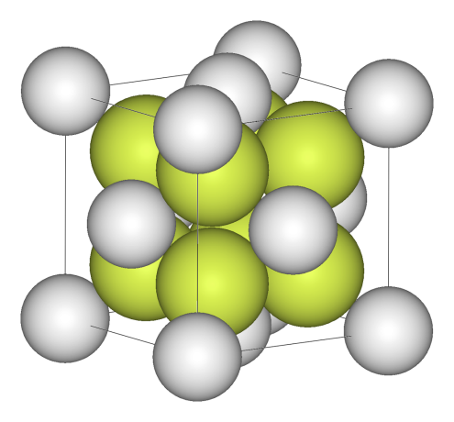
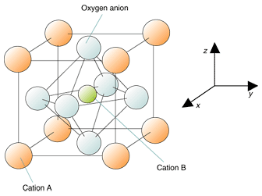
Oxides
Simple oxides
AO₂
Mixed oxides
ABO₃ (peroveskite)

Slide 18
Perovskite Structure
Typical structures consist of large-sized 12-coordinated cations at the A site and small-sized 6-coordinated cations at the B site.
Ideal, cubic ABO₃ perovskite structure belongs to Pm3m (No. 221) space group.
Although few compounds have this ideal cubic structure, many oxides have slightly distorted variants with lower symmetry (e.g., hexagonal or orthorhombic)

Slide 19

Perovskite Structure
Ideal, cubic ABO₃ perovskite structure
Tolerance factor t:
Perovskite structure is realized when 0.8≤t≤1.1, while cubic Pm3m symmetry is usually observed for materials, for which the tolerance factor is closer to 1 (0.9≤t≤1.05).

Slide 20
Perovskite Structure

Slide 21
Perovskite Structure
Because of their diversity in structures, chemical composition, and high chemical stability, perovskite oxides are widely used for preparing SOFC components.

Slide 22
La_{1-x}Sr_{x}MnO₃ (LSM)
Electrical conductivity
LaMnO₃ is an intrinsic p-type conductor. Electronic conductivity is enhanced by substitution of the La³⁺ site with divalent ions such as strontium or calcium.
When a La³⁺ ion is replaced by a Sr²⁺ ion, an electric hole is formed on the Mn³⁺ site to maintain electroneutrality and this leads to an increase in electrical conductivity:
Thermal Expansion Coefficient Matching
CTE of YSZ : 10.5ˣ10⁻⁶ K⁻¹
CTE of LaMnO₃: 11.2±0.3ˣ10⁻⁶ K⁻¹

Slide 23
mixed ionic and electronic conductivity (MIEC)

Slide 24
mixed ionic and electronic conductivity (MIEC)
The perovskite-based compounds having the general formula La_{1−x}Sr_{x}Fe_{1−y}Co_{y}O₃, where 0 <x≤0.5 and 0 <y≤0.8 has found significant attention because of their superior MIEC behaviour as well as enhanced oxygen reduction reaction (ORR) kinetics.
TEC of LaCoO₃ is about 20×10⁻⁶ K⁻¹
An alternative to the Co-rich perovskites is the Sr-doped LaFeO₃ which has a lower thermal expansion coefficient.

Slide 25
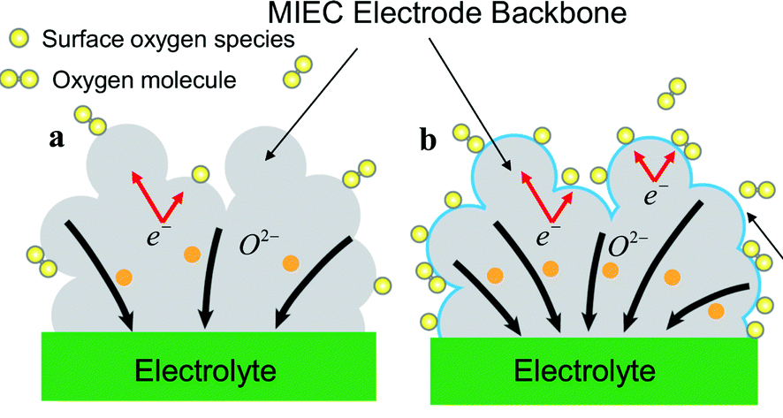
Lanthanum Cobaltite and Ferrite Perovskites
La_{1−x}Sr_{x}Fe_{1−y}Co_{y}O₃ (LSCF)
0<x≤0.5
0<y≤0.8
Superior mixed ionic and electronic conductivity (MIEC) behaviour.
Enhanced oxygen reduction reaction (ORR) kinetics.
La_{0.6}Sr_{0.4}Co_{0.2}Fe_{0.8}O_{3-d}
IT and LT-SOFC (500-800 ºC) applications
Notes:
As mentioned before, due to the negligible ionic conductivity of LSM at temperatures lower than 800 °C, development of new cathode materials is needed for intermediate temperature operation. For this purpose, several new compositions showing mixed ionic and electronic conductivity (MIEC) have been investigated as promising SOFC cathodes. Among these, the perovskite-based compounds having the general formula La1−xSrxM1−yCoyO3, where 0 < x≤0.5 and 0 < y≤0.8 (M is a transitional metal, Mn or Fe) has found significant attention because of their superior MIEC behaviour as well as enhanced oxygen reduction reaction (ORR) kinetics.
The electronic conductivity is even higher and becomes metallic at high temperatures. Sr-doped LaCoO₃ has high electronic conductivity and high ionic conductivity. However, the thermal expansion coefficient of Co-rich perovskites is generally too high for both YSZ and doped CeO₂ electrolytes. The average TEC of
LaCoO₃
is about 20×10⁻⁶ K⁻¹, which is much higher than those of LSM and YSZ. An alternative to the Co-rich perovskites is the Sr-doped
LaFeO₃
which has a lower thermal expansion coefficient and a superior chemical compatibility with doped CeO₂ electrolyte. LaFeO₃ is expected to be more stable than Ni- and Co-based perovskites because the Fe³⁺ ion has the stable electronic configuration 3d5. It is, therefore, expected that compositions in the system (La,Sr)(Co,Fe)O₃ (LSCF) will have desirable properties for intermediate temperature SOFC cathode applications [36] which is reported to be very effective for IT-SOFC (700–800 ºC) application when coupled with a Gd-doped ceria (CGO)-based interlayer.

Slide 26
Electrical Conductivity & TEC

Slide 27
Reaction with other cell components
At high temperatures, perovskites are highly active and can easily react with other cell component materials.
Formation of La₂Zr₂O₇ at the interface.
Solution: applying the GDC interlayer between cathode and electrolyte

Slide 28
perovskite-derived oxide
La₂NiO_{4+δ}

Slide 29
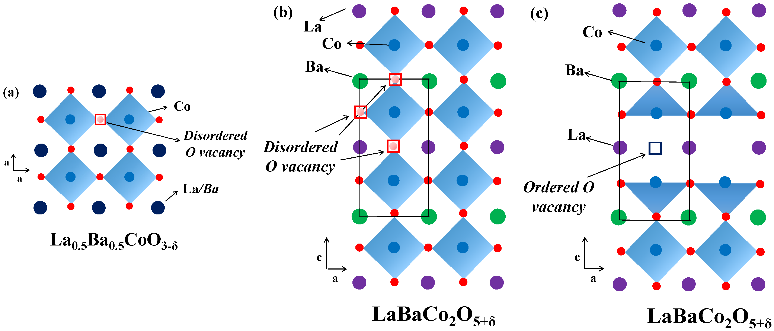
layered perovskite
LnBaM₂O_{5+d}
^{Ln: lanthanide,}
^{M: Co, Cu, Ni, …}
SmBaCo₂O_{5+d}

